Slide 1
Behavioral Health in Ohio
March 2026

Slide 2
Authors
Leyla Tosun, Ph.D.¹, Kelly L. Markowski, Ph.D.¹, Dushka Crane, Ph.D., LSSBB¹, Kraig Knudsen²
¹The Ohio Colleges of Medicine Government Resource Center, The Ohio State University
²Ohio Department of Mental Health & Addiction Services

Slide 3
Executive Summary
Recent trends in mental and physical health, as well as substance use behaviors and indicators of economic stress, are generally trending in a worrisome direction for Ohio adults with mental health impairment (MHI). Loneliness and difficulty paying for household expenses among this subpopulation stand out as particular areas of concern in 2023. A bright spot is that adults with MHI continue to face fewer difficulties paying for medical bills in 2023.
Key Findings*:
MHI prevalence declined overall in 2023, but the prevalence of MHI continues to be highest among adults with Medicaid, Black adults, female adults, adults aged 19-44, and female adults aged 19-24.
Physical health and chronic health conditions continue to be worse among adults with MHI, and some outcomes (e.g., self-rated health, obesity) have further worsened for this subpopulation.
Unmet mental health needs are higher among adults with MHI and adults with Medicaid. Finding a provider who accepts their insurance was the top obstruction to care for adults with Medicaid with an unmet care need (though those who are potentially Medicaid eligible showed a similar prevalence for this barrier). Adults with Medicaid with an unmet care need had the lowest prevalence of reporting cost as an obstruction to care, while cost was the top barrier for those who are and are not potentially Medicaid eligible.
Adults with MHI tend to use substances at rates two times greater than adults without MHI.
Economic stressors are very common for adults with MHI, and these financial difficulties generally occur at rates two to four times higher than adults without MHI.
*Note: Observed group differences should not be used to draw conclusions about underlying causes - see slide 9 for more guidance.

Slide 4
Contents
Background | Page 5
Objectives | Page 7
Methods | Page 8
Results | Page 11
Summary of Results | Page 38
References | Page 40
Acknowledgements | Page 41
Mental Health | Page 11
Physical Health | Page 20
Health Care Access | Page 23
Co-occurrence of Substance Use | Page 27
Social & Economic Stressors | Page 32

Slide 5
Background
Over the past 15 years, findings from the Ohio Medicaid Assessment Survey (OMAS) have been instrumental in understanding mental health of Ohioans and associated stressors, including comorbid physical health conditions, access to care, and socioeconomic factors. Following the onset of the COVID-19 pandemic, OMAS survey findings revealed a notable increase in mental health impairment (MHI) among Ohioans, defined as the inability to engage in work or usual activities for 14 or more days out of the last 30 days due to mental health issues. This increase was particularly prominent among Black Ohioans, as well as women aged 19 to 24, mirroring national trends.​
Research underscores the far-reaching impact of mental illness across various life domains, notably affecting physical health, life expectancy, quality of life, and healthcare costs^{1,2,3,4}. Results from prior iterations of the OMAS have demonstrated that Ohioans experiencing MHI consistently report higher rates of diabetes and hypertension, along with poorer overall self-rated health compared to their counterparts without MHI.​
Socioeconomic factors emerge as a crucial factor in both preventing and recovering from mental illness. The inclusion of a social support measure in the OMAS series since 2019 revealed significant associations between MHI and feelings of loneliness, underscoring the importance of robust support networks^{5,6}.

Slide 6
Background, continued
Economic stability also plays a pivotal role, as evidenced by research indicating higher rates of housing instability, food insecurity, and unemployment among those affected by mental health challenges.^{5,7,8}​
With Medicaid serving as a primary insurance source for Ohioans affected by mental illness, results from the OMAS have the potential to provide valuable insights that are informative to state agencies, healthcare policymakers, and other stakeholders seeking to bolster public mental health, address differences, and reduce negative emotional consequences associated with poor mental health across Ohio. Results from prior iterations of the OMAS highlighted the urgency of addressing issues of access, given the substantial number of individuals reporting unmet mental health care needs and lacking essential socioeconomic supports.
The 2023 findings reveal post-pandemic trends in MHI and associated health and socioeconomic factors. By incorporating new screening questions for depression and anxiety, the 2023 survey aims to provide a comprehensive understanding of mental health conditions. Finally, specific questions have been added about specific access barriers to mental health care to shed light on existing gaps in the provision of care. These findings may guide targeted interventions to support Ohioans with mental health conditions and to mitigate differences.

Slide 7
Objectives
The analytic goal of this chartbook is to document notable similarities and differences in the health experiences of Ohio adults with and without behavioral health needs, with a particular focus on mental health impairment (MHI), and making comparisons between adults with Medicaid, adults who are potentially eligible for Medicaid, and adults who are not potentially eligible for Medicaid. Specifically, in this chartbook we seek to:​
Examine change over time (2010-2023) in MHI prevalence and describe any differences between demographic subpopulations.​
Report the 2023 prevalence of mental health conditions that go beyond MHI, using indicators such as self-rated mental health and the PHQ anxiety and depression screeners, and track loneliness over time (2019-2023).​
Explore change over time in the co-occurrence of chronic conditions and MHI (2012-2023).​
Report the 2023 rates of unmet mental health or substance use treatment needs among adults with and without MHI and barriers to care.​
Track changes in substance use behavior, including smoking (2010-2023), e-cigarette use (2019-2023), and marijuana use (2019-2023).​
Describe the primary economic stressors for adults with and without MHI in 2023 and explore change over time as available.

Slide 8
Methods
Data Sources: This chartbook uses data from the 2023 Ohio Medicaid Assessment Survey (OMAS), as well as earlier OMAS surveys from 2012 through 2021.
The 2023 OMAS: The OMAS is a repeated cross-sectional random probability survey of non-institutionalized Ohio adults 19 years of age and older and proxy interviews of children 18 years of age and younger. It provides health status and health system-related information about residential Ohioans at the state, regional, and county levels, with a concentration on Ohio's Medicaid, Medicaid-eligible, and non-Medicaid populations. The 2023 OMAS used a combination of an address-based sampling (ABS) frame and a list frame of Medicaid enrollees and collected surveys by phone, web, and paper. The most recent iteration, the 2023 OMAS, was fielded from September 2023 – January 2024. The survey had an overall sample size of 39,626 and an eligibility-adjusted response rate of 24.0%.
Represented Population: The target population for the 2023 OMAS was all residents of Ohio. To ensure estimates are representative of this population, the 2023 OMAS survey weights were adjusted to account for any potential non-response bias. Additionally, poststratification adjustments were made to ensure that the final weights align with population totals from the 2020 5-year American Communities Survey and 2023 Ohio Medicaid enrollment data. See the 2023 methodology report for full details.
Behavioral Health, 2023 OMAS

Slide 9
Methods, continued
Demographic Information: To see additional demographic information and estimates for the Ohio population represented by the 2023 OMAS, please see the OMAS Series Dashboard at https://grcapps.osu.edu/app/omas. This interactive tool provides fast, real-time result for a data-driven view of Ohio's health and healthcare landscape.
Analysis: Descriptive statistics are reported in the figures and tables in the chartbook. No statistical testing was conducted. Estimates from OMAS are reported in this chartbook only when the data are sufficient for calculating and presenting reliable estimates. We define a reliable estimate as one where the size of the unweighted subpopulation of interest is greater than 30 individuals and the coefficient of variation for the estimate is less than 0.3. Estimates with low precision are either hidden from view or are replaced with N/A.
Interpretation: This chartbook is descriptive in nature, and any differences observed between groups should not be used to draw conclusions about underlying causes. The findings presented do not account for important factors that might influence any observed differences (e.g., income, education level, general health status etc.). Therefore, the findings in this chartbook cannot be used to conclude that group differences are due to group membership as there are many factors that may be driving these findings, and this analysis was not designed to be able to control for them.
For further details about the 2023 OMAS methodology, questionnaire, and access to the dashboard, please visit: grc.osu.edu/OMAS/2023Survey.
Behavioral Health, 2023 OMAS

Slide 10
Methods, continued
Key Variable Definitions​
Adults: 19 years old or older as identified in OMAS​
Mental Health Impairment: At least 14 days in the past 30 days where a mental health condition or emotional problem prevented work or usual activities. The 14-day threshold aligns with the CDC's recommendations for measurement classification.​
Medicaid subpopulation: Adults with Medicaid health insurance coverage​
Potentially Medicaid-eligible subpopulation: Adults who are not currently enrolled in Medicaid, but who have incomes that meet the Federal Poverty Level (FPL) requirements for enrollment (138% FPL, or 206% FPL for individuals who are pregnant)​
Not potentially Medicaid-eligible subpopulation: Adults who are not currently enrolled in Medicaid, and who have incomes that do not meet the Federal Poverty Level (FPL) requirements for enrollment (greater than 138% FPL, or 206% FPL for individuals who are pregnant)

Slide 11
RESULTS: MENTAL HEALTH Mental health impairment, self-rated mental health, depression, anxiety, and loneliness

Slide 12
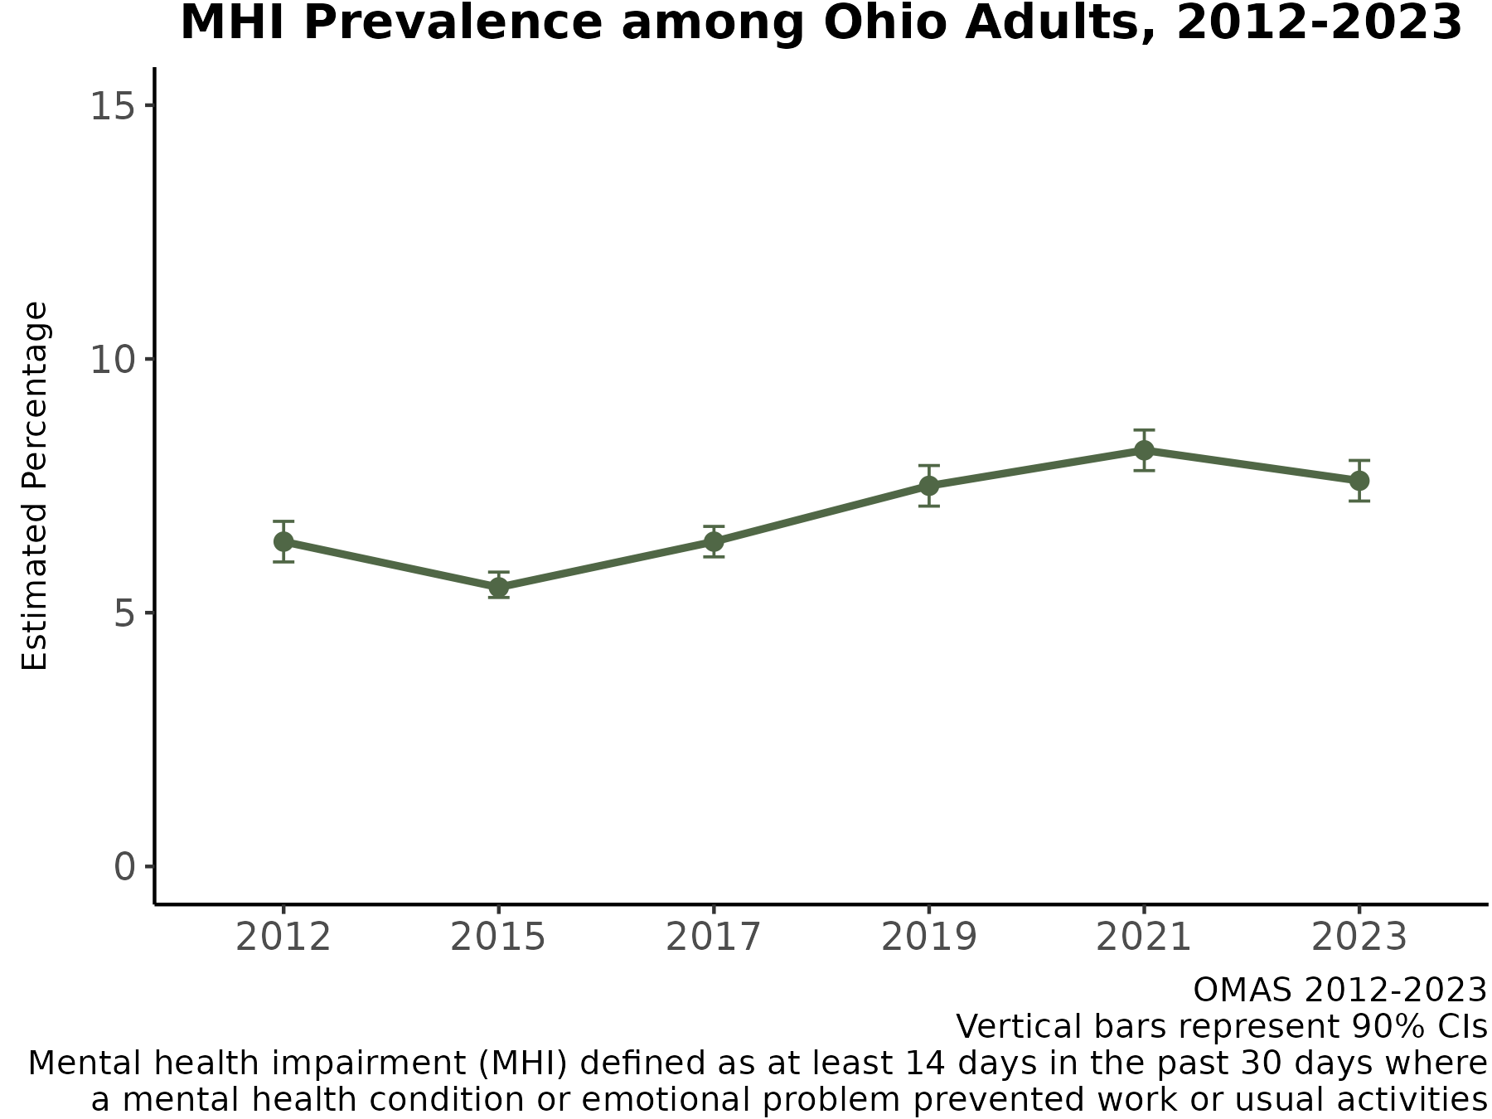
MHI Prevalence among Ohio Adults Decreased in 2023
From 2012 to 2015, mental health impairment (MHI) prevalence among Ohio adults decreased from 6.4% to a low of 5.5%. However, from 2015 to 2021, MHI prevalence steadily increased to a high of 8.2%.
From 2021 to 2023, MHI prevalence decreased to 7.5%.
The post-COVID-19 pandemic (2023) prevalence of MHI is identical to the pre-COVID-19 pandemic (2019): 7.5%.
Note: Observed group differences should not be used to draw conclusions about underlying causes - see slide 9 for more guidance.

Slide 13
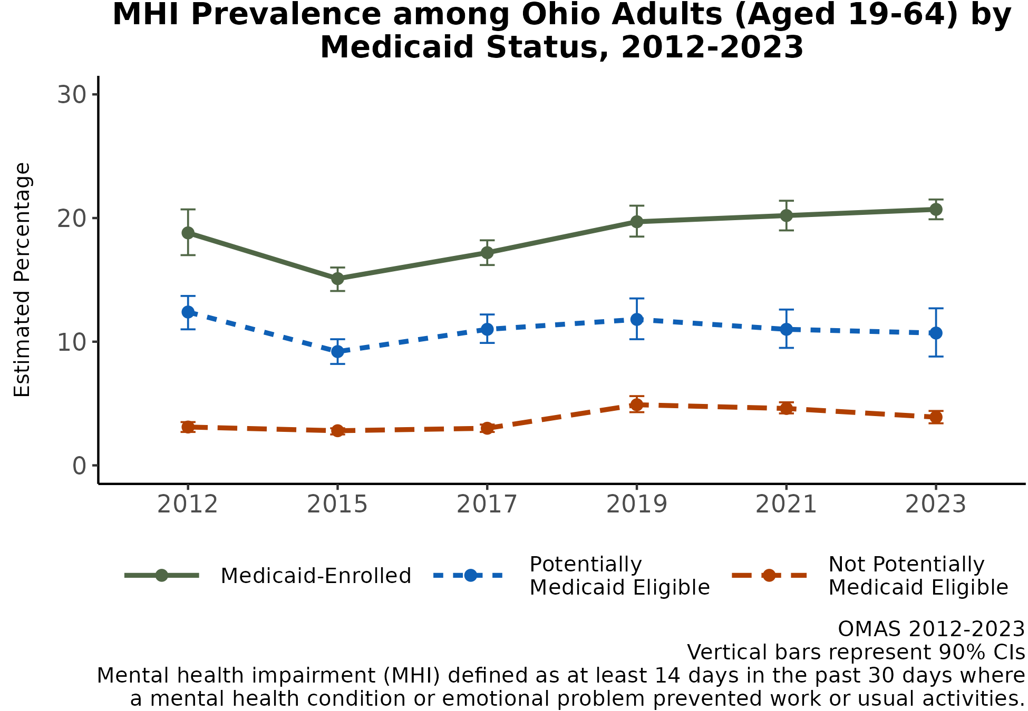
MHI Prevalence Continues to be Highest among Ohio Medicaid Enrollees
Since 2012, MHI prevalence has consistently been highest among Ohio adults with Medicaid compared to Ohio adults who are and are not potentially Medicaid eligible.
Since 2015, MHI prevalence among Ohio adults with Medicaid has steadily increased, up to a high of 20.5% in 2023.
Since 2019, MHI prevalence among Ohio adults who are and are not potentially Medicaid eligible has slightly decreased, down to 10.7% and 3.9%, respectively.
Note: Observed group differences should not be used to draw conclusions about underlying causes - see slide 9 for more guidance.

Slide 14
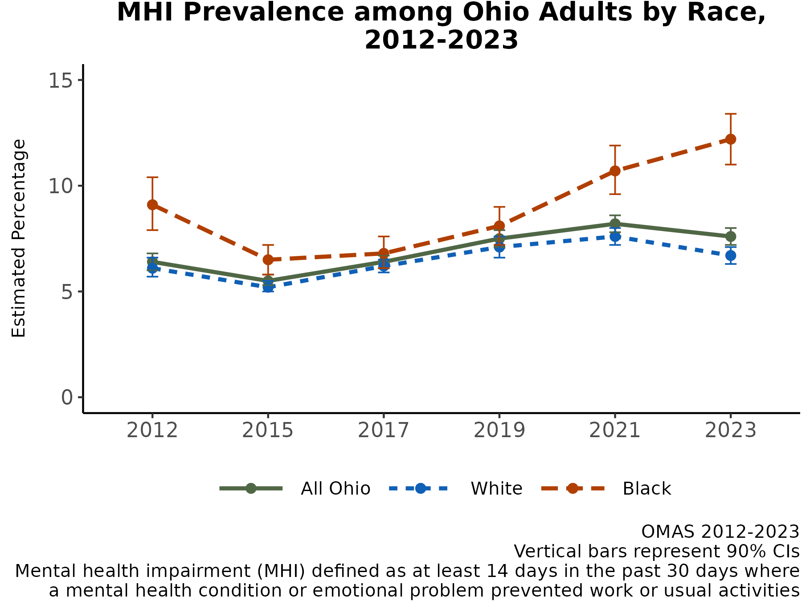
Though MHI Prevalence Decreased Overall in 2023, MHI Increased for Black Adult Ohioans
In 2012, Black adult Ohioans had higher MHI prevalence than white adult Ohioans. This trend reappeared again in 2021, and the gap widened in 2023.
Since 2012, the trend in MHI prevalence for white adult Ohioans has mirrored the overall trend in MHI prevalence for all Ohioans.
In 2023, MHI prevalence decreased among white adults to 6.6%, but MHI prevalence increased among Black adults to an overall high of 12%.
Note: Observed group differences should not be used to draw conclusions about underlying causes - see slide 9 for more guidance.

Slide 15
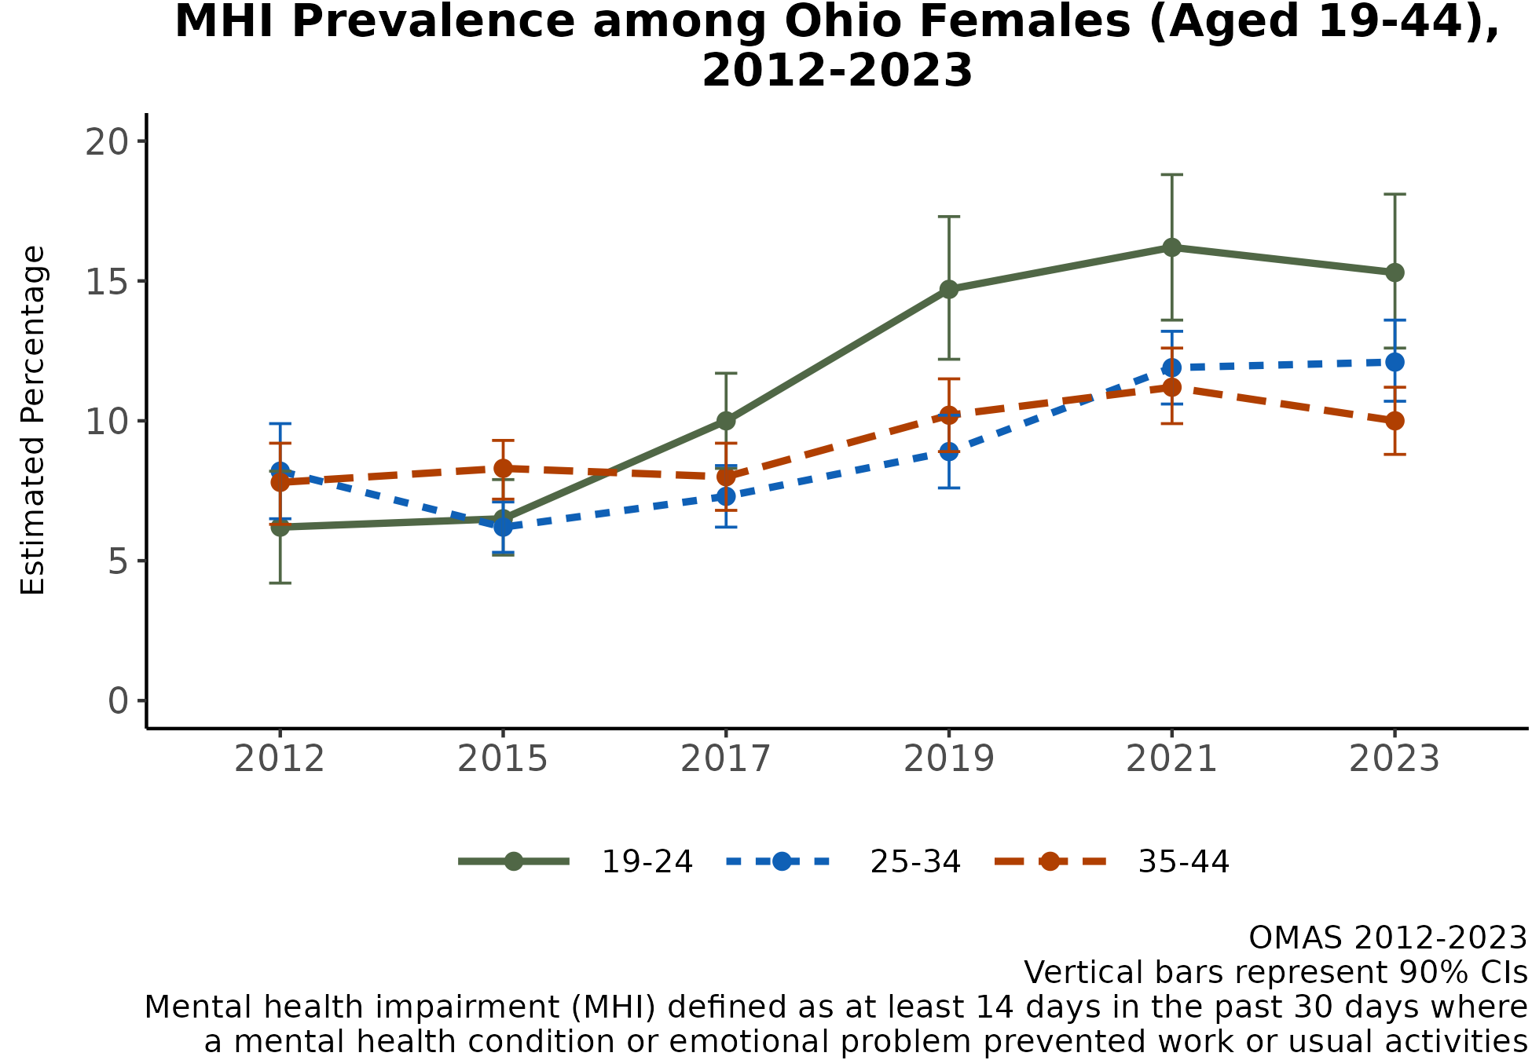
Prevalence of MHI Highest among the Youngest Ohio Females
MHI prevalence has been higher for female adult Ohioans since 2012 and higher for Ohioans aged 19-44 since 2019 (results not shown).
In 2023, MHI prevalence among all Ohio females was 8.7% (CI: 8.2-9.2) compared to 6.2% for Ohio males (CI: 5.7-6.7) (results not shown).
MHI prevalence has been highest among the youngest female Ohioans aged 19-24 since 2019.
In 2023, MHI prevalence was 15.4% for females aged 19-24, followed by 12.1% for females aged 25-34 and 9.9% for females aged 35-44.
Note: Observed group differences should not be used to draw conclusions about underlying causes - see slide 9 for more guidance.

Slide 16
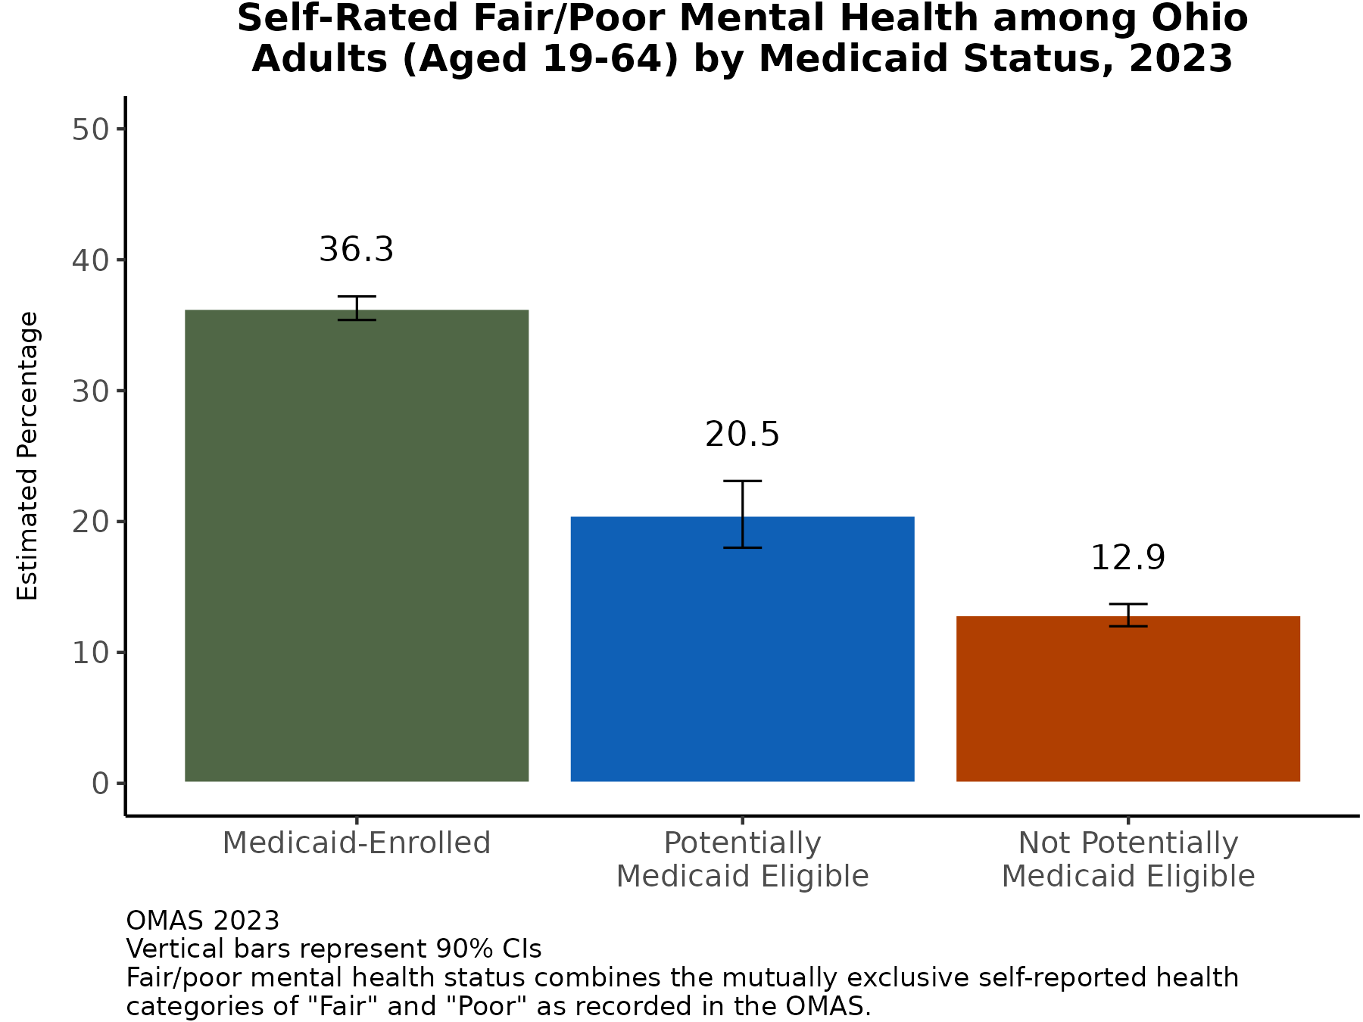
Prevalence of Fair/Poor Self-Rated Mental Health Highest among Ohio Adults with Medicaid
In 2023, nearly 1 in 5 adults aged 19-64 (19.5%, CI: 18.8-20.2) have “Fair” or “Poor” self-rated mental health (results not shown).
Adults with Medicaid had the highest prevalence of self-rated “Fair” or “Poor” mental health (36.3%, over 1 in 3).
Additional Insights (Results Not Shown)
In 2023, 22.7% (CI: 21.8-23.5) of females aged 19-64 had “Fair” or “Poor” self-rated mental health compared to 16.1% (CI: 15.1-17.1%) for males aged 19-64.
Note: Observed group differences should not be used to draw conclusions about underlying causes - see slide 9 for more guidance.

Slide 17
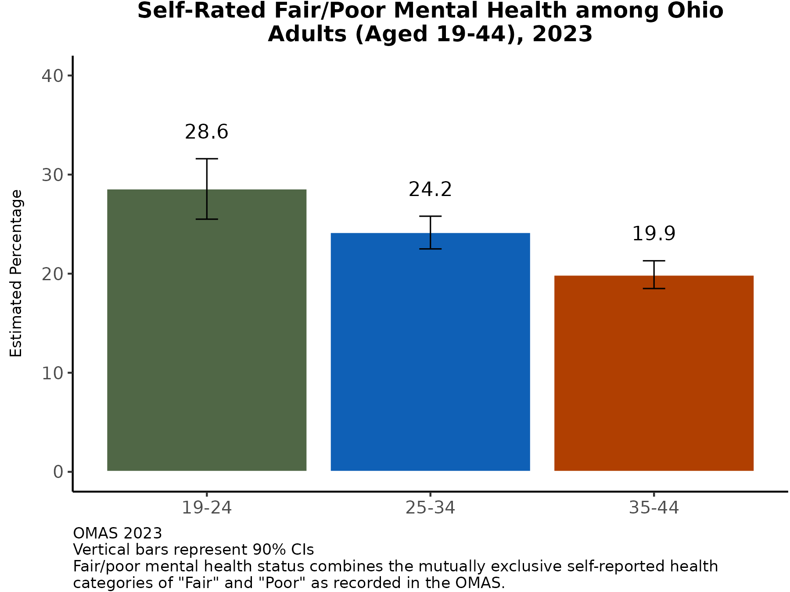
Prevalence of Fair/Poor Self-Rated Mental Health Highest among the Youngest Ohio Adults
In 2023, 23.5% (CI: 22.5-24.6) of adults aged 19-44 had “Fair” or “Poor” self-rated mental health compared to 14.1% (CI: 13.4-14.8) for those aged 45-64 and 6.1% (CI: 5.5-6.6) for those aged 65 or older (results not shown).
The prevalence of “Fair” or “Poor” self-rated mental health was highest among the youngest Ohio adults. 28.6% of those aged 19-24 had “Fair” or “Poor” self-rated mental health, followed by 24.2% of those aged 25-34 and 19.9% of those aged 35-44.
Note: Observed group differences should not be used to draw conclusions about underlying causes - see slide 9 for more guidance.
Note: Observed group differences should not be used to draw conclusions about underlying causes - see slide 9 for more guidance.

Slide 18
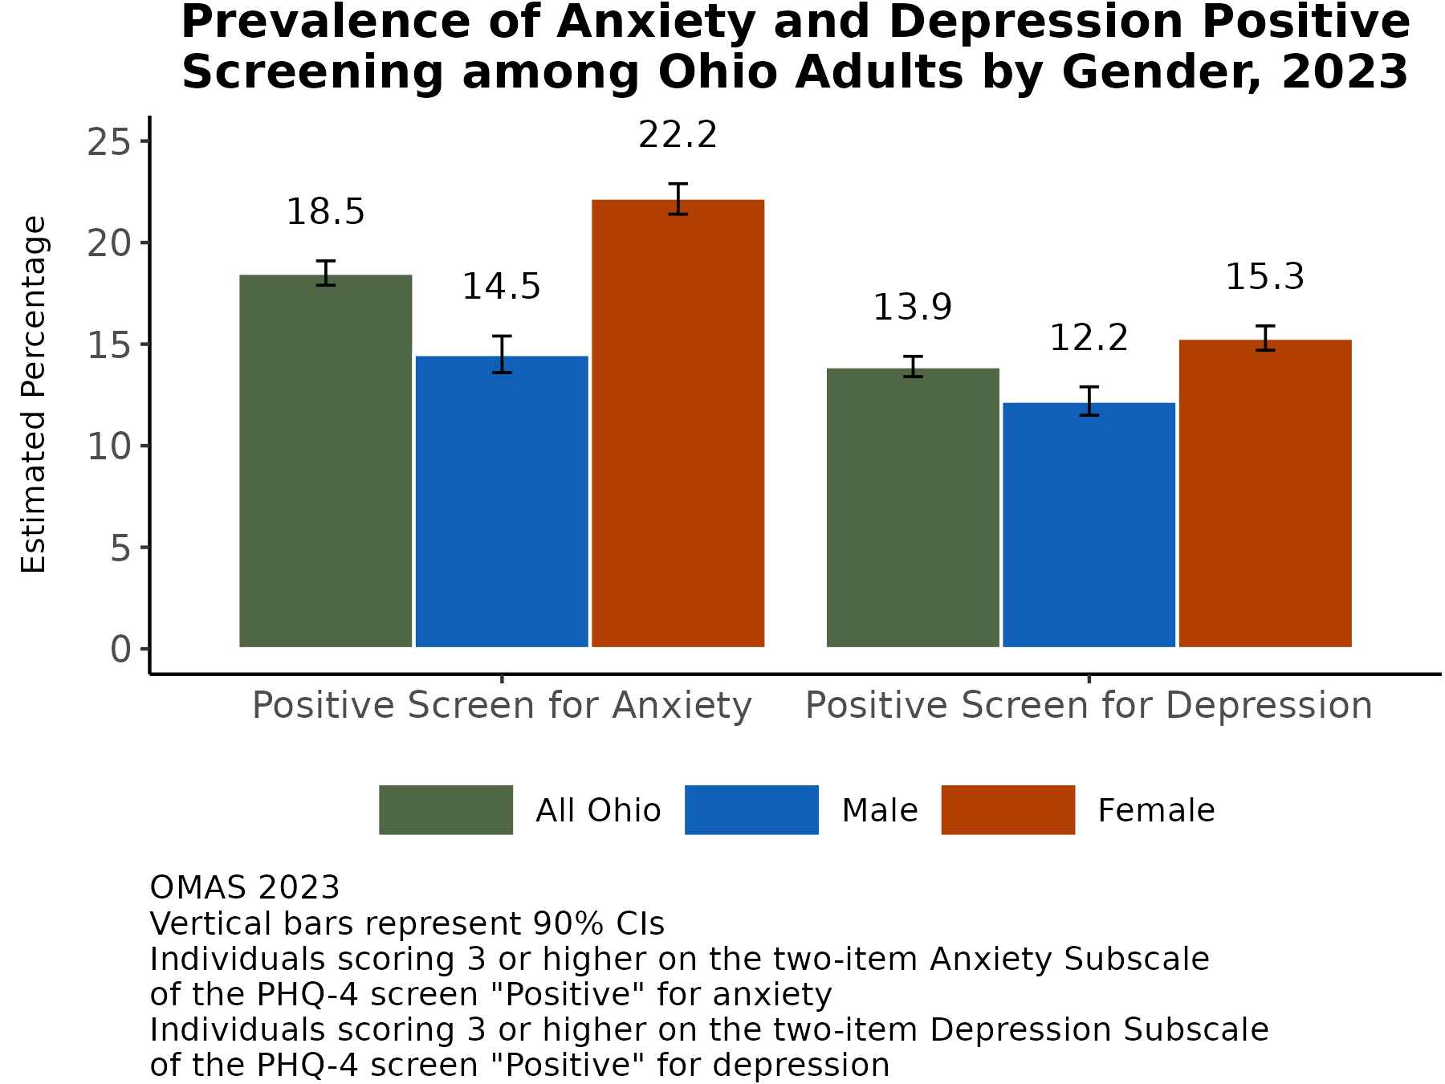
More Adult Female Ohioans Screen Positive for Anxiety, Depression in 2023
In 2023, the prevalence of Ohio adults who screened positive for anxiety was 18.5%, while the prevalence for was 13.9% for depression.
Females had higher prevalence for both (22.2% and 15.3%) compared to males (14.5% and 12.2%).
Additional Insights (Results Not Shown)
In 2023, the prevalence of positive anxiety and depression screening is higher among Black Ohioans (21.6%, CI: 20.2-23, and 19.%, CI: 17.7-20.3) compared to white Ohioans (17.7%, CI: 17.1-18.4, and 12.8%, CI: 12.2-13.3).
In 2023, the prevalence of Ohioans who co-screened positive for anxiety and depression was 10.8% (CI: 10.4-11.2).
Note: Observed group differences should not be used to draw conclusions about underlying causes - see slide 9 for more guidance.

Slide 19
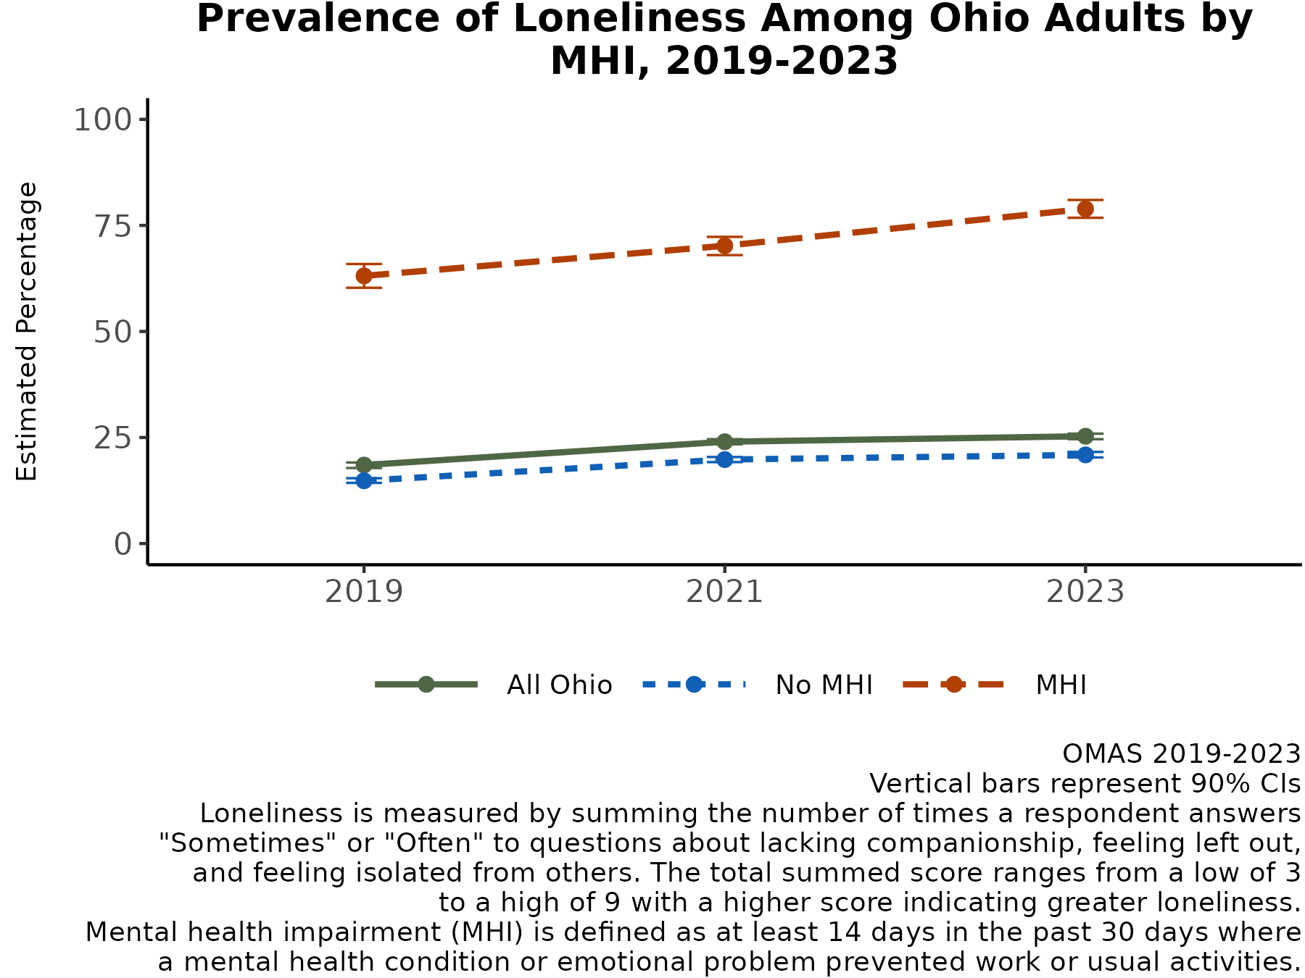
Loneliness Increasing Faster for Ohio Adults with MHI
Since 2019, loneliness among all Ohioans has slightly increased. However, since 2019, the prevalence of loneliness among Ohioans with MHI has consistently been higher than those without MHI.
In 2023, the prevalence of loneliness among Ohioans with MHI was 78.9% compared to 20.9% among adults without MHI.
Additional Insights for 2023 (Results Not Shown)
Among Ohio adults aged 19-64 with MHI who are lonely, 59.4% are female (CI: 56.4-62.5), 57% have Medicaid (CI: 53.8-60.2), 16.1% are potentially Medicaid eligible (13.1-19.2), 64.6% are aged 19-44 (CI: 62-67.2), and 35.4% are aged 45-64 (CI: 32.8-38).
Note: Observed group differences should not be used to draw conclusions about underlying causes - see slide 9 for more guidance.

Slide 20
RESULTS: PHYSICAL HEALTH Self-rated health and co-morbid chronic conditions

Slide 21
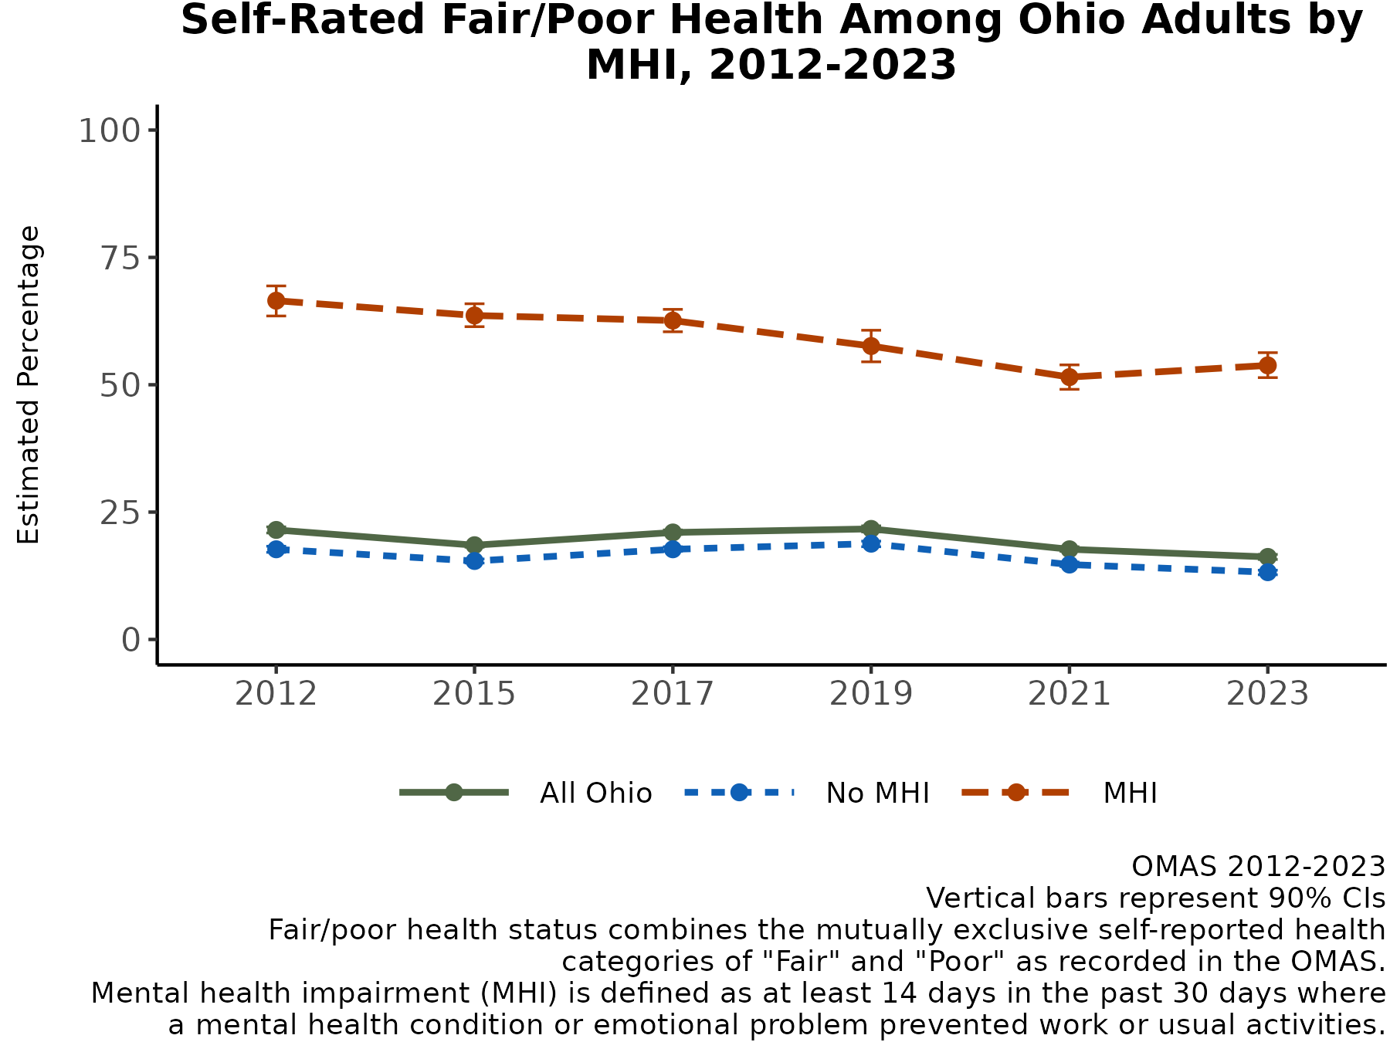
Prevalence of Fair/Poor Self-Rated Health Increased for Ohio Adults with MHI
Since 2012, the prevalence of “Fair” or “Poor” self-rated health among all Ohioans has stayed below 22%, reaching a low of 16.2% in 2023.
The difference in prevalence of “Fair” or “Poor” self-rated health between Ohioans with and without MHI decreased to a low in 2021 (36.8% difference in estimates). In 2023, the difference slightly increased (40.6% difference in estimates).
In 2023, the prevalence of “Fair” or “Poor” self-rated health among Ohioans with MHI was 53.8% (compared to 13.2% for Ohioans without MHI).
Note: Observed group differences should not be used to draw conclusions about underlying causes - see slide 9 for more guidance.

Slide 22
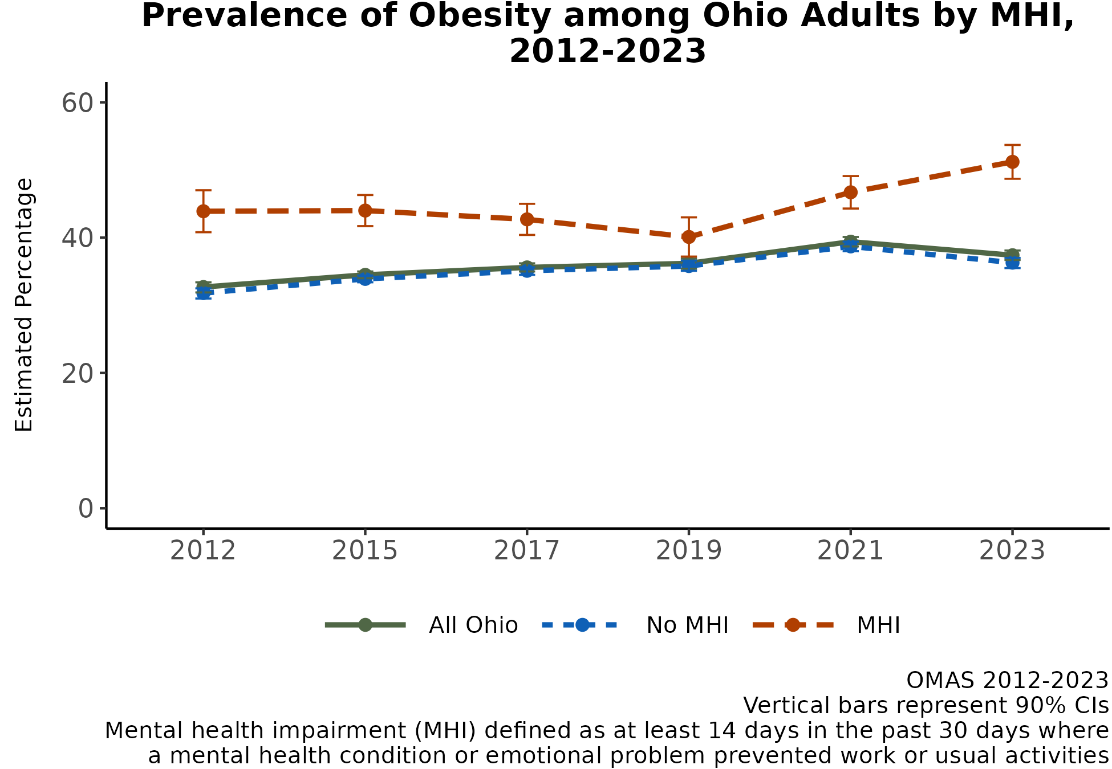
Prevalence of Obesity Increasing for Ohio Adults with MHI
Ohioans with mental health impairment (MHI) have consistently had a higher prevalence of obesity since 2012.
From 2015 to 2019, prevalence of obesity decreased among Ohioans with MHI from 43.9% to 40.1%. Since 2019, the prevalence has continued to increase.
In 2023, the prevalence of obesity among Ohioans with MHI reached a high of 50.5%.
Additional Insights (Results Not Shown)
Since 2012, Ohioans with MHI have consistently had a higher prevalence of hypertension, heart failure, heart attack, heart disease, high cholesterol, diabetes, stroke, asthma, and COPD.
Note: Observed group differences should not be used to draw conclusions about underlying causes - see slide 9 for more guidance.

Slide 23
RESULTS: HEALTH CARE ACCESS Unmet mental health and alcohol or substance use treatment needs

Slide 24
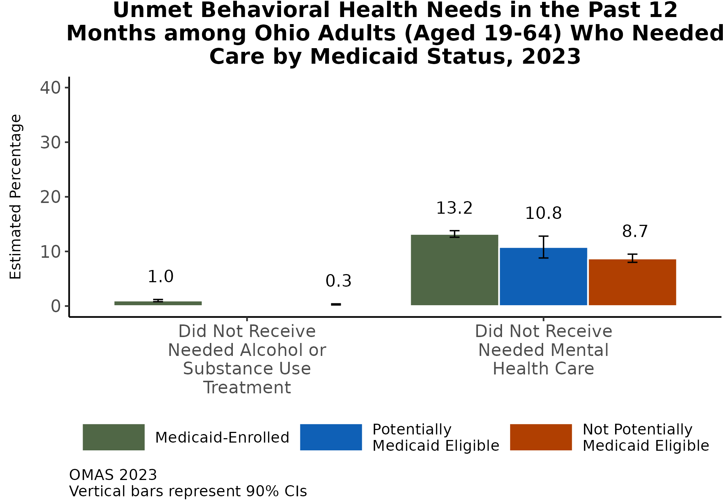
Prevalence of Unmet Mental Health Care Needs Higher for Ohio Adults with Medicaid
In 2023, the prevalence of unmet mental care health care among all Ohioans was to 8.2% (CI: 7.8-8.7), an increase from the prevalence seen in 2021 (7.5%; CI: 7.1-7.9) (results not shown).
In 2023, adults who were not potentially Medicaid eligible had the lowest prevalence of unmet mental health care needs (8.7%) and unmet alcohol or substance use treatment needs (0.3%). Adults with Medicaid had the highest prevalence (13.2% and 1.0%, respectively). (No data were available for unmet alcohol or substance use treatment needs among Ohioans who were potentially Medicaid eligible.)
Note: Observed group differences should not be used to draw conclusions about underlying causes - see slide 9 for more guidance.

Slide 25
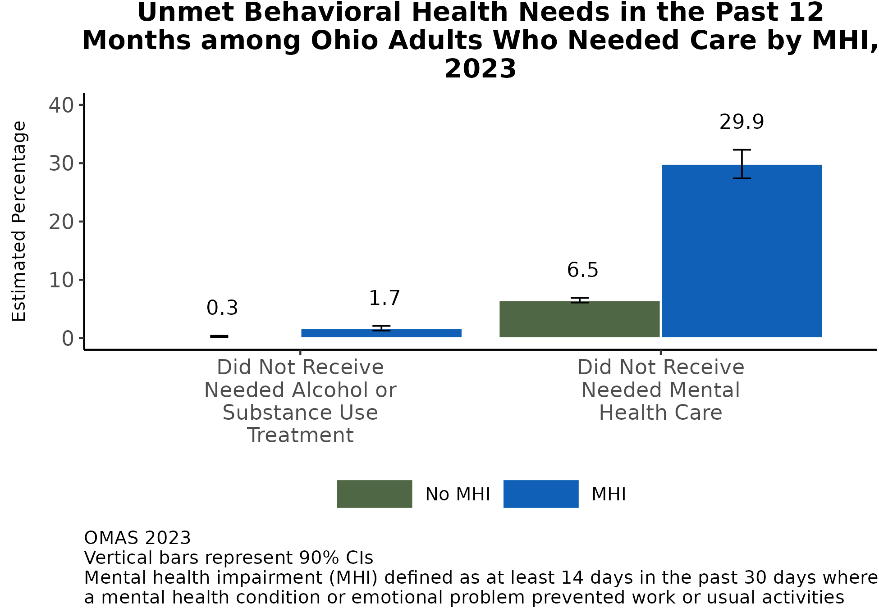
Prevalence of Unmet Mental Health Care Needs Higher for Ohio Adults with MHI
In 2023, nearly three-in-ten adults with MHI (29.9%) had unmet mental health care needs in the last 12 months. This prevalence among adults with MHI was over 4 times higher than the prevalence among adults without MHI (6.5%).
In 2023, the prevalence of unmet alcohol or substance use treatment needs in the last 12 months was low overall, although adults with MHI had a higher prevalence of this unmet need (1.7%) than adults without MHI (0.3%).
Additional Insights (Results Not Shown)
The 2023 prevalence of unmet mental health care needs among adults with MHI is similar to the 2021 prevalence (30.5%; CI: 28.2-32.8). Among adults without MHI, the 2023 prevalence increased from 2021 (5.4%; CI: 5.1-5.8).
Note: Observed group differences should not be used to draw conclusions about underlying causes - see slide 9 for more guidance.

Slide 26
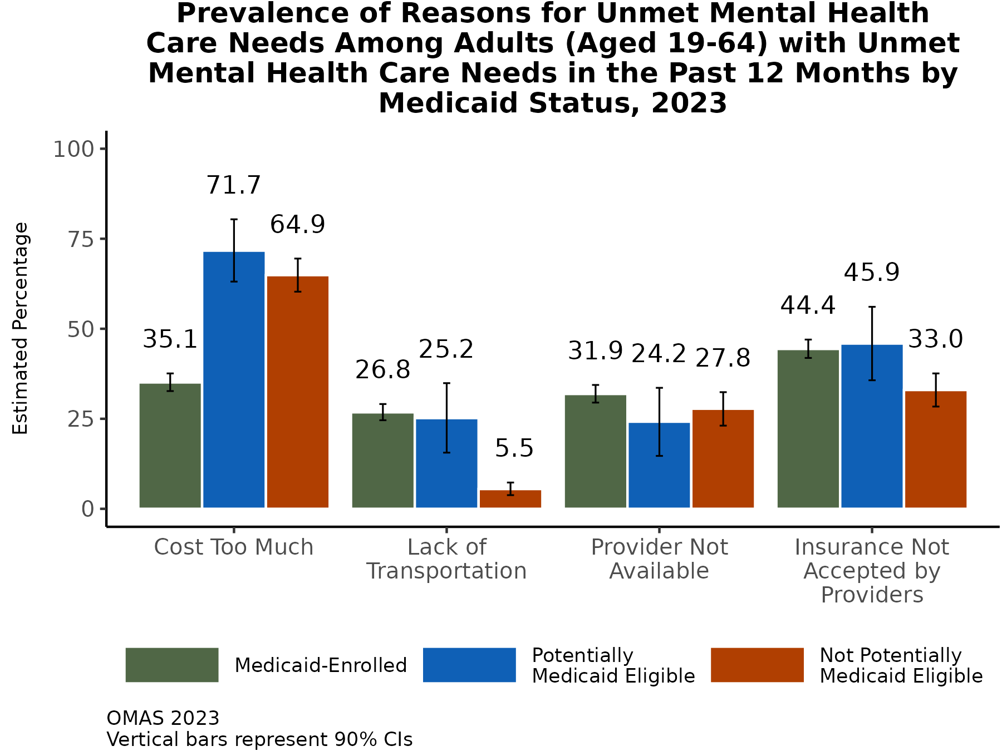
Finding Provider Who Accepts Medicaid is Top Barrier to Mental Health Care for Medicaid Members, Cost is Top Barrier for Others
Among adults with Medicaid who have unmet mental health care needs, the top barrier to care was finding a provider who accepts their insurance (44.4%).
Among adults with unmet mental health care needs who are and are not potentially Medicaid eligible, the top barrier to care was cost (71.7% and 64.9%, respectively). Adults with Medicaid had the lowest prevalence of indicating cost as a barrier (35.1%).
For nearly 1 in 4 adults with Medicaid (26.8%) and adults who are potentially Medicaid eligible (25.2%), lack of transportation was a barrier to mental health care, compared to only 5.5% of those not potentially eligible.
Additional Insights (Results Not Shown)
In 2023, 2.5 times more adults with MHI experienced lack of transportation as a barrier (25.8%, CI: 21-30.6) than those without MHI (10.9%, CI: 9.1-12.8).
Note: Observed group differences should not be used to draw conclusions about underlying causes - see slide 9 for more guidance.

Slide 27
RESULTS: CO-OCCURRENCE OF SUBSTANCE USE Prescription pain relievers, smoking, e-cigarette use, and marijuana use

Slide 28
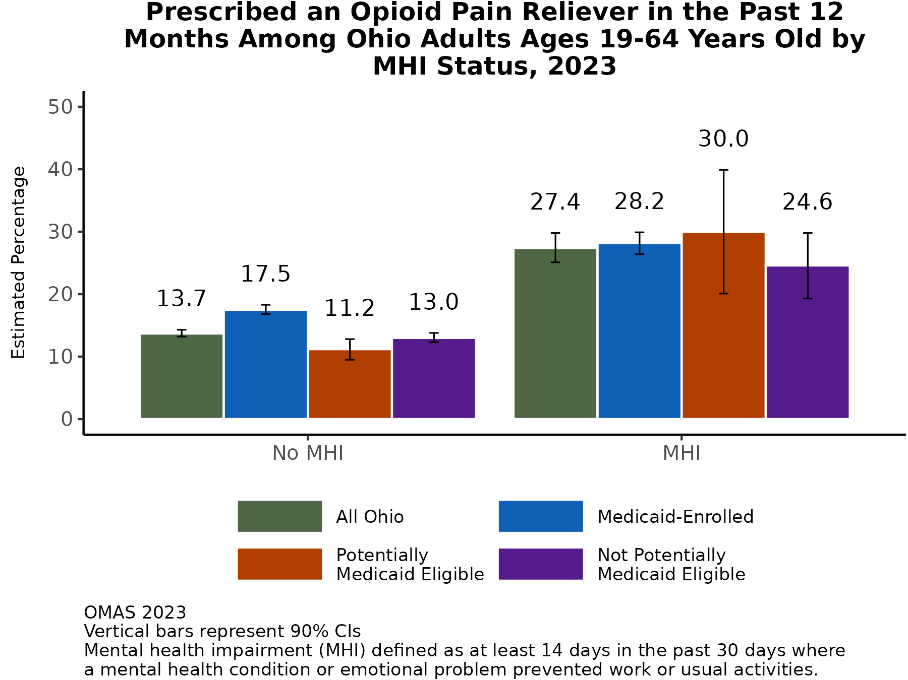
MHI Co-Occurs with Pain: 3 in 10 Ohio Adults with MHI Prescribed Opioid Pain Reliever in Past 12 Months
In 2023, an estimated 27.4% of adults with MHI were prescribed an opioid pain reliever in the past 12 months, as compared to about 13.7% of adults without MHI.
Among adults without MHI, Medicaid-enrolled adults had the highest rates of opioid reliever prescription (17.5%) as compared to the general population and the potentially and not potentially Medicaid eligible subpopulations.
Additional Insights (Results Not Shown)
The prevalence of using a prescription opioid that was not prescribed was slightly elevated for adults with MHI (7.3%, CI: 5.5%-9.1%) as compared to adults without MHI (3.2%, CI: 2.8%-3.5%) in 2023.
Note: Observed group differences should not be used to draw conclusions about underlying causes - see slide 9 for more guidance.

Slide 29
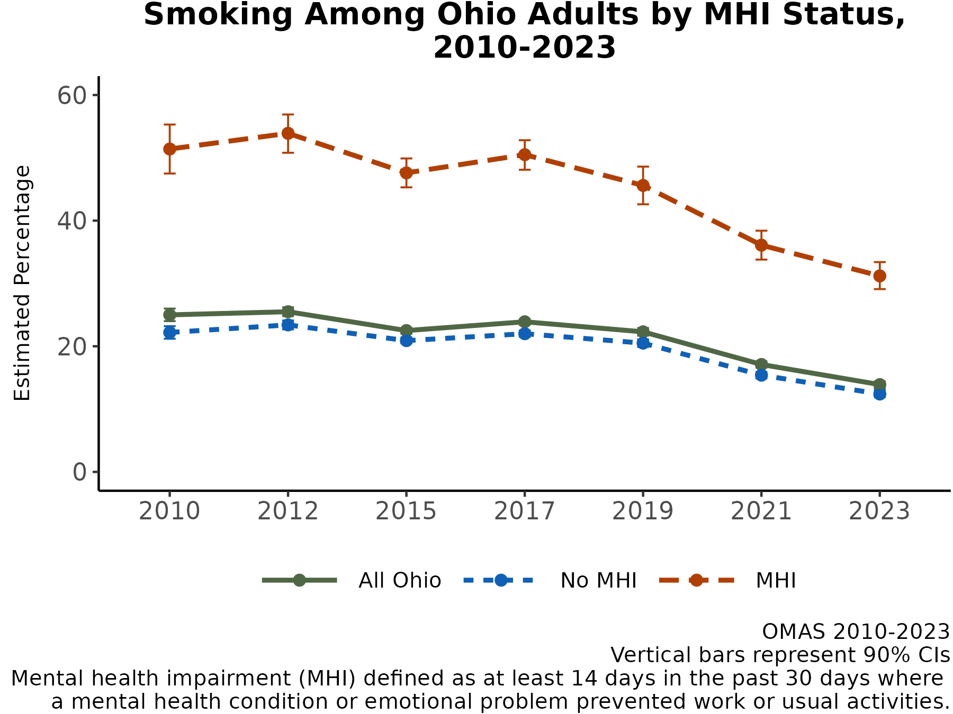
Ohio Adults with MHI Continue to Smoke Less But Smoke 2 Times More than Ohio Adults without MHI
Smoking among adults continues to decline, with the sharpest decline among adults with MHI - about 14.4 percentage points between 2019 and 2023.
Between 2019 and 2023 the difference between smoking rates among adults with and without MHI decreased from 25.1 percentage points to 18.8 percentage points, but adults with MHI continue to smoke at rates 2 times higher than adults without MHI (31.2% vs. 12.4%, respectively).
Note: Observed group differences should not be used to draw conclusions about underlying causes - see slide 9 for more guidance.

Slide 30
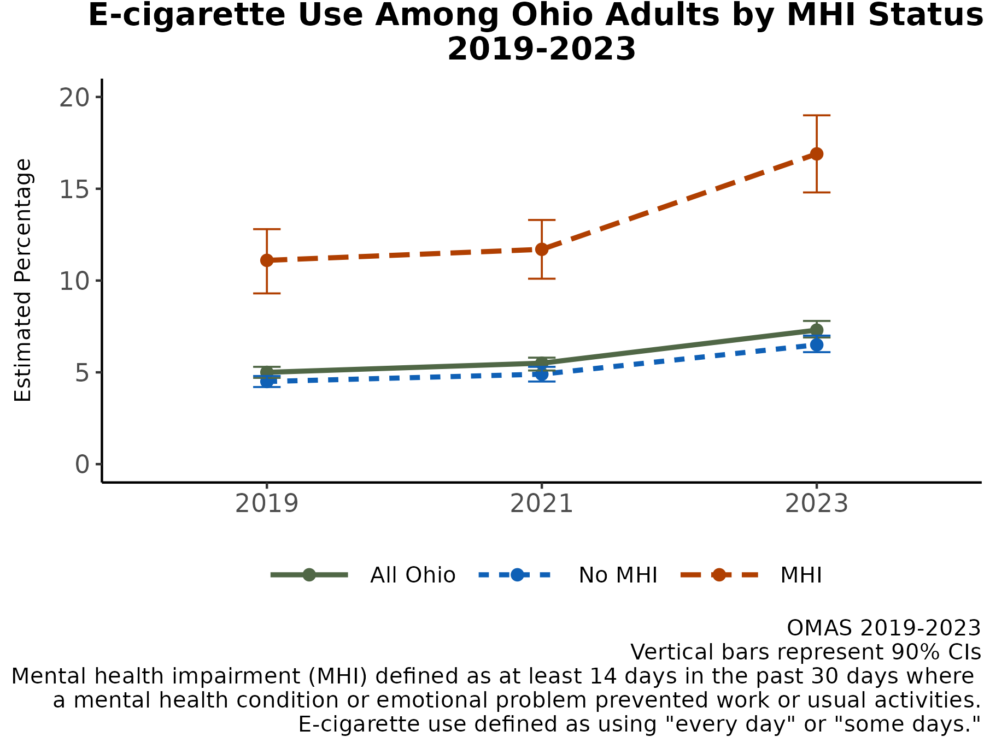
E-Cigarette Use Increased Among Ohioans in 2023, Largest Increase Among Ohio Adults with MHI
E-cigarette use among all adults increased between 2021 and 2023, with the largest increase among adults with MHI (from an estimated 11.7% to 16.9%). This 5.2 percentage point increase is larger than the 4.9 percentage point decrease in smoking among adults with MHI between 2021 and 2023 (see slide 28), so the net overall change in nicotine use as measured in the survey was 0.3 percentage points.
While the difference in smoking rates between adults with and without MHI decreased between 2019 and 2023 (see slide 28), the difference in e-cigarette use between these two subpopulations grew in 2023, from an estimated 6.8 percentage points in 2021 to 10.4 percentage points in 2023.
Note: Observed group differences should not be used to draw conclusions about underlying causes - see slide 9 for more guidance.

Slide 31
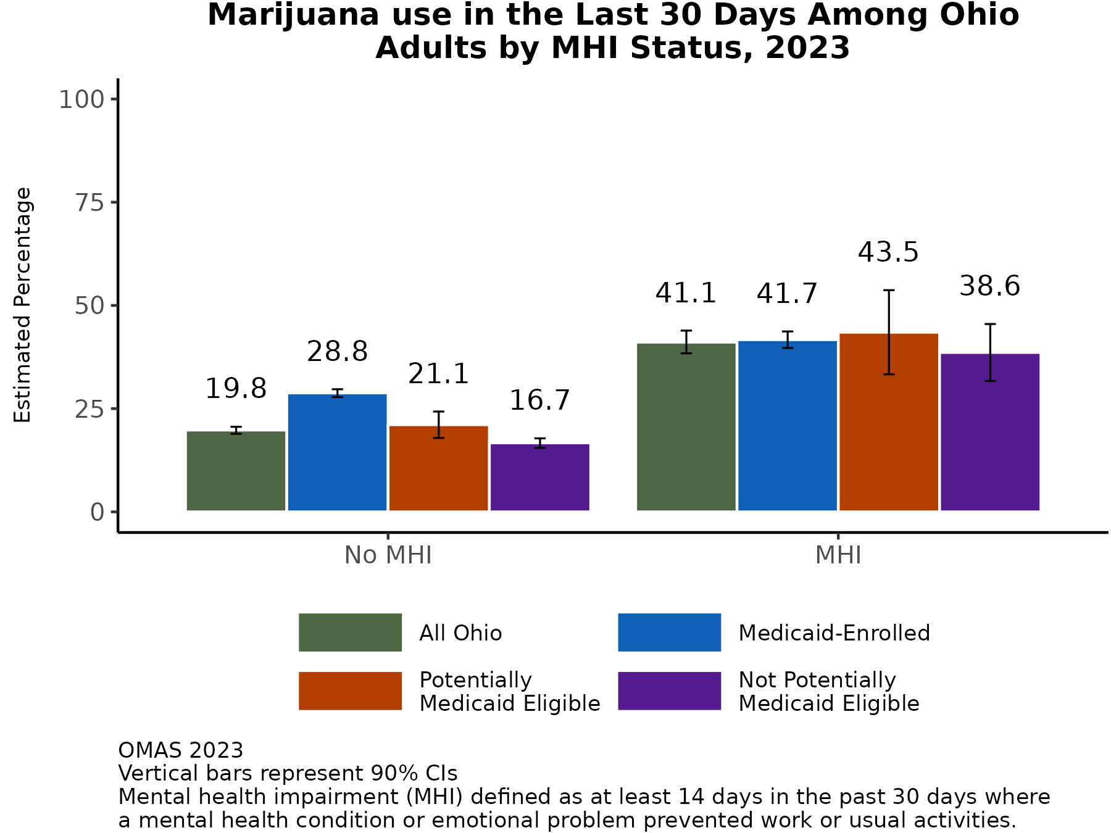
Marijuana Use Highest Among Ohio Adults with MHI
An estimated 41.1% of adults with MHI used marijuana in the last month in 2023. This rate is consistent across the insurance subpopulations.
Generally, rates of marijuana use among adults with MHI are more than twice rates among adults without MHI. The difference in rates is lowest for Medicaid-enrolled adults (1.5 times) and highest for adults who are not potentially Medicaid-eligible (2.3 times).
Among adults without MHI, Medicaid-enrolled adults have the highest prevalence of marijuana use in the last 30 days (28.8%).
Additional Insights (Results Not Shown)
About two-thirds of Ohioans with MHI ever used marijuana (66.3%, CI:64.8%-68.7%), as compared to about half of Ohioans without MHI (49.4%, CI: 48.4%-50.4%).
Note: Observed group differences should not be used to draw conclusions about underlying causes - see slide 9 for more guidance.

Slide 32
RESULTS: SOCIAL AND ECONOMIC STRESSORS Household expenses, reliable transportation, food, medical bills, and work

Slide 33
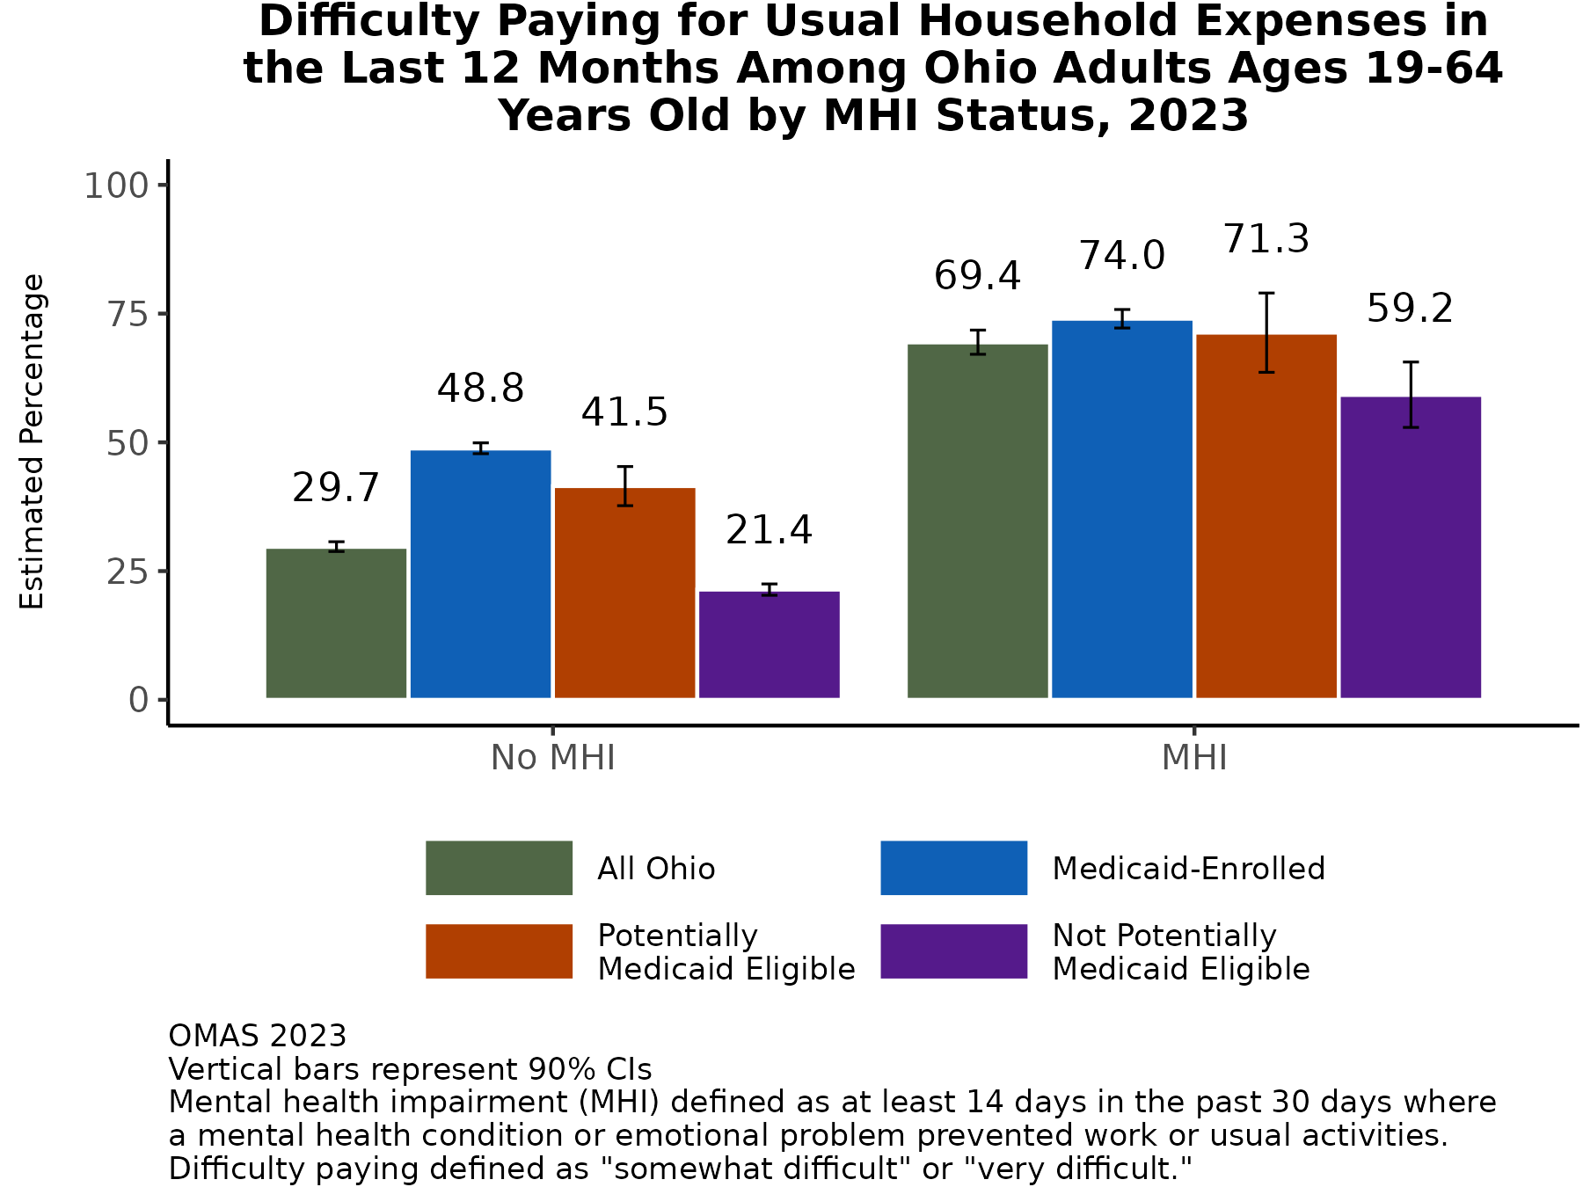
Twice as Many Ohio Adults with MHI Have Difficulty Paying for Household Expenses than Ohio Adults without MHI
In 2023, about seven-in-ten adults with MHI had difficulty paying for usual household expenses in the last 12 months (69.4%) as compared to about three-in-ten adults without MHI (29.7%).
Among both adults with and without MHI, the Medicaid subpopulation had the highest rates of difficulty paying for usual household expenses – 74.0% among those with MHI and 48.8% among those without MHI.
Additional Insights (Results Not Shown)
For other measures of economic stress, such as difficulty paying debt and paying for food, there were similar estimates for the three Medicaid status subpopulations and the general adult population in 2023.
Note: Observed group differences should not be used to draw conclusions about underlying causes - see slide 9 for more guidance.

Slide 34
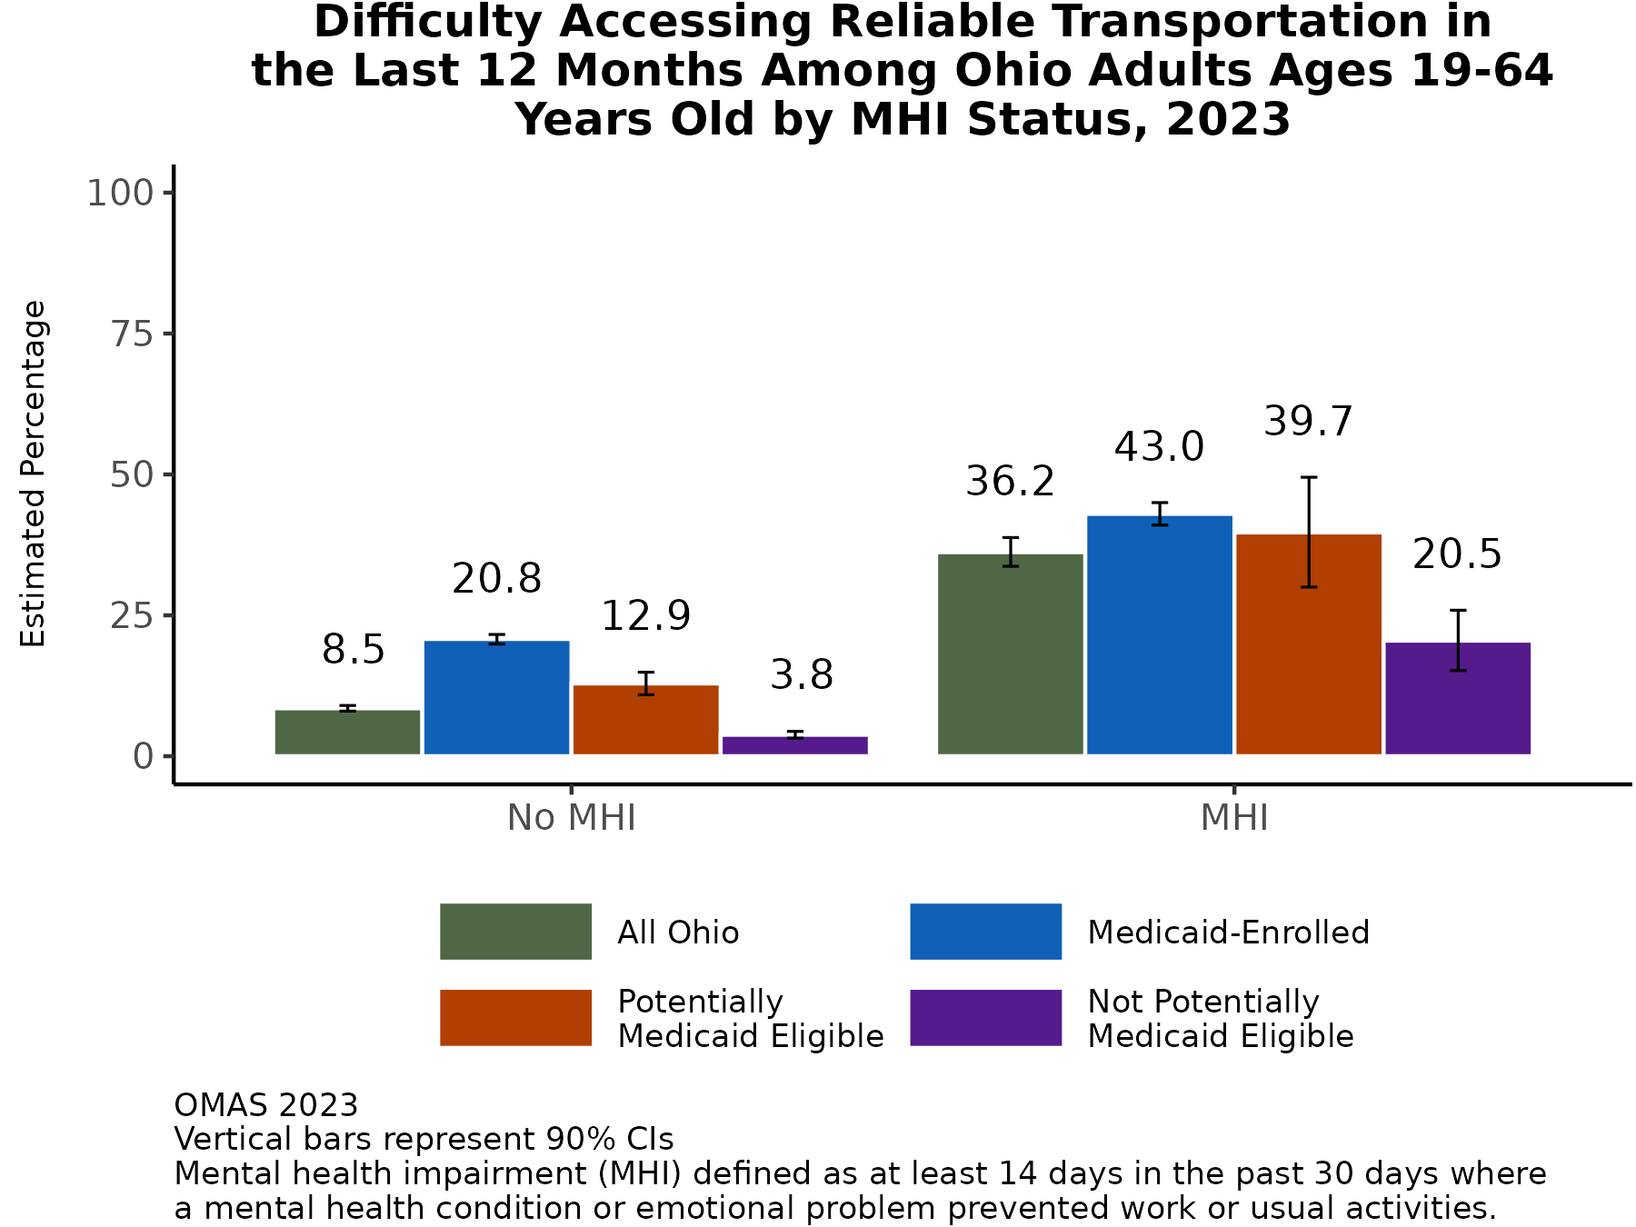
Ohio Adults with MHI Have 2 to 5 Times More Difficulty Accessing Reliable Transportation Than Ohioans without MHI
Among the Medicaid subpopulation and the potentially Medicaid eligible subpopulation, adults with MHI have about 2 to 3 times more difficulty accessing reliable transportation than adults without MHI.
In comparison, among the general adult population and the not potentially Medicaid eligible subpopulation, adults with MHI have about 4 to 5 times more difficulty accessing reliable transportation.
However, among adults with MHI, those with Medicaid insurance have twice the difficulty accessing reliable transportation than those who are not potentially Medicaid eligible (43.0% vs. 20.8%, respectively).
Note: Observed group differences should not be used to draw conclusions about underlying causes - see slide 9 for more guidance.

Slide 35
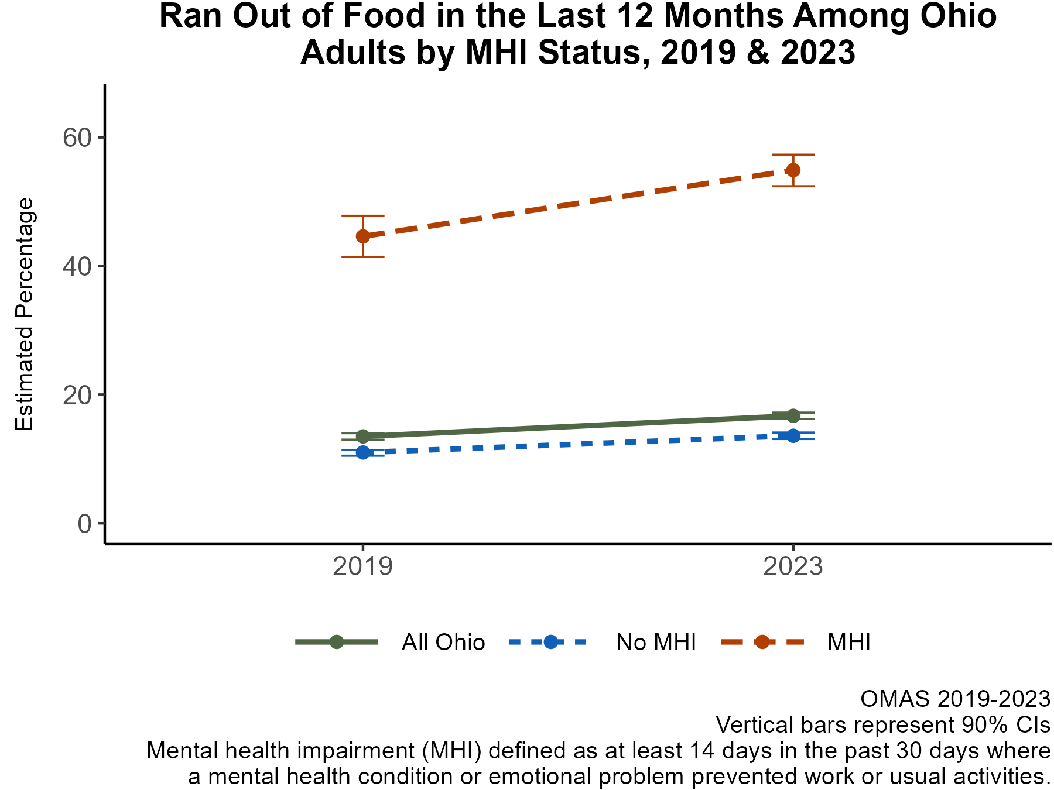
Ohio Adults with MHI have 4 Times the Prevalence of Running Out of Food in Last 12 Months
In both 2019 and 2023, adults with MHI had about 4 times the prevalence of running out of food in the last 12 months as compared to adults without MHI.
Running out of food was prevalent among adults with MHI in 2023 (54.9%).
Between 2019 and 2023 there was an increase in the proportion of adults who ran out of food in the last 12 months, with the largest increase among adults with MHI (10.3 percentage points).
Additional Insights (Results Not Shown)
In 2023, an estimated 61.6% (CI:59.7%-63.5%) of adults with MHI and Medicaid insurance ran out of food, as compared to 60.6% (CI:53%-68.2%) with MHI and who are potentially Medicaid eligible, and 40.3% (CI:34.2%-46.3%) with MHI and who are not potentially Medicaid eligible.
Note: Observed group differences should not be used to draw conclusions about underlying causes - see slide 9 for more guidance.

Slide 36
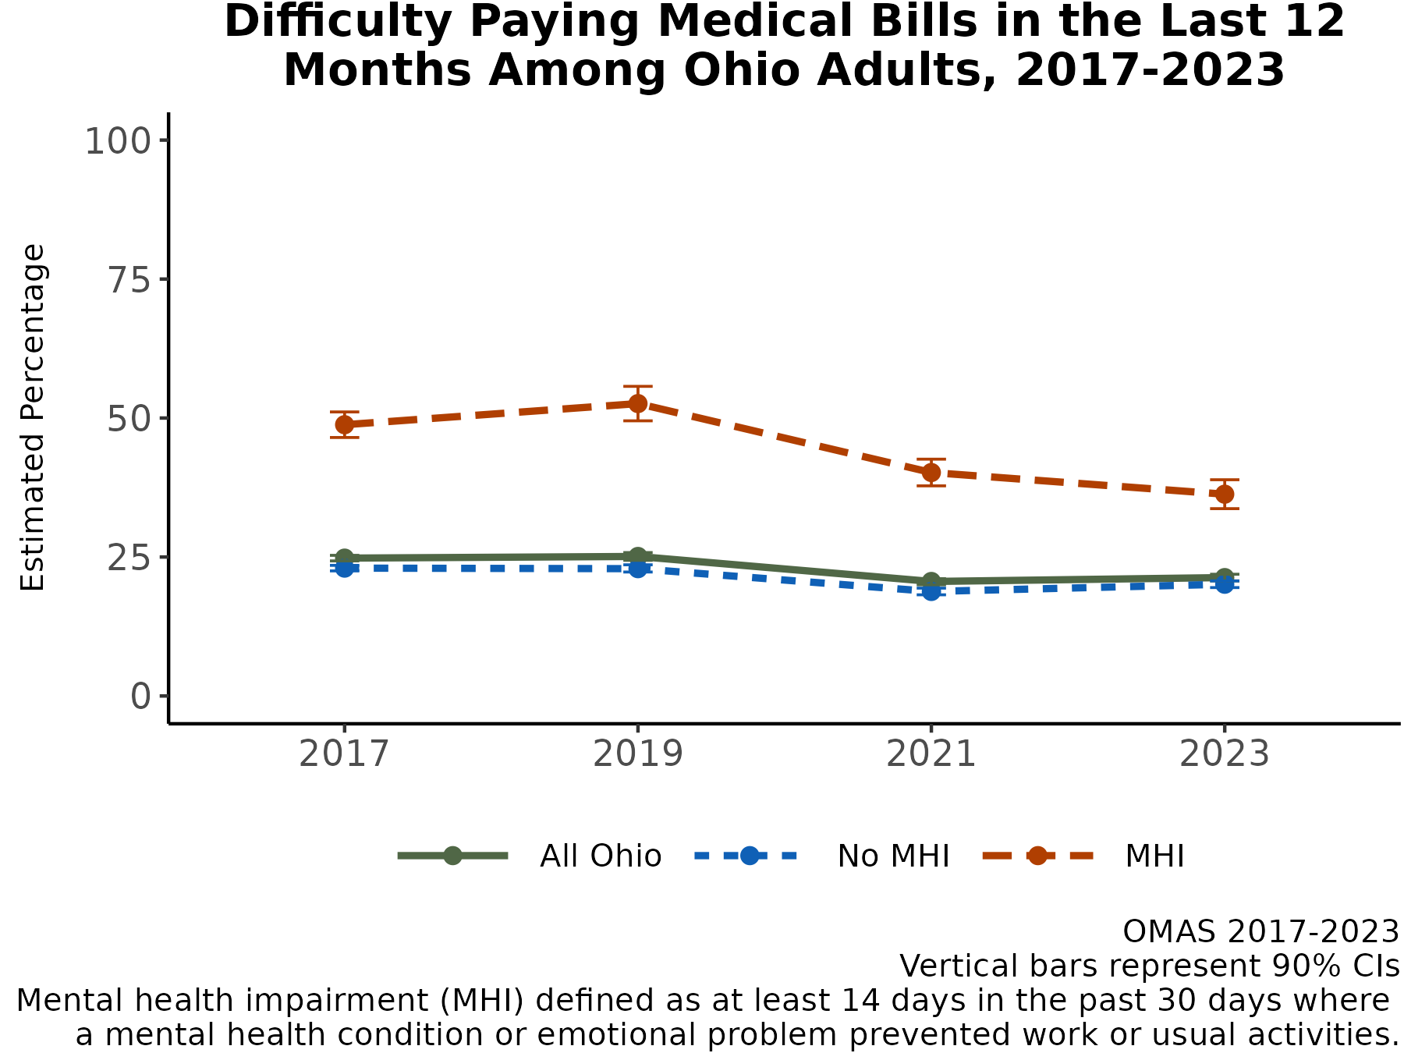
Fewer Ohio Adults with MHI Face Difficulties Paying Medical Bills in Last 12 Months
Trends in difficulty paying medical bills in the last 12 months have stayed relatively flat between 2017 and 2023 among the general adult population. About 21.3% experienced this difficulty in 2023.
The starkest reduction in difficulties paying medical bills was among the adult population with MHI – from an estimated 52.6% in 2019 to 40.2% in 2021 and 36.3% in 2023 – although these rates consistently remain much higher than those for adults without MHI (16.2 percentage points higher in 2023).
Note: Observed group differences should not be used to draw conclusions about underlying causes - see slide 9 for more guidance.

Slide 37
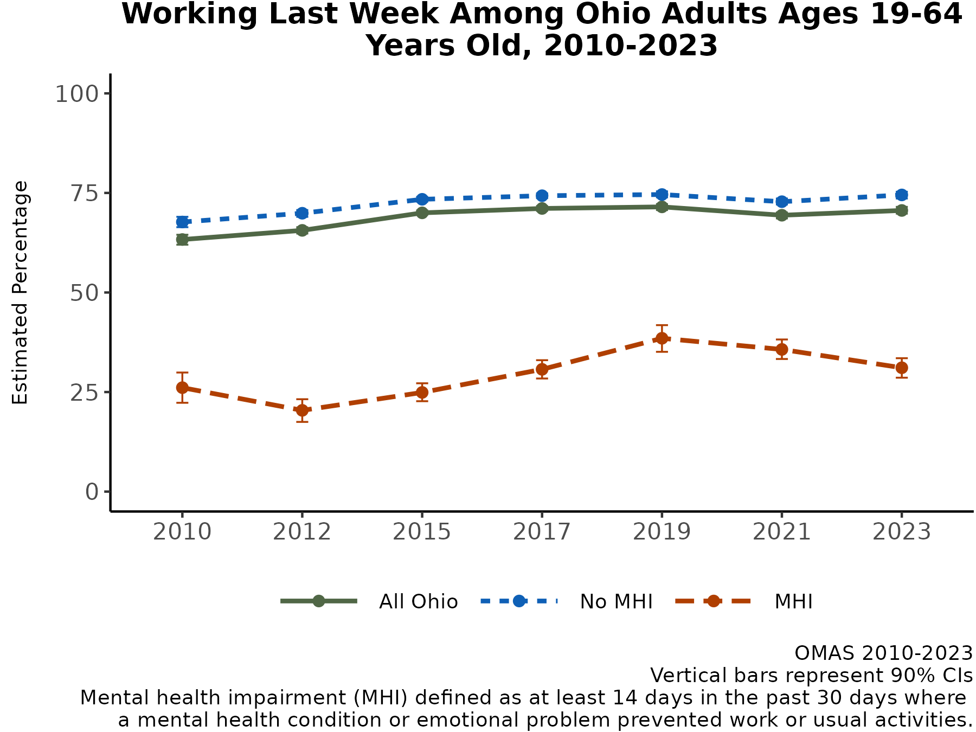
Fewer Ohio Adults with MHI are Working
Following a relative peak in 2019 (38.5%), rates of working have continued to fall among the adult population with MHI, from 35.7% in 2021 to 31.1% in 2023. These rates remain much higher than 2010-2015.
In 2023, adults with MHI were working at rates about half of those of adults without MHI (74.5%).
Note: Observed group differences should not be used to draw conclusions about underlying causes - see slide 9 for more guidance.

Slide 38
Summary of Results
MHI Prevalence: Differing from the steady increase between 2015 and 2021, MHI prevalence among all adults in Ohio decreased in 2023 to 7.5%. However, this recent decrease was not seen equally among all groups. MHI prevalence slightly decreased for adults not potentially Medicaid eligible and white adults but increased among adults with Medicaid and Black adults. MHI prevalence continued to be higher among female adults, adults aged 19-44, and the youngest female adults aged 19-24.
Other Mental Health Indicators: Nearly one in five adults have “Fair” or “Poor“ self-rated mental health, and 18.5% of adults met the threshold to screen positive for anxiety while 13.9% met the threshold to screen positive for depression. Like with MHI prevalence, the prevalence of fair/poor self-rated mental health is higher among adults with Medicaid and the youngest females (aged 19-24), while the prevalence of anxiety and depression are higher among females. Loneliness continued to increase faster among adults with MHI, and lonely Ohioans with MHI are proportionately more female, Medicaid-enrolled, and aged 19-44.
General Health: The prevalence of "Fair" or "Poor“ self-rated general health continues to be higher among adults with MHI, and the prevalence for adults with MHI increased between 2021 and 2023. Adults with MHI continue to have higher prevalence of all chronic conditions captured in the OMAS. Adults with MHI also continue to have higher prevalence of obesity, which increased for adults with MHI but decreased for adults without MHI between 2021 and 2023.

Slide 39
Summary of Results, continued
Health Care Access: In 2023, the prevalence of unmet mental health care needs was higher for Ohioans with Medicaid and those potentially Medicaid eligible as well as those with MHI. Overall, the prevalence of unmet alcohol or substance use treatment needs remains low (under 2%). The top reason for unmet mental health care needs for adults with Medicaid with an unmet mental health care need was finding a provider who accepts their insurance (though adults who are potentially Medicaid eligible showed a similar prevalence for this barrier). Adults with Medicaid with an unmet care need had the lowest prevalence of experiencing cost as a barrier, while the cost was the top barrier for those who are and are not potentially Medicaid eligible. Adults with Medicaid with an unmet care need also had the lowest prevalence of experiencing transportation as a reason for unmet mental health care needs, but adults with MHI experienced transportation as a barrier to mental health care 2.5 times more than adults without MHI.
Substance Use: Ohioans are continuing to smoke less in 2023 but are using e-cigarettes more than in 2021. Adults with MHI have much higher rates of substance use than adults without MHI.
Social and Economic Stressors: Financial difficulties are common among adults with MHI, with nearly three-quarters struggling to pay for household expenses and more than half running out of food in 2023. However, fewer Ohioans with MHI are having difficulty paying medical bills as compared to 2019.

Slide 40
References
Kochanek KD, Xu JQ, Arias E. Mortality in the United States, 2019. NCHS Data Brief, no 395. Hyattsville, MD: National Center for Health Statistics. 2020.
Albani TJ, Rajanbabu A. Chronic Disease Prevalence in Ohio: 2017 Findings. Columbus, OH: Ohio Colleges of Medicine Government Resource Center; 2019:7
The Impact of Chronic Disease in Ohio: 2015. Chronic Disease Epidemiology and Evaluation Section, Bureau of Health Promotion, Ohio Department of Health; 2015.
Chapel JM, Ritchey MD, Zhang D, Wang G. Prevalence and Medical Costs of Chronic Diseases Among Adult Medicaid Beneficiaries. Am J Prev Med. 2017;53(6):S143-S154. doi:10.1016/j.amepre.2017.07.019
Kokubo Y, Iwashima Y. Higher Blood Pressure as a Risk Factor for Diseases Other Than Stroke and Ischemic Heart Disease. Hypertension. 2015; 66(2)254-259. https://doi.org/10.1161/HYPERTENSIONAHA.115.03480
Buttorff C, Ruder T, Bauman M. Multiple Chronic Conditions in the United States. Santa Monica, California: RAND Corporation; :33. https://www.rand.org/content/dam/rand/pubs/tools/TL200/TL221/RAND_TL221.pdf.
Sommers BD, Gawande AA, Baicker K. Health Insurance Coverage and Health — What the Recent Evidence Tells Us. N Engl J Med. 2017;377(6):586-593. doi:10.1056/NEJMsb1706645
Asay GR, Roy K, Lang JE, Payne RL, Howard DH. Absenteeism and Employer Costs Associated With Chronic Diseases and Health Risk Factors in the US Workforce. Prev Chronic Dis 2016; 13:150503. DOI:http://dx.doi.org/10.5888/pcd13.150503

Slide 41
Acknowledgments

