Slide 1
Chronic Diseases in Ohio in 2023
March 2026

Slide 2
Authors
Amy Ferketich, PhD¹, Marsha Lewis, PhD²
¹The Ohio State University College of Public Health
²Ohio University Voinovich School of Leadership and Public Service

Slide 3
Executive Summary
Chronic diseases are among the leading causes of death for Ohio adults. In this chartbook, we identify the prevalence of several chronic diseases in 2023 and compare the prevalence by race/ethnicity, geography, education level, and Medicaid status. The chartbook also examines the prevalence of several known risk factors for chronic disease such as binge drinking and obesity.
Key Findings*:
Hypertension was the most prevalent of the chronic diseases assessed in the 2023 OMAS. Almost 40% of adult Ohioans had ever been diagnosed with hypertension.
Differences persist in the prevalence of chronic diseases among Ohio adults. For example, nearly all chronic conditions assessed were highest among Black adults. The prevalence of chronic diseases decreased as education level increased.
The prevalence of most chronic disease in Ohio varied by geography. For example, the prevalence of hypertension was highest among adults living in Appalachian and metropolitan counties.
For nearly all chronic diseases assessed, working-age adults enrolled in Medicaid and those potentially eligible for Medicaid had higher prevalence of chronic conditions than those not potentially eligible for Medicaid.
Ohio adults had a high prevalence of certain risk factors for chronic disease, including binge drinking and obesity.
*Note: Observed group differences should not be used to draw conclusions about underlying causes - see slide 8 for more guidance.

Slide 4
Contents
Background | Page 5
Objectives | Page 6
Methods | Page 7
Results
Medicaid and Chronic Diseases | Page 30
Summary of Results | Page 36
References | Page 38
Acknowledgments | Page 39
Prevalence of all Conditions | Page 12
Hearth Disease | Page 14
Asthma and COPD | Page 18
Diabetes, Heart Disease, and Stroke | Page 22
Risk Factors for Chronic Diseases | Page 26

Slide 5
Background
Chronic diseases consistently account for 6 of the 10 leading causes of death among Ohio adults. These chronic diseases adversely affect individuals, families, communities, and the State as a whole. They reduce the quality of life and lifespan for individuals, take people away from work, family and community activities, and are costly to individuals and the healthcare system.
Chronic diseases have many shared risk factors including alcohol consumption, smoking, and obesity that, if reduced, would lower the prevalence of chronic diseases among Ohioans. These risk factors tend to be more prevalent in Ohio compared to national data. Differences persist in the prevalence of these risk factors based on race/ethnicity, geography, income, and education level.
This chartbook adds value to the work to reduce chronic disease in Ohio in the following ways:
Examines the most current data on the prevalence of risk factors for chronic disease among Ohio adults.
Illuminates current differences in the prevalence of these risk factors by characteristics such as race/ethnicity, geography, education level, and Medicaid status.
Current data on chronic disease prevalence and risk factors in Ohio are necessary and actionable for state agencies and other stakeholders as we all work to improve the health and quality of life of all Ohioans.

Slide 6
Objectives
The goal of this chartbook is to present current estimates of chronic diseases among adults in Ohio, overall and by important characteristics that highlight risk factors and health differences. This information can be used by public health professionals and other stakeholders to guide policies and programs to reduce risk factors and the prevalence of chronic disease.
The following are the objectives of the Chronic Diseases in Ohio in 2023 chartbook:
Present 2023 estimates of the prevalence of selected chronic diseases among Ohio adults, including diabetes, heart disease, hypertension, stroke, asthma, and COPD.
Identify similarities and differences in chronic disease prevalence in Ohio by characteristics such as race/ethnicity, county type, education, and Medicaid status.
Present 2023 estimates on risk factors for chronic disease, such as binge drinking, smoking, obesity, and food insecurity.
Identify similarities and differences in risk factors by characteristics such as race/ethnicity, county type, education, and Medicaid status.

Slide 7
Methods
Data Sources: This chartbook uses data from the 2023 Ohio Medicaid Assessment Survey (OMAS), as well as earlier OMAS surveys from 2012 through 2021.
The 2023 OMAS: The OMAS is a repeated cross-sectional random probability survey of non-institutionalized Ohio adults 19 years of age and older and proxy interviews of children 18 years of age and younger. It provides health status and health system-related information about residential Ohioans at the state, regional, and county levels, with a concentration on Ohio's Medicaid, Medicaid-eligible, and non-Medicaid populations. The 2023 OMAS used a combination of an address-based sampling (ABS) frame and a list frame of Medicaid enrollees and collected surveys by phone, web, and paper. The most recent iteration, the 2023 OMAS, was fielded from September 2023 – January 2024. The survey had an overall sample size of 39,626 and an eligibility-adjusted response rate of 24.0%.
Represented Population: The target population for the 2023 OMAS was all residents of Ohio. To ensure estimates are representative of this population, the 2023 OMAS survey weights were adjusted to account for any potential non-response bias. Additionally, poststratification adjustments were made to ensure that the final weights align with population totals from the 2020 5-year American Communities Survey and 2023 Ohio Medicaid enrollment data. See the 2023 methodology report (https://grc.osu.edu/OMAS/2023Survey) for full details.
Chronic Disease, 2023 OMAS

Slide 8
Methods, continued
Demographic Information: To see additional demographic information and estimates for the Ohio population represented by the 2023 OMAS, please see the OMAS Series Dashboard at https://grcapps.osu.edu/app/omas. This interactive tool provides fast, real-time result for a data-driven view of Ohio's health and healthcare landscape.
Analysis: Descriptive statistics are reported in the figures and tables in the chartbook. No statistical testing was conducted. Estimates from OMAS are reported in this chartbook only when the data are sufficient for calculating and presenting reliable estimates. We define a reliable estimate as one where the size of the unweighted subpopulation of interest is greater than 30 individuals and the coefficient of variation for the estimate is less than 0.3. Estimates with low precision are either hidden from view or are replaced with N/A.
Interpretation: This chartbook is descriptive in nature, and any differences observed between groups should not be used to draw conclusions about underlying causes. The findings presented do not account for important factors that might influence any observed differences (e.g., income, education level, general health status etc.). Therefore, the findings in this chartbook cannot be used to conclude that group differences are due to group membership as there are many factors that may be driving these findings, and this analysis was not designed to be able to control for them.
For further details about the 2023 OMAS methodology, questionnaire, and access to the dashboard, please visit https://grc.osu.edu/OMAS/2023Survey.
Chronic Disease, 2023 OMAS

Slide 9
Methods, continued
Variable Definitions
Adults: 19 years old or older as identified in OMAS
Medicaid subpopulation: Adults/children with Medicaid health insurance coverage
Potentially Medicaid-eligible subpopulation: Adults who are not currently enrolled in Medicaid, but who have incomes that meet the Federal Poverty Level (FPL) requirements for enrollment (138% FPL, or 206% FPL for individuals who are pregnant)
Not potentially Medicaid-eligible subpopulation: Adults who are not currently enrolled in Medicaid, and who have incomes that do not meet the Federal Poverty Level (FPL) requirements for enrollment (greater than 138% FPL, or 206% FPL for individuals who are pregnant)
Chronic conditions: The chronic conditions in this chartbook are all based on self-report, whereby respondents were asked if a doctor or healthcare provider ever told them that they had the condition (heart failure, heart attack, coronary artery disease, chronic obstructive pulmonary disease (COPD), asthma, hypertension, diabetes, and stroke)
Risk factors: The risk factors in this chartbook are all based on self-report of cigarette smoking (every day or some days), binge drinking in the past month (5 drinks in a sitting for men; 4 for women), obesity (body mass index at 30 or higher), and food insecurity (assessed as running out of food in the past 12 months)

Slide 10
Methods, continued
Variable Definitions, continued
Activity Limitations: This chartbook uses self-reported self-care difficulty (difficulty dressing or bathing), independent living difficulty (difficulty doing errands alone), and ambulatory difficulty (serious difficulty walking or climbing stairs) as proxies for physical activity limitations.

Slide 11
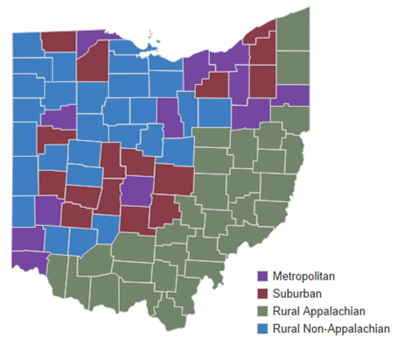
OMAS County Types
OMAS assigns counties to one of four mutually exclusive county types – rural Appalachian, rural non-Appalachian, metropolitan, and suburban. OMAS defines these county types in accordance with federal definitions, as follows: (1) rural Appalachian is defined using the Appalachian Regional Commission (ARC) standard; (2) metropolitan is defined using US Census Bureau definitions incorporating urban areas and urban cluster parameters; (3) rural non-Appalachian is defined by the Federal Office of Rural Health Policy at the Health Resources and Services Administration (HRSA), excluding Appalachian counties; (4) suburban is defined by the US Census Bureau and is characterized as a mixed-use or predominantly residential area within commuting distance of a city or metropolitan area.
For further details about the OMAS county types, please visit: grc.osu.edu/OMAS/2023Survey.

Slide 12
RESULTS: Prevalence of Chronic Conditions Assessed Among Adults in Ohio in 2023 Heart disease, asthma, COPD, stroke, hypertension, and diabetes

Slide 13
Prevalence of chronic conditions assessed in OMAS in 2023
Year | Subpopulation | Condition | Prevalence | 90% CI
2023 | Adults age 19+ | Hypertension | 38.8% | 38.1%-39.5%
2023 | Adults age 19+ | Asthma | 15.3% | 14.8%-15.9%
2023 | Adults age 19+ | Diabetes | 11.5% | 11.1%-11.9%
2023 | Adults age 19+ | Any heart disease* | 8.3% | 7.9%-8.6%
2023 | Adults age 19+ | COPD | 5.1% | 4.8%-5.3%
2023 | Adults age 19+ | Stroke | 3.5% | 3.3%-3.8%
The most prevalent chronic condition assessed in OMAS was hypertension, with nearly 4 in 10 adults ever being told that they had hypertension in 2023. The next most common condition was asthma, followed by diabetes, and heart disease (congestive heart failure, heart attack, and/or coronary heart disease).
Note: Observed group differences should not be used to draw conclusions about underlying causes - see slide 8 for more guidance.

Slide 14
RESULTS: Prevalence of Heart Diseases in Ohio in 2023 Heart disease prevalence by gender, county type, and education

Slide 15
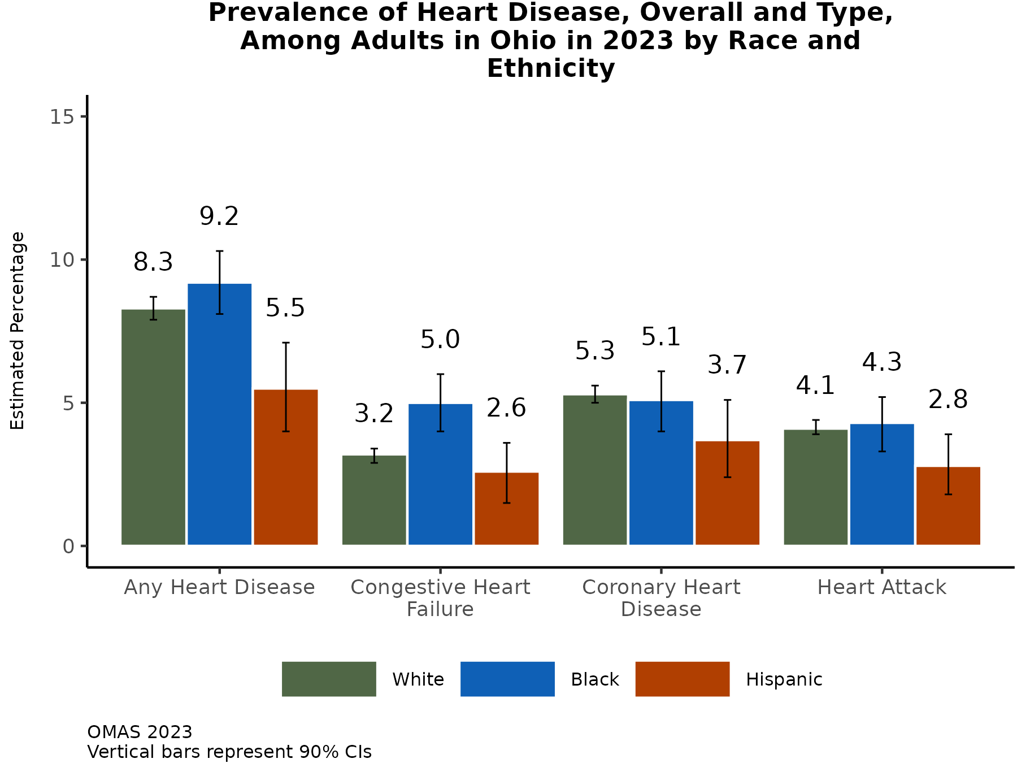
For all heart diseases examined in OMAS, prevalence was lowest among Hispanic adults
In general, there is not a lot of variability in the prevalence of ever being diagnosed with any of the heart diseases assessed in OMAS among adults who identify as Black or White.
However, Black adults have a slightly higher prevalence of congestive heart failure.
Additional Insights in 2023 (Results Not Shown)
Age is strongly associated with any heart disease prevalence: as age increases so does the prevalence of all heart disease types assessed in OMAS.
The prevalence estimates for all heart diseases are higher among men compared to women.
Note: Observed group differences should not be used to draw conclusions about underlying causes - see slide 8 for more guidance.

Slide 16
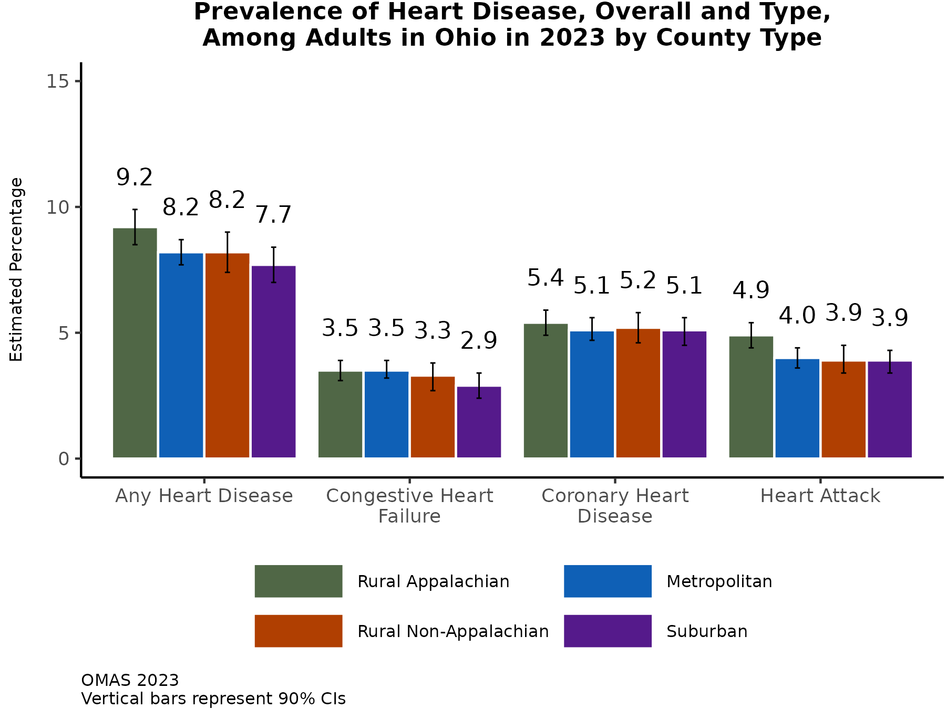
There is little variation in the prevalence of heart disease by county type in Ohio
There is a slightly higher prevalence of ever being diagnosed with any heart disease (i.e., congestive heart failure, coronary heart disease, or heart attack) among adults in Appalachian counties.
There is little variability in the prevalence of the individual heart diseases by county type.​
Additional Insights (Results Not Shown)
County type prevalence estimates were less variable among low-income adults (< 138% FPL) in 2023.
Since 2012, any heart disease prevalence has decreased in each county type grouping.
In 2023, the prevalence of any heart disease was about 2 percentage points lower compared to 2012 in each county type.
Note: Observed group differences should not be used to draw conclusions about underlying causes - see slide 8 for more guidance.

Slide 17
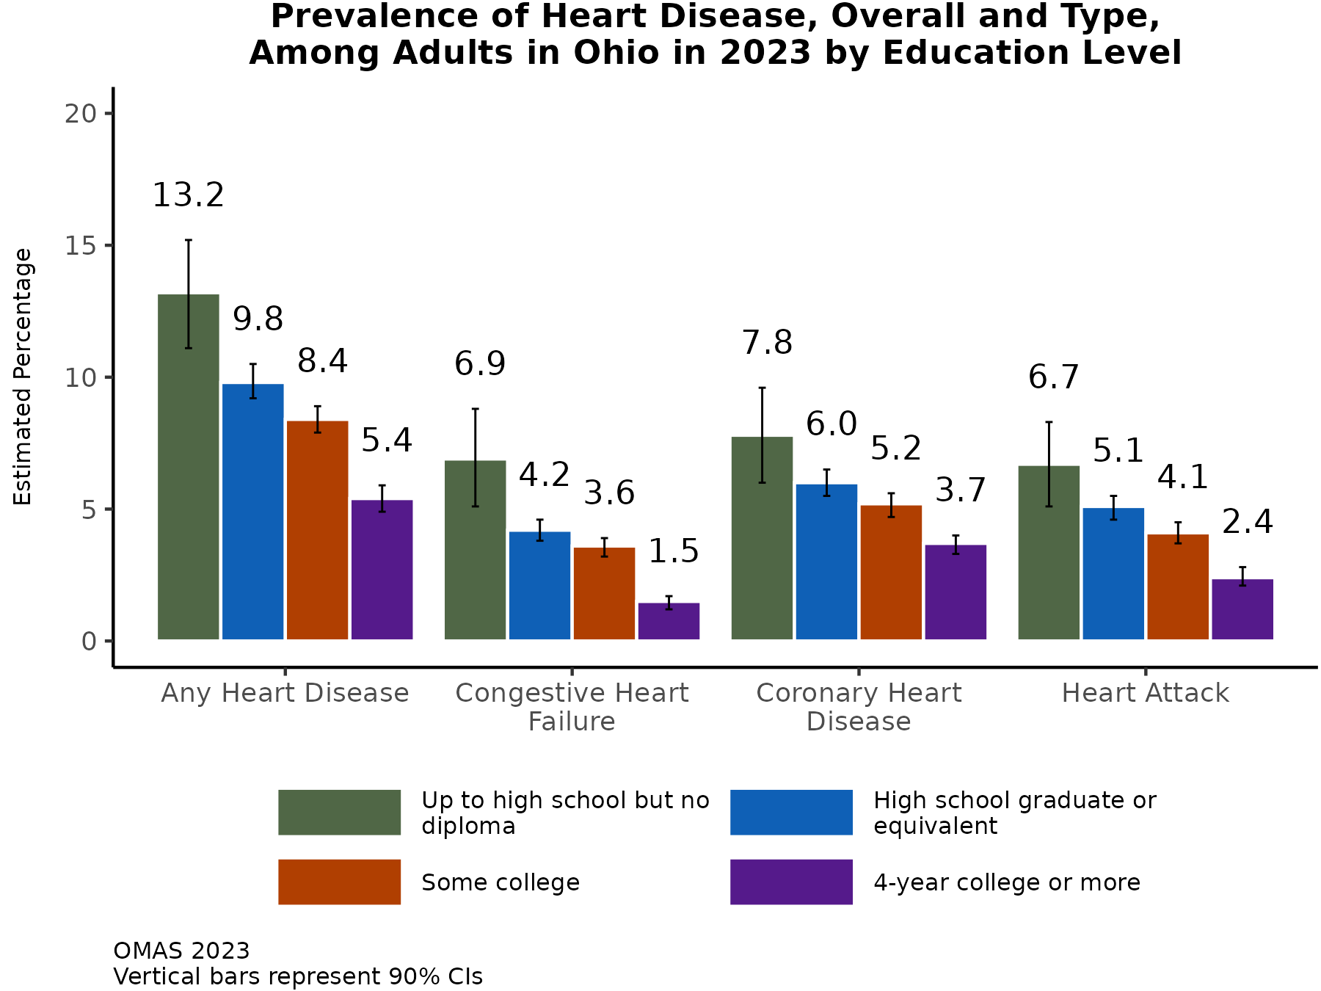
For all heart diseases, there is a consistent decline in prevalence as education level increases
The prevalence of ever being diagnosed with any heart disease types (i.e., congestive heart failure, coronary heart disease, or heart attack) is more than twice as high among adults with less than a high school diploma compared to those with a college degree or more.
All types of heart disease demonstrate a decreasing prevalence as education level increases.​
Additional Insights in 2023 (Results Not Shown)
In 2023, when examining household income as a marker of socioeconomic status, the associations between income and heart diseases were less pronounced, although adults in the highest income group had the lowest prevalence of each heart disease.
Note: Observed group differences should not be used to draw conclusions about underlying causes - see slide 8 for more guidance.

Slide 18
RESULTS: Prevalence of Asthma and COPD in Ohio in 2023 Asthma and COPD prevalence by race/ethnicity, county type, and education

Slide 19
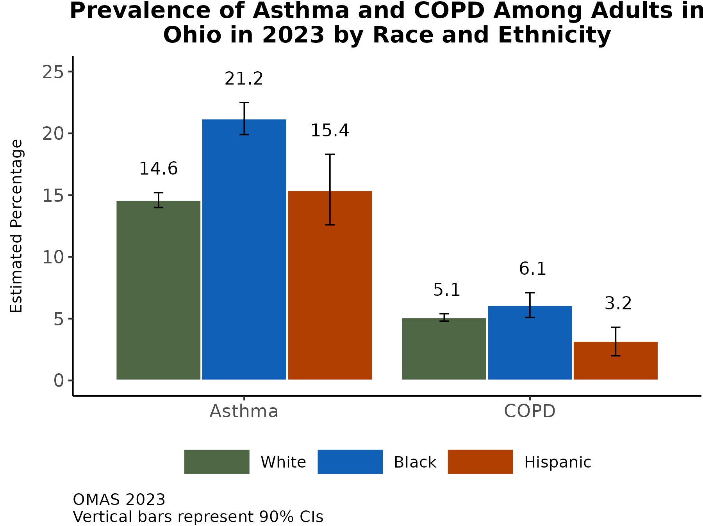
Over 1 in 5 Black adults in Ohio were told they had been diagnosed with asthma
The prevalence of ever being diagnosed with asthma is highest among Black adults in Ohio, followed by Hispanic and White adults.
COPD prevalence is similar between White and Black adults, and lowest among Hispanic adults.
Additional Insights (Results Not Shown)
Younger adults have a higher prevalence of ever being diagnosed with asthma and lower prevalence of ever being diagnosed with COPD than adults aged 65 and older.
The prevalence of asthma was about 6 percentage points higher among women compared to men.
The prevalence of COPD was slightly higher among women compared to men.​
Note: Observed group differences should not be used to draw conclusions about underlying causes - see slide 8 for more guidance.

Slide 20
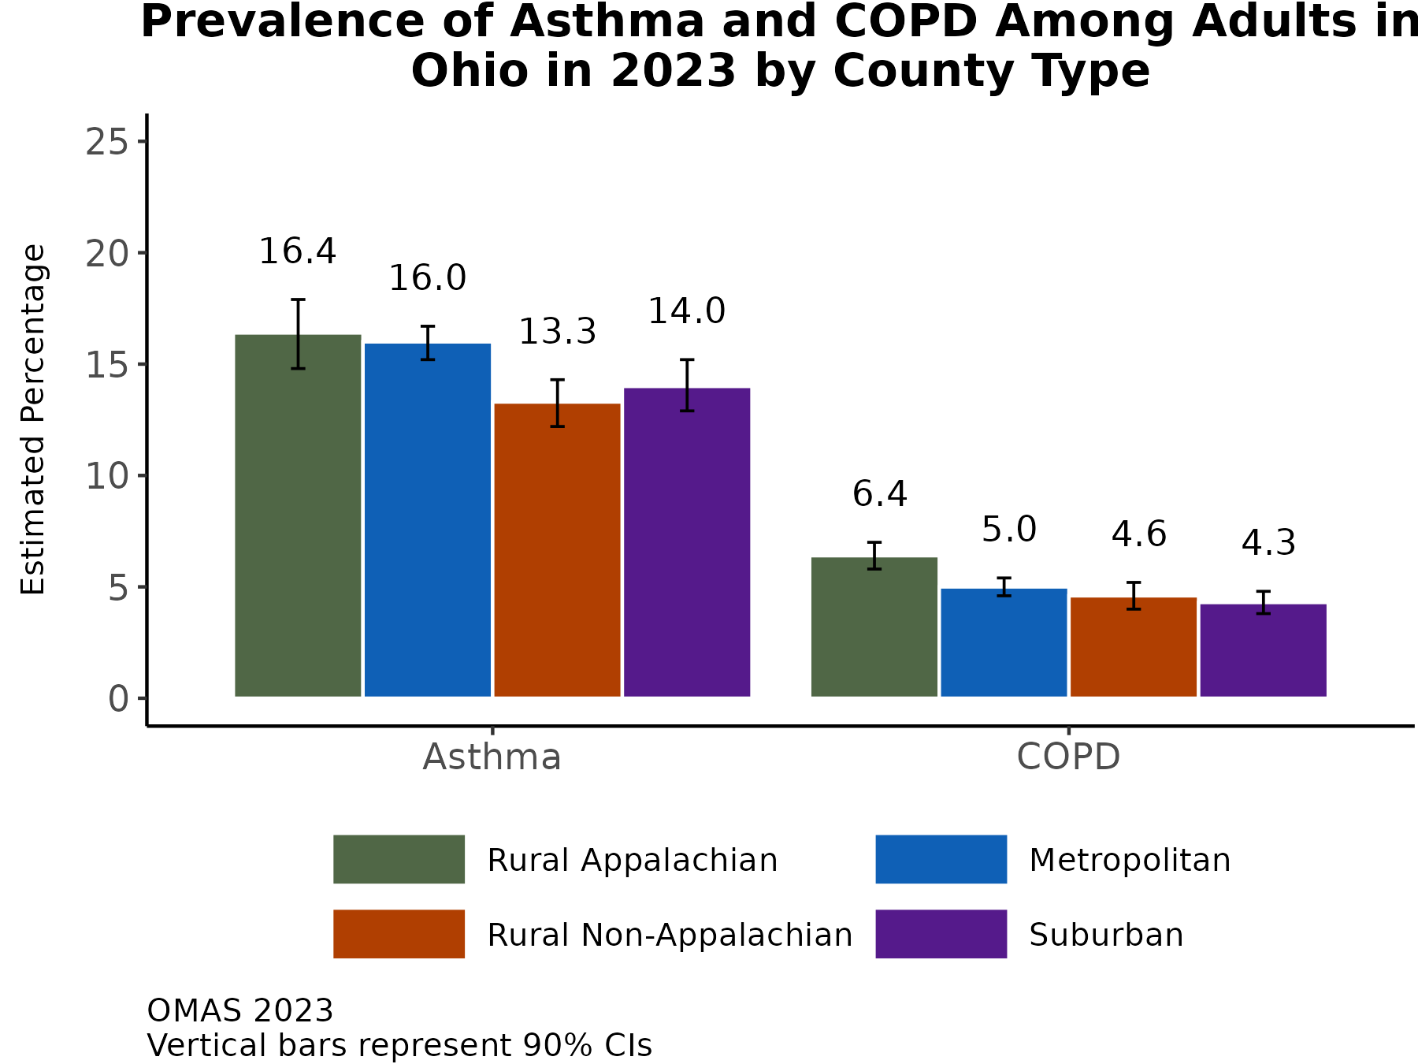
Adults in Appalachian and metropolitan counties have a slightly higher prevalence of asthma compared to other county types
The prevalence of ever being diagnosed with asthma is lowest in rural non-Appalachian counties.​
The prevalence of ever being diagnosed with COPD is highest in Appalachian counties, followed by other county types that have little variability.​
Additional Insights (Results Not Shown)
County type asthma prevalence estimates vary less among women compared to men.
The difference in asthma prevalence between rural Appalachian and rural non-Appalachian county types is large among young adults aged 19-24 (7.2 percentage points higher in Appalachian counties). Among adults aged 65 and older, the prevalence is 4.1 percentage points higher in Appalachian counties.
Note: Observed group differences should not be used to draw conclusions about underlying causes - see slide 8 for more guidance.

Slide 21
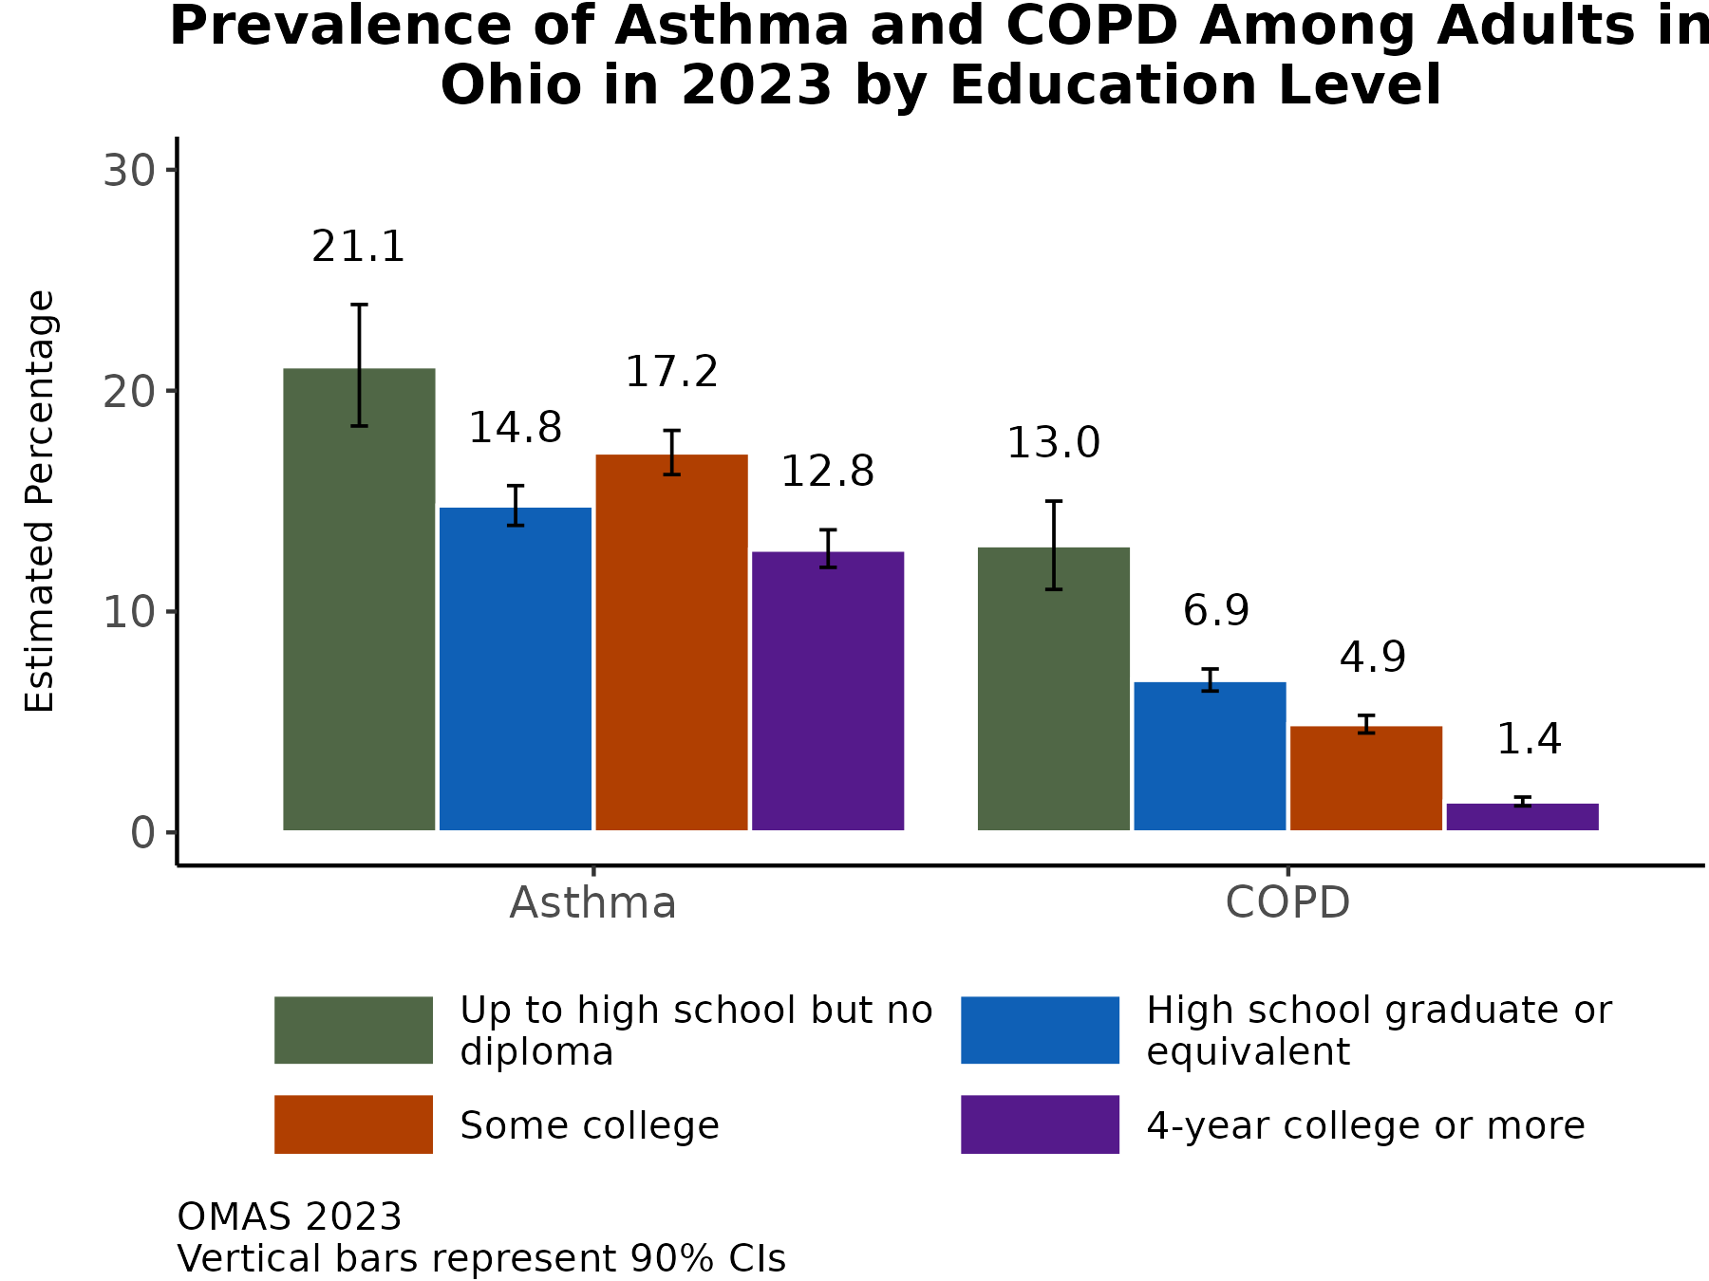
There is a steep decline in COPD prevalence as education level increases (less so for asthma)
The prevalence of ever being diagnosed with asthma is more than 1.5 times higher among adults with less than a high school diploma compared to adults with a college degree.​
COPD is more prevalent among adults with less than a high school diploma compared to adults with a high school or higher education.
Additional Insights (Results Not Shown)
When examining household income as a marker of socioeconomic status, the associations between income and asthma and COPD were pronounced. There is a nearly four-fold increase in the prevalence of COPD among adults in low-income households (< 138% FPL) compared to adults in households in the highest income group (> 400% FPL).
Note: Observed group differences should not be used to draw conclusions about underlying causes - see slide 8 for more guidance.

Slide 22
RESULTS: Prevalence of Diabetes, Hypertension, and Stroke in Ohio in 2023 Diabetes, hypertension, and stroke prevalence by race/ethnicity, county type, and education

Slide 23
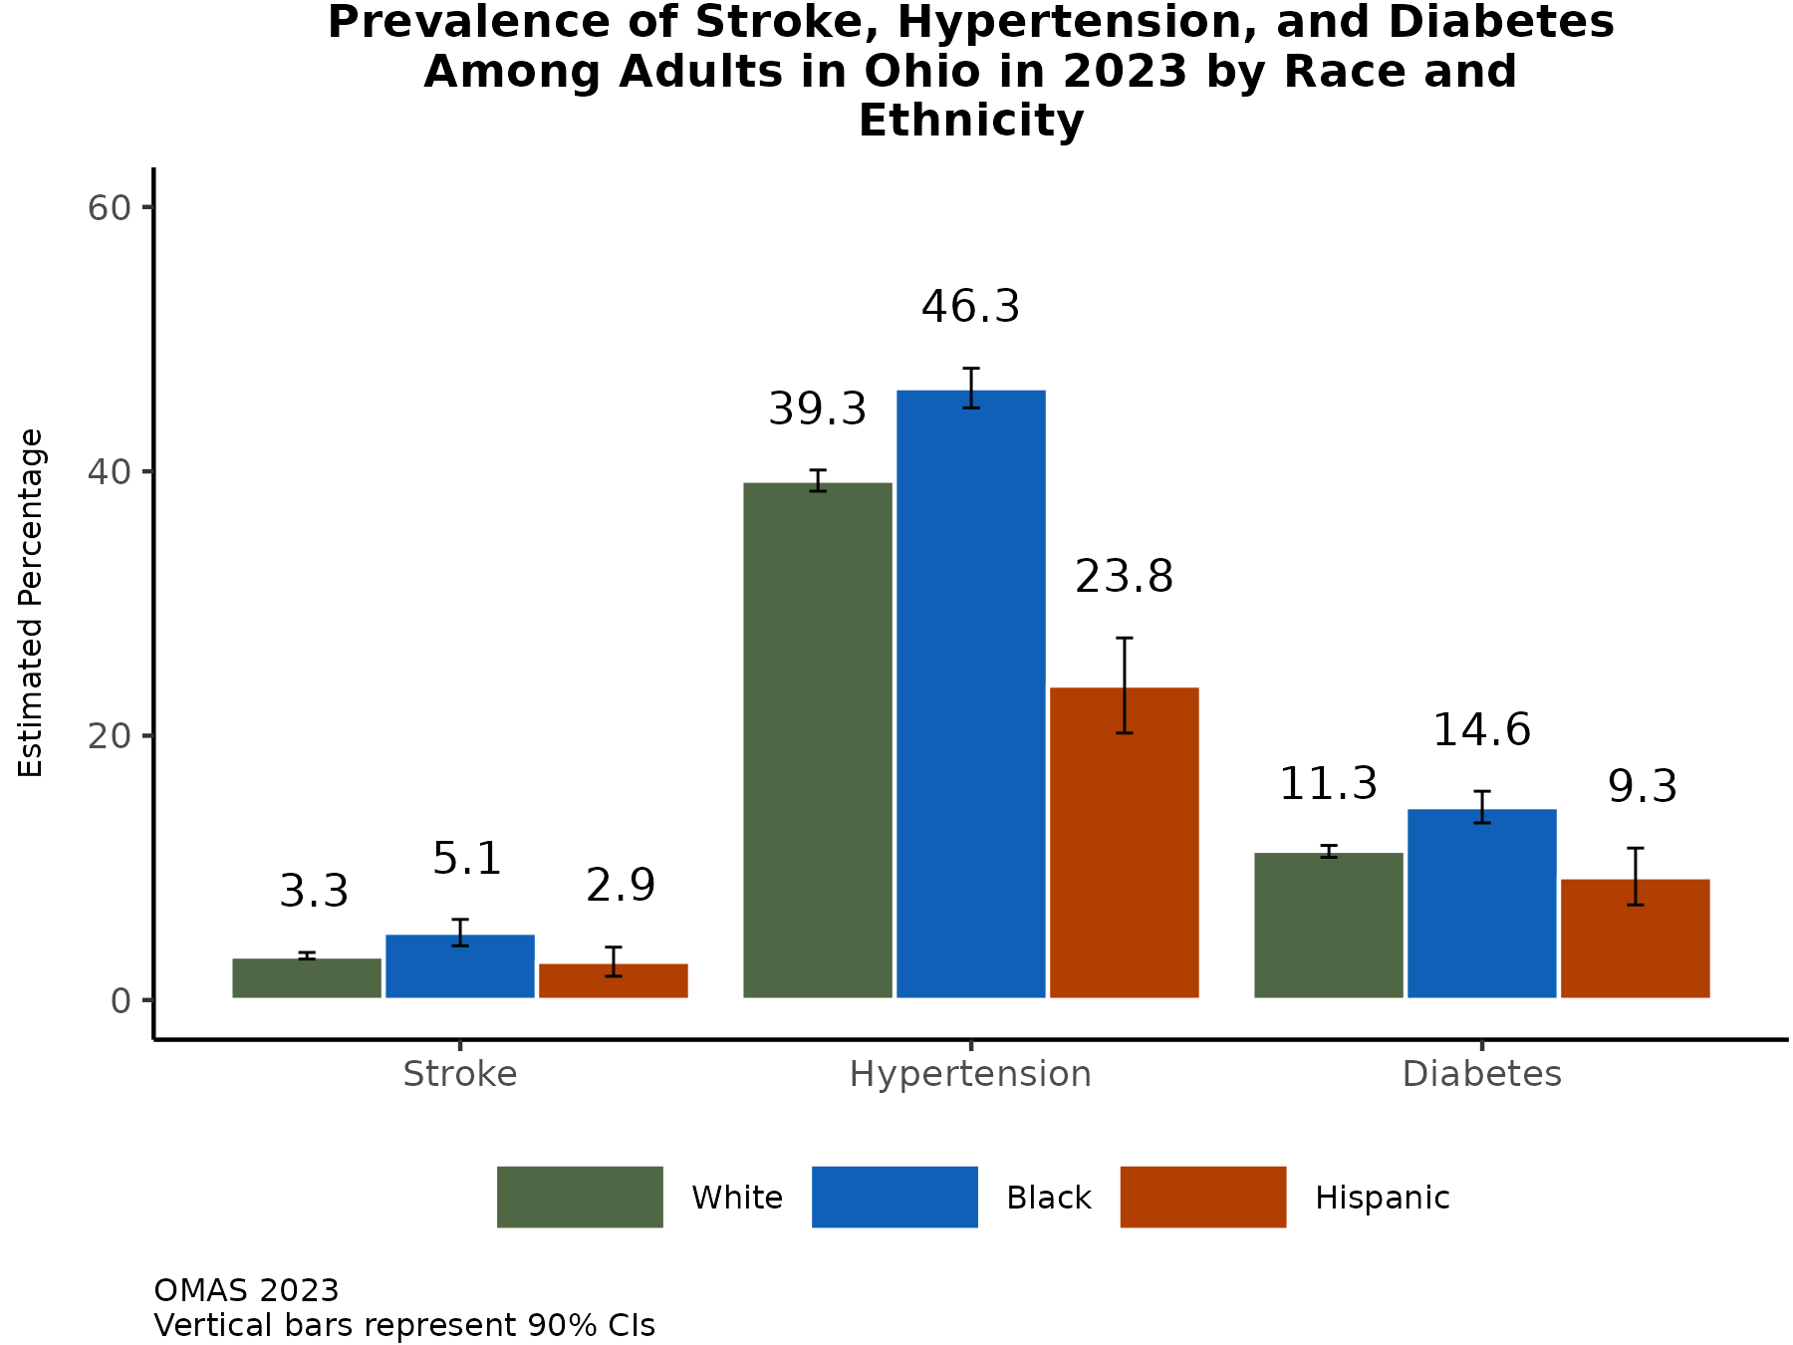
Nearly half of Black adults in Ohio had been diagnosed with hypertension by 2023
Black adults have the highest prevalence of ever being diagnosed with stroke, hypertension, and diabetes while Hispanic adults have the lowest prevalence.
Additional Insights (Results Not Shown)
Age is a strong risk factor for ever being diagnosed with these chronic conditions: compared to adults aged 19-44 years, those aged 65 and older have anywhere from a 3-fold to 7-fold increased prevalence.
The prevalence estimates of diabetes and stroke are similar among men and women.
The prevalence of hypertension is higher among men compared to women.​
Note: Observed group differences should not be used to draw conclusions about underlying causes - see slide 8 for more guidance.

Slide 24
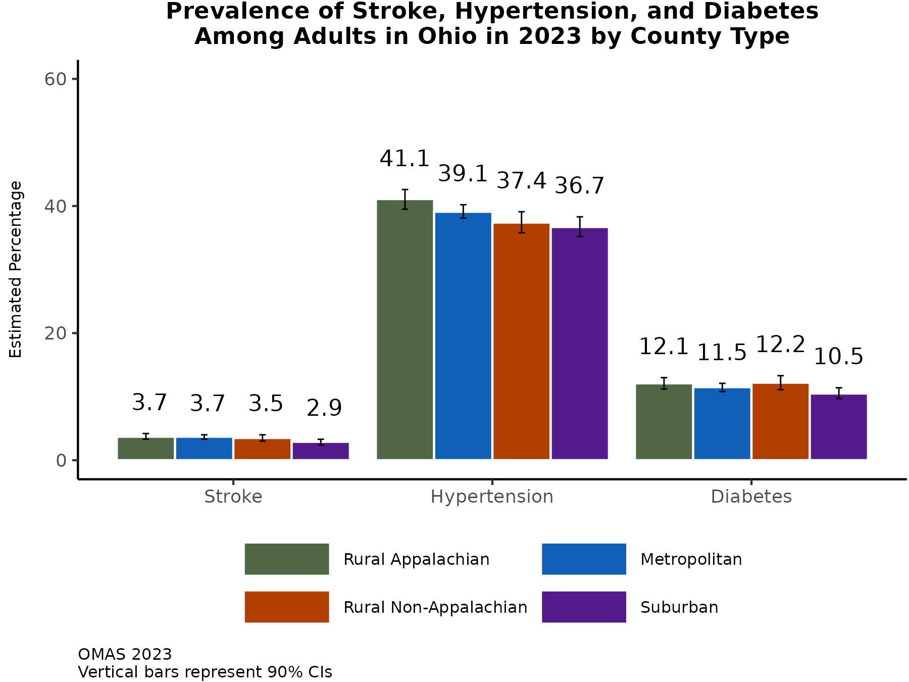
Stroke, hypertension, and diabetes prevalence vary little by county type in Ohio
There is little variability in the prevalence of ever being diagnosed with diabetes and stroke by county type.
The prevalence of ever being diagnosed with hypertension is highest among adults living in Appalachian counties.​
Additional Insights (Results Not Shown)
Since 2012, hypertension prevalence has changed little in each county type grouping.
Similarly, stroke prevalence has changed little since 2012 in each county type grouping.
Note: Observed group differences should not be used to draw conclusions about underlying causes - see slide 8 for more guidance.

Slide 25
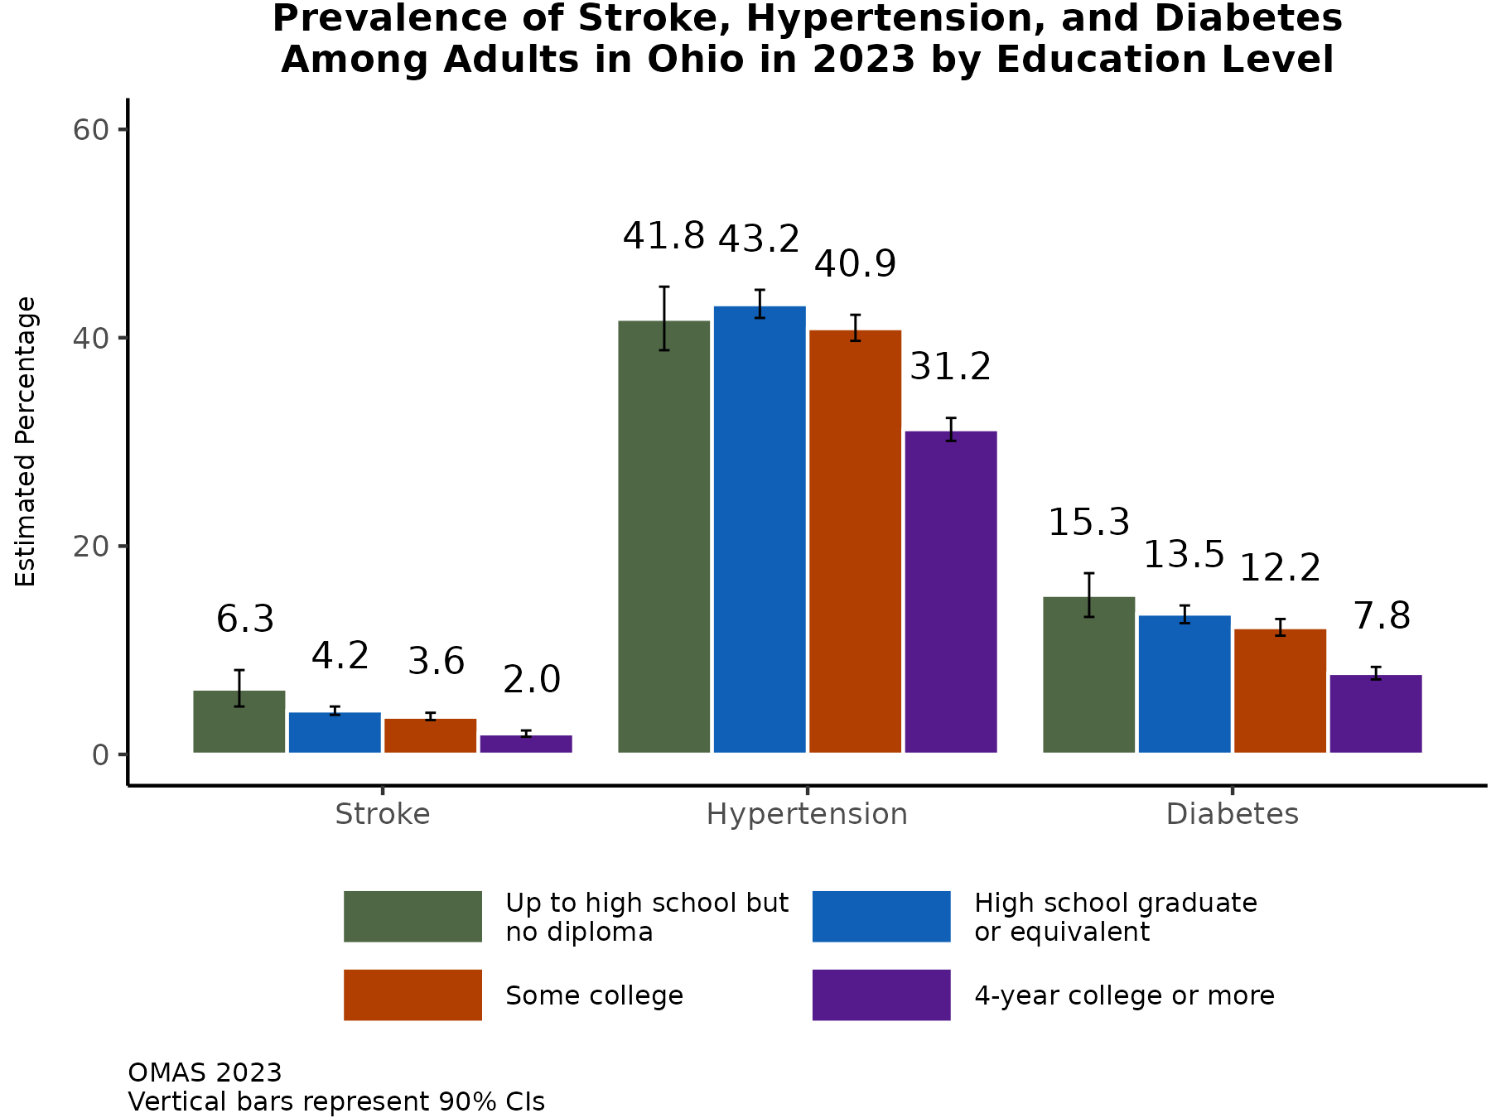
As education level increases, prevalence of stroke and diabetes decrease (less consistent change for hypertension)
There are large differences in the prevalences of ever being diagnosed with diabetes and stroke between the least and most educated.
There is little variability in the prevalence of ever being diagnosed with hypertension among the groups with less than a college degree. Adults with a college degree or higher have a lower prevalence.
Additional Insights (Results Not Shown)
Using household income as a measure of socioeconomic status, an inverse association between income and stroke prevalence is observed.
Associations between household income and hypertension and diabetes are less consistent: prevalence increases initially and then decreases among the highest income category.
Note: Observed group differences should not be used to draw conclusions about underlying causes - see slide 8 for more guidance.

Slide 26
RESULTS: Prevalence of Chronic Disease Risk Factors in Ohio in 2023 Risk factor prevalence by race/ethnicity, county type, and education

Slide 27
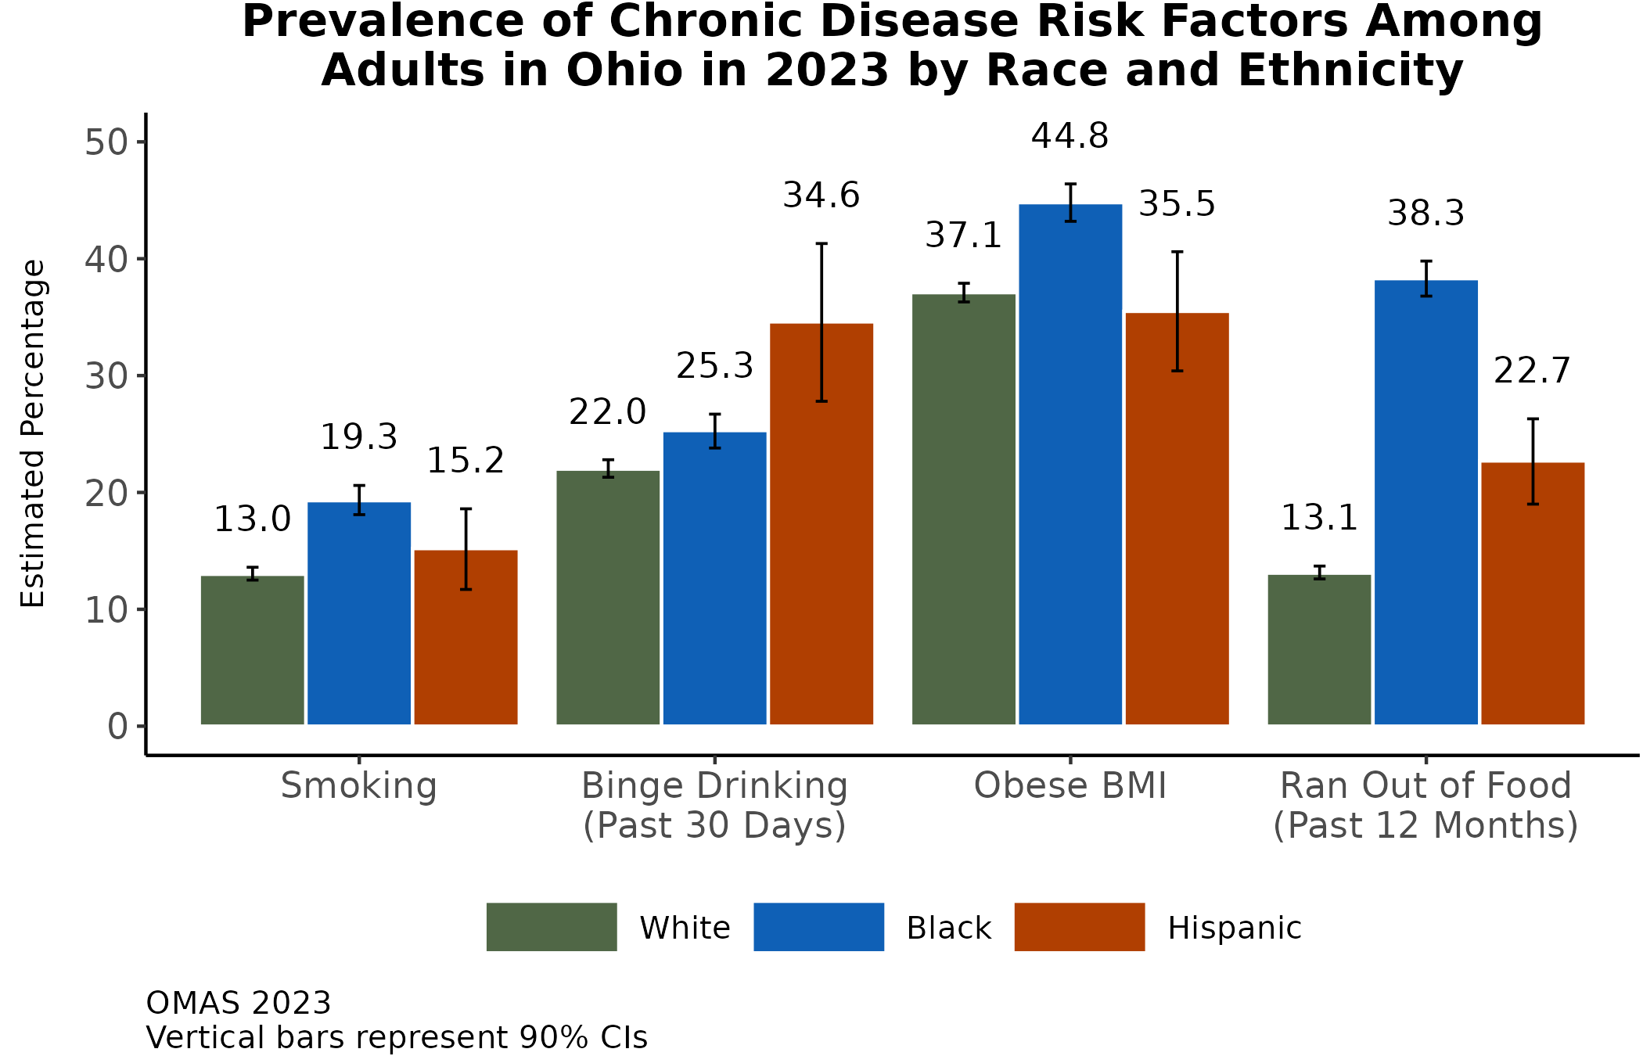
Risk factors for chronic diseases are prevalent in Ohio, particularly binge drinking and obesity
Smoking prevalence is highest among Black adults, followed by Hispanic adults.
Close to half of Black adults are obese in Ohio.
Over one-third of Hispanic adults reported past-month binge drinking.
Food insecurity was nearly three times as high among Black adults compared to White adults.
Additional Insights (Results Not Shown)
Obesity is more prevalent among women.
Past-month binge drinking is more common among men.
About one-fifth of women ran out of food in the past year.
Note: Observed group differences should not be used to draw conclusions about underlying causes - see slide 8 for more guidance.

Slide 28
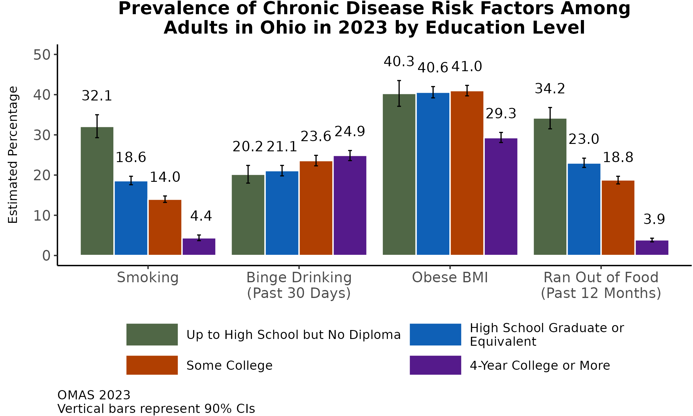
Except for binge drinking, chronic disease risk factors are more prevalent among adults with less than a college degree
The prevalence of running out of food and smoking have a clear inverse association with education level.
There is little variability in the prevalence of obesity among education levels less than a college degree (40-41% prevalence). Under one-third of adults with a college degree or higher in Ohio are obese.​
The prevalence of binge drinking increases with increasing education level.
Additional Insights (Results Not Shown)
When examining household income as a marker of socioeconomic status, similar patterns emerge.
Note: Observed group differences should not be used to draw conclusions about underlying causes - see slide 8 for more guidance.

Slide 29
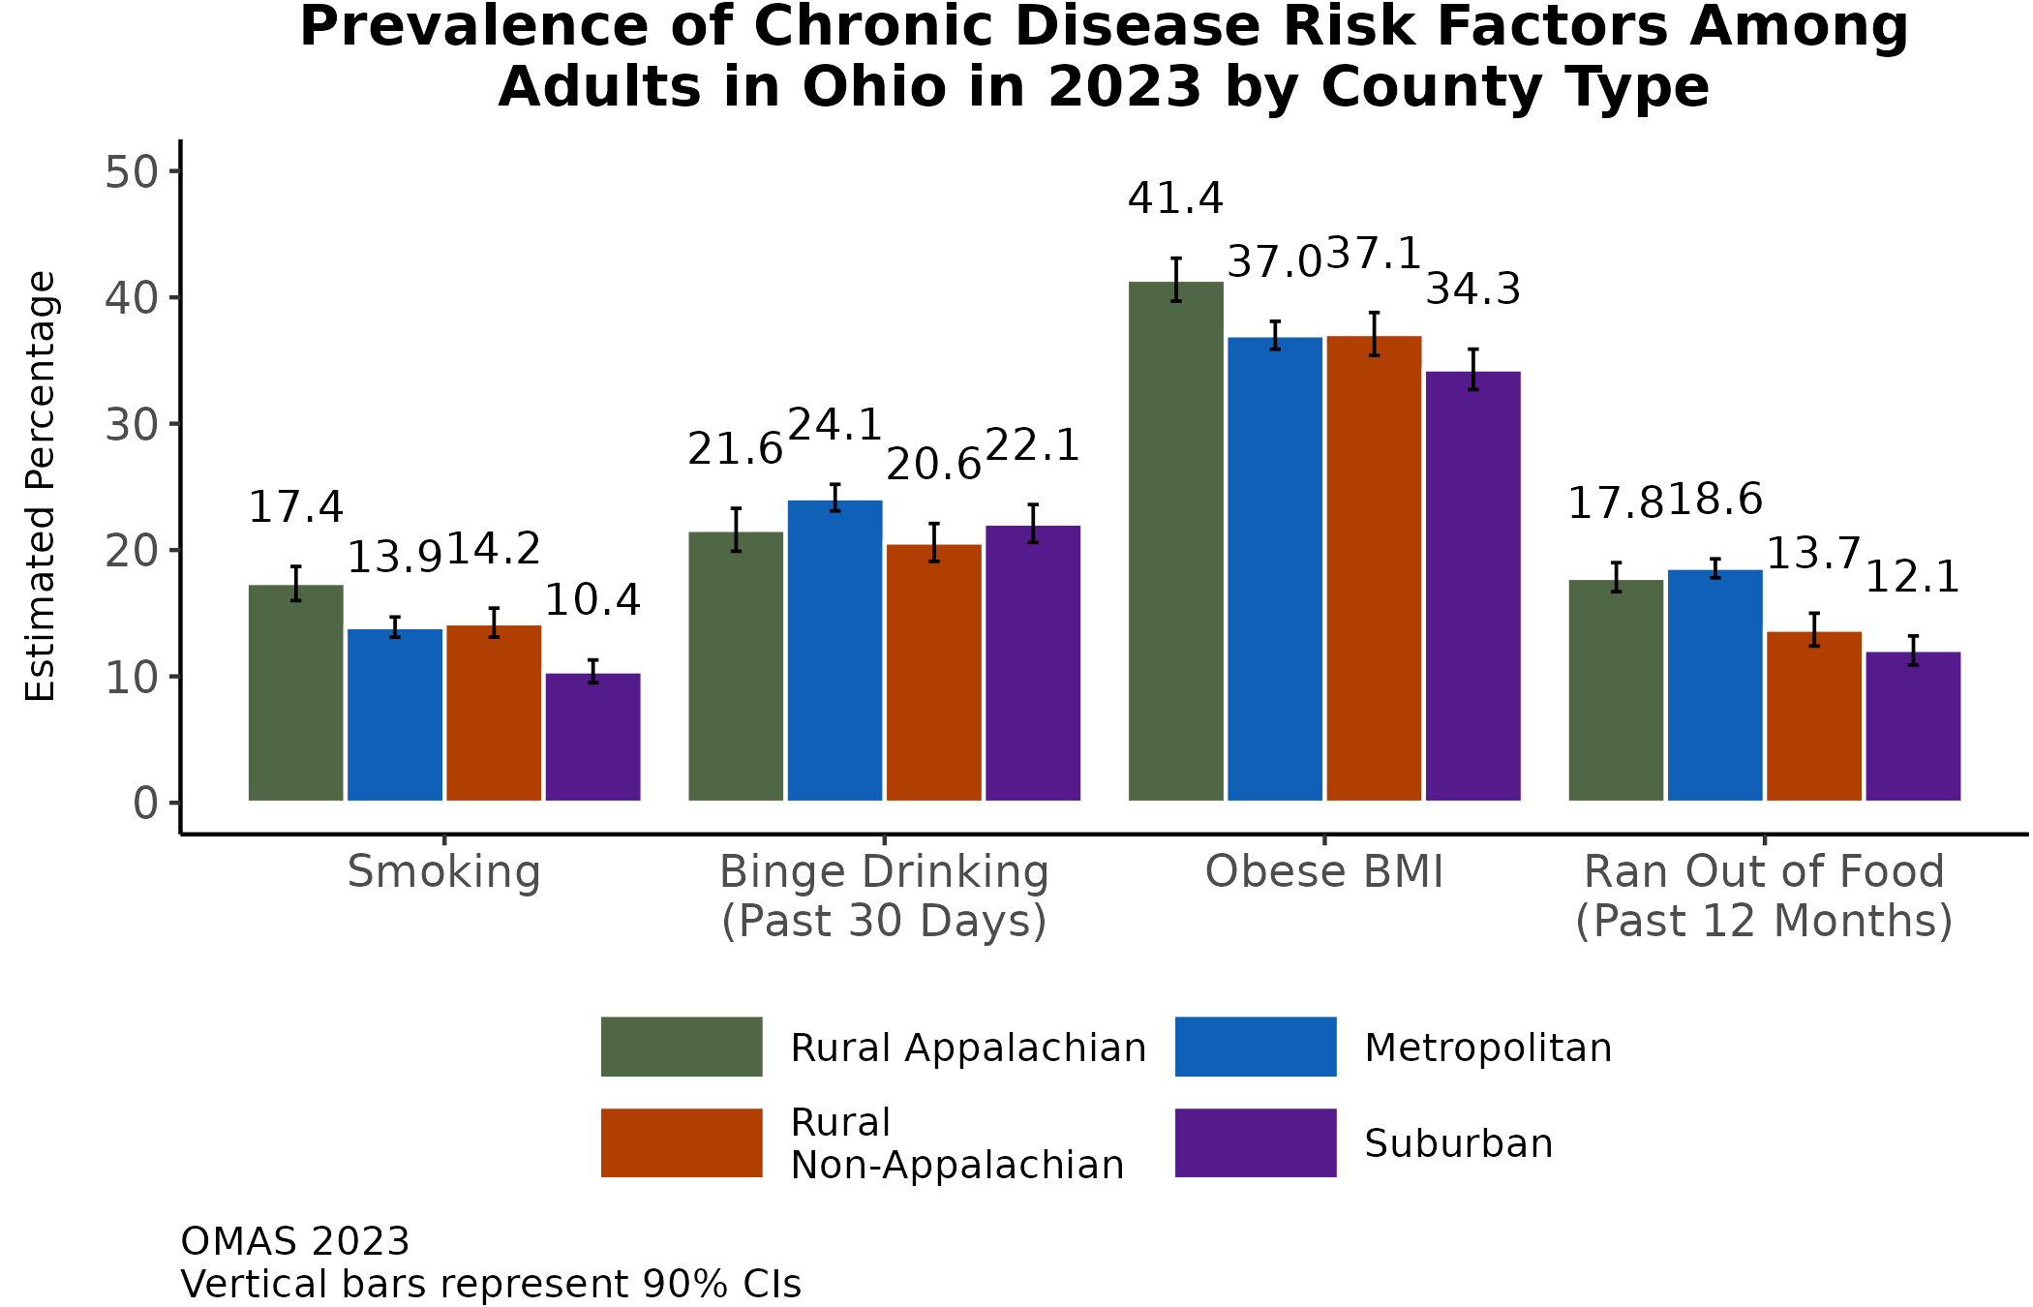
No consistent pattern for risk factor prevalence by county type, but Appalachian and metropolitan counties tend to be high
Adults in Appalachia have the highest prevalence of smoking and obesity.
Adults in metropolitan counties reported the highest prevalence of past-month binge drinking and running out of food in the past year.​
Additional Insights (Results Not Shown)
Since 2010, smoking prevalence decreased and binge drinking increased in each county type in Ohio.
Since 2010, obesity prevalence increased in each county type group, with the largest increase in Appalachia (10 percentage points).
Since 2019, the prevalence of running out of food increased in each county type group, with the largest increase in Appalachia (5 percentage points).
Note: Observed group differences should not be used to draw conclusions about underlying causes - see slide 8 for more guidance.

Slide 30
RESULTS: Prevalence of Chronic Disease and Risk Factors by Medicaid Status in Ohio in 2023 Chronic disease and factor prevalence by Medicaid enrollment and potentially eligible adults

Slide 31
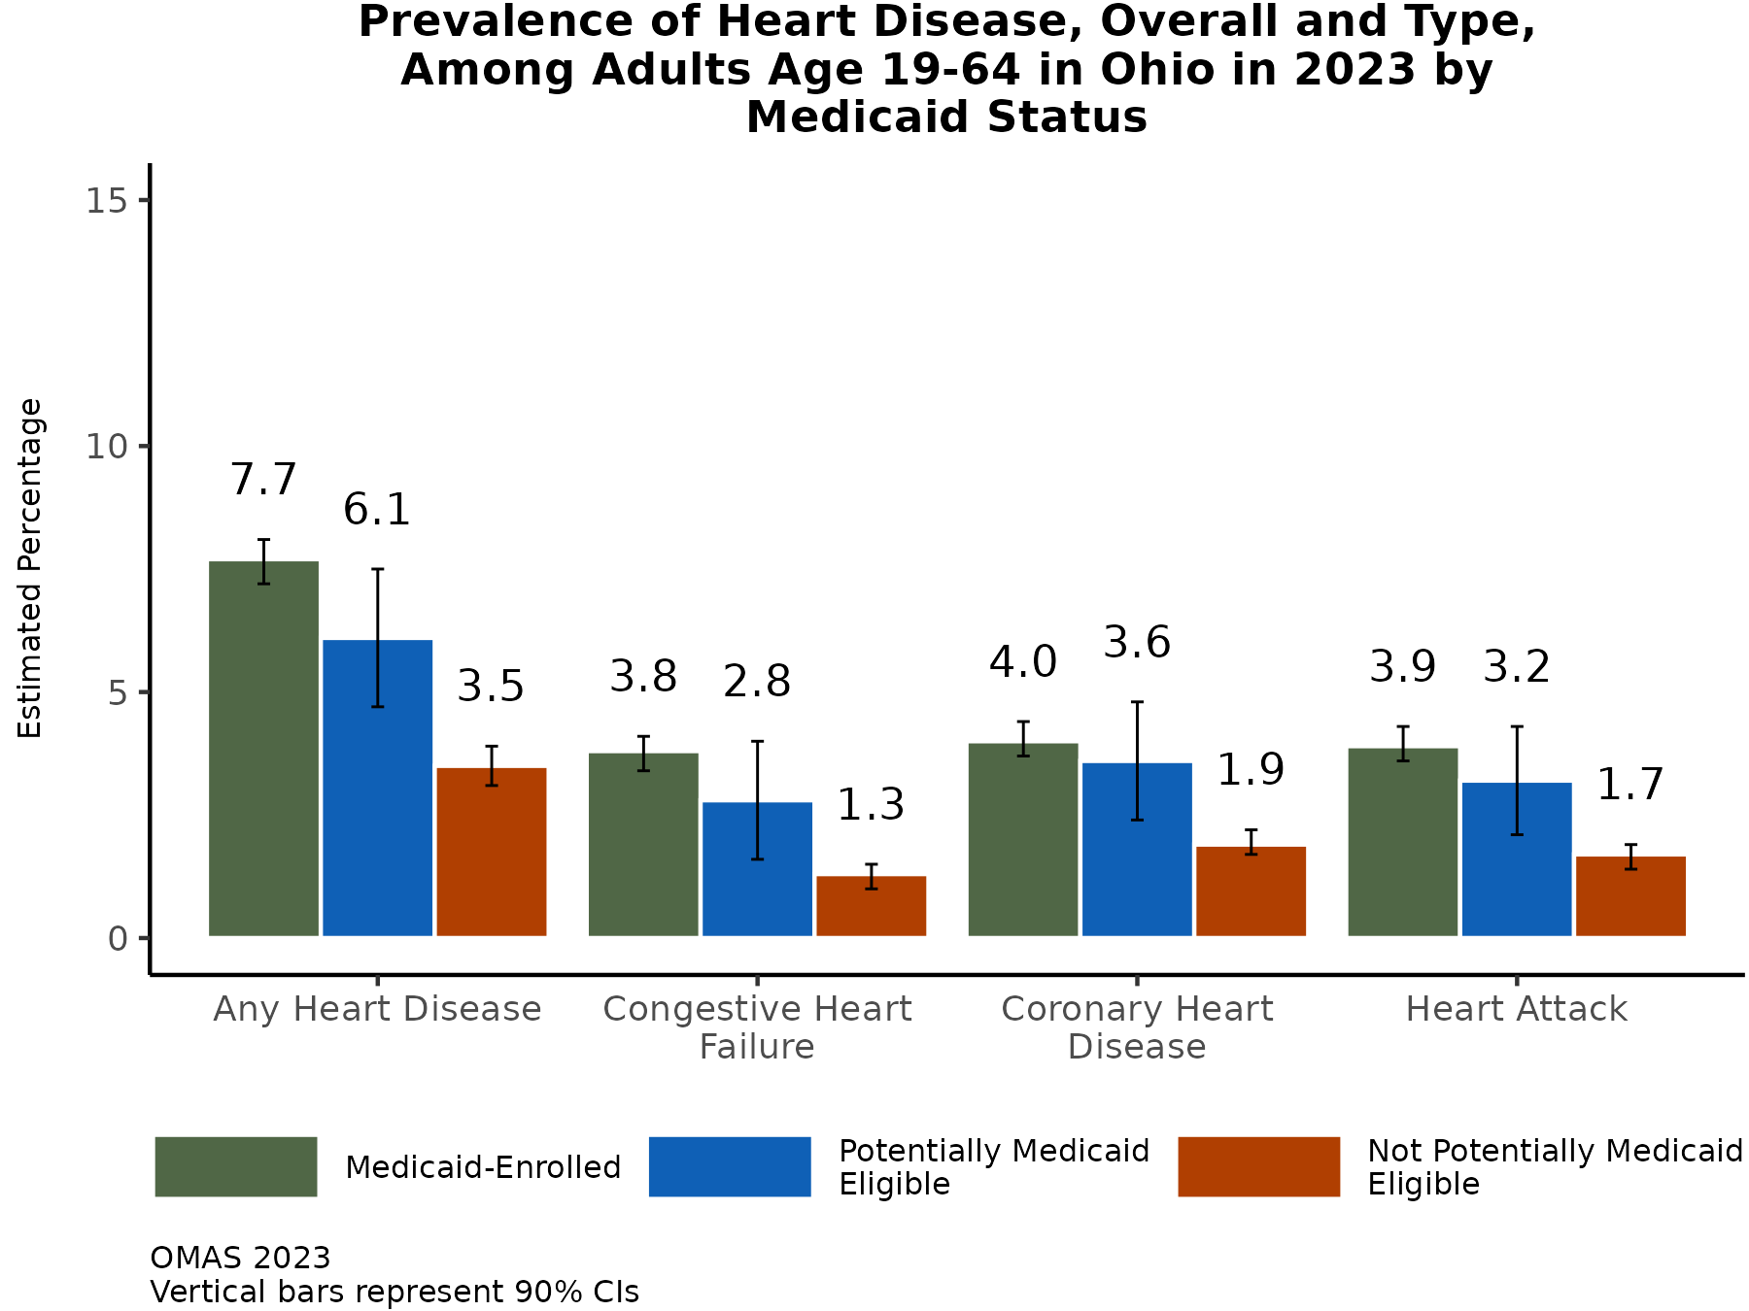
Working-age adults enrolled in Medicaid and those potentially eligible have a higher prevalence of heart disease
The prevalence of ever being diagnosed all individual heart diseases and any heart disease (of the ones measured in OMAS) is nearly double (or more) among adults between ages 19 and 64 and who are enrolled in Medicaid or who are potentially eligible for Medicaid compared to those not potentially eligible for Medicaid.​
Additional Insights (Results Not Shown)
The prevalence of any heart disease (congestive heart failure, coronary heart disease, and/or heart attack) is higher among men than among women enrolled in Medicaid.
The prevalence of any heart disease is similar among men and women who are potentially eligible for Medicaid.
Note: Observed group differences should not be used to draw conclusions about underlying causes - see slide 8 for more guidance.

Slide 32
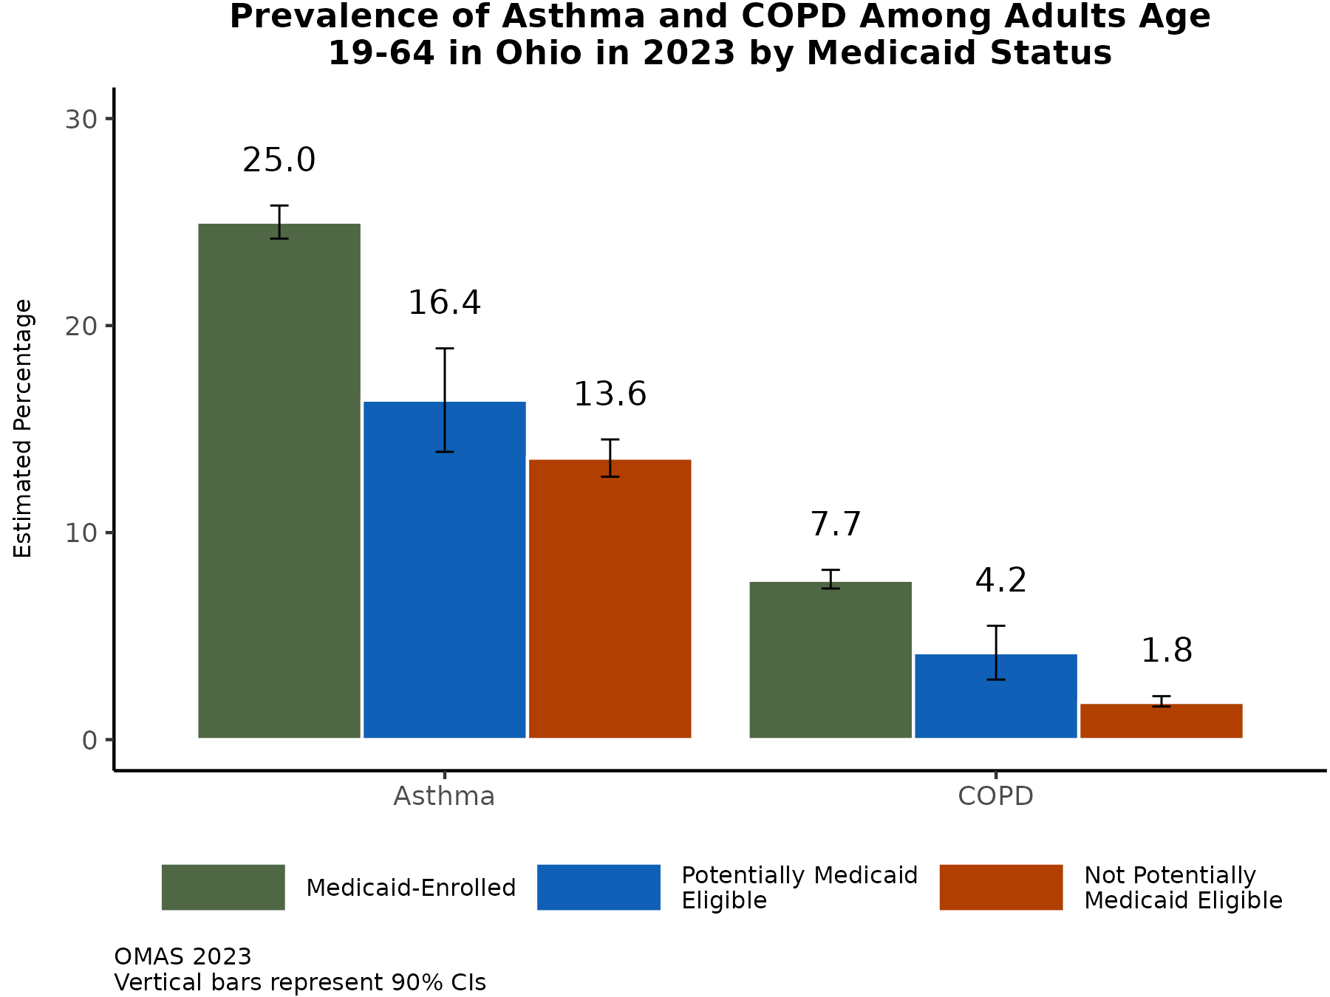
Working-age adults enrolled in Medicaid and those potentially eligible have higher prevalence of asthma and COPD
Adults between ages 19 and 64 enrolled in Medicaid have a nearly two-fold increased prevalence of ever being diagnosed with asthma and a four-fold increased prevalence of ever being diagnosed with COPD compared to adults who are not potentially eligible for Medicaid.
The prevalence of respiratory conditions among working-age adults potentially eligible for Medicaid is between the estimates for Medicaid-enrolled and adults not potentially eligible.
Additional Insights (Results Not Shown)
Among adults enrolled in Medicaid, the prevalence of asthma was higher among women compared to men and the prevalence of COPD was higher among men compared to women.
Note: Observed group differences should not be used to draw conclusions about underlying causes - see slide 8 for more guidance.

Slide 33
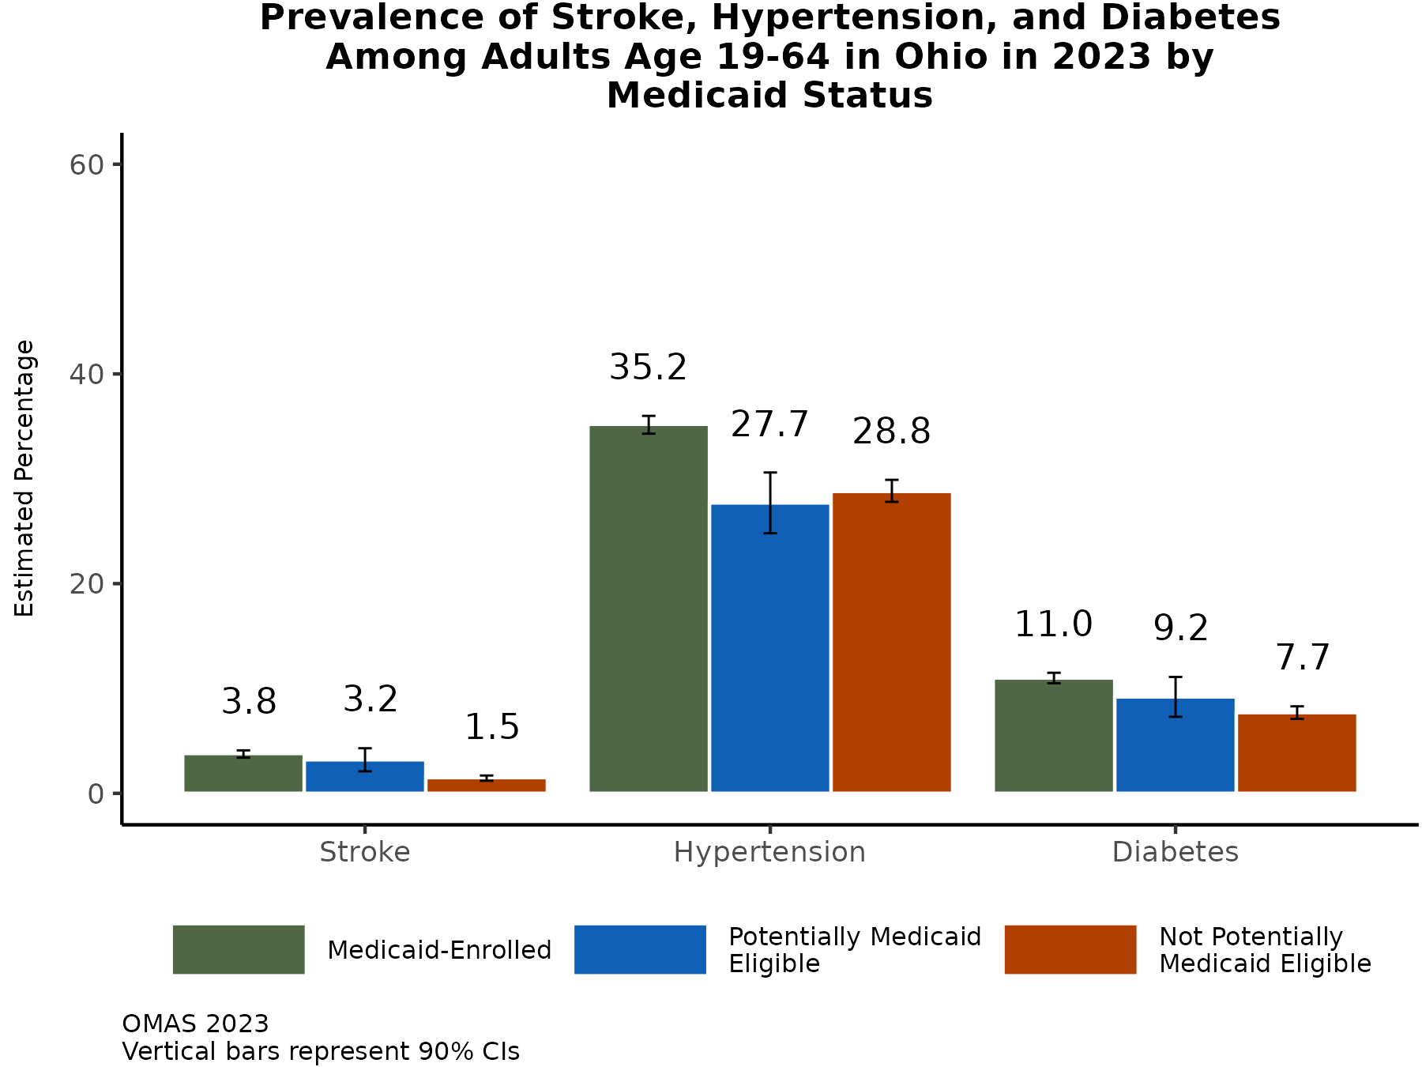
Working-age adults enrolled in Medicaid have the highest prevalence of stroke, hypertension, and diabetes
The prevalence of ever being diagnosed with a stroke is low in Ohio, but over two-fold higher among Medicaid-enrolled and those potentially eligible for Medicaid.
Over one-third of working-age adults (19 to 64 years) enrolled in Medicaid have ever been diagnosed with hypertension, compared to just over one-quarter of those potentially eligible and not potentially eligible.
Diabetes is most prevalent among adults between ages 19 and 64 who are enrolled in Medicaid, followed by those potentially eligible for Medicaid.​
Additional Insights (Results Not Shown)
Among adults enrolled in Medicaid, the prevalence of ever being diagnosed with hypertension was higher among men compared to women.
Note: Observed group differences should not be used to draw conclusions about underlying causes - see slide 8 for more guidance.

Slide 34
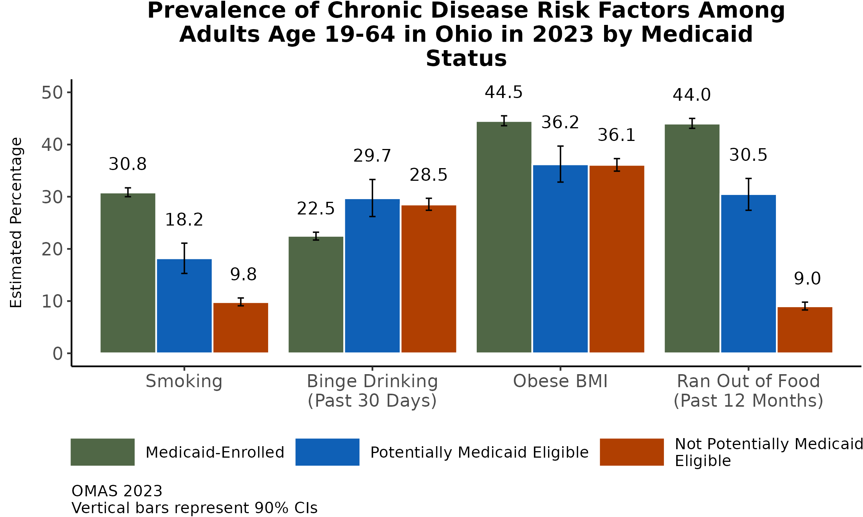
Working-age adults enrolled in Medicaid and those potentially eligible have higher prevalence smoking and food insecurity
There are large differences (2-4-fold) in the prevalence of food insecurity and smoking between working age adults enrolled in Medicaid and those potentially eligible for Medicaid compared to those not potentially eligible.
Binge drinking, on the other hand, is less prevalent among adults enrolled in Medicaid.​
Obesity prevalence is highest among adults enrolled in Medicaid.
Additional Insights (Results Not Shown)
One-half of women enrolled in Ohio Medicaid are obese and nearly half reported running out of food.
Obesity among Medicaid enrolled increased by 1.1%.
One-third of men enrolled in Ohio Medicaid reported current smoking.
Note: Observed group differences should not be used to draw conclusions about underlying causes - see slide 8 for more guidance.

Slide 35
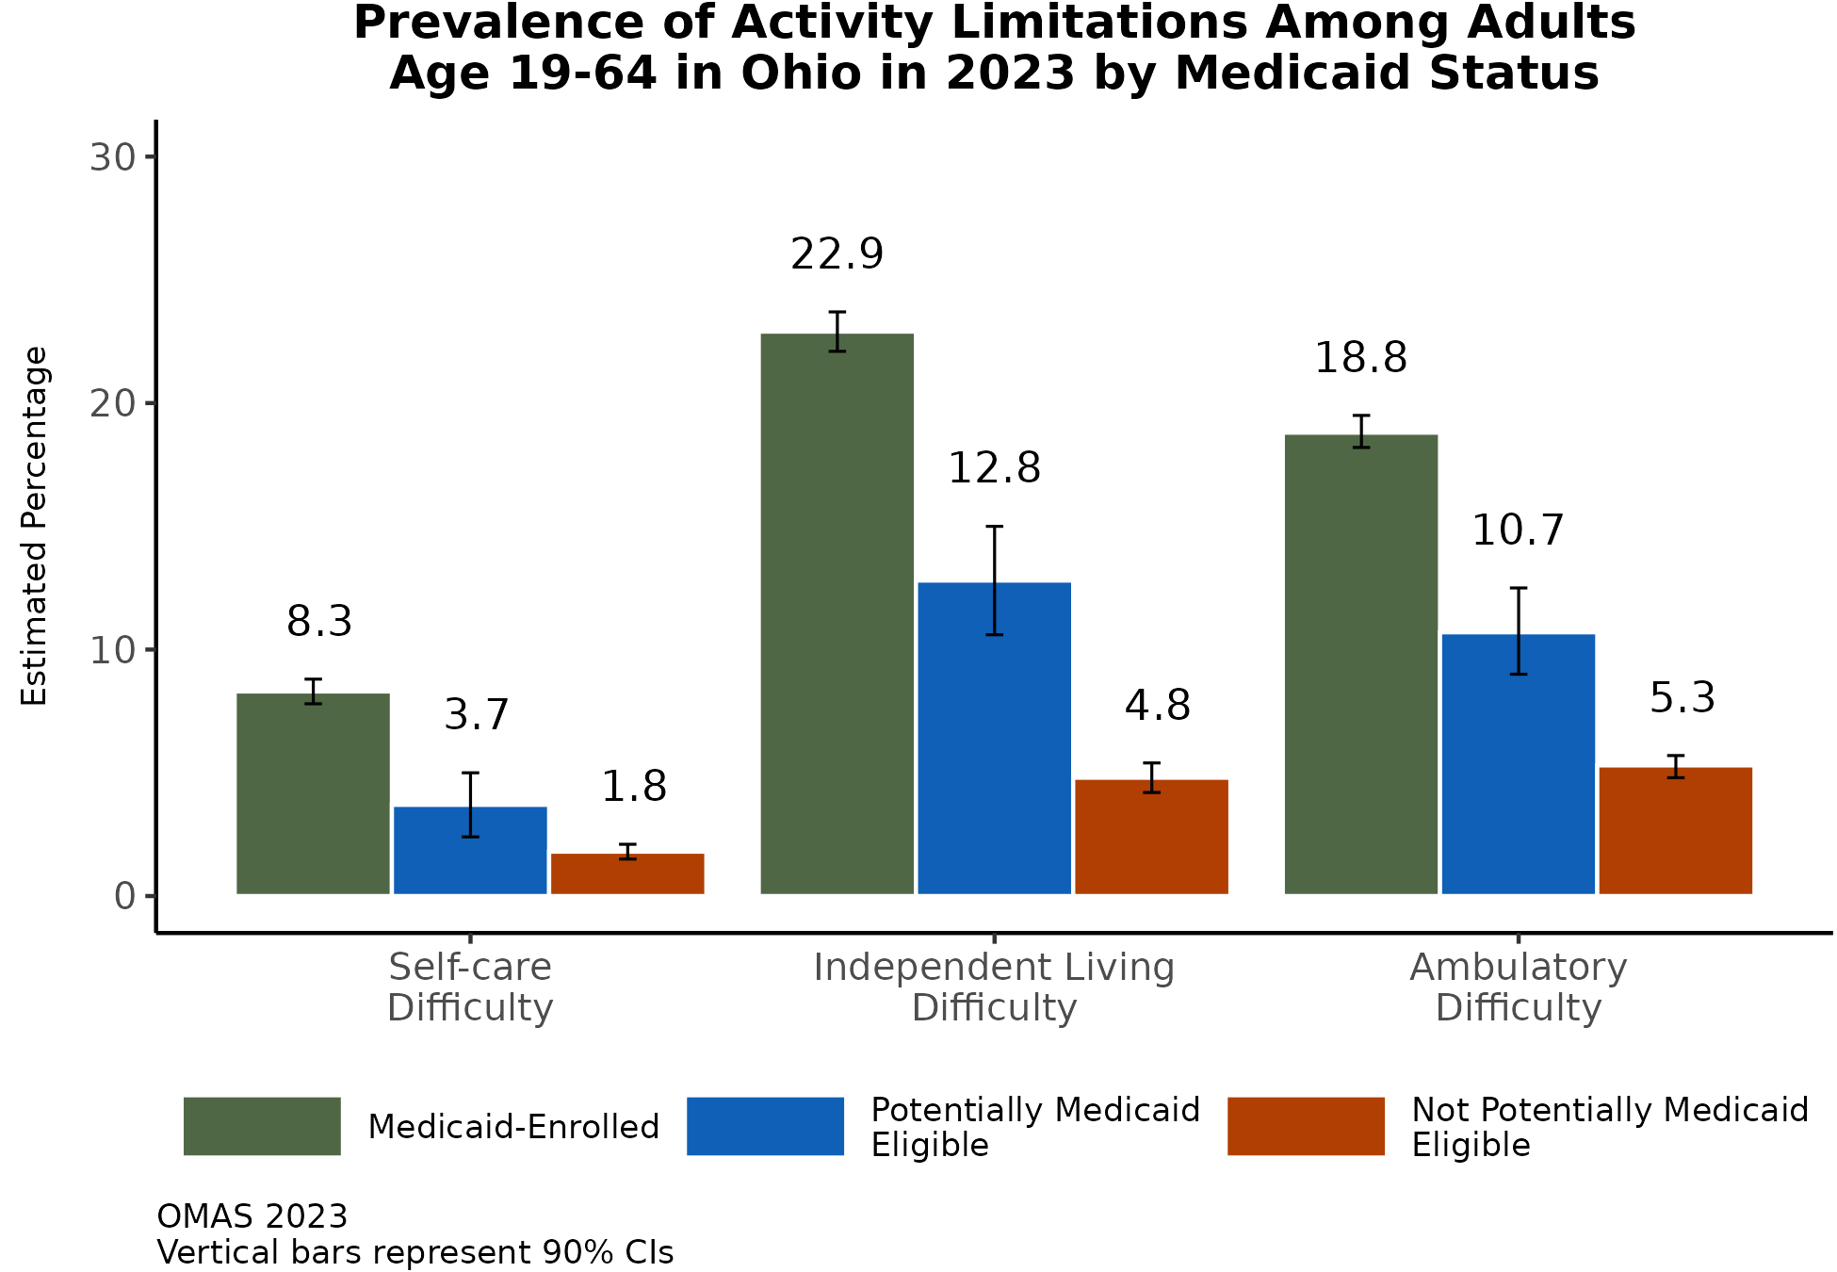
Working-age adults enrolled in Medicaid and those potentially eligible have higher prevalence of activity limitations
There are large differences in the prevalence of physical activity limitations* such as dressing, running errands, and walking between adults enrolled in Medicaid and potentially eligible for Medicaid compared to those not potentially eligible.
Additional Insights (Results Not Shown)
Among Medicaid enrollees, the prevalence of self-care difficulty and independent living difficulty is slightly higher for males than for females. The prevalence of ambulatory difficulty is similar for males and females enrolled in Medicaid.
*Self-care (difficulty dressing or bathing), independent living (difficulty doing errands alone), and ambulatory (serious difficulty walking or climbing stairs) as proxies for physical activity limitations.
Note: Observed group differences should not be used to draw conclusions about underlying causes - see slide 8 for more guidance.

Slide 36
Summary of Results
Prevalence of Chronic Diseases in Ohio:
Hypertension was the most prevalent of the chronic diseases assessed in OMAS in 2023. Almost 40% of adult Ohioans had ever being diagnosed with hypertension. The prevalence of hypertension was highest among adults living in Appalachian and metropolitan counties.
Heart disease prevalence was highest among Black adults in Ohio and was higher for adults in Appalachian counties than for adults in other county types. Approximately 15% of Ohio adults in 2023 had ever been diagnosed with diabetes, and 3.5% had ever been told they had a stroke.
The statewide prevalence of ever being diagnosed with asthma in 2023 was 15.3%. Asthma and COPD were more prevalent among Black adults. Also, asthma was the only chronic condition assessed with a higher prevalence for female Ohioans. Asthma was more prevalent in Appalachian and Metropolitan counties than in rural non-Appalachian and suburban counties. There was a steep decline in COPD prevalence as education increases. This pattern was less clear for asthma.
Medicaid and Chronic Diseases:

Slide 37
Summary of Results, continued
Risk Factors for Chronic Diseases:
As in previous years, Ohio adults continue to have a high prevalence of certain risk factors for chronic disease compared to adults in other states. Obesity was the most prevalent of the risk factors measured, with nearly half of Black adults indicating they were obese. Binge drinking was more prevalent among Hispanic adults, potentially Medicaid eligible adults, adults with four or more years of college education, and metropolitan county residents. The prevalence of food insecurity and smoking was higher for adults aged 19-64 enrolled in Medicaid and potentially eligible for Medicaid compared to those not potentially eligible.
Medicaid and Chronic Diseases:
For nearly all chronic diseases assessed, working-age adults enrolled in Medicaid and those potentially eligible had higher prevalence of chronic conditions than those not potentially eligible for Medicaid. The prevalence of all individual heart diseases and any heart disease was nearly double (or more) among adults between ages 19 and 64 and who were enrolled in Medicaid or who were potentially eligible for Medicaid compared to those not potentially eligible for Medicaid.

Slide 38
References
Ohio Department of Health. Chronic Disease Disparities among Males and Females, Ohio, 2022. Chronic Disease Epidemiology and Evaluation Section and the Ohio Diabetes and Heart Disease Prevention and Management Program, July 2022.
Kochanek KD, Xu JQ, Arias E. Mortality in the United States, 2019. NCHS Data Brief, no 395. Hyattsville, MD: National Center for Health Statistics. 2020.
Albani TJ, Rajanbabu A. Chronic Disease Prevalence in Ohio: 2017 Findings. Columbus, OH: Ohio Colleges of Medicine Government Resource Center; 2019:7
The Impact of Chronic Disease in Ohio: 2015. Chronic Disease Epidemiology and Evaluation Section, Bureau of Health Promotion, Ohio Department of Health; 2015.
Chapel JM, Ritchey MD, Zhang D, Wang G. Prevalence and Medical Costs of Chronic Diseases Among Adult Medicaid Beneficiaries. Am J Prev Med. 2017;53(6):S143-S154. doi:10.1016/j.amepre.2017.07.019
Kokubo Y, Iwashima Y. Higher Blood Pressure as a Risk Factor for Diseases Other Than Stroke and Ischemic Heart Disease. Hypertension. 2015; 66(2)254-259. https://doi.org/10.1161/HYPERTENSIONAHA.115.03480
Buttorff C, Ruder T, Bauman M. Multiple Chronic Conditions in the United States. Santa Monica, California: RAND Corporation; :33. https://www.rand.org/content/dam/rand/pubs/tools/TL200/TL221/RAND_TL221.pdf.
Sommers BD, Gawande AA, Baicker K. Health Insurance Coverage and Health — What the Recent Evidence Tells Us. N Engl J Med. 2017;377(6):586-593. doi:10.1056/NEJMsb1706645
Asay GR, Roy K, Lang JE, Payne RL, Howard DH. Absenteeism and Employer Costs Associated With Chronic Diseases and Health Risk Factors in the US Workforce. Prev Chronic Dis 2016; 13:150503. DOI:http://dx.doi.org/10.5888/pcd13.150503

Slide 39
Acknowledgments

