Slide 1
Trends in Substance Use in Ohio
March 2026

Slide 2
Authors
Amy Ferketich, PhD¹
Beth Canfield-Simbro, PhD²
¹The Ohio State University College of Public Health
²University of Mount Union

Slide 3
Executive Summary
Summary: Substance use remains a serious issue for many adult Ohioans. While cigarette smoking continues to decline, vaping has increased. Recreational marijuana use is now legal in Ohio; thus, it will be important to track trends in marijuana use going forward.
Key Findings*:
The smoking prevalence in Ohio in 2023 (13.9%) was nearly half of what it was in 2010 (25%). However, e-cigarette and vape use increased from 5% in 2019 to 7.3% in 2023.
Binge drinking prevalence increased in Ohio, from 17.6% in 2010 to 22.9% in 2023.
In 2023, nearly 1 in 5 adults in Ohio had used marijuana, cannabis, or THC in the past month.
Differences still exist, as these three behaviors are more common among younger adults and adults with a lower level of education. However, smoking is more common in Appalachian counties and vaping, binge drinking, and marijuana use are more common in Metropolitan counties. Smoking is also more common among working-age adults enrolled in Medicaid and those potentially eligible for Medicaid.
Fewer than 1 in 5 adults reported receiving a prescription for an opioid in Ohio in 2023. Misuse is more common among adults with less than a high school education, living in Metropolitan counties, and enrolled in and potentially eligible for Medicaid.
*Note: Observed group differences should not be used to draw conclusions about underlying causes - see slide 10 for more guidance.

Slide 4
Contents
Background | Page 5
Objectives | Page 8
Methods | Page 9
Results
Summary of Results | Page 38
References | Page 39
Acknowledgements | Page 40
Cigarette Smoking | Page 13
E-Cigarette/Vape Use | Page 18
Binge Drinking | Page 23
Marijuana Use | Page 28
Prescription Pain Reliver Use | Page 33

Slide 5
Background
Cigarette smoking prevalence has decreased considerably over the past 60 years in the United States, from close to 50% in 1964 (the year in which the first Surgeon General’s Report on smoking was released), to about 11.5% in 2022 (Cornelius, 2023). This reduction is largely due to education about the harmful effects of tobacco and highly effective tobacco control policies, including taxes on tobacco, clean indoor air laws (Levy et al., 2016), and, more recently, age restrictions (known as Tobacco 21). Moreover, widespread cessation services, through Quit Lines, has helped people quit smoking. Not all groups have experienced these declines. Groups that continue to have a high smoking prevalence include those living in rural areas and individuals with lower levels of education.
E-cigarette use, or vaping, on the other hand, is a more recent trend and is particularly popular among youth and young adults. E-cigarettes arrived in the United States in the early 2000’s but did not become popular until around 2014, which is when they became the most popular tobacco product among youth (Jamal et al., 2015). Given that the middle and high school students in 2014 are now young adults, it is important to track the long-term impact of e-cigarette initiation among this birth cohort.

Slide 6
Background, continued
Binge drinking is defined as consuming 5 (for men) or 4 (for women) or more drinks on one occasion. Azagba and colleagues (2020) examined trends in binge drinking over time among men and women in the United States. Using data from the Behavioral Risk Factor Surveillance Survey (BRFSS), they reported that binge drinking decreased from 2011 through 2014 but then increased through 2017. Men had consistently higher prevalence of binge drinking compared to women and the age group with the highest prevalence is young adults aged 18–34 years.
Marijuana use has been increasing nationally, and particularly in states that have legalized recreational marijuana. Cerdra et al. (2020) examined national data and found that the increase in past-month marijuana use was 28% greater among adults living in states with recreational marijuana laws compared to adults living in states without such laws. Among all adults in the United States, current use of marijuana increased from 7% in 2013 to 17% in 2023 (Gallup, 2024).
The opioid epidemic has been negatively impacting the health and wellbeing of Ohioans for over a decade. While the number of unintentional drug overdose deaths decreased in 2021 from 2020, which hit a record, Ohio still experienced 4,138 deaths due to opioid overdose (ODH, n.d.). OMAS tracks prescription opioid use and misuse and in this report we present data on prevalence of these indicators.

Slide 7
Background, continued
The COVID-19 pandemic resulted in decreases in substance use in some populations and increases in others. Between 2019 and 2021, we observed decreases in smoking and vaping in Ohio and a slight increase in binge drinking. It is important to continue to examine how the population prevalence is changing in Ohio with respect to nicotine product use, alcohol consumption, and marijuana use given the impact these substances have on health and wellbeing.

Slide 8
Objectives
The motivation for this chartbook is to document changes in cigarette smoking, vaping, binge drinking, and marijuana use over time, and current use of prescription opioid pain relievers among adults in Ohio. Given the large differences in substance use, trends will also be reported by sociodemographic characteristics and geography. Specifically, in this chartbook we seek to:
Describe trends in adult cigarette smoking prevalence over time by age, education level, county type, and Medicaid enrollment.
Describe trends in e-cigarette use (vaping) since 2019 by age, education level, county type, and Medicaid enrollment.
Describe trends in binge drinking over time by age, education level, county type, and Medicaid enrollment.
Describe past-month marijuana, cannabis, or THC use in 2023 by age, education level, county type, and Medicaid enrollment.
Describe patterns in opioid pain reliever prescription and misuse among adults in Ohio by age, education level, county type, and Medicaid enrollment.
The figures in this chartbook will provide public health professionals and policymakers with important information related to key populations that are at risk for the adverse health outcomes associated with various substances.

Slide 9
Methods
Data Sources: This chartbook uses data from the 2023 Ohio Medicaid Assessment Survey (OMAS), as well as earlier OMAS iterations from 2012 through 2021.
The 2023 OMAS: The OMAS is a repeated cross-sectional random probability survey of non-institutionalized Ohio adults 19 years of age and older and proxy interviews of children 18 years of age and younger. It provides health status and health system-related information about residential Ohioans at the state, regional, and county levels, with a concentration on Ohio's Medicaid, Medicaid-eligible, and non-Medicaid populations. The 2023 OMAS used a combination of an address-based sampling (ABS) frame and a list frame of Medicaid enrollees and collected surveys by phone, web, and paper. The most recent iteration, the 2023 OMAS, was fielded from September 2023 – January 2024. The survey had an overall sample size of 39,626 and an eligibility-adjusted response rate of 24.0%.
Represented Population: The target population for the 2023 OMAS was all residents of Ohio. To ensure estimates are representative of this population, the 2023 OMAS survey weights were adjusted to account for any potential non-response bias. Additionally, poststratification adjustments were made to ensure that the final weights align with population totals from the 2020 5-year American Communities Survey and 2023 Ohio Medicaid enrollment data. See the 2023 methodology report (https://grc.osu.edu/OMAS/2023Survey) for full details.
Trends in Substance Use, 2023 OMAS

Slide 10
Methods, continued
Demographic Information: To see additional demographic information and estimates for the Ohio population represented by the 2023 OMAS, please see the OMAS Series Dashboard at https://grcapps.osu.edu/app/omas. This interactive tool provides fast, real-time result for a data-driven view of Ohio's health and healthcare landscape.
Analysis: Descriptive statistics are reported in the figures and tables in the chartbook. No statistical testing was conducted. Estimates from OMAS are reported in this chartbook only when the data are sufficient for calculating and presenting reliable estimates. We define a reliable estimate as one where the size of the unweighted subpopulation of interest is greater than 30 individuals and the coefficient of variation for the estimate is less than 0.3. Estimates with low precision are either hidden from view or are replaced with N/A.
Interpretation: This chartbook is descriptive in nature, and any differences observed between groups should not be used to draw conclusions about underlying causes. The findings presented do not account for important factors that might influence any observed differences (e.g., income, education level, general health status etc.). Therefore, the findings in this chartbook cannot be used to conclude that group differences are due to group membership as there are many factors that may be driving these findings, and this analysis was not designed to be able to control for them.
For further details about the 2023 OMAS methodology, questionnaire, and access to the dashboard, please visit https://grc.osu.edu/OMAS/2023Survey.
Trends in Substance Use, 2023 OMAS

Slide 11
Methods, continued
Variable Definitions
Adults: 19 years old or older as identified in OMAS
Medicaid subpopulation: Adults/children with Medicaid health insurance coverage
Potentially Medicaid-eligible subpopulation: Adults who are not currently enrolled in Medicaid, but who have incomes that meet the Federal Poverty Level (FPL) requirements for enrollment (138% FPL, or 206% FPL for individuals who are pregnant)
Not potentially Medicaid-eligible subpopulation: Adults who are not currently enrolled in Medicaid, and who have incomes that do not meet the Federal Poverty Level (FPL) requirements for enrollment (greater than 138% FPL, or 206% FPL for individuals who are pregnant)
Cigarette smoking and e-cigarette use: Adults who smoke cigarettes or use e-cigarettes daily or most days (self-reported)
Binge drinking: Past-month drinking 4+ drinks in one sitting for women and 5+ drinks in one sitting for men
Marijuana use: Past-month use of marijuana, cannabis or THC (excluding CBD or other hemp products not intended to cause a “high”)
Opioid prescription pain relievers: Prescription in the past 12 months and misuse of a prescription in the past 12 months (used a pain reliever not prescribed to oneself)

Slide 12
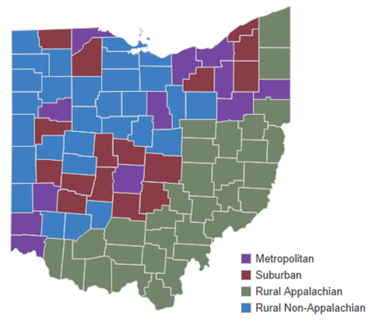
OMAS County Types
OMAS assigns counties to one of four mutually exclusive county types – rural Appalachian, rural non-Appalachian, metropolitan, and suburban. OMAS defines these county types in accordance with federal definitions, as follows: (1) rural Appalachian is defined using the Appalachian Regional Commission (ARC) standard; (2) metropolitan is defined using US Census Bureau definitions incorporating urban areas and urban cluster parameters; (3) rural non-Appalachian is defined by the Federal Office of Rural Health Policy at the Health Resources and Services Administration (HRSA), excluding Appalachian counties; (4) suburban is defined by the US Census Bureau and is characterized as a mixed-use or predominantly residential area within commuting distance of a city or metropolitan area.
For further details about the OMAS county types, please visit: grc.osu.edu/OMAS/2023Survey.

Slide 13
RESULTS: Trends in Cigarette Smoking from 2010-2023
Current smoking among adults ages 19 and older in Ohio

Slide 14
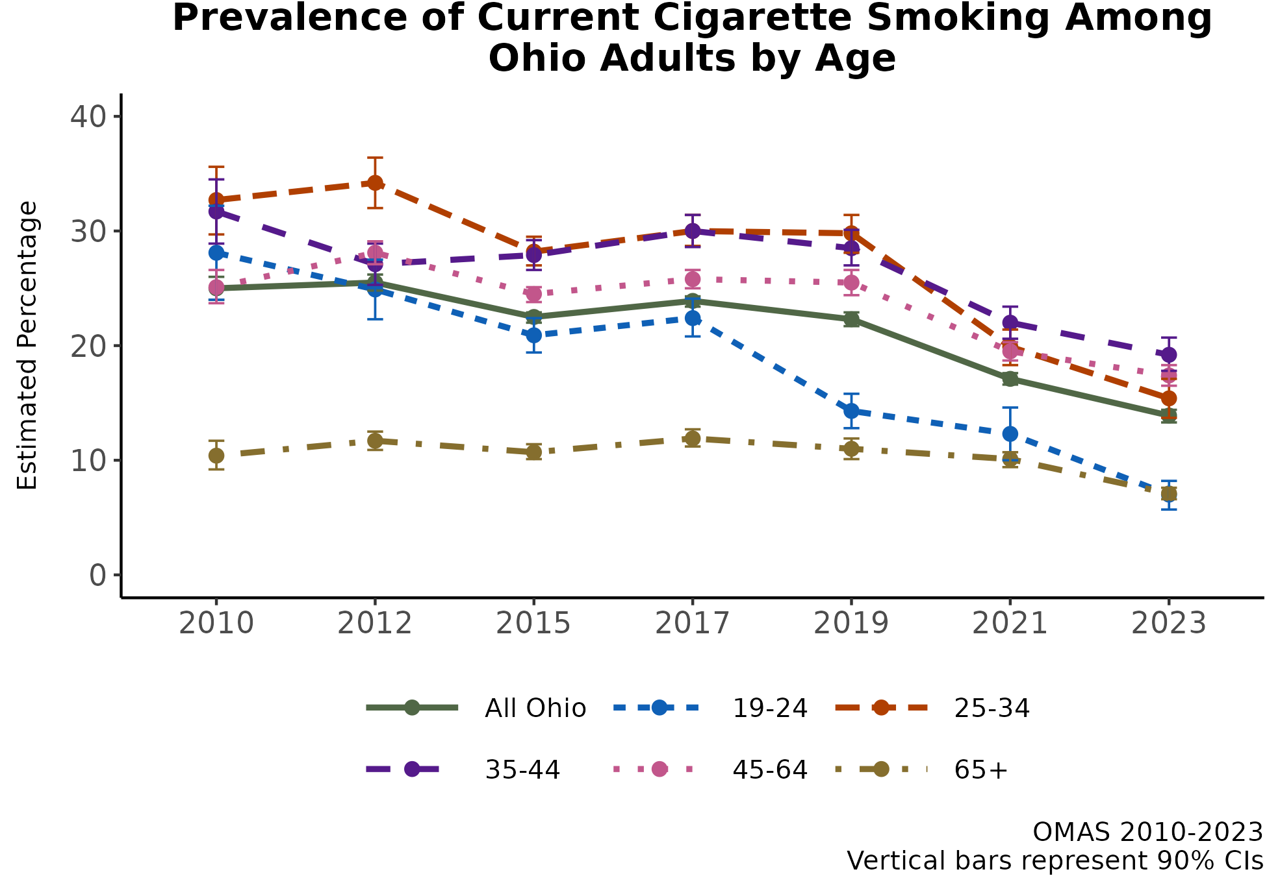
Smoking has declined among all ages, but younger adults experienced the steepest decline and older adults changed little
Smoking prevalence in Ohio in 2023 was nearly half of what it was in 2010 (25% in 2010 vs. 13.9% in 2023).​
The 19-24 age group experienced the largest change over time, from 28.1% to 7.0%.​
The 45-64 age group demonstrated a less steep decline over time, from 25.1% to 17.4%.​
Adults 65 years or older have consistently had the lowest smoking prevalence, with little change over time (10.4% in 2010 and 7.1% in 2023).​
Additional Insights (Results Not Shown)
The decrease in smoking prevalence was similar among men and women, but men almost always had a higher prevalence of smoking compared to women.
Note: Observed group differences should not be used to draw conclusions about underlying causes - see slide 10 for more guidance.

Slide 15
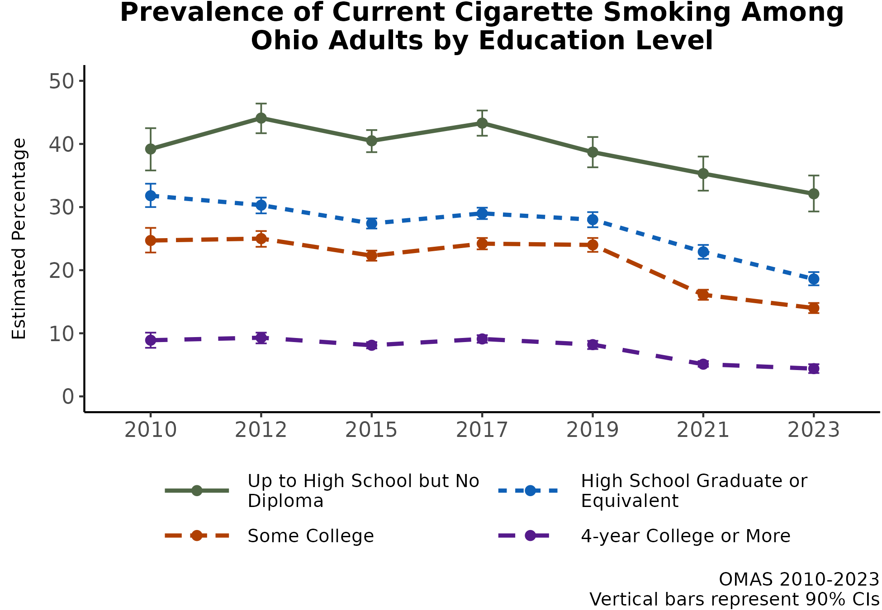
Education-related smoking differences have persisted in Ohio, with the least educated experiencing the smallest decline
There is a clear and consistent pattern in smoking prevalence by education level. As education level increases, the smoking prevalence decreases.
All education groups experienced a decline in smoking prevalence over time from 2010 to 2023.
While the differences in smoking between adults with a college degree and those with a high school or equivalent degree narrowed over time, the gap widened for the least educated group.
Additional Insights (Results Not Shown)
A nearly identical pattern is observed when examining income categories, with smoking prevalence decreasing as income increases. All groups experienced a decline over time.
Note: Observed group differences should not be used to draw conclusions about underlying causes - see slide 10 for more guidance.

Slide 16
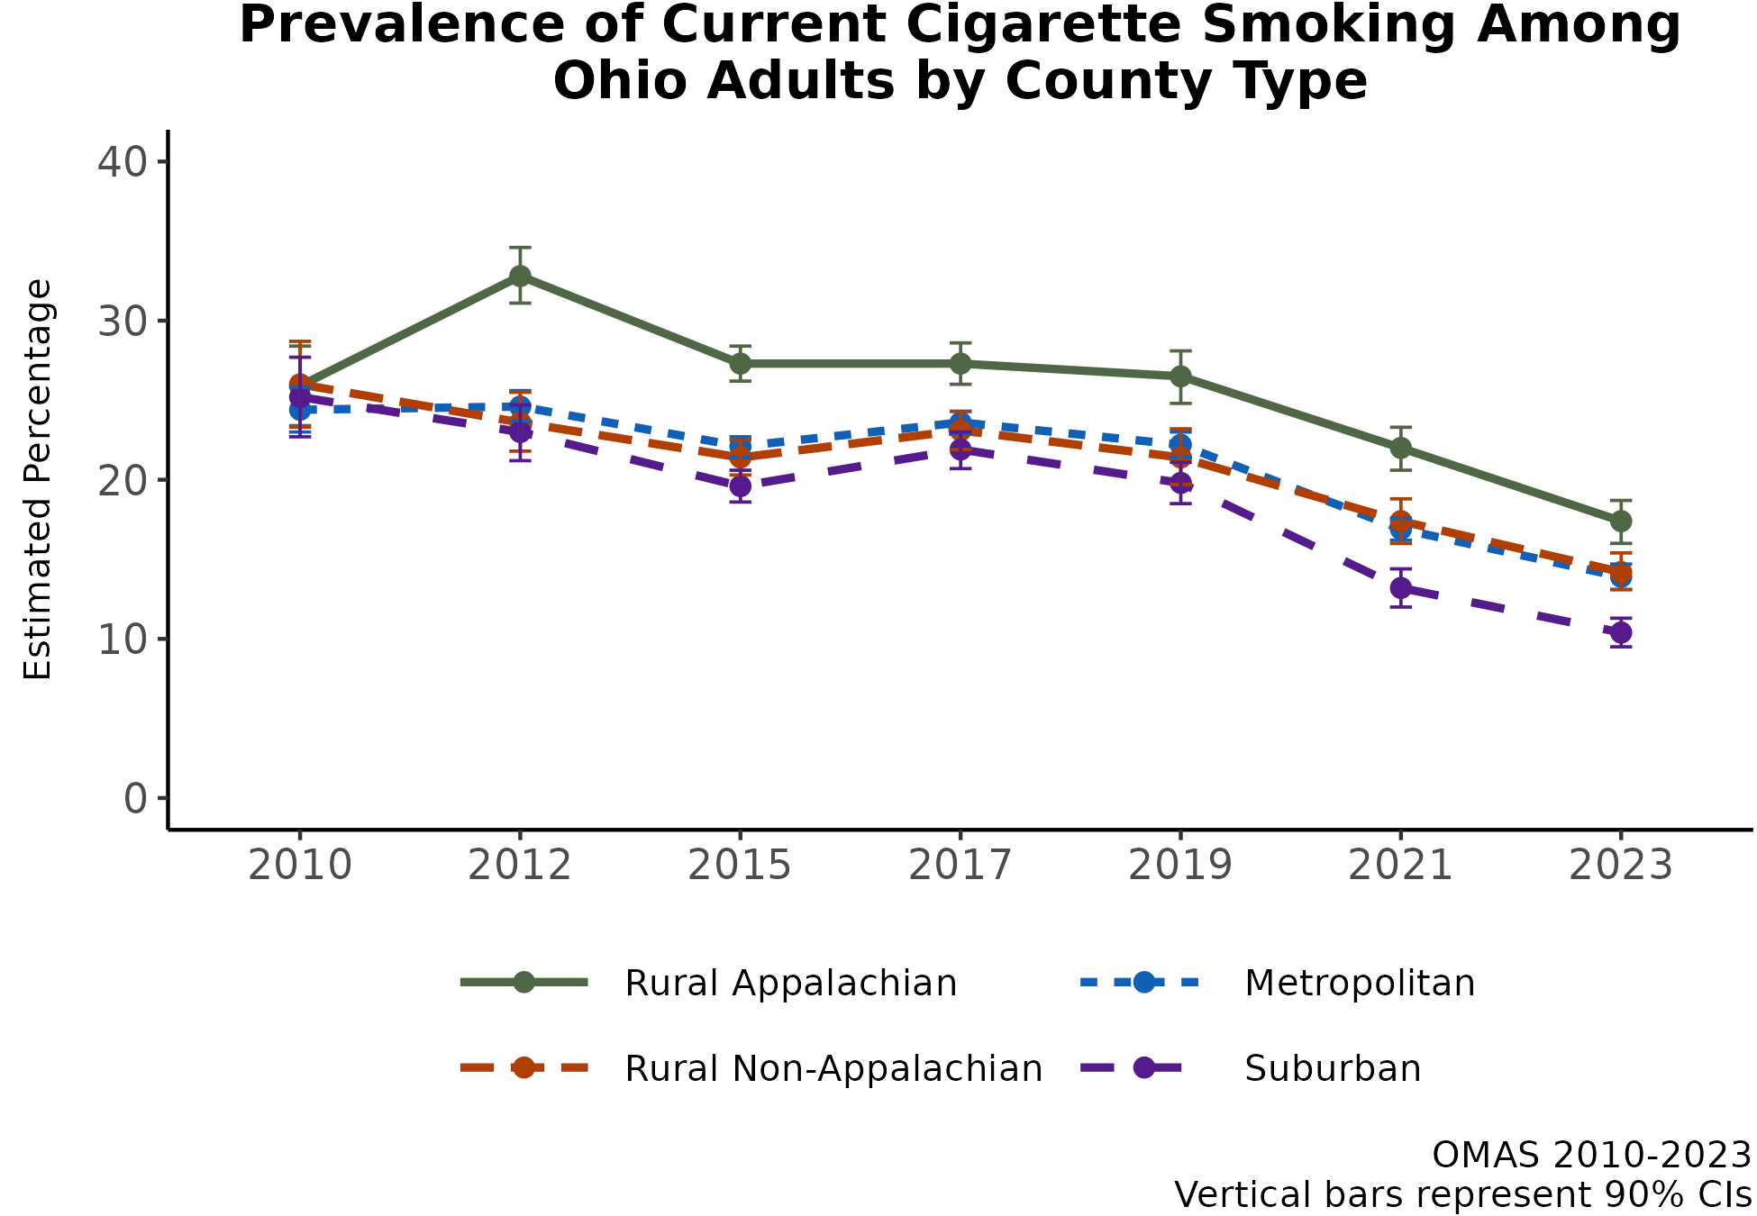
Smoking has declined in all regions, but Appalachian counties consistently have the highest smoking prevalence in Ohio
Appalachian counties have consistently experienced the highest and suburban counties the lowest smoking prevalence in Ohio.
All county types experienced a decline in smoking prevalence from 2010 to 2023.
In 2010, smoking prevalence did not vary considerably by county type, but by 2023 there was a wider range in prevalence by county type.
Additional Insights (Results Not Shown)
County type differences are less prominent among adults aged 55 and older, where the differences are minimal.
County type differences are also less prominent among low-income compared to high-income groups.
Note: Observed group differences should not be used to draw conclusions about underlying causes - see slide 10 for more guidance.

Slide 17
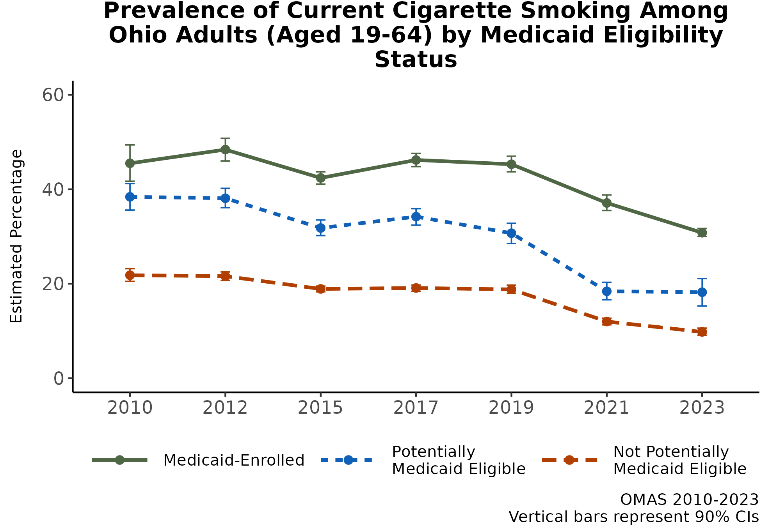
Smoking differences have persisted for working-age adults enrolled in Medicaid and those potentially vs. not potentially eligible
Adults 19-64 years who are enrolled in Medicaid or who are potentially eligible for Medicaid have consistently demonstrated the highest smoking prevalence.
All groups have demonstrated a rather steep decline from 2019 through 2023.
Additional Insights (Results Not Shown)
Smoking prevalence among 19-34-year-olds enrolled in Medicaid dropped by more than half over time.
Smoking prevalence among adults aged 50 and older and enrolled in Medicaid changed little over time.
In 2023, among adults enrolled in Medicaid, the smoking prevalence among men was 5 percentage points higher than the prevalence among women.
Note: Observed group differences should not be used to draw conclusions about underlying causes - see slide 10 for more guidance.

Slide 18
RESULTS: Trends in E-Cigarette Use / Vaping from 2019-2023
Current use of e-cigarettes/vaping among adults ages 19 and older in Ohio

Slide 19
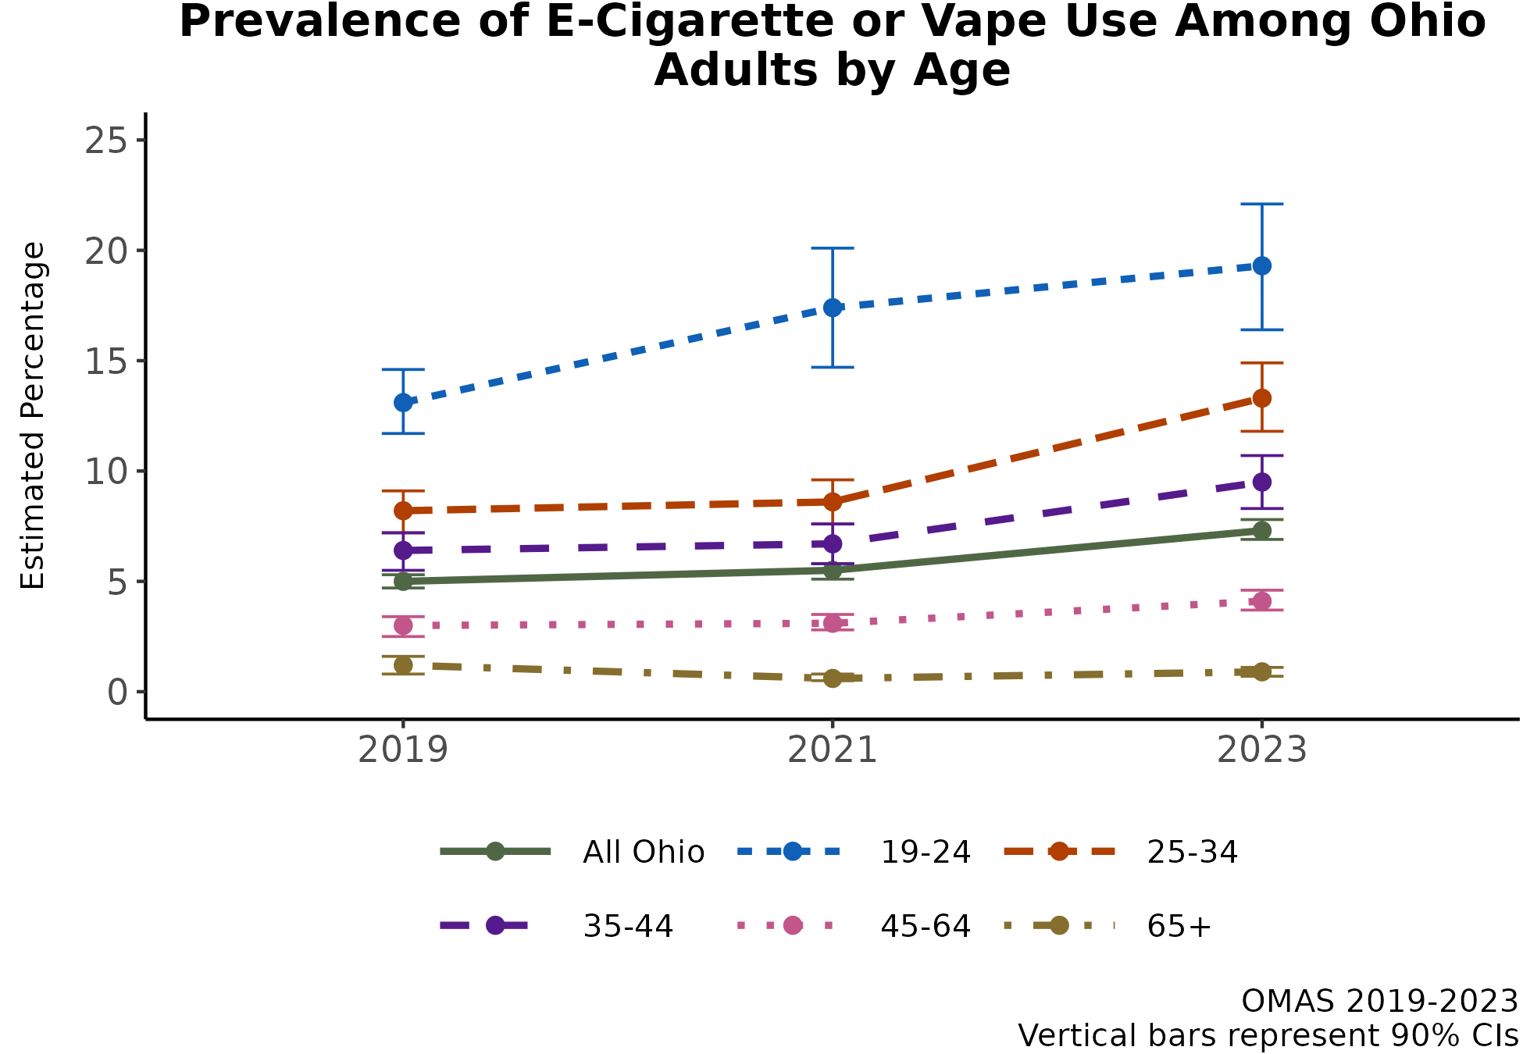
In contrast to cigarette smoking, e-cigarette/vaping prevalence increased since 2019 among all age groups but those age 65+ years
The prevalence of e-cigarette or vape use in Ohio increased from 5% in 2019 to 7.3% in 2023.
All age groups, except for the oldest (65 years plus), demonstrated an increase in prevalence since 2019.
Young adults aged 19-24 have the highest prevalence of e-cigarette/vape use, and use has steadily increased in this group over time.
Additional Insights (Results Not Shown)
The prevalence of e-cigarette/vape use increased steadily from 2019 to 2023 among females (4.1% to 7.0%), whereas the prevalence decreased from 2019 to 2021 (6.0% to 5.5%) and increased again (to 7.7%) in 2023 among males.
Note: Observed group differences should not be used to draw conclusions about underlying causes - see slide 10 for more guidance.

Slide 20
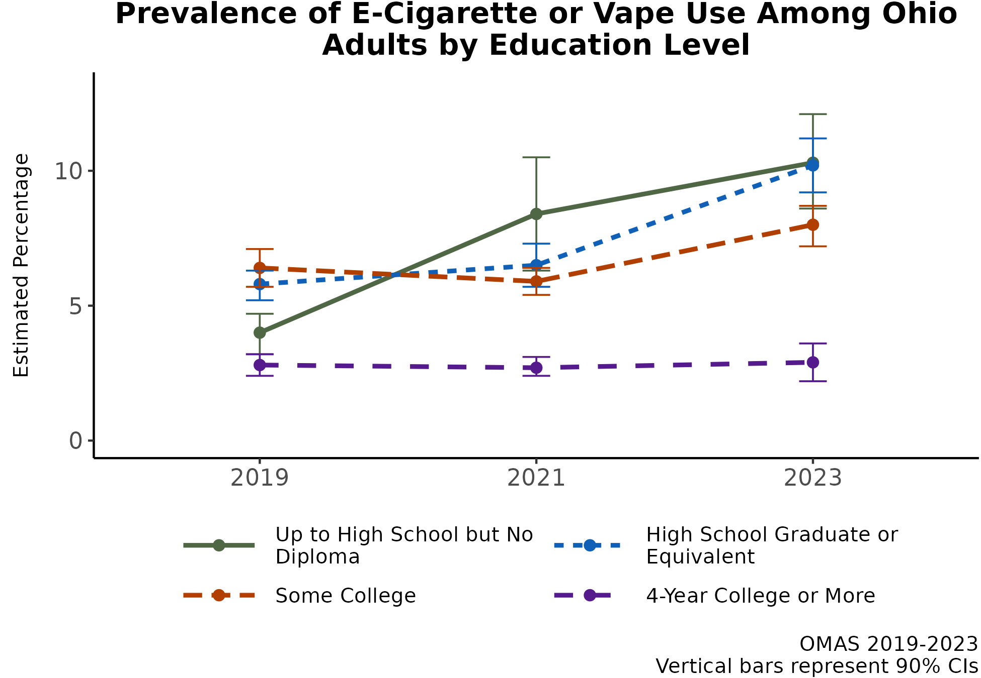
E-cigarette/vaping prevalence increased over time for all education groups except those with a 4-year college degree or more
From 2019 to 2023, e-cigarette/vaping prevalence remained consistent among adults with a college education or higher degree.
In contrast, adults with less than a college degree experienced an increase in e-cigarette/vaping prevalence.
The education-related differences are widening when comparing those with a college degree or higher level of education to those with less education.
Additional Insights (Results Not Shown)
A similar pattern is observed when using income as a measure of socioeconomic status: the highest income group had the smallest increase in prevalence over time, and lower income groups increased prevalence to a greater extent from 2019 to 2023.
Note: Observed group differences should not be used to draw conclusions about underlying causes - see slide 10 for more guidance.

Slide 21
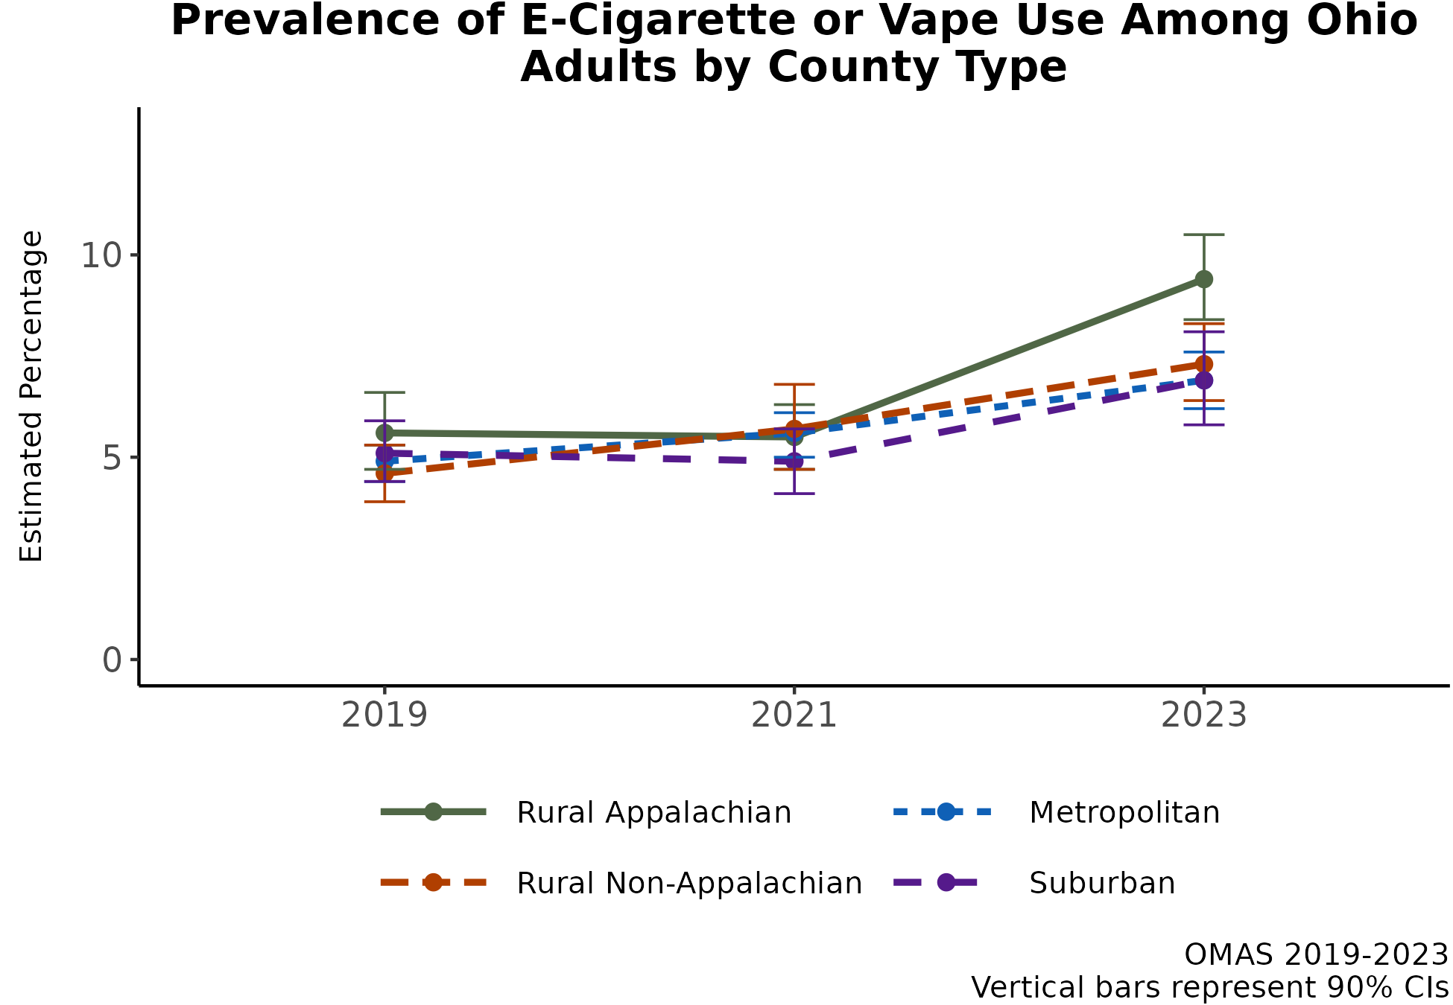
E-cigarette/vaping prevalence increased over time in all county types, with the sharpest increase in Appalachian counties
Appalachian counties have consistently experienced the highest e-cigarette/vaping prevalence in Ohio.
All county types experienced an increase in e-cigarette/vaping prevalence from 2019 to 2023.
In 2019, e-cigarette/vaping prevalence did not vary considerably by county type (4.6% to 5.6%), but by 2023 the range in prevalence was greater (6.9% to 9.4%).
Additional Insights (Results Not Shown)
County type differences in e-cigarette/vaping prevalence are less pronounced among adults aged 19-34 compared to all adults.
In 2023, the differences between Appalachian vs. other counties are most pronounced among low-income adults (< 138% FPL).
Note: Observed group differences should not be used to draw conclusions about underlying causes - see slide 10 for more guidance.

Slide 22
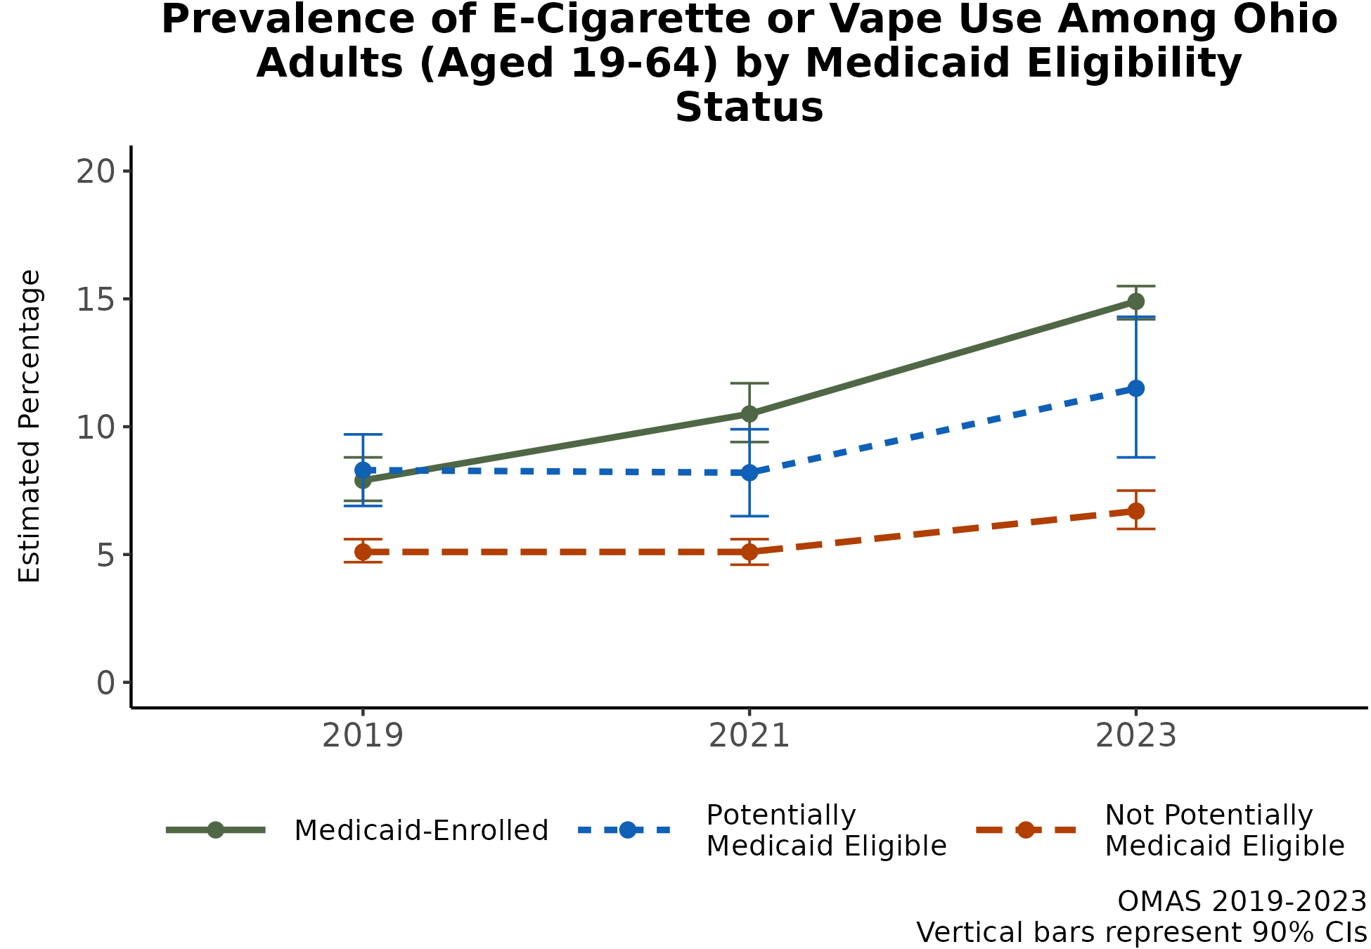
E-cigarette/vaping prevalence increased more sharply among Medicaid-enrolled and those potentially eligible for Medicaid
Adults 19-64 years who are enrolled in Medicaid or who are potentially eligible for Medicaid have consistently demonstrated the highest e-cigarette/ vaping prevalence.
Differences have widened since 2019, particularly among adults enrolled in Medicaid.
Those who are not potentially eligible for Medicaid have consistently experienced the lowest prevalence.
Additional Insights (Results Not Shown)
Among women, the gap in e-cigarette/vaping prevalence narrowed over time for potentially eligible and not potentially eligible.
Among adults aged 40-64, prevalence is similar between potentially eligible and not potentially eligible.
Note: Observed group differences should not be used to draw conclusions about underlying causes - see slide 10 for more guidance.

Slide 23
RESULTS: Trends in Binge Drinking from 2010-2023
Past-month binge drinking among adults ages 19 and older in Ohio

Slide 24
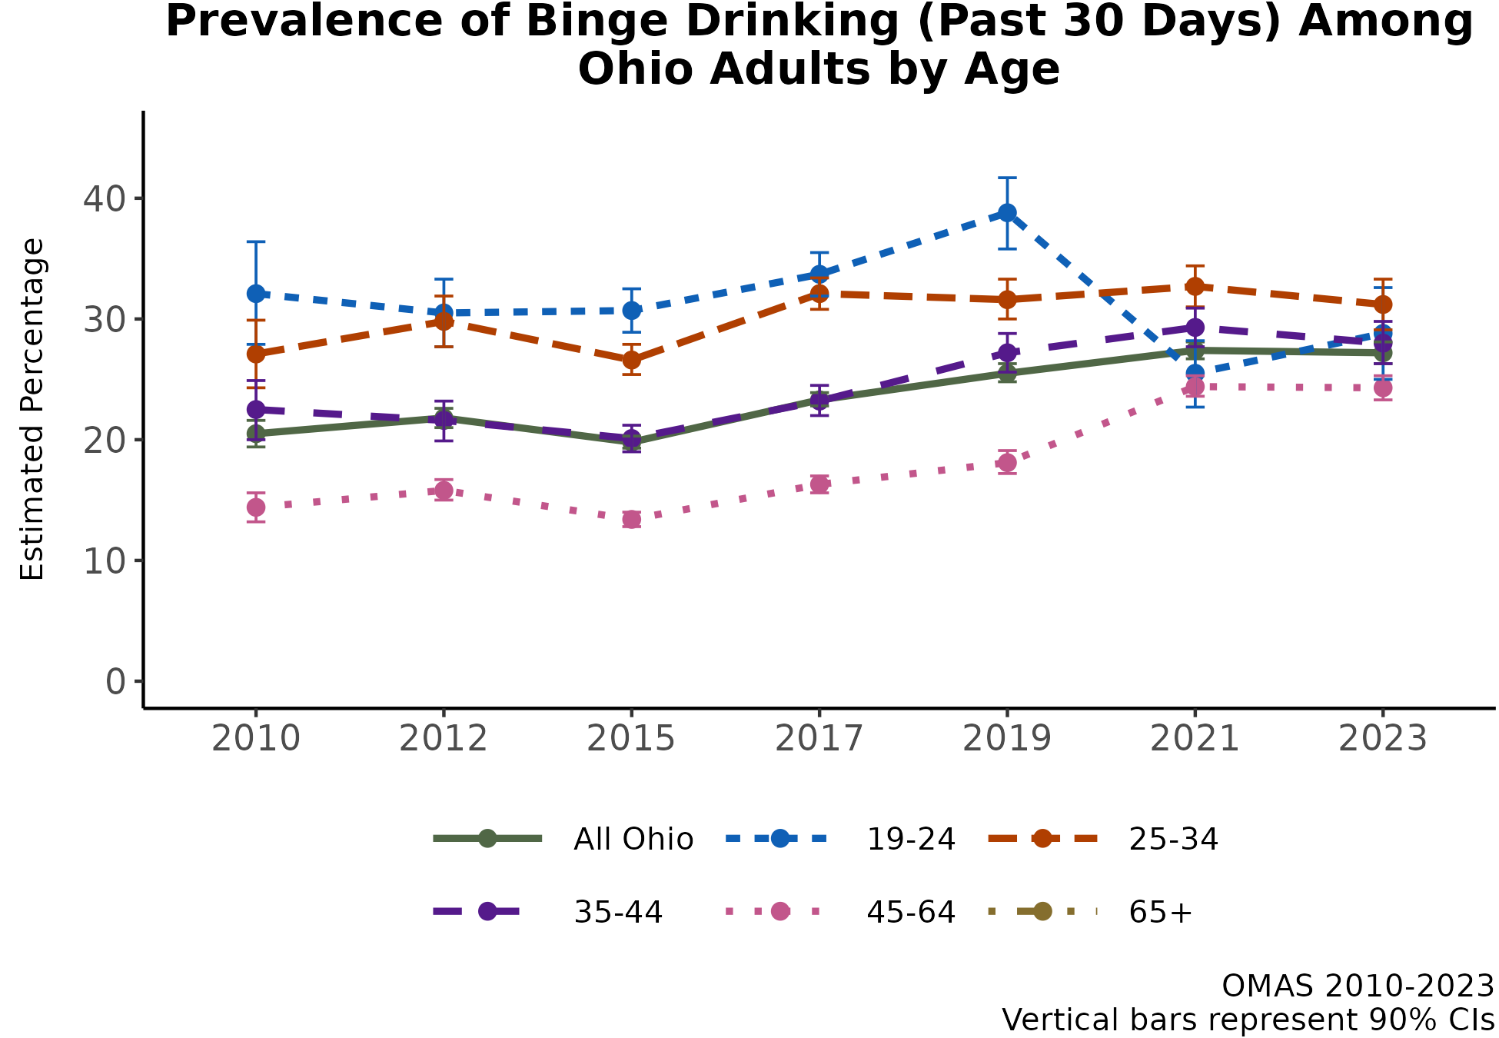
Over time, past-month binge drinking has increased for all groups except the youngest adults (age 19-24 years)
The binge drinking prevalence in Ohio increased from 17.6% in 2010 to 22.9% in 2023.
There has been a lot of variability in binge drinking prevalence among the youngest adults, increasing through 2019 but then sharply decreasing during the pandemic.
The 45-64 age group demonstrated a sharp increase, from 14.4% to 24.3%.
Adults 65 years or older demonstrated a two-fold increase in prevalence, from 4.3% to 9.1%.
Additional Insights (Results Not Shown)
Males have consistently had a higher prevalence of binge drinking compared to females. However, the gap has been narrowing over time.
Note: Observed group differences should not be used to draw conclusions about underlying causes - see slide 10 for more guidance.

Slide 25
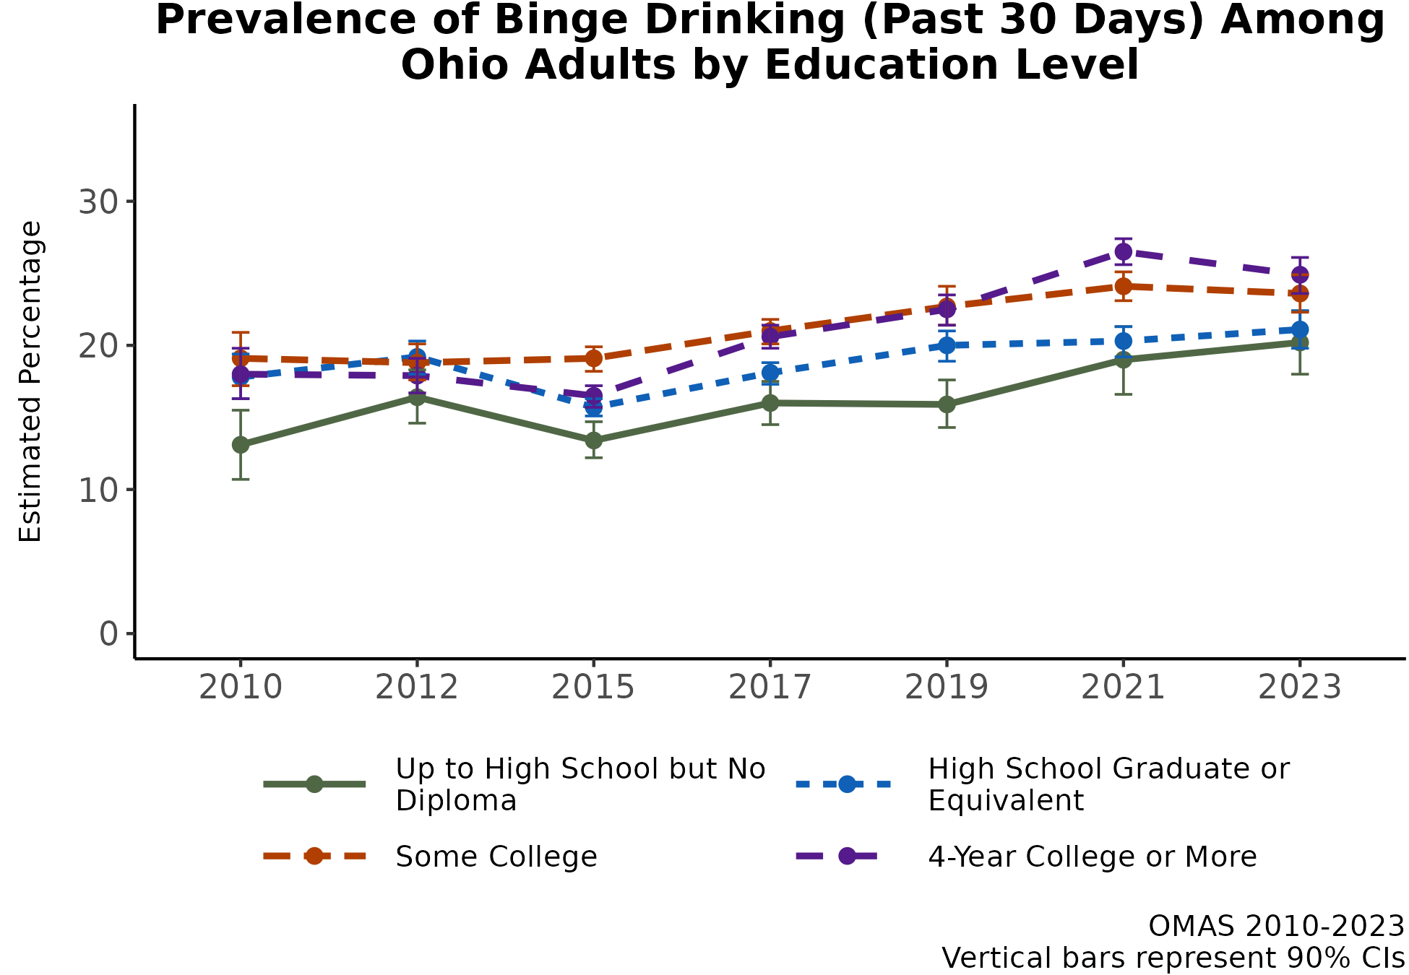
Binge drinking prevalence increased over time, and more rapidly during the COVID-19 pandemic, for most groups
All education groups experienced an increase in binge drinking over time from 2010 to 2023.
Education-related gaps in binge drinking narrowed over time, largely driven by sharp increases in binge drinking prevalence among adults with less than a high school education since 2019.
Additional Insights (Results Not Shown)
Historically, binge drinking was more prevalent among higher income groups. Since 2015, binge drinking prevalence has been rising sharply among low-income adults (< 138% FPL).
In 2023, binge drinking prevalence was similar between the highest income (> 400% FPL) and the lowest income (< 138% FPL) groups.
Note: Observed group differences should not be used to draw conclusions about underlying causes - see slide 10 for more guidance.

Slide 26
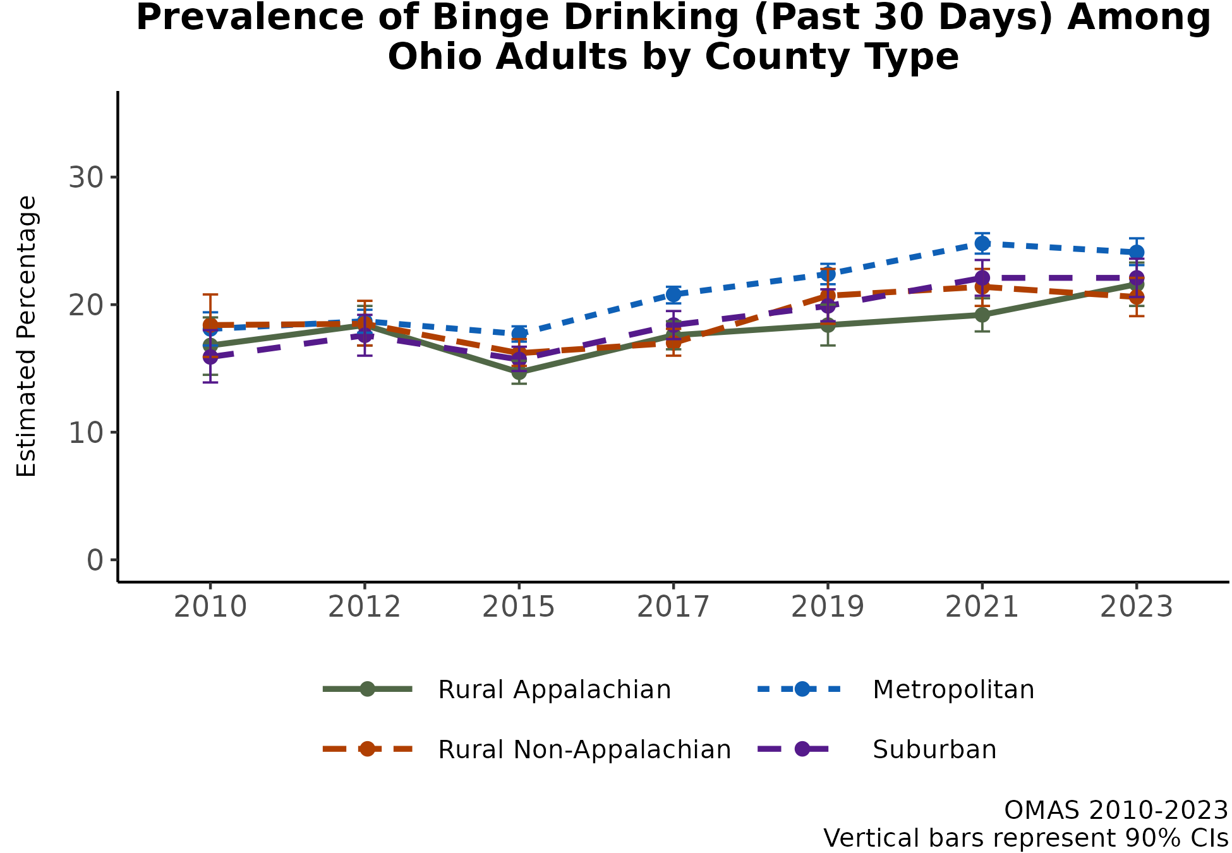
Binge drinking has been increasing for all county types since 2015, with sharp increases among rural Appalachian counties
All county types experienced an increase in binge drinking prevalence from 2010 to 2023.
Only rural Appalachian counties continued to experience an increase in binge drinking from 2021 to 2023.
County type differences have been similar over time, as evidenced by a similar range in binge drinking prevalence in 2010 and 2023.
Additional Insights (Results Not Shown)
County type differences are not as pronounced among males as they are among females over time.
County type in binge drinking over time are similar among low-income and high-income adults.
Note: Observed group differences should not be used to draw conclusions about underlying causes - see slide 10 for more guidance.

Slide 27
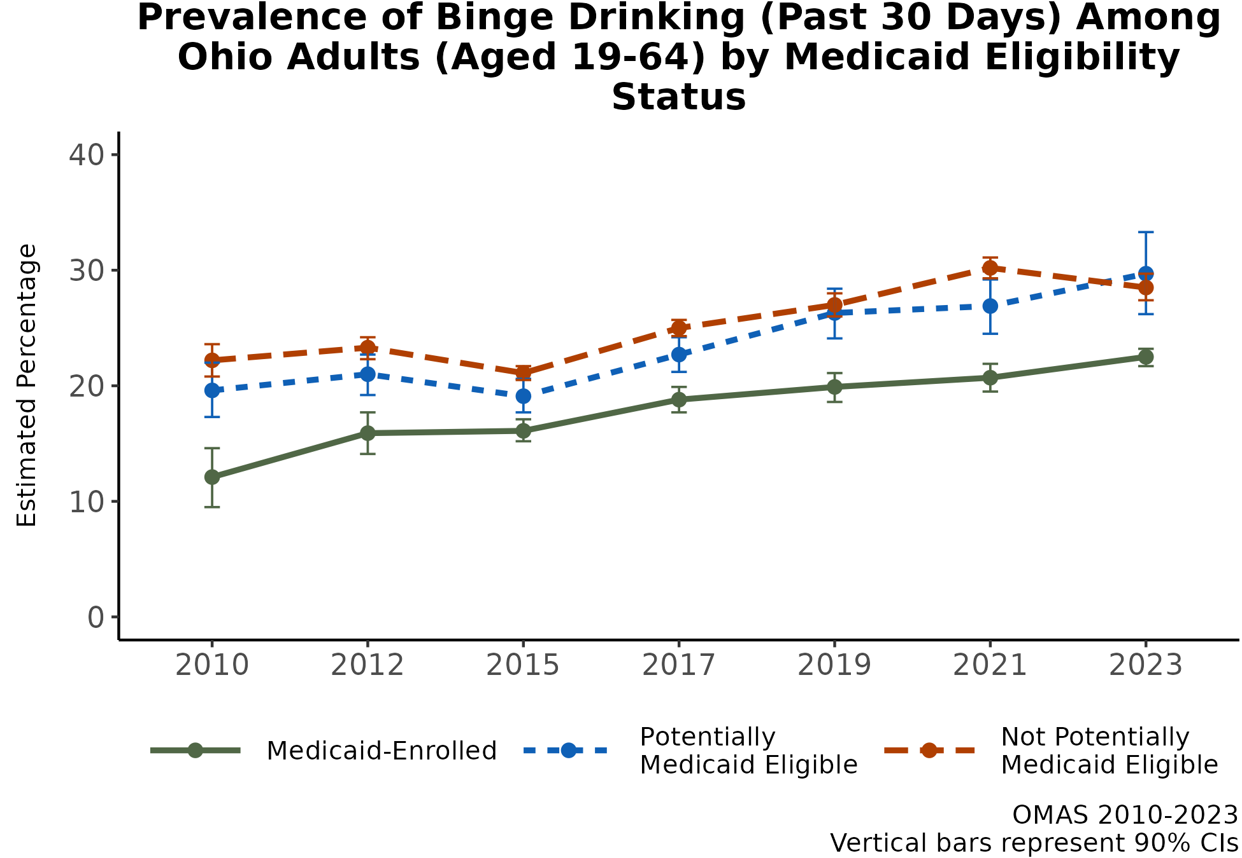
Adults aged 19-64 years and enrolled in Medicaid have had the lowest prevalence of binge drinking over time
All groups experienced an increase in the prevalence of binge drinking from 2010 to 2023.
Differences in binge drinking prevalence among groups defined by Medicaid status have decreased over time.
From 2021 to 2023, binge drinking prevalence increased among potentially eligible adults and decreased among not potentially eligible adults.
Additional Insights (Results Not Shown)
Over time, the binge drinking prevalence differences between the three groups defined by Medicaid status/eligibility are greater for males than females.
Among adults aged 50-64, binge drinking prevalence is similar between the three groups defined by Medicaid status/eligibility.
Note: Observed group differences should not be used to draw conclusions about underlying causes - see slide 10 for more guidance.

Slide 28
RESULTS: Marijuana Use in 2023
Past-month use of marijuana among adults ages 19 and older in Ohio

Slide 29
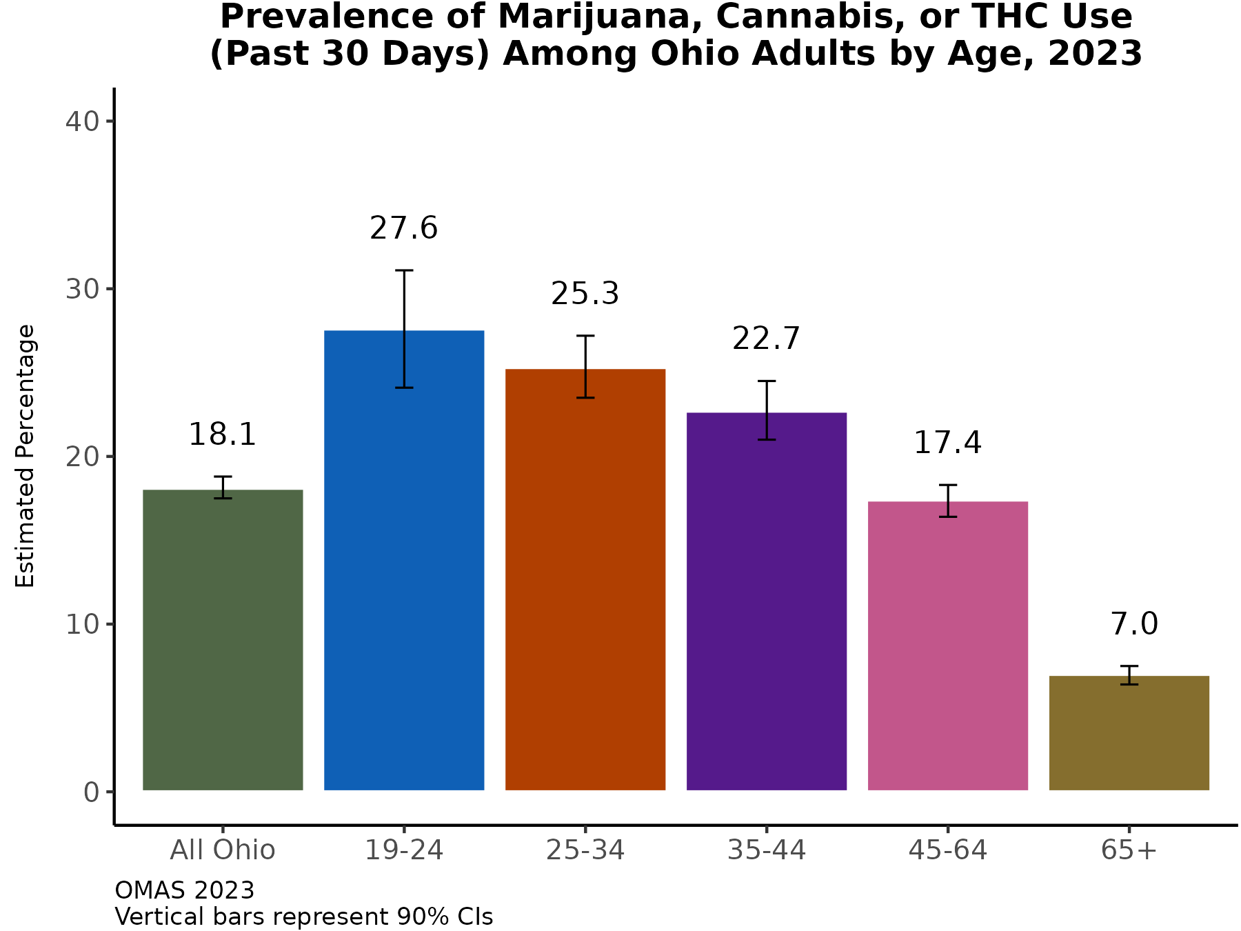
Nearly 1 in 5 adults in Ohio had used marijuana, cannabis, or THC in the past month in 2023
In 2023, over one-quarter of adults between ages 19 and 34 used marijuana, cannabis, or THC in the past 30 days
The prevalence of marijuana, cannabis, or THC use is low among those 65 years or older.
Additional Insights (Results Not Shown)
Males have a higher prevalence of marijuana, cannabis, or THC use compared to females (20.1% vs. 16.0%).
Age-related differences in prevalence are consistent for males and females.
Note: Observed group differences should not be used to draw conclusions about underlying causes - see slide 10 for more guidance.

Slide 30
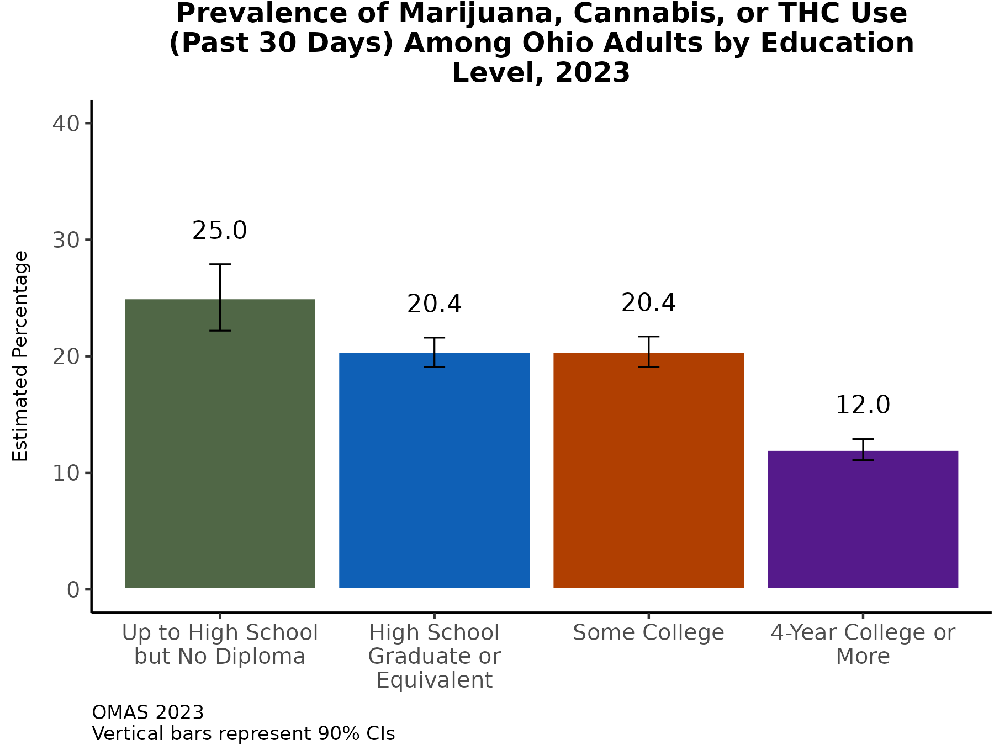
Adults with less than a high school education have the highest prevalence of marijuana, cannabis, or THC use
In 2023, one-quarter of adults with less than a high school education had used marijuana, cannabis, or THC in the last month.
While the prevalence is lower among adults with a high school degree or some college, it is still one-fifth of the population.
Additional Insights (Results Not Shown)
When examining the association between marijuana, cannabis, or THC use and income categories, adults in the lowest category (< 138% FPL) have the highest prevalence of use.
Adults in the other three income groups have a similar use prevalence.
Note: Observed group differences should not be used to draw conclusions about underlying causes - see slide 10 for more guidance.

Slide 31
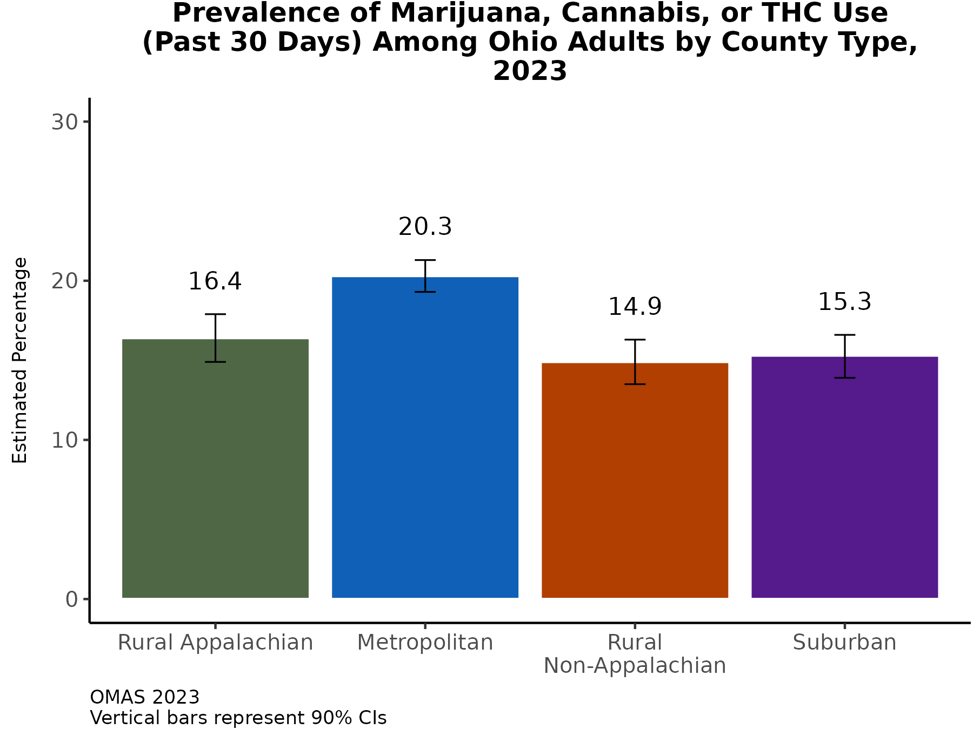
Past-month prevalence of marijuana, cannabis, or THC use is highest in metropolitan counties
In 2023, the prevalence of marijuana, cannabis, or THC use was similar among adults living in the rural Appalachian, rural non-Appalachian, and suburban counties.
Additional Insights (Results Not Shown)
County type differences in the prevalence of marijuana, cannabis, or THC use are more pronounced for young adults (aged 19-34) compared to older adults (aged 50 and older).
Patterns in county type differences in use prevalence are similar for low-income and high-income groups.
Note: Observed group differences should not be used to draw conclusions about underlying causes - see slide 10 for more guidance.

Slide 32
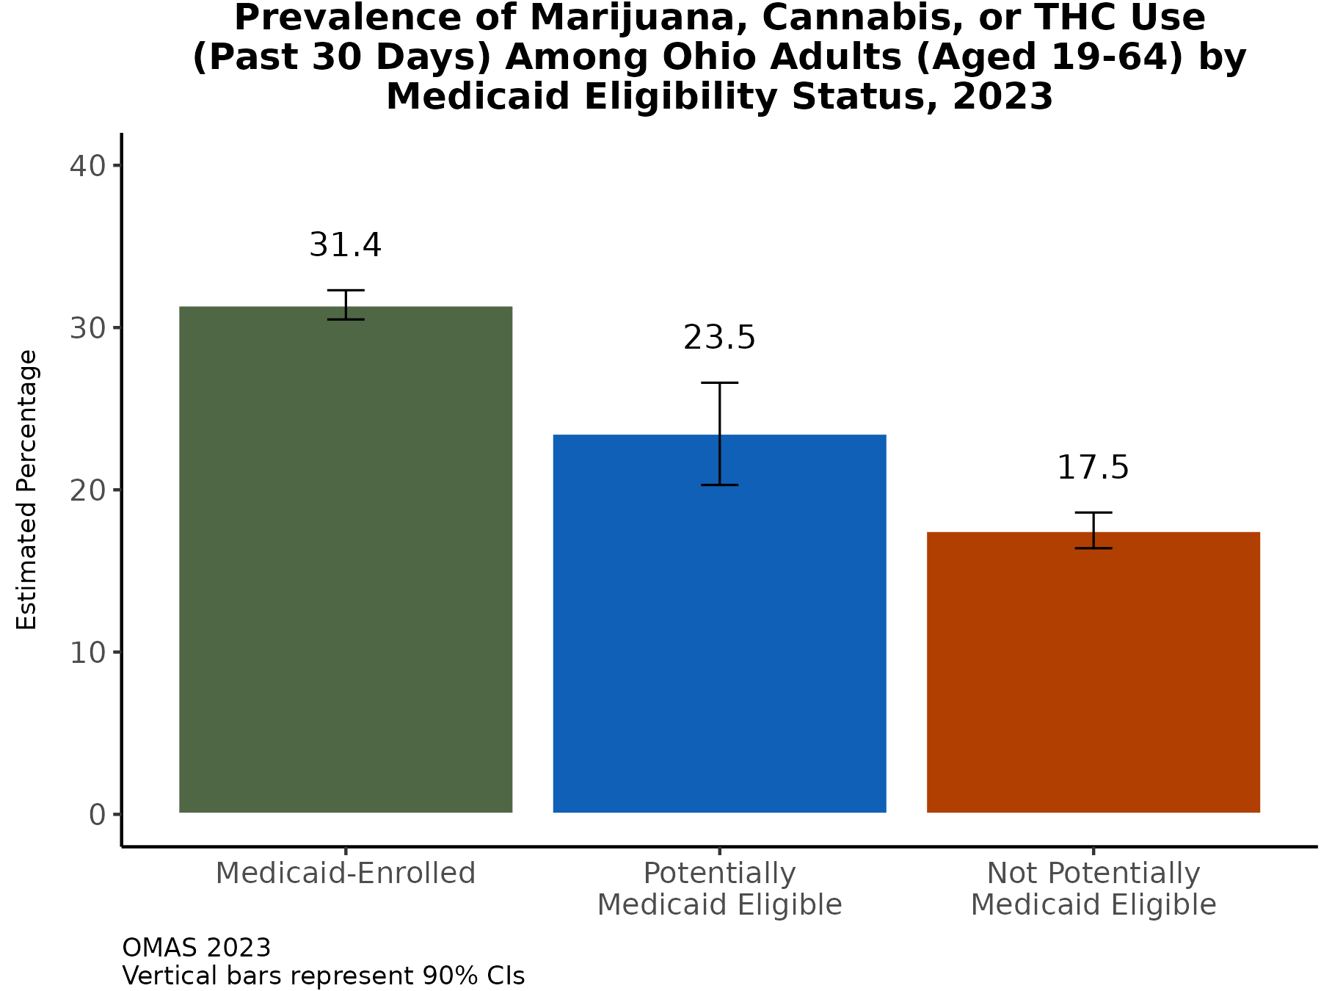
Past-month prevalence of marijuana, cannabis, or THC use is highest among adults enrolled in Medicaid
In 2023, nearly one-third of adult Medicaid members aged 19-64 years had used marijuana, cannabis, or THC in the past 30 days.
Nearly one-quarter of adults potentially eligible for Medicaid had used marijuana, cannabis, or THC in the past 30 days.
Additional Insights (Results Not Shown)
Patterns by Medicaid enrollment and eligibility are similar for males and females.
Differences in use prevalence by Medicaid status are less pronounced among young adults (aged 19-34) than they are for older adults (aged 50-64).
Note: Observed group differences should not be used to draw conclusions about underlying causes - see slide 10 for more guidance.

Slide 33
RESULTS: Prescription pain reliever use in 2023
Prescription pain reliever use and misuse among adults ages 19 and older in Ohio

Slide 34
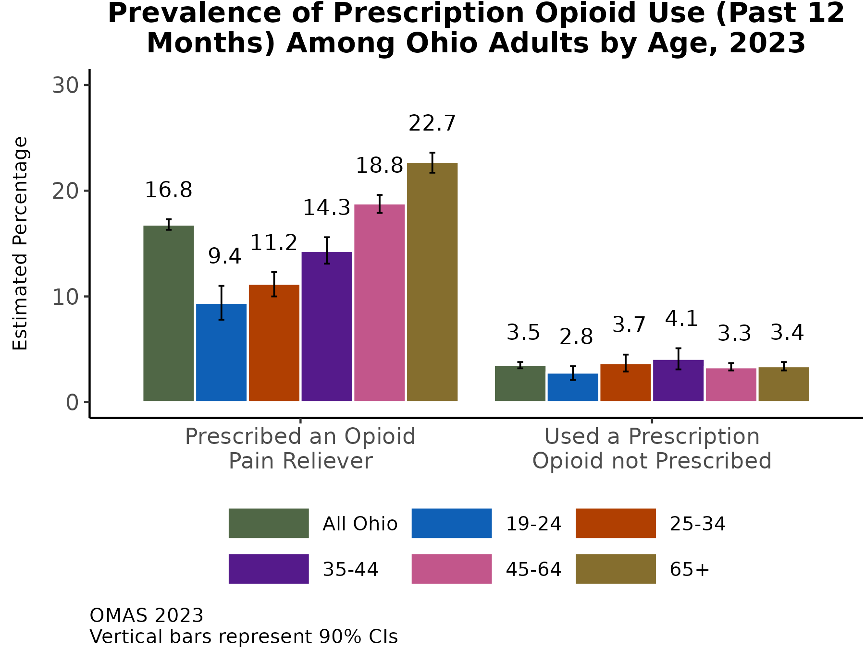
As age increases, the prevalence of receiving a prescription for an opioid pain reliever in the last 12 months increases
Fewer than 1 in 5 adults received a prescription for an opioid in Ohio in 2023.
Prescriptions increased with increasing age, from 9.4% among 19-24-year-olds to 22.7% among 65 and older.
Misuse of prescription opioids, defined as using an opioid not prescribed, is very low in Ohio and does not vary by age.
Additional Insights (Results Not Shown)
Prevalence of receiving a prescription for an opioid pain reliever in the past 12 months was higher among females compared to males.
Prevalence of misuse was similar by gender.
Note: Observed group differences should not be used to draw conclusions about underlying causes - see slide 10 for more guidance.

Slide 35
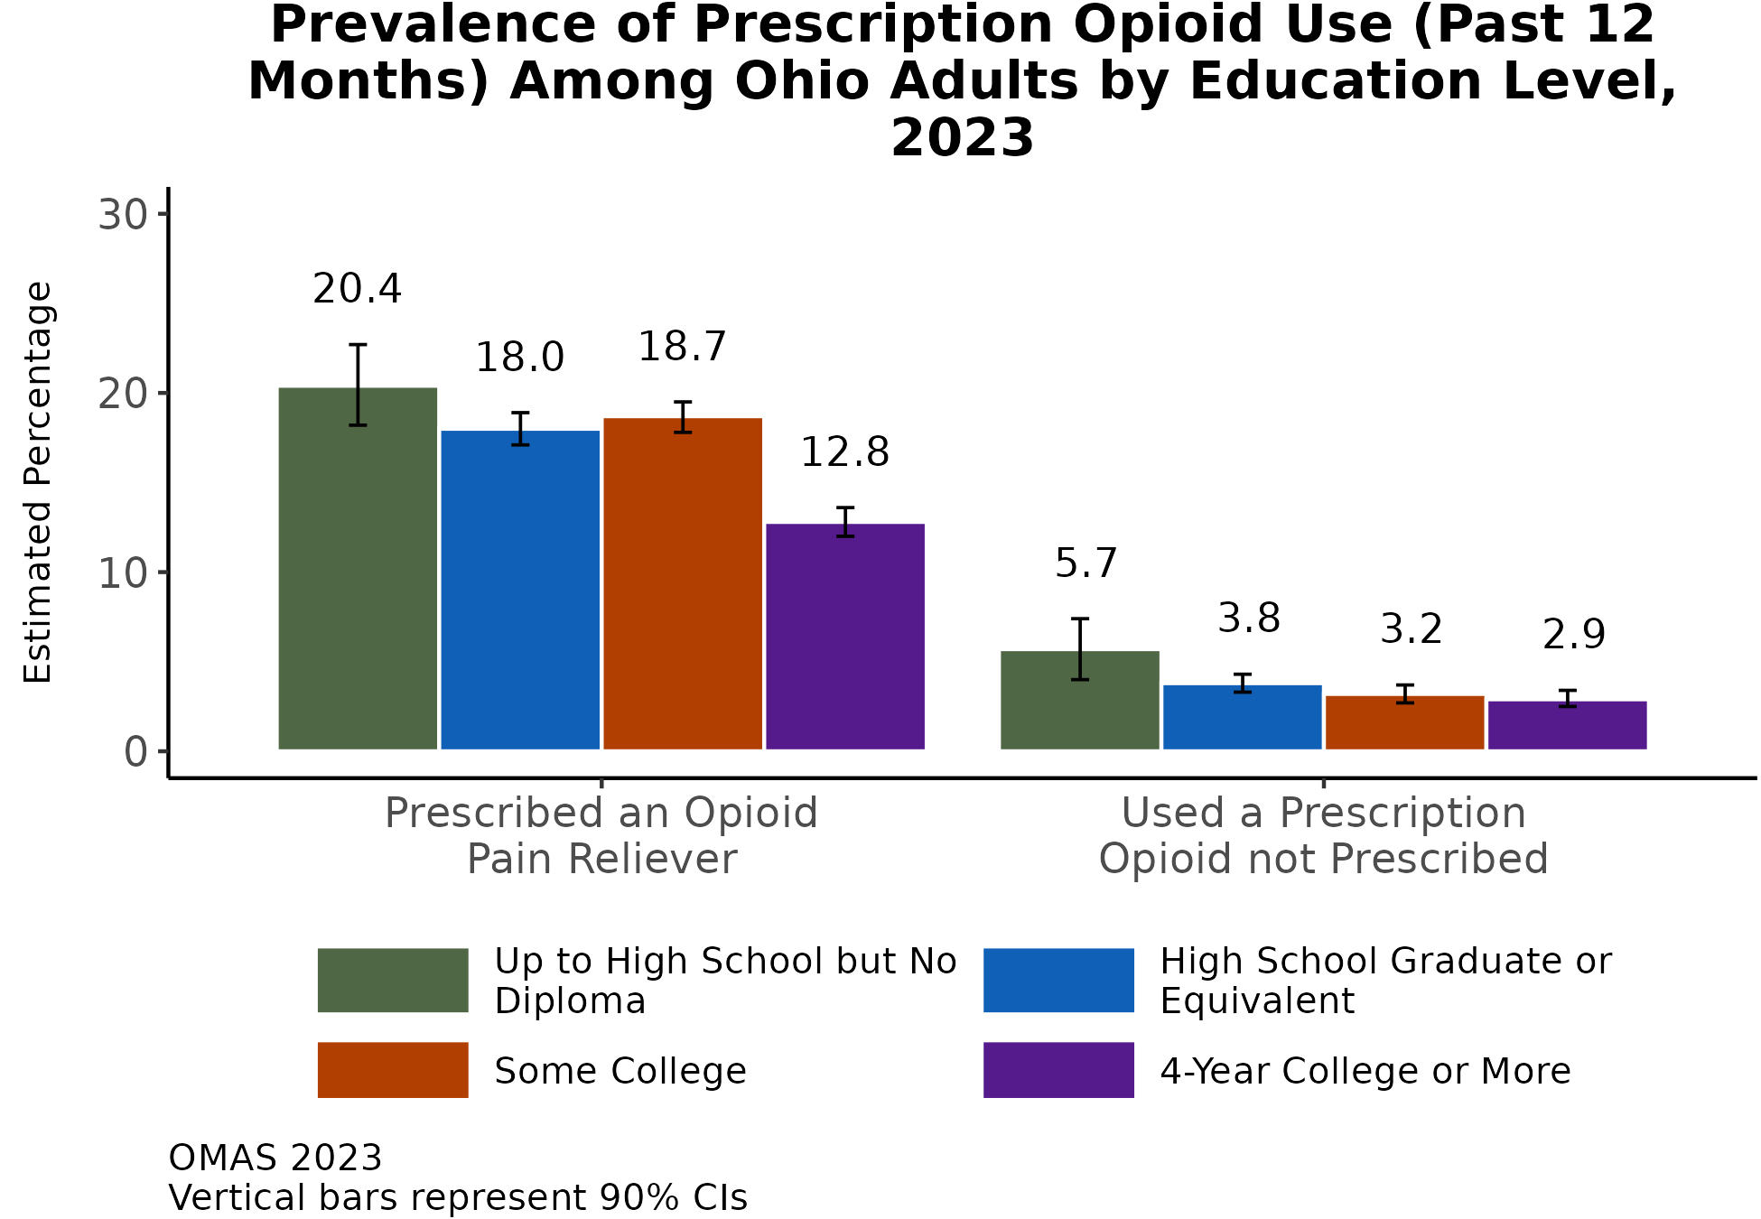
As education increases, past-year prevalence of receiving an opioid pain reliever prescription and using one not prescribed decrease
1 in 5 adults who did not complete high school received a prescription for an opioid in 2023.
A lower percentage (12.8%) of adults with a college degree or higher received an opioid prescription.
Using an opioid not prescribed to oneself was most prevalent among adults with less than a high school education.
Additional Insights (Results Not Shown)
When using household income as a socioeconomic status measure, patterns were nearly identical.
Note: Observed group differences should not be used to draw conclusions about underlying causes - see slide 10 for more guidance.

Slide 36
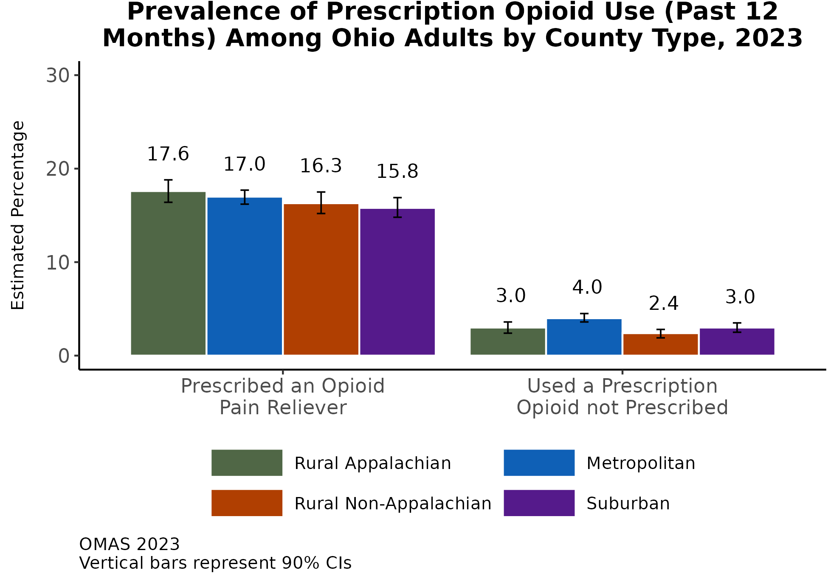
Opioid pain reliever prescriptions and misuse in the last 12 months did not vary considerably by county type in 2023
In general, the prevalence of receiving an opioid prescription was similar by county type (range 15.8 – 17.6%).
Similarly, the misuse indicator suggests that there are not large differences by county type. Although, the prevalence was lowest in rural non-Appalachian counties.
Additional Insights (Results Not Shown)
Patterns in county type prevalence of prescription opioid pain reliever indicators were similar among males and females.
County type patterns are also similar for young adults (aged 19-34) and adults aged 50 and older.
Note: Observed group differences should not be used to draw conclusions about underlying causes - see slide 10 for more guidance.

Slide 37
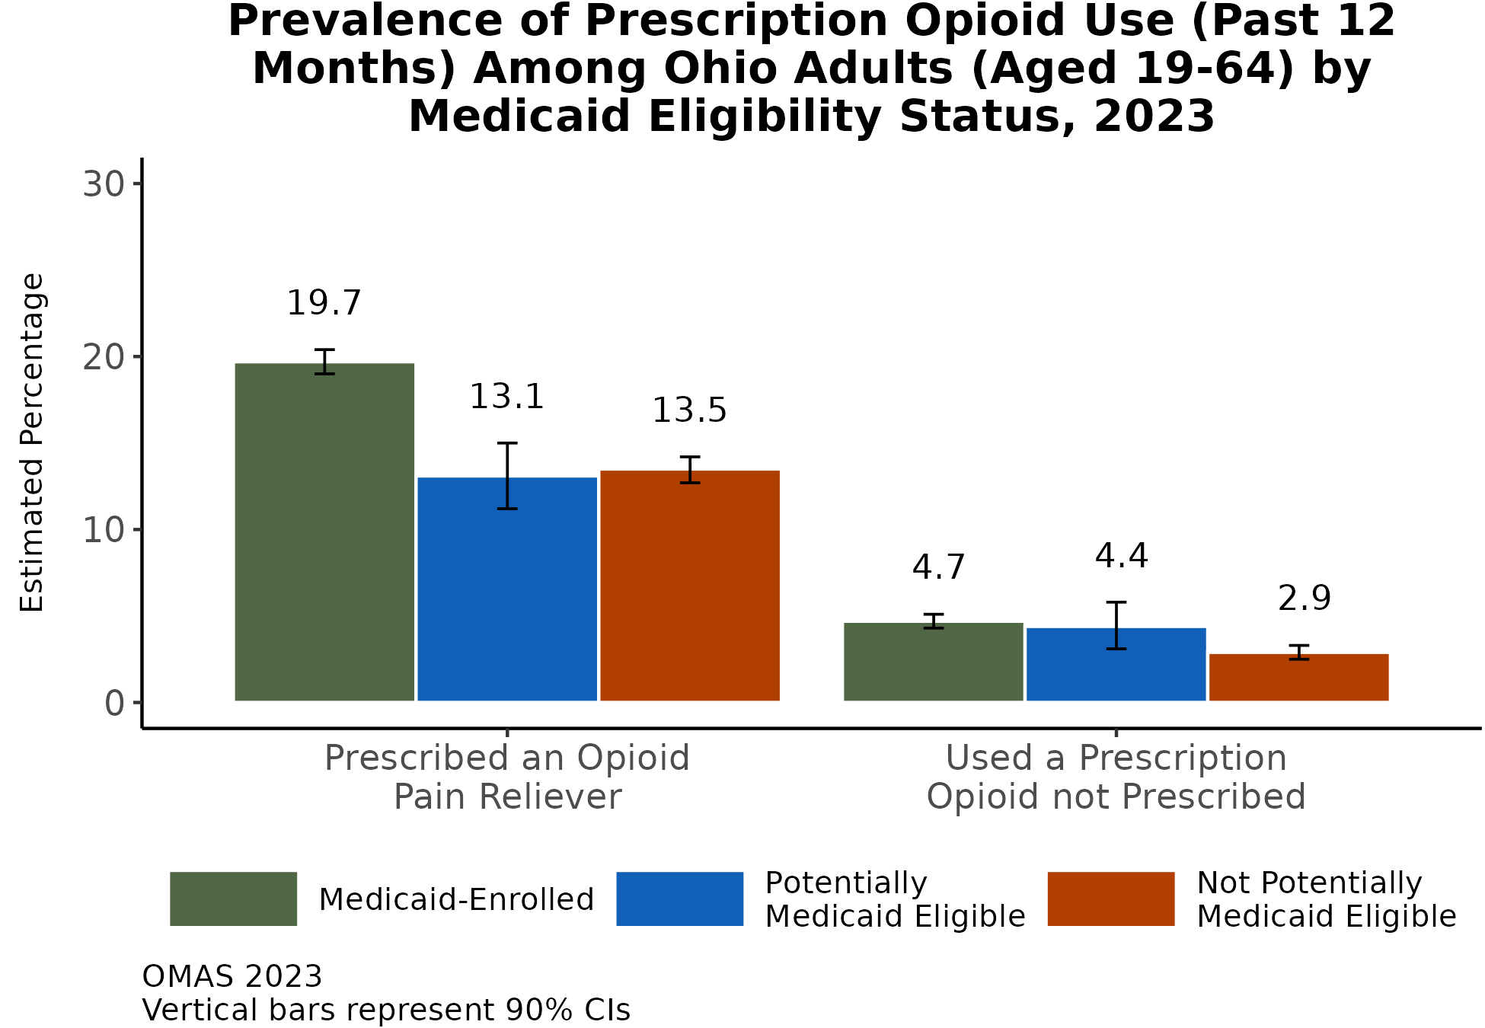
Opioid prescription pain reliever prescription in the last 12 months was most prevalent among working-age adults enrolled in Medicaid
Working-age adults enrolled in Medicaid had the highest prevalence of receiving an opioid pain reliever prescription, followed by those not potentially eligible for Medicaid.
With respect to the misuse indicator, the prevalence was higher for potentially eligible and those enrolled in Medicaid compared to those not potentially eligible.
Additional Insights (Results Not Shown)
Patterns in use and misuse were similar among males and females.
Note: Observed group differences should not be used to draw conclusions about underlying causes - see slide 10 for more guidance.

Slide 38
Summary of Results
Smoking and Vaping in Ohio: The smoking prevalence in Ohio in 2023 (13.9%) was nearly half of what it was in 2010 (25%). Differences still exist, however, as smoking prevalence is highest among adults with the lowest level of education, living in Appalachian counties, and enrolled in and potentially eligible for Medicaid.
E-cigarette or vape use prevalence increased considerably over time, from 5% in 2019 to 7.3% in 2023. Prevalence is highest among adults in the youngest age group (19-24 years), adults with less than a high school education, adults living in Metropolitan counties, and adults enrolled in or potentially eligible for Medicaid.
Binge Drinking in Ohio: Binge drinking prevalence increased in Ohio, from 17.6% in 2010 to 22.9% in 2023. All age groups increased binge drinking behavior, but the older age groups appeared to increase more considerably, with adults aged 65 and older experiencing a two-fold increase in the prevalence of binge drinking. Binge drinking is more common among adults with more education and those living in Metropolitan counties. Among working-age adults, binge drinking is less common among those enrolled in Medicaid (compared to those potentially or not potentially eligible for Medicaid).
Marijuana Use in Ohio: Past-month marijuana, cannabis, or THC use was 18.1% in 2023. Use was most common among adults who are younger, have less education, live in Metropolitan counties, and are enrolled in or potentially eligible for Medicaid.
Opioid pain reliver prescription and misuse in Ohio: Fewer than 1 in 5 adults received a prescription for an opioid in 2023. Misuse is very low and does not vary by age. Misuse is more common among adults with less than a high school education, living in Metropolitan counties, and enrolled in and potentially eligible for Medicaid.

Slide 39
References
Azagba, S., Shan, L., Latham, K., Manzione, L. (2020). Trends in Binge and Heavy Drinking among Adults in the United States, 2011-2017. Substance Use and Misuse, 55, 6, 990-997.
Cerdá M, Mauro C, Hamilton A, et a.. (2020). Association Between Recreational Marijuana Legalization in the United States and Changes in Marijuana Use and Cannabis Use Disorder From 2008 to 2016. JAMA Psychiatry, 77, 2, 165-171.
Cornelius, M.E., Loretan, C.G., Jamal, A., et al. (2023). Tobacco Product Use Among Adults – United States, 2021. MMWR Morbidity and Mortality Weekly Report, 72, 475–483.
Gallup. What percentage of Americans smoke marijuana? February 5, 2024. https://news.gallup.com/poll/284135/percentage-americans-smoke-marijuana.aspx
Jamal A, Gentzke A, Hu SS, et al. (2017). Tobacco use among middle and high school students—United States, 2011–2016. MMWR Morb Mortal Wkly Rep, 66, 597–603.
Levy DT, Huang AT, Havumaki JS, Meza R. (2016). The role of public policies in reducing smoking prevalence: results from the Michigan SimSmoke tobacco policy simulation model. Cancer Causes Control. 27, 5, 615-25.
Ohio Department of Health. 2022 Ohio Unintentional Drug Overdose Report. Not Dated. https://odh.ohio.gov/wps/wcm/connect/gov/dea64cca-767c-4495-a75c-61b6f9d0f8fa/2022+Unintentional+Drug+Overdose+Annual+Report.pdf?MOD=AJPERES&CONVERT_TO=url&CACHEID=ROOTWORKSPACE.Z18_79GCH8013HMOA06A2E16IV2082-dea64cca-767c-4495-a75c-61b6f9d0f8fa-oNOoofn.

Slide 40
Acknowledgments

