Slide 1

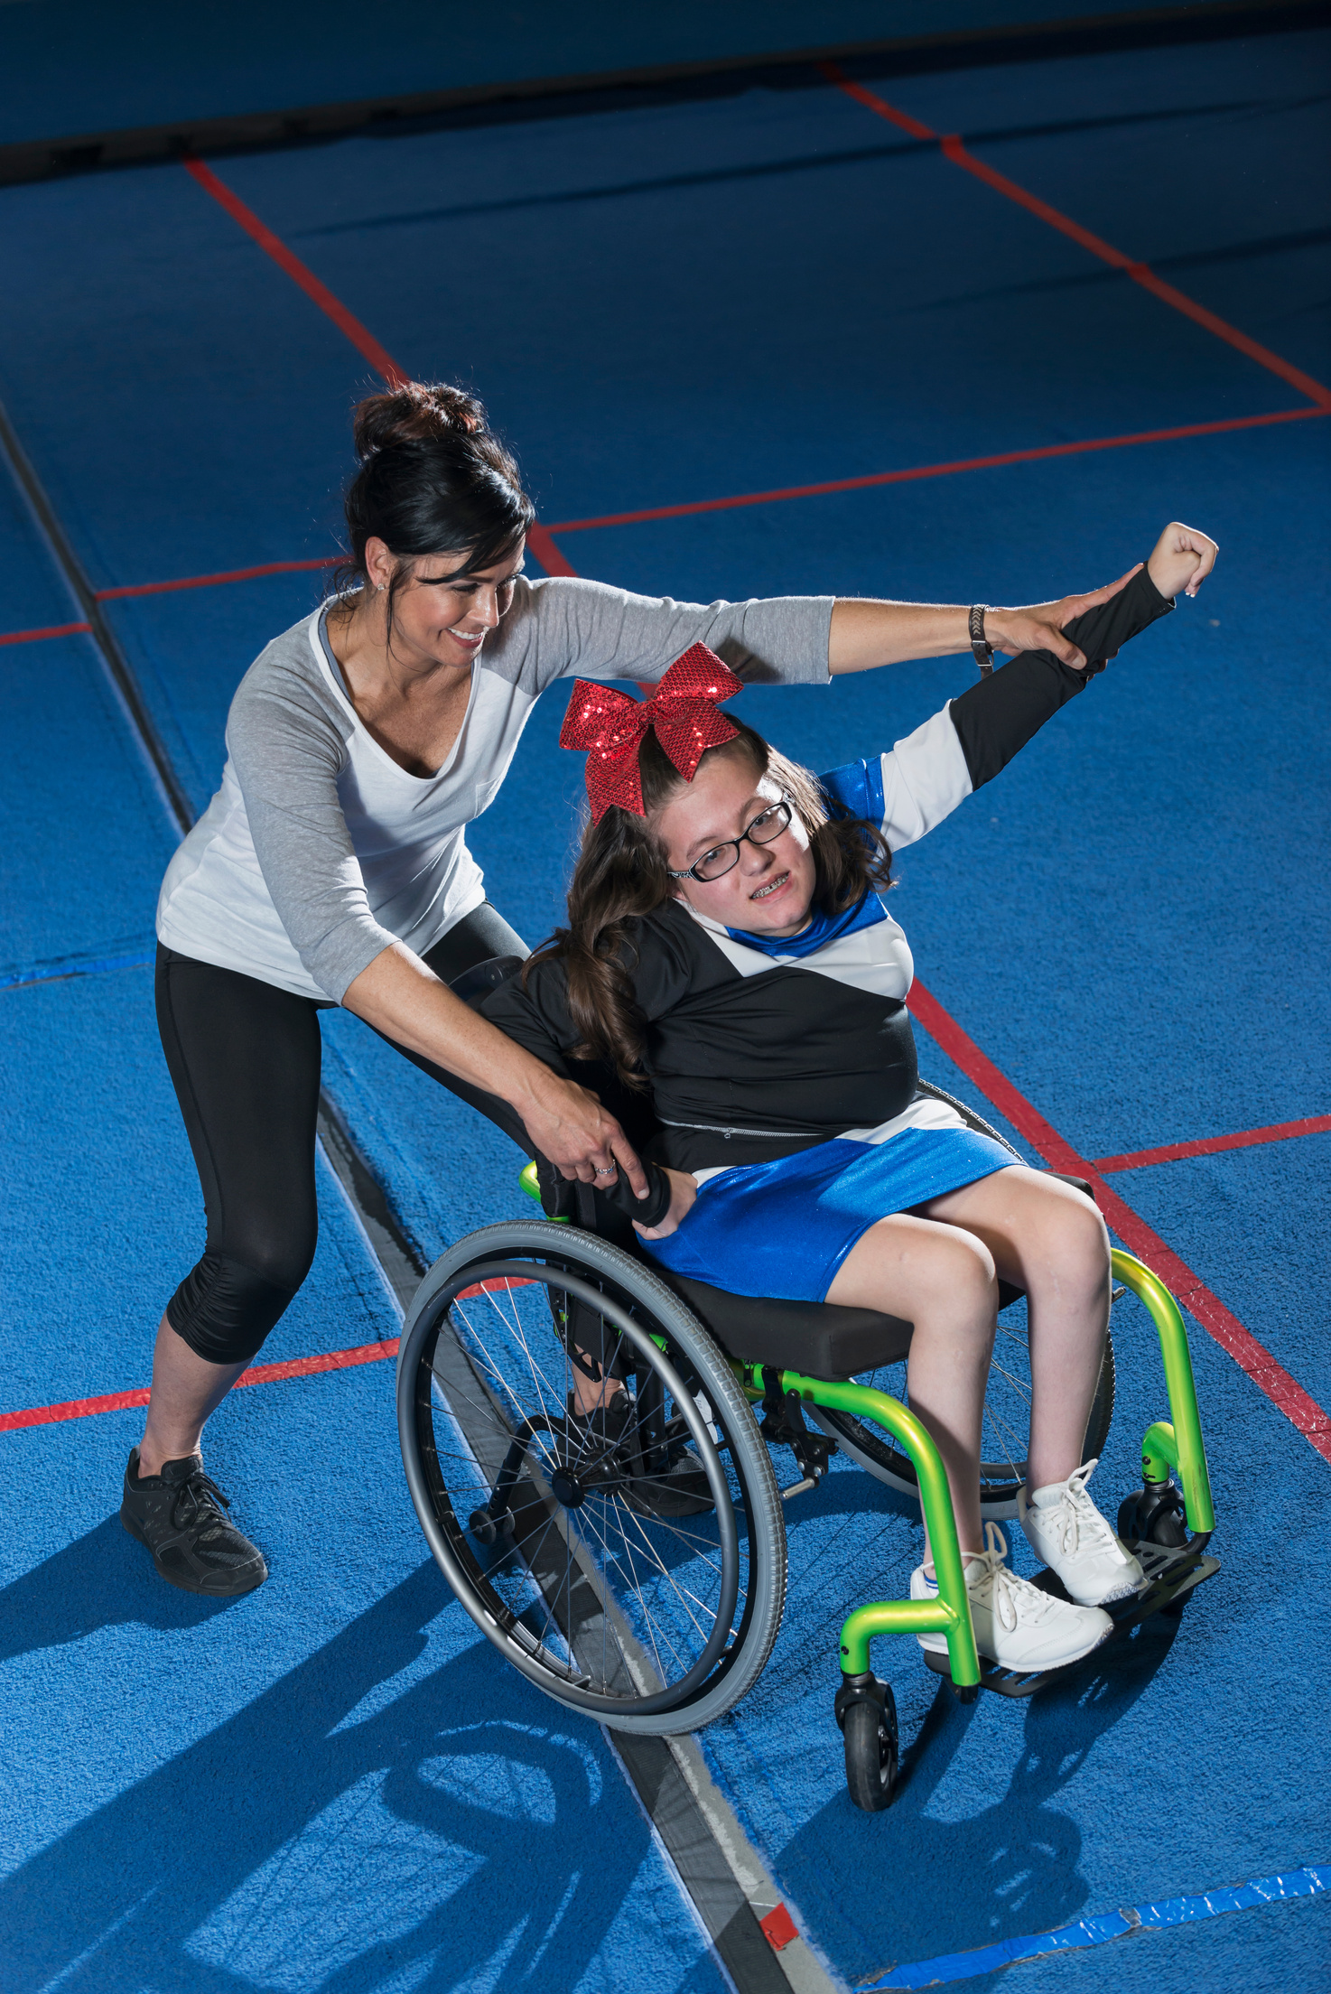
GRAIDs
GRAIDs
The Power of Inclusion
Using the GRAIDs domains to address barriers.
Equipping coaches to be more inclusive

Slide 2




Reality for Kids with a Disability
>3 MILLION
38% HIGHER
Children in the US have a disability.
Obesity rates for youth with a disability.
REALITY FOR KIDS WITH A DISABILITY
70% OF YOUTH WITH IDD
4.5 TIMES LOWER
and 40% of youth with a physical disability felt they get the same level of participation in PE.
physical activity levels for kids with a disability..

Slide 3
GRAIDs Domains
GRAIDs Domains
Guidelines Recommendations and Adaptations Including Disability
A comprehensive approach to ensure coaches are equipped to offer accessible inclusive sports.
1
2
3
4
5
Built Environment
Instruction
Equipment and Technology
Services
Policy

Slide 4
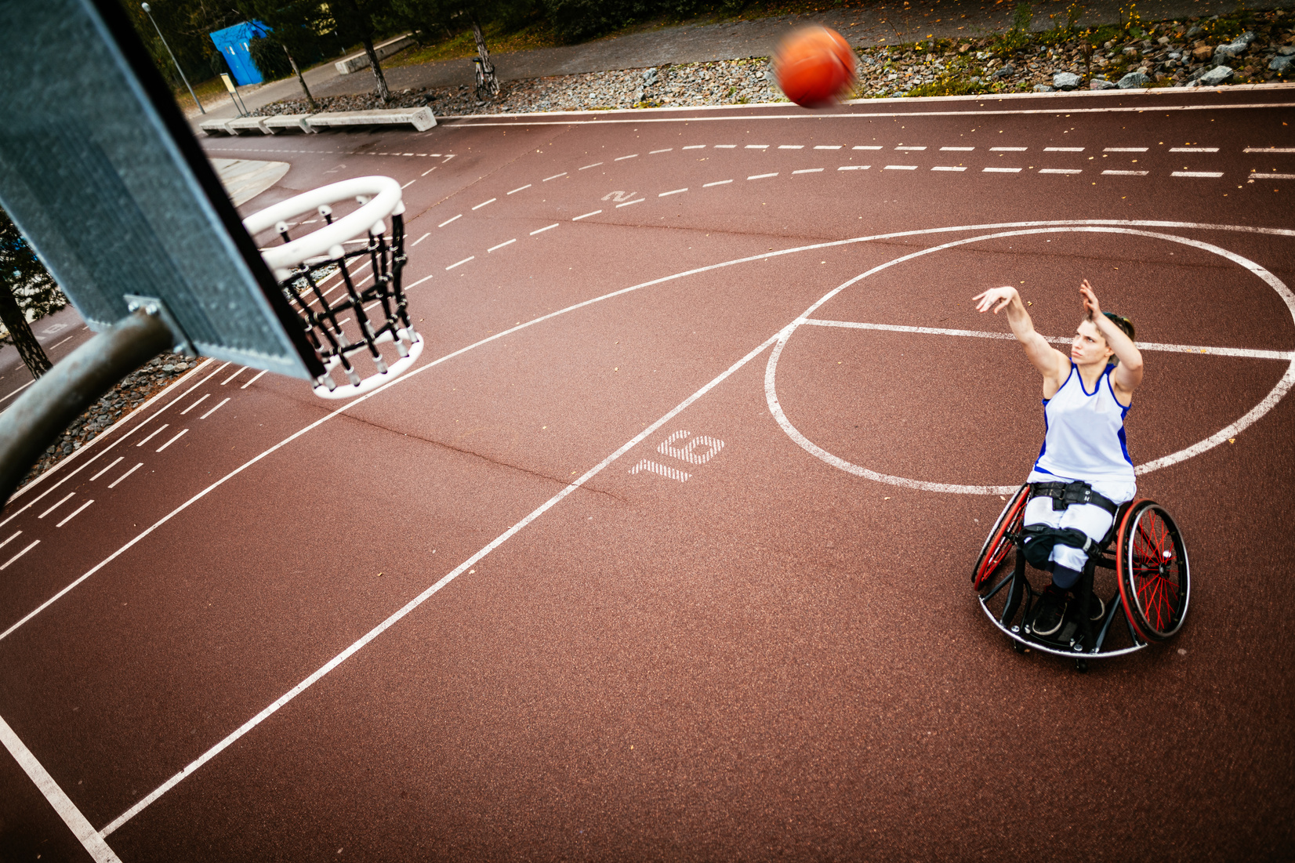

GRAIDs Domains Continued
GRAIDs Domains
Domain:
Examples:
BUILT ENVIRONMENT:structural features built into the facility
Ramps, Signage, Sidewalks, Curb Cuts, Hard floor surfaces, Lighting
Accessible Spaces
Assess your Space
All spaces must be accessible in order to offer inclusive programs. This includes the parking lot, restrooms and activity space.
To find out if your built environment is accessible you need to conduct an assessment. There are a number of different tools you can use.
ADA Checklist
CHII
AIMFREE
https://www.adachecklist.org/
Community Health Inclusion Index
AIMFREE

Slide 5

GRAIDs Domains Continued 2
GRAIDs Domains
Domain:
Examples:
Instruction: techniques used to enhance learning
Webinars, Lunch and learns, Seminars, In-service trainings, Certificate programs
Instruction for Staff
Inclusive Programming
There are numerous trainings available that can help equip coaches to better engage athletes with a disability. All staff regardless of their position in a facility should be required to take a disability education training.
Instruction can also apply to the accessibility of the content you provide to your athletes and parents. Information should be delivered in an accessible manner such as large print or braille, providing an interpreter if requested, making sure voices are amplified using a microphone etc.
1.Seek out training around disability for all staff.
2.Ensure Coaches are trained on inclusive/ adapted sports.
3.Enlist the help of individuals with a disability to evaluate your inclusive instructions.
4.Provide opportunities for athletes to request accommodations
5. Stay up to date on language preferences; person first and identity first.
Solutions:

Slide 6
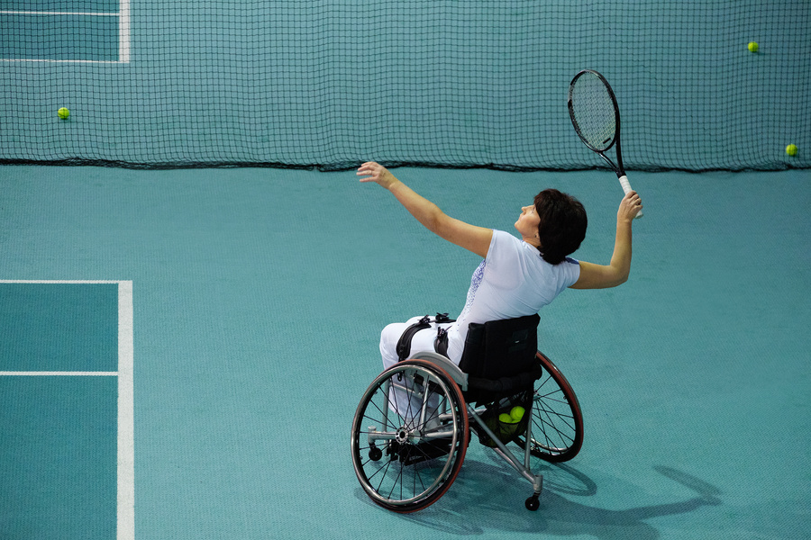
GRAIDs Domains Continued 3
GRAIDs Domains
Domain:
Examples:
EQUIPMENT AND TECHNOLOGY- PRODUCTS OR TOOLS USED TO PROMOTE AND ALLOW FOR PARTICIPATION
Sports related products, automatic sliding doors, bus lifts, communication device
Equipment
Technology
Equipment is a big piece of inclusive sport. Imagine trying to run a marathon in heels. Without the right equipment some athletes may not be able to participate fully or at all. Equipment can include a device they participate in like a sports wheelchair or part of the sports equipment like a beep baseball.
Technology also plays a big role in access. For example, registration forms should be in an accessible format with options in large print or digital. Closed captioning should be used on all tv’s. Having a check-in system that is accessible to every individual that comes in is vital and any digital content whether by app or website needs to be able to be read by a screen reader.
Solutions:
Partner with the local disability community or adapted sport provider to provide feedback on the accessibility of your services.

Slide 7
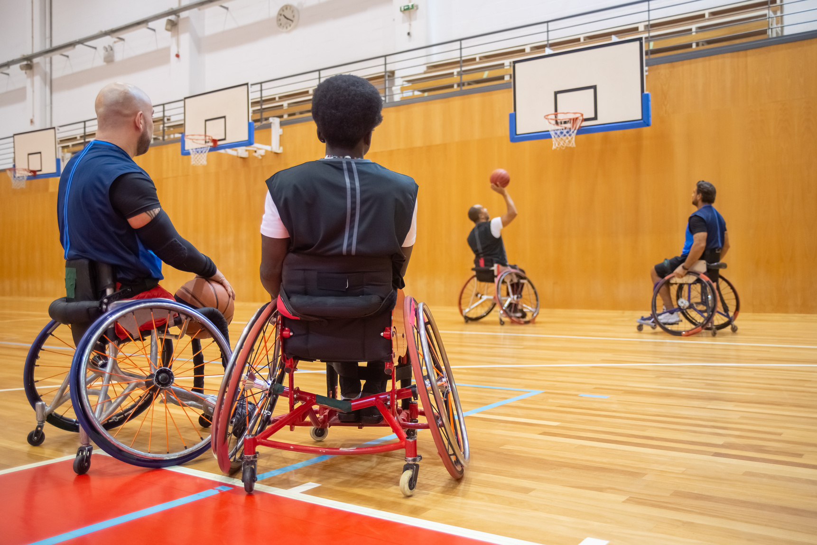
GRAIDs Domains Continued 4
GRAIDs Domains
Domain:
Examples:
Services: Person to person assistance or other assistance that increases participation
Providing accessible transportation, a peer assistant, inclusive advertisement and communication.
Inclusive Services
Inclusive Advertisement
Services are the coaching expertise you provide. Making sure you offer inclusive or adaptive sports will be the key ingredient. Providing a second coach or peer assistant could be very beneficial. Ensuring that all coaches use inclusive language is an important piece of the services you offer.
You may already provide inclusive programming but if that isn’t evident in the images or language you use in your advertisements you may be missing out. Most individuals won’t reach out to see if your services are inclusive they will rely on your website and promotional materials. Don’t miss out on this economic impact.
1.Look into accessible transportation if needed.
2. Provide inclusive and adapted sports
3. Provide opportunities for interns, students or other players to serve as peer assistants.
4. Make sure 1 in 4 marketing materials are inclusive in image and language.
5. Survey the disability community to see if your services meet their needs.
Solutions:

Slide 8

GRAIDs Domains Continued 5
GRAIDs Domains
Domain:
Examples:
Policy: Laws, regulations, rules protocols and procedures designed to guide or influence behavior
Examples: Staff training requirements, protocols to maintain equipment, organizational rules on accessibility.
Big P little p
Sample policies
You or your organization may not have an opportunity to affect Big P legislative policy however you can play a role in your organization’s policies. Every organization should have policies around disability inclusion and accessibility. Without appropriate policies in place an organizations commitment to inclusion may waver through the years.
To ensure proper representation organizational hiring policies should include priority given to those with the lived experience of having a disability. Ensuring that all staff are trained in disability education is another great policy to include. Universal design, accessible documents, trainings and equipment purchases should all be included in your policies so you can ensure people with disability will have access to your center.
Creating a policy ensures that the criteria is followed from year to year and often helps put funding behind it.

Slide 9
Using GRAIDs for coaches
Using GRAIDs for coaches
5-Step Inclusion Process
Policy
Equipment and Technology
Services
5
4
Instruction
Built Environment
3
2
1
Each domain adds to the level of inclusion you offer. Consistent assessment by the disability community will ensure your programs meet the needs of all your athletes.

Slide 10
GRAIDs Application
GRAIDS APPLICATION
Putting the process into practice
Built Environment | Instruction | Equipment & Technology | Services | Policy
Accessible pathway from parking lot to practice space. | All staff completed disability education training | Accessible sport equipment is available/ used | Provide accessible transportation if team travels | Require all staff to take disability trainings
Accessible sport court or field. | Staff use inclusive terminology | Sport specific mobility devices | Provide interpreter if one is requested. | Website and registration accessibility required.
Accessible restrooms | Staff provide sport specific adaptations | Accessible web-based platforms | Disability depicted in promotional material | Hire coaches with a disability
Accessible water fountains | Have coaches consider using the Universal Design for Learning. | Accessible registration forms | Provide inclusive and or adapted sports. | Embed access and inclusion in everything.
Accessible spectator viewing |  | Closed captioning used on game video or other video
What ways can you think of to make your program more inclusive ?

Slide 11
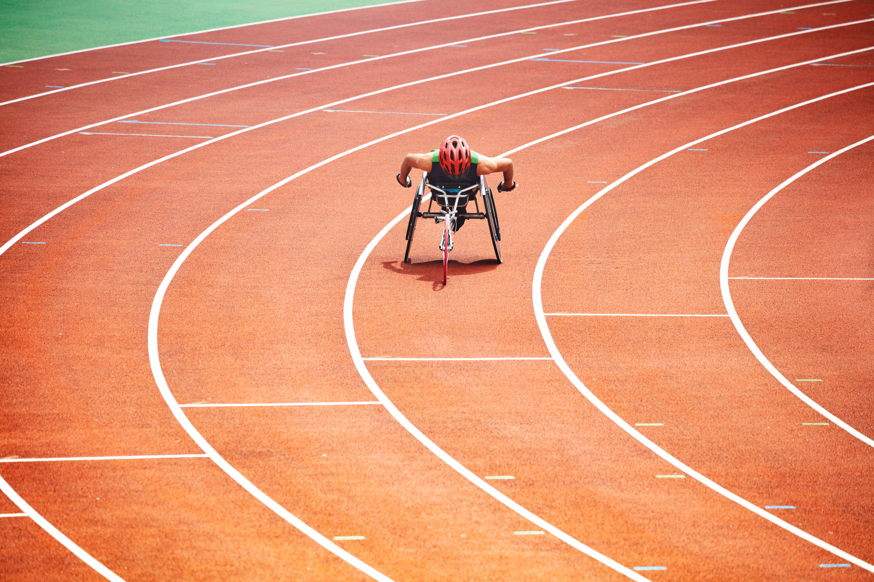

Thank you!
Thank you!
The Power of Inclusion
For More Information Contact:
Kelly Bonner KellyB@lakeshore.org

