Slide 1
Health Outcomes
Differences in Outcomes for People with Disabilities
Notes:
Hi I am Cara Whalen Smith and now that we have a better understanding about people with disabilities, we now want to share the unfair differences in health outcomes for people with disabilities experience compared to people without disabilities and why access to physical activity is important for this population

Slide 2
Nationally
Notes:
We will first look at these differences nationally in the United states

Slide 3
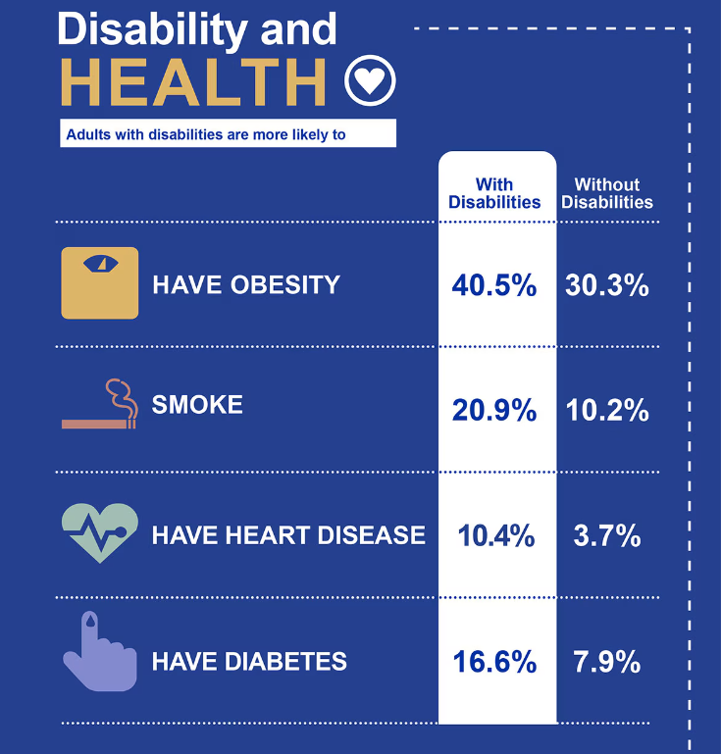
Differences in Health Outcomes: U.S.
Image: CDC (2024)
Notes:
It is well documented that people with disabilities experience worse health outcomes than people without disabilities globally. Some examples according to the CDC is that adults with disabilities are 1.3 times more likely to have obesity, are 2 times more likely to smoke, almost 3 times more likely to have heart disease and 2 times more likely to have diabetes than adults without disabilities

Slide 4
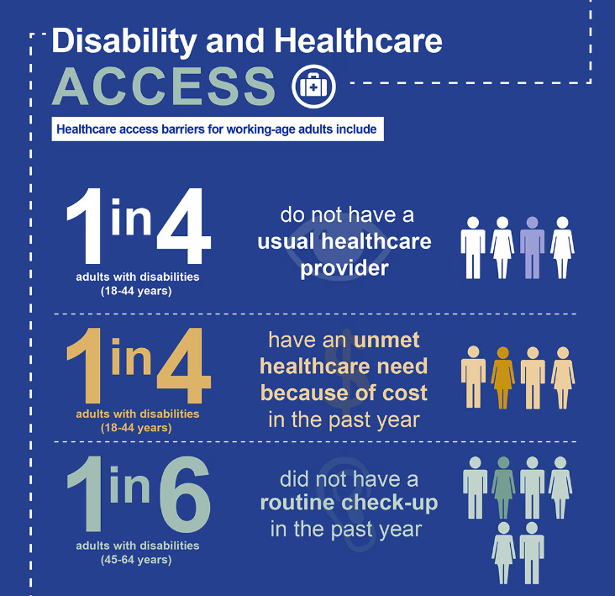
Differences in Healthcare Access
Image: CDC (2024)
Notes:
And these differences in health outcomes usually have nothing to do with the underlying health conditions of the person with a disability but rather due to inadequate access to healthcare and other social determinants of health. For examples, 1 in 4 adults with disabilities across the US do not have a primary care provider and have unmet healthcare needs due to cost and 1 in 6 people with disabilities have not had a routine check up in the past year

Slide 5
Ohio
Notes:
And the story is the same in Ohio

Slide 6
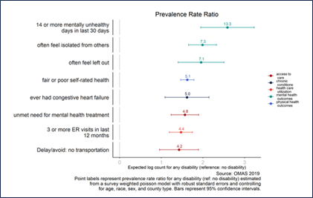
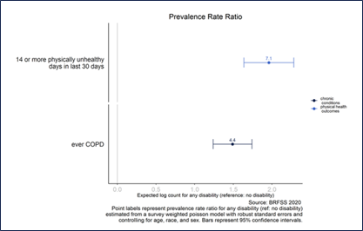
Differences in Health Outcomes: Ohio
Whalen Smith et al. (2022)
Notes:
Specifically, in ohio, our residents with disabilities are faring even worse than national averages. For example, adults with disabilities were 13.3 times more likely than adults without disabilities to report 14 or more mentally unhealthy days in the last 30 days, 7.3 times more likely to report often feeling isolated from others, 7.1 times more likely to report often feeling left out, 7.1 times more likely to report 14 or more physically unhealthy days in the last 30 days, 5.1 times more likely to report fair or poor self-rated health, 5.0 times more likely to report having congestive heart failure, 4.8 times more likely to report an unmet need for mental health treatment, 4.4 times more likely to report having chronic obstructive pulmonary disease, 4.4 times more likely to report having 3 or more emergency room visits in the last year, and 4.2 times more likely to report delaying or avoiding care due to a lack of transportation. And we know that regular participation in physical activity and sports can have a positive impact on all of this physical health and mental health chronic conditions as well as these social health outcomes where Ohioans with disabilities are really struggling.

Slide 7
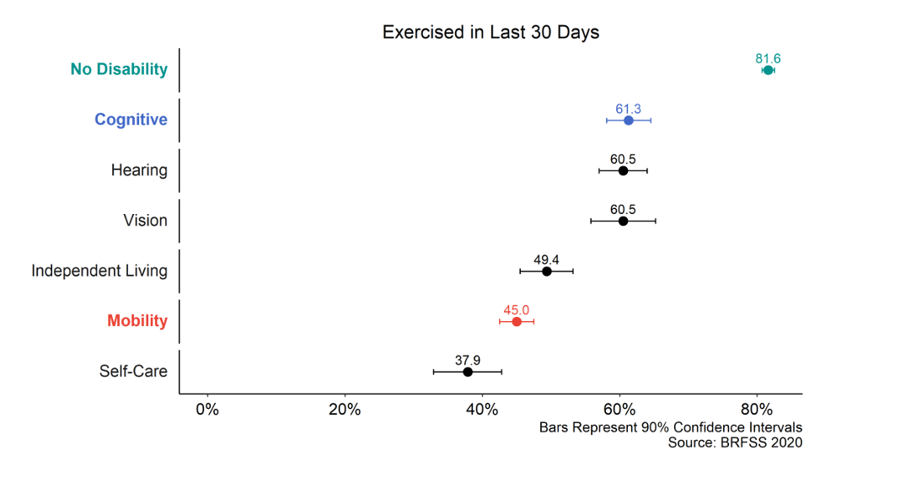
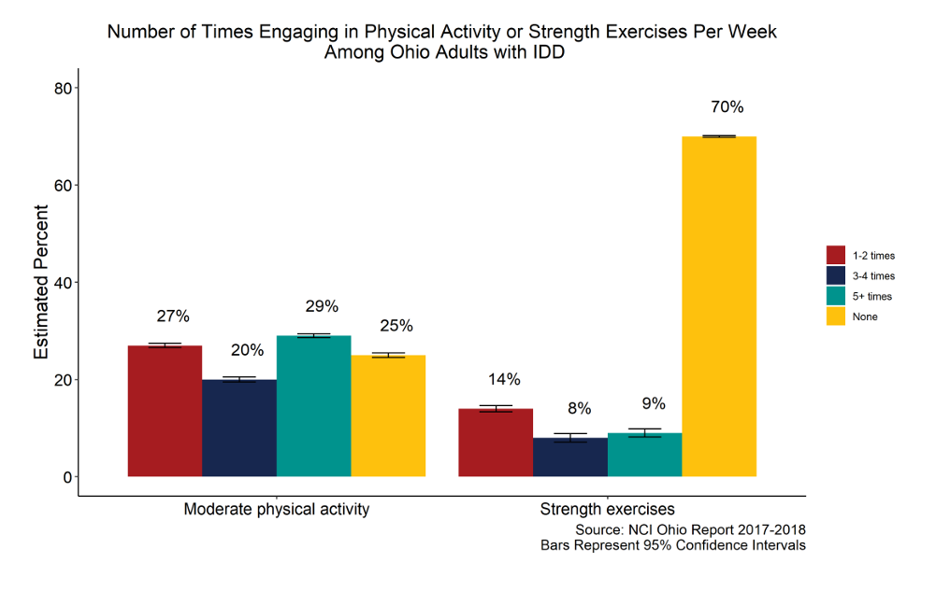
Differences in Physical Activity: Ohio
Whalen Smith et al. (2022)
Notes:
And we also know that Ohioans with disabilities are getting less physical activity than Ohioans without disabilities, largely due to a lack of access and barriers to access as we discussed in the results of our inclusive sports needs assessment. While an estimated 81.6% of adults without disabilities reported having participated in a physical activity or exercise (such as running, calisthenics, golf, gardening, or walking for exercise) during the last month, only 61.3% of adults with cognitive limitations and 45% of adults with mobility limitations reported doing these activities.
For the Ohio adults intellectual and developmental disabilities in particular, regular participation in moderate physical activity is overall very low and a majority never participate in strength exercises.
Also according to the 2020 ohio state health improvement plan, 43.9% of people with disabilities in Ohio report no leisure time spent in physical activity.
We also know that starting physical activity routines at a young age is beneficial for setting up that behavior into adulthood; so there is an opportunity to change these outcomes in adults with disabilities by adding more inclusive physical activity opportunities in children with disabilities to help set them up with healthy lifestyle behaviors across their lifespan.

Slide 8
Ohio School-Age Children: Health
37.5%
0.8%
Notes:
In terms of the data that we have on school age children with disabilities; we find that children with disabilities are 7 times as likely to report being in poor or fair overall health compared to children without disabilities

Slide 9
Ohio Children with Disabilities: Health Status by County
37.5%
7.6%
Notes:
And when looking at children with disabilities by county type, children in rural counties are slightly more likely to report being in fair or poor overall health than children with disabilities in metropolitan counties

Slide 10
Ohio School-Aged Children: Obesity
37.5%
21.7%
Notes:
And furthermore school-aged children with disabilities are more likely to experience obesity than children without disabilities in Ohio

Slide 11
Ohio Children with Disabilities: Obesity by County
33.8%
30.7%
Notes:
And again, children with disabilities in rural and applachian counties are more likely to experience obesity than children with disabilities in metropolitan and suburban counties

Slide 12
These outcomes are preventable!
Major barrier:
  Attitudes and incorrect assumptions about people with disabilities
Solution:
  Presume competence and ability
  Include children with disabilities in school physical activities
Notes:
The good news is that all of these negative health outcomes and lack of access to healthy lifestyle behaviors are all preventable. It is well documented that the greatest barrier that leads to these negative health outcomes and lack of access to physical activity are attitudes and incorrect assumptions about people with disabilities which was also supported in several studies that have been done in Ohio
And some easy first steps to help improve the health and well-being of people with disabilities is to presume that people with disabilities are competent and have the ability to participate with the appropriate supports and accommodations and to find opportunities to include children with disabilities in school physical activities. The rest of this training will seek to provide you with some tools in your tool box on some simple small steps that every school can take to create a more inclusive environment for children with disabilities and expand their access and opportunity to participate in physical activity and sport

Slide 13
References
Centers for Disease Control and Prevention (CDC). Disability Impacts all of Us. Last updated July 3, 2024. Accessed July 23, 2024. https://www.cdc.gov/ncbddd/disabilityandhealth/infographic-disability-impacts-all.html
Whalen Smith CN, Tosun L, Shetterly S, Hackenberg L, Munir A, Randle K, Ellsworth D, Coleman E, Riddle I, Havercamp SM. Ohio Disability and Health Partnership Statewide Needs Assessment of Ohio Adults with Disabilities. Columbus, Ohio: The Ohio Disability and Health Partnership; July 2022. https://go.osu.edu/odhpassessment2022
Ohio Colleges of Medicine Government Resource Center. 2021 OMAS Survey. 2021. Accessed June 1, 2024. https://grc.osu.edu/OMAS/2021Survey

