Slide 1
Ohio Inclusive Sports Project Training Options
Cara Whalen Smith, Brynne Presser Funderburg, and David Ellsworth

Slide 2
Share with Us in the Chat!
What is your profession?
What organization do you represent?
Why are you interested in this webinar?

Slide 3
When you consider the words disability or disabled what images, thoughts, or phrases immediately come to mind?

Slide 4
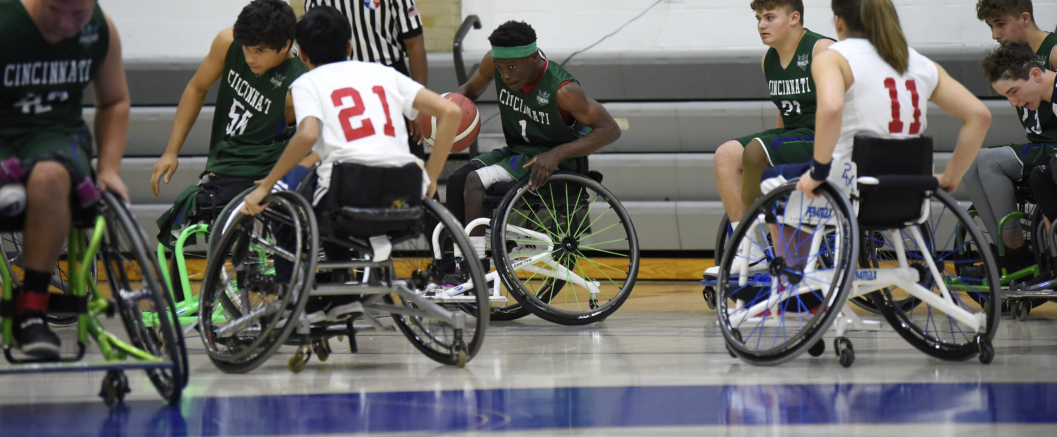
For most, the image is not an athlete
https://cincinnatidragons.com/

Slide 5
Webinar Agenda
Ohio Inclusive Sports Project Overview
Why Inclusion Matters
Needs Assessment Results
Training Development and Pilot in Athens
Description of Training Options
Registration
Questions

Slide 6

Funding Acknowledgements
This project is supported, in part by the Ohio Developmental Disabilities Council, under grant number 23CH01FA23 from the U.S. Administration for Community Living, Department of Health and Human Services, Washington, D.C. 20201. Grantees undertaking projects with government sponsorship are encouraged to express freely their findings and conclusions. Points of view or opinions do not, therefore, necessarily represent official ACL policy.

Slide 7
Inclusive Sports Project Overview

Slide 8
Project Goal
Expand inclusive sports opportunities and promote equitable access to physical activity and recreational opportunities for youth with disabilities in Ohio schools

Slide 9
Project Overview
Year 1: Develop and do a needs assessment​
Year 2: Develop a training and a method to evaluate the training​
Year 3: Test the training in Athens County and make changes to the training based on the evaluation​
Year 4: Deliver final training statewide

Slide 10
Why Inclusion Matters
Inclusion in sports is not just a nice-to-have feature. It is a crucial component that fosters supportive and enriching environments for all participants. As our communities become more diverse, sports programs must reflect this diversity, providing equal opportunities for youth of all backgrounds and abilities.
Key Points:
Youth with disabilities are 4.5 times less active than their peers
Obesity rates are 38% higher among youth with disabilities
The biggest barrier is often simply lack of awareness about how to engage youth with various abilities
Sapp, 2024; Morrissey and Neumann, 2021

Slide 11
Physical Health Benefits
Improved cardiovascular fitness, strength, and endurance
Better control of weight and reduction in obesity risk
Healthier bone density and reduced risk of chronic diseases (diabetes, heart disease)
Enhanced motor skills and physical function
Decreased complications of immobility
Sapp, 2024

Slide 12
Mental and Emotional Health Benefits
Reduction in anxiety and depression symptoms
Improved self-esteem
Increased psychological resilience and emotional well-being
Better emotional regulation and coping mechanisms
Reduced isolation - prevalence of loneliness is 45% for those with disabilities vs. 10% without
RHYTHM Foundation, 2023; DASA 2025; Shao et al., 2025; PCA, 2025

Slide 13

Building Community and Belonging
Social Benefits:
Enhanced social integration and communication skills
Development of meaningful friendships on and off the field
Strong sense of belonging and community connection
Breaking down stereotypes and fostering acceptance
Improved social skills through teamwork and collaboration
Educational and Life Skills:
Better academic performance and cognitive health
Development of leadership skills and resilience
Improved time management and goal-setting abilities
Career skills development and competitive spirit
Improved school/work performance
Sapp, 2024; DASA 2025; Shao et al., 2025; Toktas and Kose, 2023

Slide 14
The Cost of NOT Including
Participation Gaps:
Children with disabilities participate almost one month less annually in sports than peers without disabilities
Only 20.6% to 60.1% of adults with disabilities meet physical activity guidelines (compared to 53.7% to 91.1% without disabilities)
For children ages 11-15 with disabilities, only 8.5% to 40.4% meet physical activity guidelines
Health Equity Issues:
People with disabilities are less likely to meet physical activity guidelines
Higher risk of serious health problems related to inactivity
Increased risk of secondary conditions: obesity, weakness, fatigue, mobility issues
Greater dependency on personal assistance for daily living activities
Solomon, 2025; Martin Ginis et al., 2021

Slide 15
Years 1 and 2 summary

Slide 16
Why did we do a needs assessment?
To better understand current inclusive sport options in schools for Ohio youth with disabilities

Slide 17
How did we collect information?
Surveys for athletes with disabilities, family members of athletes with disabilities, and school professionals
Interviews with experts across Ohio about inclusive and adaptive sports
Listening Sessions with athletes with disabilities and their families about inclusive sports in Ohio
Searched for resources and programs

Slide 18
What did we learn?
Most participants felt that school sports:
  Are not inclusive, welcoming, or accessible
  Do not meaningfully including athletes with disabilities
Most school professionals have not had any inclusive sports training but want it
Most agree that coaches and staff need inclusive sports training
Whalen Smith et al., 2023

Slide 19
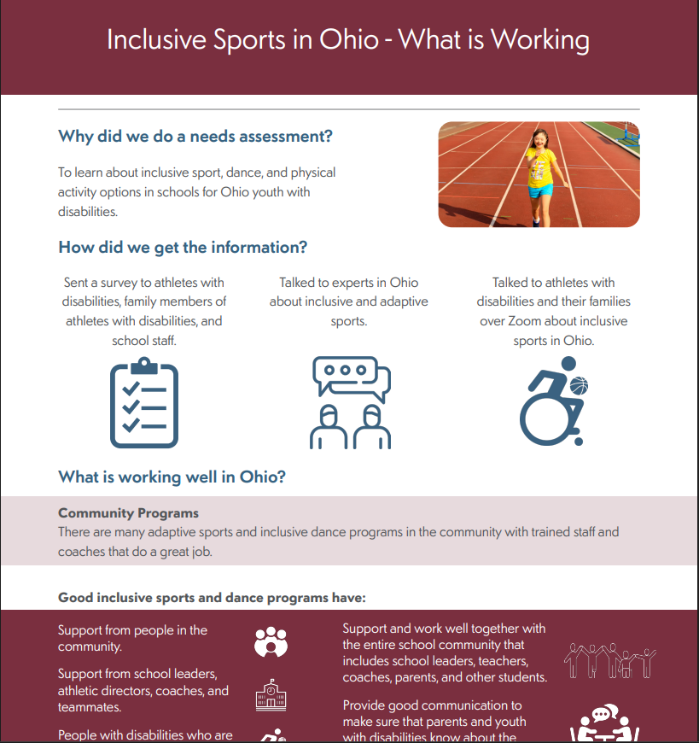
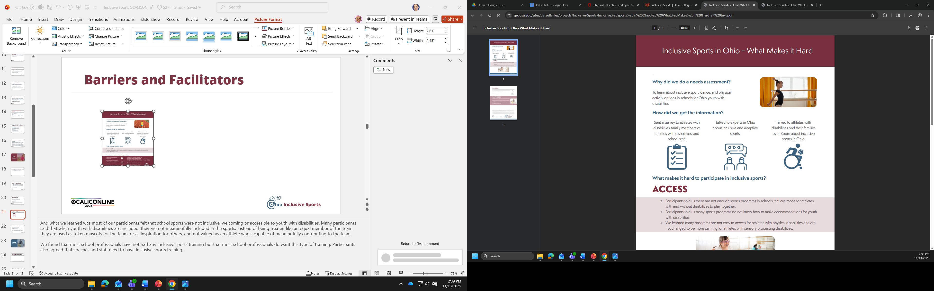
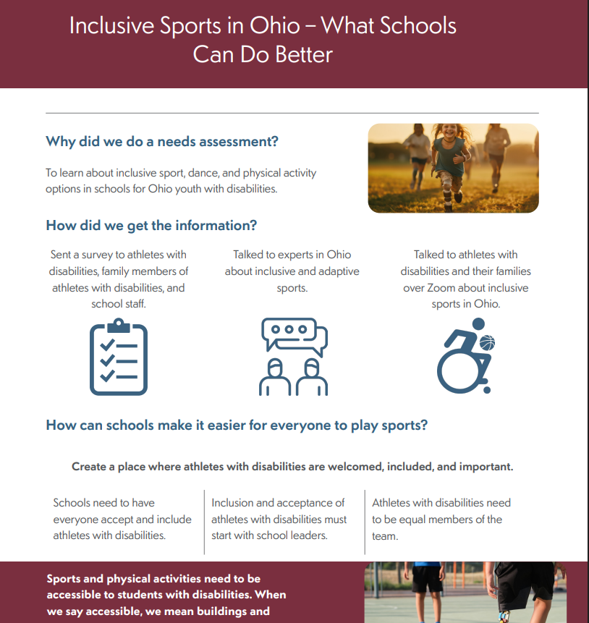
Barriers and Facilitators

Slide 20
What else did we learn?
Lots of opportunities and interest!
Most participants want to create more inclusive sports opportunities in their schools
Lots of resources that people don’t know about
  Opportunity to connect people to resources
Many examples of individual-based sports that are working well
Whalen Smith et al., 2023

Slide 21
Year 3 Pilot Training

Slide 22
Ohio Inclusive Sports Advisory Committee
Members
Process
Adam Ayers
MeMe Earnest-Stanley
Allison Hoit Tubbs
Lindsey Mullis
Morgan Turner
Meredith Erlewine
Needs Assessment
Training Development
Implementation and TA

Slide 23
Training Overview
Inclusive Sports Coaching Training
  8 hour online self-paced free training
In-Person Inclusive Sports Training and Learning Community
  Half-day free in-person training with 2 technical assistance calls

Slide 24
Pilot Program
Piloted trainings in Athens County during Year 3
  Facilitated three webinars in October 2024
  Launched online training in October 2024
  Hosted in-person skills training in Athens County in January 2025
Survey Item | Online Training | In-Person Training
I learned something new from this training. | 8/8 agree | 10/10 agree
I feel more confident working with athletes with disabilities after this training. | 7/8 agree 1/8 neutral | 10/10 agree
Overall, I am satisfied with this introductory training on inclusive sports and plan to expand opportunities for youth with disabilities. | 7/8 agree 1/8 neutral | 10/10 agree

Slide 25
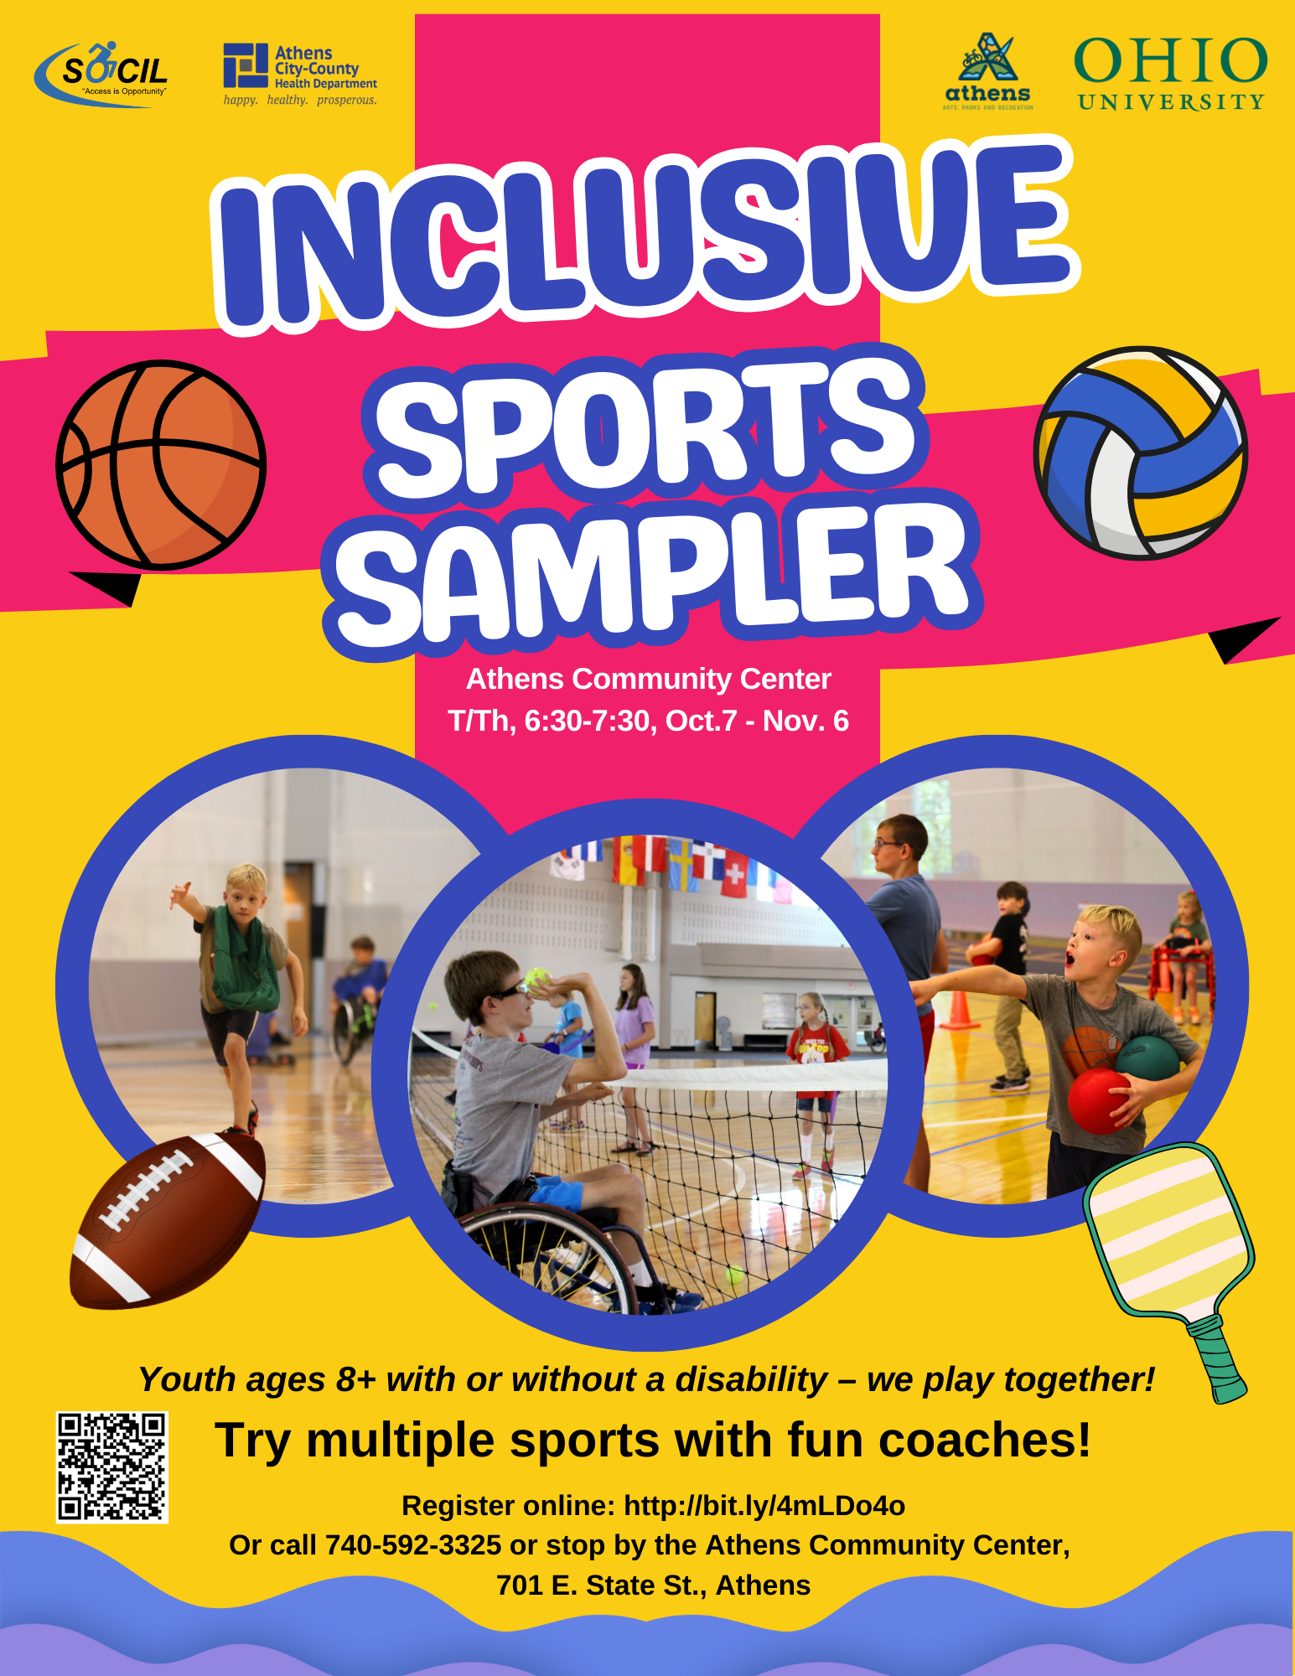
Athens County Inclusive Sports Sampler

Slide 26
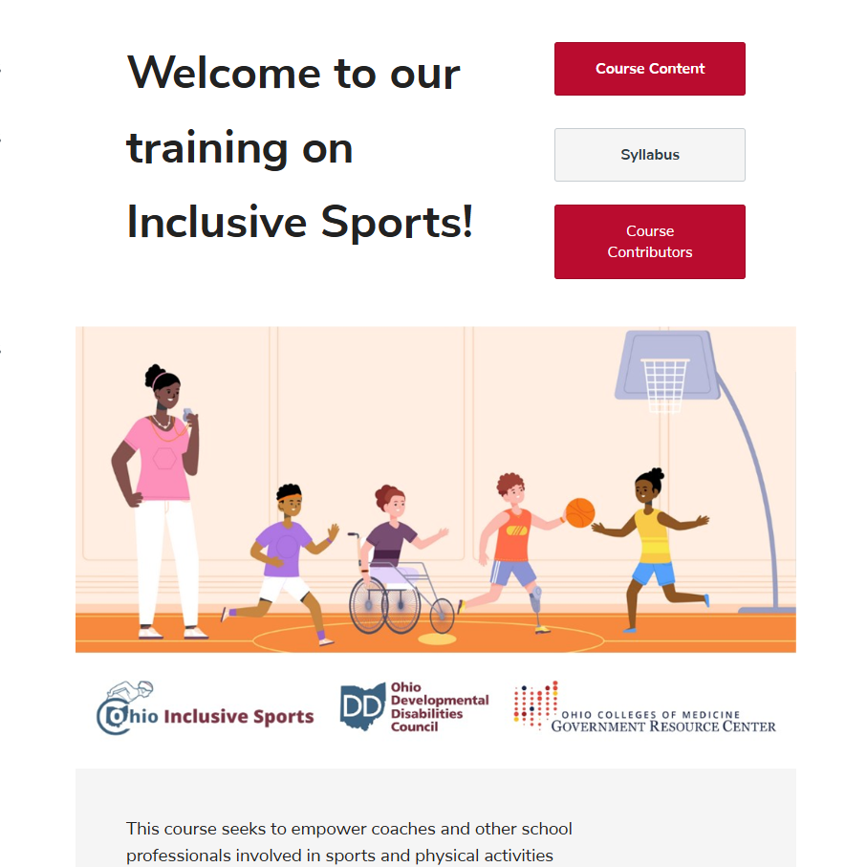
Inclusive Coaching Online Training
When: Enrollment open October 2025 – September 2026
Objective: Equip coaches/staff with the knowledge and skills to include athletes with disabilities in school sports and physical activities
Five topics covered:
  Introduction to Inclusive Sports Coaching
  Adapting Sports for Inclusion
  Communication
  Individualized Planning and Support
  Ongoing Support and Community Building

Slide 27
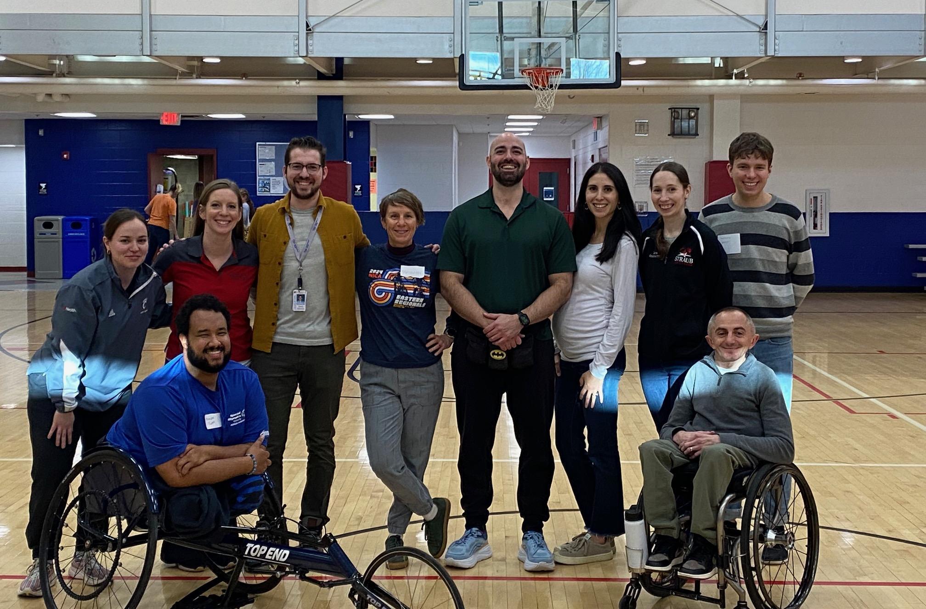
In-Person Inclusive Sports Training
When: February 27, 2026 12:30-4 PM
Where: Columbus, Ohio
Objective: To learn and practice applying universal design principles in inclusive sports coaching
Agenda:
  Equipment Show and Tell
  Universal Design Activity
  Station Rotation & Group Discussion
  Panel Discussion on Inclusive Coaching

Slide 28
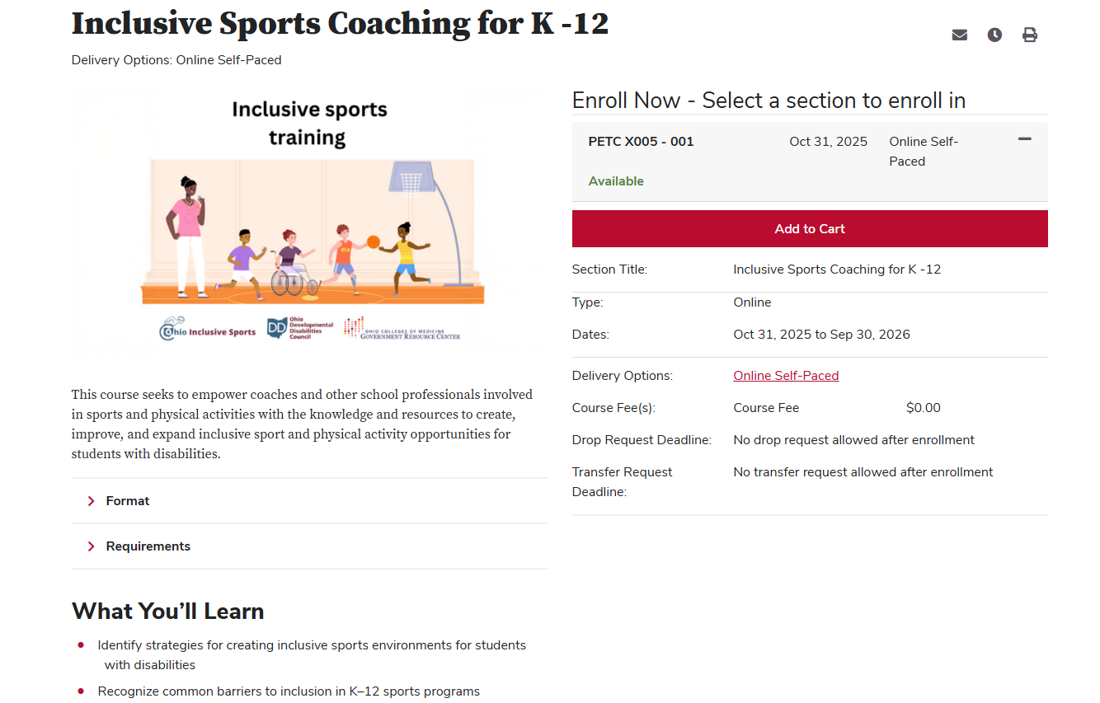
Online Training Demo

Slide 29
Years 3 and 4 next steps

Slide 30
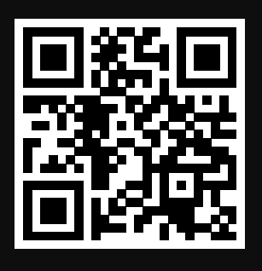
Online Training:
Inclusive Sports Coaching for K - 12
Register at: go.osu.edu/OhioInclusiveSports

Slide 31
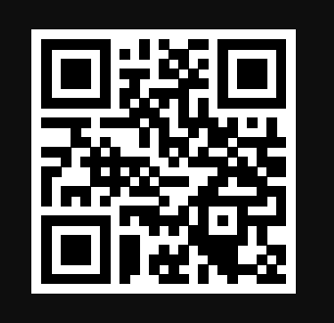
In-Person Skills Training & TA Calls
Complete our skills training interest form: go.osu.edu/SkillsTraining

Slide 32
Community Health Inclusion Index (CHII)
Pronounced "CHEE"
What is the CHII?
A comprehensive assessment tool that helps communities evaluate how inclusive their health and wellness resources are for people with disabilities - going beyond ADA compliance to true inclusion.
Developed by: Center on Health Promotion Research for Persons with Disabilities (University of Illinois at Chicago) & National Center on Health, Physical Activity and Disability (NCHPAD)
What It Assesses:
Five community sectors (schools, workplaces, healthcare, community organizations, parks/trails) across five domains:
Built Environment, Equipment, Programs/Services, Staff Training & Knowledge, Policies & Procedures
Why It Matters:
The CHII identifies specific barriers to participation and provides actionable data to guide improvements, making it the perfect tool for evaluating and enhancing inclusive sports opportunities.

Slide 33
Using CHII to Evaluate Recreation Center Inclusion
Built Environment:
Accessible parking and automatic doors?
Routes throughout facility ≥60" wide?
Accessible restrooms with grab bars?
Clear wayfinding signage?
Equipment:
Adaptive equipment (recumbent bike, arm ergometer)?
Roll-in access to strength equipment?
Front desk ≤34 inches high?
Pool lift or transfer system?
Programs/Services:
Inclusive sports/recreation programs offered?
Accommodations available upon request?
Promotional materials show people with disabilities?
Accessible registration (online and phone)?

Slide 34
Beyond Physical Access - Evaluating Inclusion Culture
Staff Training:
Disability etiquette and communication?
Adaptive equipment use?
Accommodations requirements?
Designated accessibility coordinator?
Policies:
Written accommodation policy?
Service animal policy posted?
Flexible membership options?
Community input includes people with disabilities?
From Assessment to Action: ​
CHII results prioritize improvements: staff training → adaptive equipment → facility renovations. Data-driven roadmap for truly inclusive recreation spaces.

Slide 35
Getting Started with the CHII
Key Resources:
NCHPAD Website: nchpad.org
CHII Dashboard: inclusion.nchpad.org
Assessment Tools: Available for download with manual and instructions
Training: Available through NCHPAD
Call to Action:
Community Coalitions: Consider incorporating CHII into community health assessments
CHC Programs: Integrate disability inclusion assessment into active living work
Schools: Use CHII to evaluate athletic facilities and recreation programs
Advocates: Use CHII data to support inclusion initiatives
Contact for Ohio Support:
Ohio Disability and Health Partnership (ODHP)
National Center on Health, Physical Activity and Disability (NCHPAD)

Slide 36
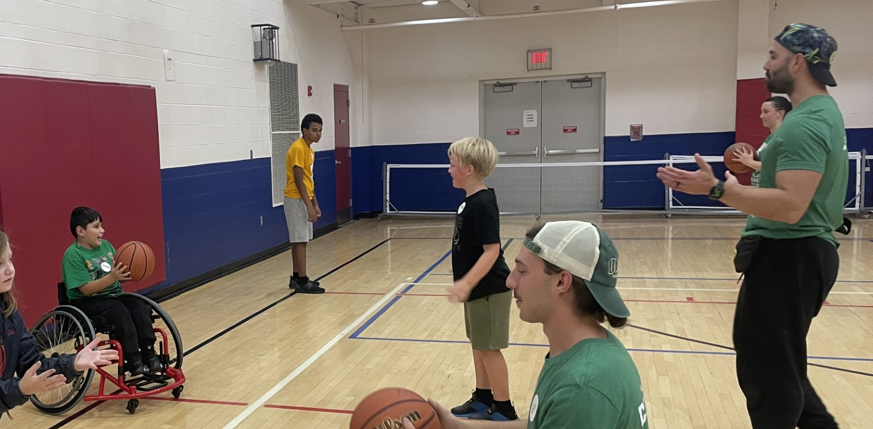
Disability = valued teammate
Athens County Inclusive Sports Sampler

Slide 37
Q&A

