Slide 1
Disability 101
Introduction to Disability
Notes:
Hi I am Cara Whalen Smith and before we dive into inclusive sports content, we first want to level set on some general disability topics so that you can understand this population better. And we will first begin with a general introduction to disability.

Slide 2
Definitions
Notes:
So let's first start with some definitions.

Slide 3
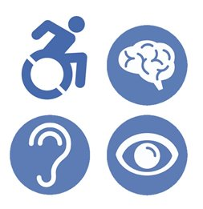
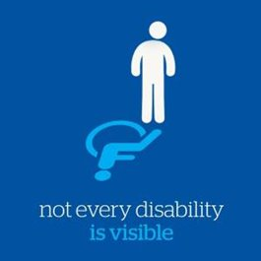
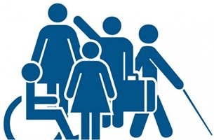
What is Disability?
According to the World Health Organization (WHO), a disability is any cognitive or physical impairment, activity limitation, and/or participation restriction
Disability is the interaction between an individual's health condition and personal and environmental factors
WHO (2011); WHO (2001)
Notes:
Now, what do we mean when we say disability in this training? To define disability, we will use the widely accepted World Health Organization definition, which defines disability as an umbrella term to describe any cognitive or physical impairment (which means any problem in a body function or structure that affect a person’s ability to engage independently in aspects of day-to-day life), an activity limitation (which means difficulties an individual may have in executing activities) and or a participation restriction (which means difficulties an individual may have in involvement in life situations).​
​
And this definition takes into account the interaction between the individuals health condition and personal and environmental factors, which make up the physical, social, and attitudinal environment in which people live. So for example, for an individual with a certain impairment, depending on their personal and environmental factors, they may not be considered as having disability.​
​
And it is also important to recognize that not every disability is visible, many types of disabilities are considered to be invisible.
On this slide are three images. The first image is a group of stick figure people with one person in a wheelchair, a few people standing with one holding a brief case, and one person who is using a long cane. And this image represents the diversity of the disability community and the middle image points out that not every disability is visible with another stick figure drawing with a shadow casted from the person showing the more recognizable symbol of disability to most lay people which is the accessible parking symbol of a person in a wheelchair, and the final image is a group of icons that denote four common functional disability types denoting mobility disability, intellectual or cognitive disability, and sensory disabilities denoting those who are hard of hearing or Deaf or blind or who have low vision.

Slide 4
ADA Definition
The Americans with Disabilities Act (ADA) states a “person with a disability is someone who:
  has a physical or mental impairment that substantially limits one or more major life activities,
  has a history or record of such an impairment (such as cancer that is in remission), or
  is perceived by others as having such an impairment (such as a person who has scars from a severe burn).”
ADA 1990
Notes:
I'd also like to highlight the definition of disability under the Americans with disabilities act, which defines disability as a physical or mental impairment that substantially limits one or more major life activities, has documentation of an impairment, or is perceived by others as having such an impairment.
According to the ADA, The term “substantially limits” is interpreted broadly and is not meant to be a demanding standard. But not every condition will meet this standard. An example of a condition that is not substantially limiting is a mild allergy to pollen.
In terms of major life activities, Major life activities are the kind of activities that you do every day, including your body’s own internal processes. There are many major life activities. Some examples include:
Actions like eating, sleeping, speaking, and breathing
Movements like walking, standing, lifting, and bending
Cognitive functions like thinking and concentrating
Sensory functions like seeing and hearing
Tasks like working, reading, learning, and communicating and
The operation of major bodily functions like circulation, reproduction, and individual organs
Citation: https://www.ada.gov/topics/intro-to-ada/

Slide 5
IDEA Definition
The Individuals with Disabilities Education Act (IDEA) states that in general the “term ‘child with a disability’ means a child –
  (i) with intellectual disabilities, hearing impairments (including deafness), speech or language impairments, visual impairments (including blindness), serious emotional disturbance, orthopedic impairments, autism, traumatic brain injury, other health impairments, or specific learning disabilities; and
  (ii) who, by reason thereof, needs special education and related services.”
US Department of Education, 2019
Notes:
In terms of definitions within the education system, I also want to highlight that the individuals with disabilities education act states that a child with a disability includes a child with intellectual disabilities, hearing impairments, speech or language impairments, visual impairments, serious emotional disturbance, orthopedic impairments, autism, traumatic brain injury, and other health impairments or specific learning disabilities and who need special education and related services
Citation: https://sites.ed.gov/idea/statute-chapter-33/subchapter-i/1401
(B) Child aged 3 through 9
The term “child with a disability” for a child aged 3 through 9 (or any subset of that age range, including ages 3 through 5), may, at the discretion of the State and the local educational agency, include a child—
(i) experiencing developmental delays, as defined by the State and as measured by appropriate diagnostic instruments and procedures, in 1 or more of the following areas: physical development; cognitive development; communication development; social or emotional development; or adaptive development; and
(ii) who, by reason thereof, needs special education and related services.

Slide 6
Prevalence
Notes:
Now let's look at the overall size of this population

Slide 7
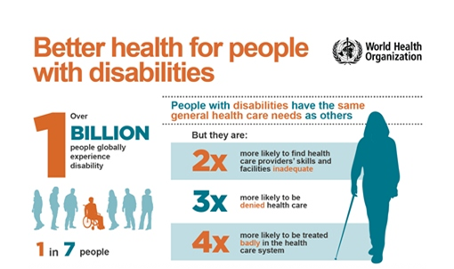
Prevalence of Disability Globally
WHO (2022)
Notes:
In terms of global prevalence, more than 1 billion people or about 15% of world population has a disability. To put that into perspective, if all the people with disabilities in the world formed a country, they would be the third largest country in the world behind China and India.
Of note in terms of the distribution of the global prevalence, low income countries have a higher prevalence of people with disabilities and globally. In fact, eight percent of the 1 billion people with disabilities lives in the global south.
Also, disability is more common in women, older adults, and those in poverty.
Also, people with disabilities have the same general healthcare needs as people without disabilities as people without disabilities but are more likely to find health care provider skills and facilities inadequate, more likely to be denied care, and more likely to be treated poorly within the healthcare system globally. Persons with disabilities encounter significant barriers to participation in society, including accessing development programs and funds, education, employment, health care, communication, and transportation services.

Slide 8
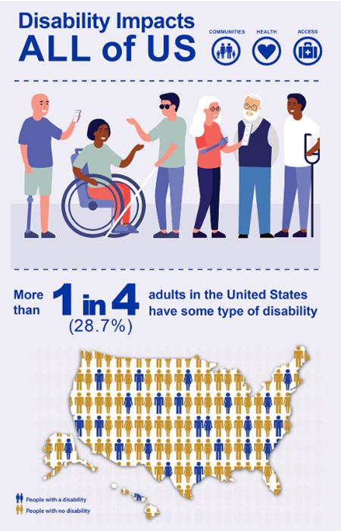
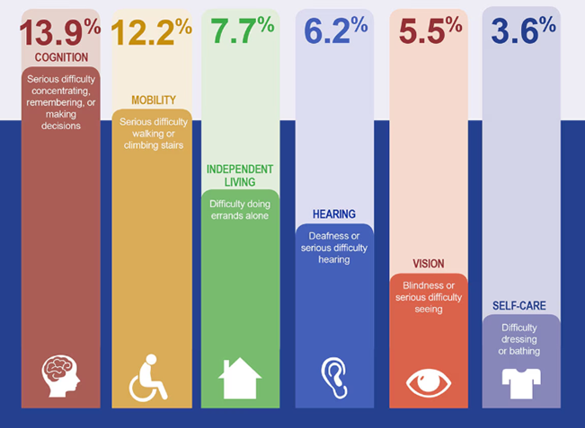
Prevalence of Disability Nationally
Images: CDC (2024)
Notes:
Here in the United States, more than 1 in 4 adults or nearly 29% of adults have a disability making them the largest unrecognized minority population in the US. In terms of the functional disability types from the six-item minimum data set to measure disability that in the US the top 2 most prevalent types of functional disabilities among those nearly 29% of adults with disabilities are in cognition and mobility.
In terms of the geographic distribution of disability in the US, there is a higher prevalence of people with disabilities in our southern states.

Slide 9
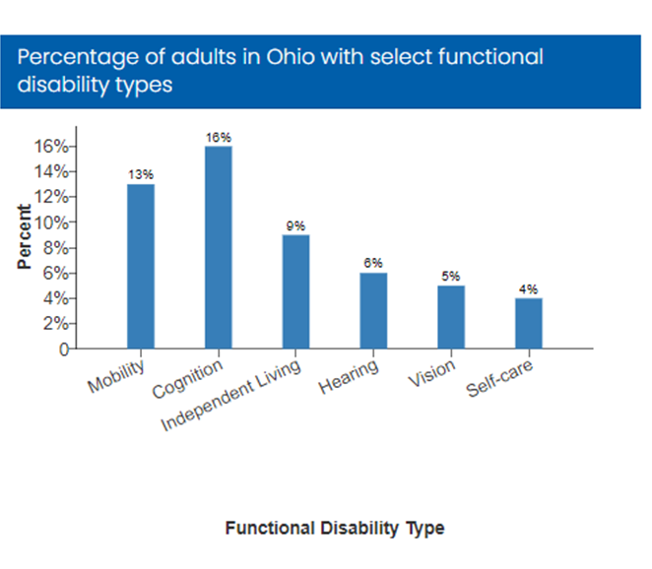
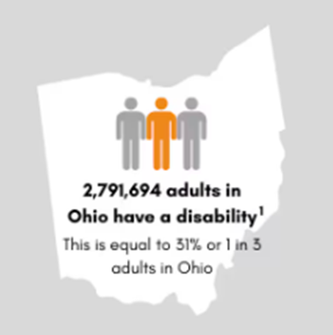
Prevalence of Disability in Ohio
Images: CDC (2024)
Notes:
Here in Ohio, we have a higher prevalence of the disability community living in our state than the national level with more than 31% of Ohio adults with a disability and some other population surveys estimating that there are around 34% of Ohio adults with a disability which is around 1 and 3 adults or between 2.7 and 3 million Ohio adults alone.

Slide 10
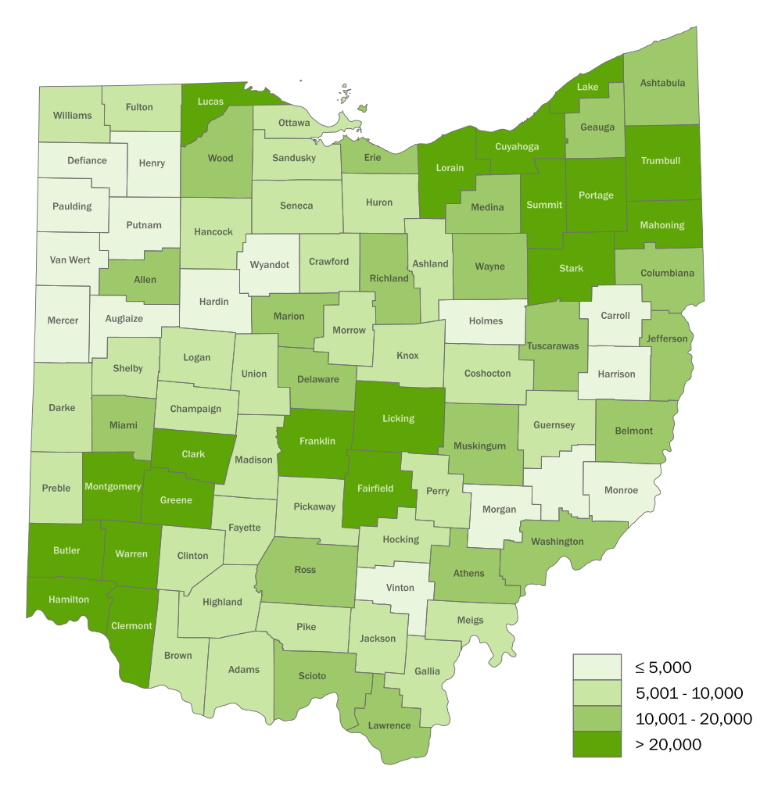
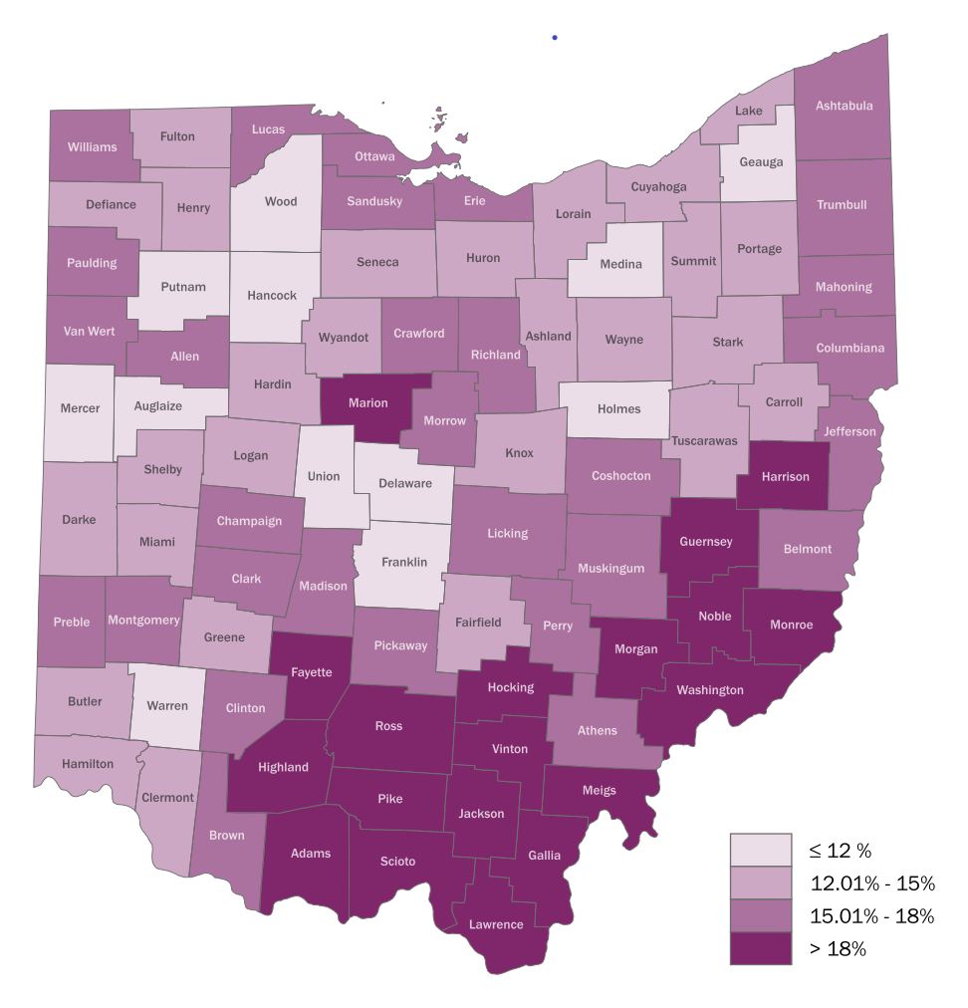
Prevalence of Disability in Ohio by County
Count by County
Proportion by County
Notes:
And looking at disability prevalence by county, in terms of raw numbers, there are more people with disabilities in our major urban areas of the state like the Columbus, Cincinnati, Dayton, Cleveland, Akron, and toledo areas. But in terms of the relative proportion of disability to total residents in that county, disability is much more prevalent in our rural Appalachian counties in southeast Ohio; where there are also more health professional shortage areas.
When speaking about global, national, and state level prevalence of disability, I want you to understand that all these estimates severely underestimate the true prevalence of disability because of problems in measurement and do not account for short-term disability and often only include adults.

Slide 11
Prevalence of Children with a Disability in Ohio
44.5%
37.5%
18.0%
Notes:
When looking at the estimated number of children with a disability in Ohio, about 29.1% of children ages 0-17 have a disability which is over 591,000 ohio children. Among those children, 18% of children with disabilities are aged 0 to 5 years, 37.5% are aged 6 to 11 years, and 44.5% are aged 12 to 17 years. And when looking just at school aged children, about 37% of school aged children between the ages of 6 to 17 years have a disability; which is a little over 485,000 ohio children, and over a quarter of a million specifically in high school
https://grcapps.osu.edu/app/omas
Disability size by group
0-5: 106,324
6-11: 221,918
12-17: 263,119
TOTAL: 591,361; 485,037 (school age)
Nondisabled size by age group
0-5: 720828
6-11: 640863
12-17: 668974
TOTAL: 2,030,665; 1,309.937

Slide 12
Common Disability Classifications
Physical/Mobility
Intellectual
Developmental
Mental/Behavioral Health
Sensory
Notes:
So from our first definition, disability is a global umbrella term that represents a variety of different conditions. And as such the disability community is a very diverse group in terms of disability types, age, gender, race, ethnicity, and socioeconomic status. We know that disability occurs across the lifespan. Disability can occur from birth or be acquired at any point during a person’s lifetime. It can also be a temporary condition, such as after an injury or can be a chronic long-term condition. And it is likely that we will all experience disability at some point in our lives or know someone with a disability. And it is very likely that you have students with disabilities or your students have family members with disabilities who are engaging in sports
There are many types of disabilities that can affect vision, movement, thinking, remembering, learning, communicating, hearing, mental health, and social relationships.
There are many different ways that disability is reported and discussed. So you can either look at the disability community as a whole or by different categories or classifications. And the most common that you will see discussed are listed here on this slide in no particular order. So first there are physical or mobility disabilities. Some examples here would include someone with paralysis, so quadriplegia, paraplegia, diplegia, or hemiplegia, which could be from a spinal cord injury, or stroke, or spina bifida, or cerebral palsy; other examples could be amputation, or just general balance and mobility limitations.
Other classifications include intellectual and developmental disabilities
There are also mental health or behavioral health disabilities;
And finally sensory disabilities which include blindness or visual impairment and deafness or hearing impairment
None of these categories are mutually exclusive; so an individual could fit in one or all of these categories or any combination.
another common way to group different subsets of disability to group by functional disability or functional impairment types which include mobility, cognition, independent living, hearing, vision, and self-care.
For IDD definition in Ohio: --https://education.ohio.gov/Topics/Special-Education/Disability-Specific-Resources/Intellectual-Disability

Slide 13
Reflection
When you hear or see the words disability or disabled, what words or phrases immediately come to your mind?
Notes:
So before moving on, let's pause here and reflect. When you hear or see the words disability or disabled, what words or phrases immediately come to your mind?
There is a link to an assignment in this portion of module 1 where you can enter those words or phrases that immediately come to your mind. Then as you are going through the conceptual models of disability keep those words in mind to see if you can identify which model of disability you have been using when thinking about disability.

Slide 14
References
World Health Organization (WHO) & the World Bank. World Report on Disability. Published 2011. Accessed December 23, 2020. http://www.who.int/disabilities/world_report/2011/en
World Health Organization (WHO). International Classification of Functioning, Disability and Health (ICF). Published Geneva: 2001. Accessed December 23, 2020. https://www.who.int/classifications/international-classification-of-functioning-disability-and-health
Americans With Disabilities Act of 1990, Pub. L. No. 101-336, 104 Stat. 328 (1990).
US Department of Education. IDEA: Individuals with Disabilities Education Act Section 1401 Definitions. Last modified 2019. Accessed July 30, 2024. https://sites.ed.gov/idea/statute-chapter-33/subchapter-i/1401
Notes:
So before moving on, let's pause here and reflect. When you hear or see the words disability or disabled, what words or phrases immeditately come to your mind?
There is a link to an assignment in this portion of module 1 where you can enter those words or phrases that immediately come to your mind. Then as you are going through the conceptual models of disability keep those words in mind to see if you can identify which model of disability you have been using when thinking about disability.

Slide 15
References Continued
World Health Organization. Global Report on Health Equity for Persons with Disabilities. Geneva: World Health Organization; 2022. License: CC BY-NC-SA 3.0 IGO.
Centers for Disease Control and Prevention (CDC). Disability Impacts all of Us. Last updated July 3, 2024. Accessed July 23, 2024. https://www.cdc.gov/ncbddd/disabilityandhealth/infographic-disability-impacts-all.html
Whalen Smith CN, Tosun L, Shetterly S, Hackenberg L, Munir A, Randle K, Ellsworth D, Coleman E, Riddle I, Havercamp SM. Ohio Disability and Health Partnership Statewide Needs Assessment of Ohio Adults with Disabilities. Columbus, Ohio: The Ohio Disability and Health Partnership; July 2022. https://go.osu.edu/odhpassessment2022
Ohio Colleges of Medicine Government Resource Center. 2021 OMAS Survey. 2021. Accessed June 1, 2024. https://grc.osu.edu/OMAS/2021Survey

