Slide 1
Disability 101
Models of Disability
Notes:
Hi this is Cara Whalen Smith and Now that we have a better sense of the disability community and the diversity of disability that exists in our world, we will go through a few different conceptual models of disability that describe how people have historically conceptualized or understood disability. It is important to understand these different models of disability, because they have directly impacted how people with disabilities are viewed in the world.

Slide 2
Early Models of Disability
Notes:
We will first begin with one of the earliest models of disability

Slide 3
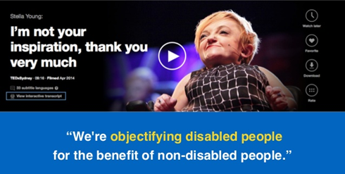
Charity Model
Encourages charitable support towards people with disabilities
Does not focus on the rights or capabilities of people with disabilities
Stella Young TED Talk
Notes:
So one of the earliest models of disability globally in which people first understood disability is the charity model of disability. And for the general public, this is often the way the most people view disability today without really realizing it. According to this model, a person has a disability, and that disability is a problem in their body or mind, and quote unquote good citizens without disabilities should feel pity for people with disabilities because disability is a tragedy or something to overcome or if people without disabilities don't feel pity then they should be inspired by the achievements of people with disabilities. It is important to note that in this model people do not really focus on the rights of people with disabilities or on their capabilities. For example, a program that donates clothes or other goods to a person with a disability but that does not try to support that person in finding a job or being financially independent would be defined as a charitable approach. Also a very common way people without disabilities reflect this model of disability is through viewing people with disabilities as being objects of inspiration. This concept was illustrated the TED talk by Stella Young which is linked to on this slide, where she speaks to this concept of people without disabilities objectifying people with disabilities for their own benefit.
And when we stop to think through how the media has portrayed disability over the past century it is not surprising that many people hold these kind of charitable views and sometimes negative opinions or assumptions about disability.

Slide 4
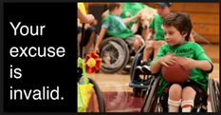
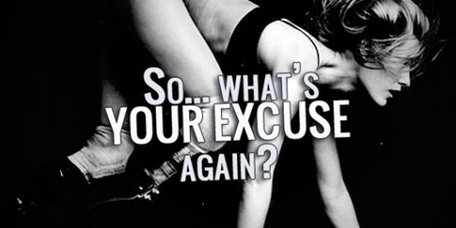
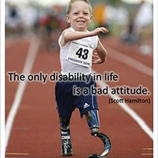
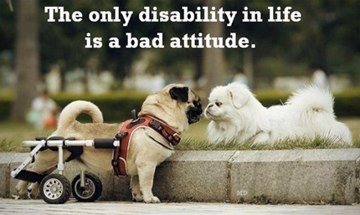
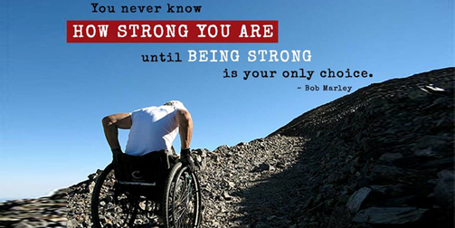
Media Representations of Disability: The "Inspiration" or "Super Human"
Notes:
The first example of this is that you will find many images and stories about disability that fit into the trope that people with disabilities are inspirational or superhuman for doing pretty ordinary things. And the captions are often aimed at people without disabilities to make them motivated or inspired to get through challenges in their own life because the implication is at least you don’t have a disability. Which is obviously a problematic way to view disability. At a talk I was in the past a disability self-advocate illustrated this nicely through suggesting putting together a media bingo card with spaces that contain phrases like “they didn't let their disability stop them!" , "confined to a wheelchair" , "if you saw them doing (insert whatever activity) you'd never know they were disabled", "defying the odds" "courageous battle" "proving you can achieve anything if you really try.," etc. If you watch a news story about disability in your local community, you'd probably get a bingo pretty fast looking for phrases that imply people with disabilities are objects of inspiration or super humans. And on this slide are several images of people with or animals with visible disabilities with phrases like your excuse is invalid, the only disability in life is a bad attitude, so what's your excuse again. And you never know how strong you are until being strong is your only choice. And all the intended messages here are aimed at people without disabilities to be inspired by people with disabilities who are doing things like playing basketball, or running track, or enjoying nature with the implicit message that these are not spaces where people with disabilities should be and these people are inspirational because they've overcome their disability and have become super human to do these typically ordinary things.
I do want to be clear that it is absolutely fine to be inspired by the actual achievements of people with disabilities just as you can be inspired by actual achievements of anyone. But there is definitely a strong argument to be made that there is a difference in how the achievements of people with disabilities are portrayed in the media that carries the implication that disability is an inherently negative thing that is to be overcome. I challenge you to watch commercial about how the media portray athletes without disabilities versus athletes with disabilities at the olympics and I suspect you will see more of this inspiration or super human narrative among the ads for the paralympics. With the big difference being that we have set the assumptions and expectation bar so low for what we as a society think that people with disabilities can do, that it appears to be superhuman when these athletes are participating in the same sports as people without disabilities.

Slide 5
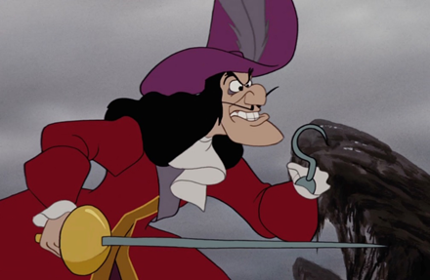
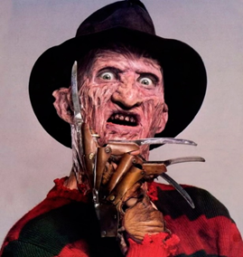

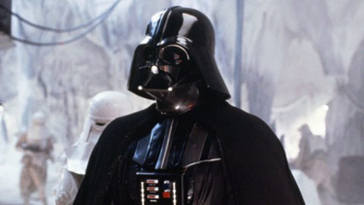
Media Representations of Disability: "The Villain"
Notes:
A second media trope you will often see is that if disability shows up in a movie, they are often villains, who have an amputation or some sort of physical impairments or disfiguration. So on this slide are villians like freddy kruger who has scarring on his face and a prosteteic hand, captain hook who also uses a prostethic hand, darth vader who has a quadruable amputation and uses a machine to assist with breathing, and a pirate who wears an eye patch from pirates of the carribean. And the implicit association here when people with disabilities are portrayed as villians is that people with disabilities are to be feared or ugly or are not natural, when in fact disability is a very ordinary and normal part of the spectrum of diversity of human life.

Slide 6
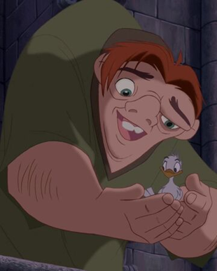
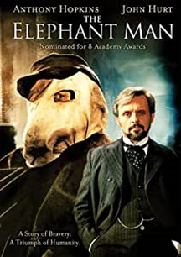
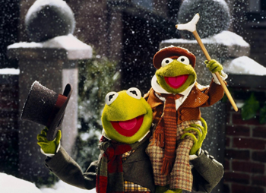
Media Representations of Disability: "The Victim"
Notes:
Another common trope is that if there is a person with a disability in a story who is not the villain then they are the one dimensional victim who we should pity, so like Tiny Tim in Charles dickens a christmas carol for example or the hunchback of notre dame.
So these examples are all ways that contribute to the still pervasive charity model of disability in society at large, and until the way people with disabilities are portrayed in the media changes, these implicit attitudes will continue to be common. And if you reflect that the only way that people with disabilities stories are being told is through narratives that they are some sort of tragic figure or some sort of super hero are not really accurate nuanced portrayals and certainly influence how people without disabilities interact with or don't interact with people with disabilities.

Slide 7
Contemporary Models of Disability

Slide 8
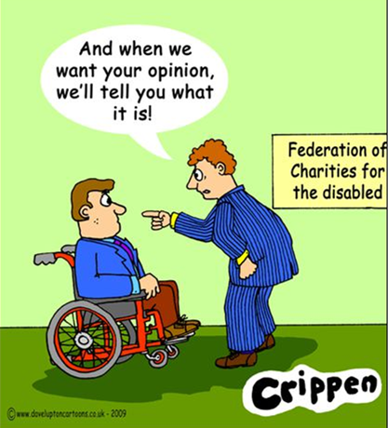
Medical Model of Disability
Disability is a result of a person’s physical impairments and seeks to find a cure for those impairments even when they do not cause pain or illness
Notes:
The next model of disability that emerged is the medical model which looks at what is “wrong” with the person and seeks to provide treatment. The primary concern with this approach is that people with the same impairment may have very different experiences as to how this impacts their lives. For example, imagine having a long-term ankle injury; this may cause an athlete to retire from a lucrative career, but in contrast someone with a desk job they may not experience as big of an impact on their livelihood if they fail to recover from the injury. The medical model therefore does not recognize the role of the environment or external factors in defining disability. So in this model health professionals see disabilities as a problem with someone’s body or mind that needs to be fixed and health professionals are the only hope for a cure or normality. And importantly these concepts of overcoming and normality are the goals of the model. Disability is purely viewed as a negative health outcome that needs to be fixed. Thus, providers who hold a strictly medical model of disability may have attitudes which limits a person’s potential to achieve their highest level of functioning and quality of life. This is the dominant view of looking at disability in the health professions and unfortunately some people with disabilities may be getting the message from their providers that there is something wrong with their body or mind that needs to be fixed, and so there is a great opportunity for school-based coaches to have higher expectations of students with disabilities and to help flip any negative internal narratives about their value as a person and value as being a part of a team.

Slide 9
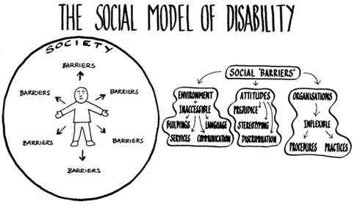
Social Model of Disability
Disability is a result of the way society is organized rather than by a person’s impairment and seeks to remove barriers that restrict quality of life
Notes:
So the Social model of disability was developed as a direct response to the medical model in the 1970s.
This way of thinking views disability as being due to society’s failure to respond to the needs of people with impairments and health conditions. The social model looks at ways of removing barriers that restrict life choices for PWDs. In the social model, disability is only a social construct that we make up and is dependent on the environment they are in; meaning you may have a disability in one environment but not in another.
For example if basketball players in the NBA were considered to be the average “normal” size of a human being, the universal design for buildings, cars, and homes would be much different and people who are currently not considered to be disabled in our current society would become disabled in this society because most people would not be able to reach door handles to get in and out of rooms without assistive devices, they would not be able to reach the steering wheel of a car, etc. The social model says that the way a room or environment is created makes a person disabled; the problem is with the room not the person. However, The criticism of this model is it only has a focus on societal barriers, the model does not give enough attention to the role of the individual’s impairment in their disability. For instance, being in constant pain from a health condition will limit a person’s quality of life even if society is fully inclusive, so you still need the medical model to an extent to address a person’s impairments that cause limitations in their independence and quality of life.
As a coach, think about all the barriers that have nothing to do with disability that would disable someone from being able to participate in sports. Things like is your practice area wheelchair accessible? Do people in the school hold such low expectations of people with disabilities from a charity model view of disability that students with disabilities don't even receive invitations to try out for sports teams or calls for open practices?

Slide 10
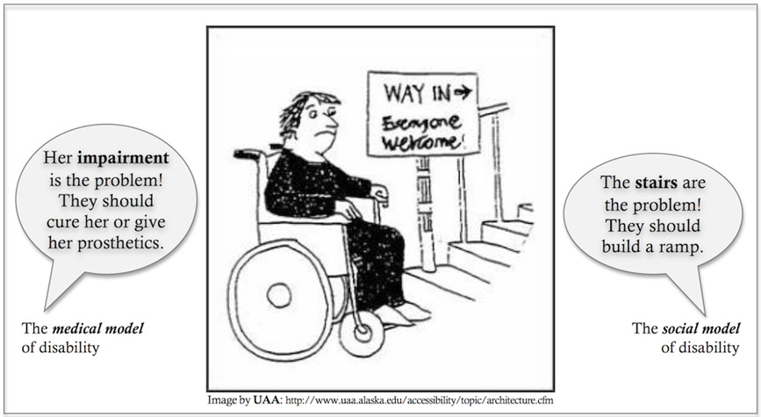
Medical Model vs Social Model
Notes:
This is a nice graphic which compares and contrasts the different viewpoints of the medical and social models of disability. On this slide is an image of a person in a wheelchair in front of a staircase with a sign that says way in with an arrow pointing up the stairs and everyone welcome. In this example the medical model would focus is on the individuals impairments as being the problem in not being able to climb the stairs and would look for interventions or devices to help that person climb the stairs; whereas the social model says the problem is the environment that is causing the disability, not the person’s impairments and that society should be designed in a way that is universally accessible to people of all abilities, and in this case there should be a ramp for the individual to get into the building.

Slide 11
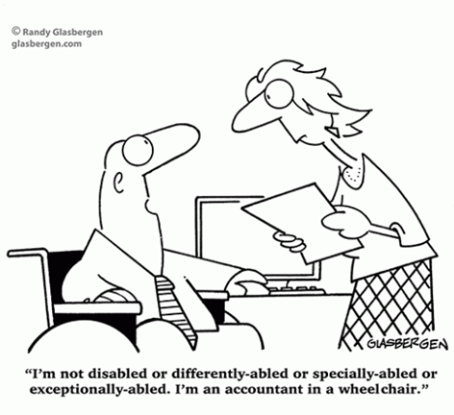
Human Rights Model of Disability
“Nothing about us without us” is the core of this model
Calls for full inclusion of people with disabilities as a human right
Notes:
Another model that has evolved beyond the medical and social models is the human rights model of disability where the focus of the discussion has moved beyond the removal of barriers as the social model would suggest and argues that full participation in all aspects of life is a human right that can and should be claimed by everyone. The United Nations Convention on the Rights of Persons with Disabilities from 2006 , reinforces this framework. This model calls for the full inclusion of PWDs and for them to take control over their own fate with the motto of “nothing about us without us.” Meaning people with disabilities need an equal seat at the table where decisions are being made that directly impact their lives. This model says that disability is an ordinary condition of all human beings. It is likely that we will all experience disability at some point. Disability is an important dimension of human culture and is not a health problem. Many disability self-advocacy groups use this model and reject certain treatments from medical professionals which attempt to alter their behaviors or to quote unquote fix them to fit in with typical society. And many within the disability community prefer identity first language rather than person first language. For example many in the deaf community prefer to be called a deaf person rather than a person who is deaf and many adults with autism prefer to be called autistic. To many in the disability community disability is a cultural identity and as an example in the deaf community they would reject any attempt at trying to heal them or improve their hearing. So it is important to recognize here that while some people with disabilities want cures or treatments for their condition many don't and that all disability experiences are valid and all people should have access to all our basic human rights. So key to this model in the application of an inclusive sports program is the idea of nothing about us without us; if you are developing an inclusive sports program you should connect with athletes with disabilities and their families on what that should look like and partner with local disability advocacy groups to help with the planning and implementation of such a program.

Slide 12
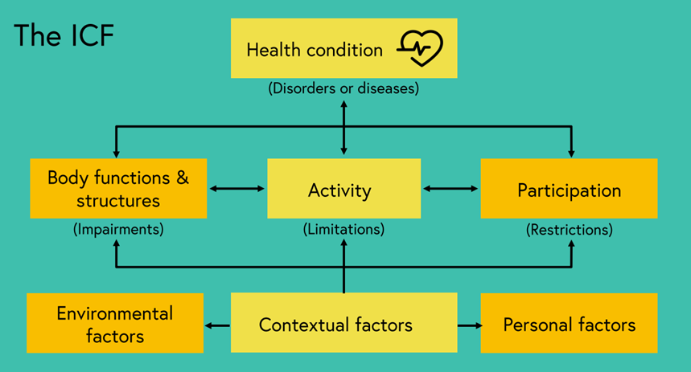
Biopsychosocial Model: International Classification of Functioning, Disability, and Health (ICF) Model of Disability
Notes:
Finally, another widely accepted model globally to view disability today is the ICF model which is also known as the biopsychosocial model, from the World Health Organization, which puts all of the ideas of the medical, social, and human rights models together in one model.
This model is the basis for the way we defined the umbrella term of disability at the beginning of the session. The ICF model was created by the WHO in 2001
-According to the ICF, a health condition can lead to an impairment. For instance, glaucoma can lead to visual impairment. This can then lead to reduced activities such as difficulty walking. These limitations in activities can then restrict full participation in aspects of society like being able to go to work and therefore result in a disability
-This model therefore recognizes 3 levels at which disability is experienced:
1)At the level of the body in terms of impairments
2)At the level of the person in terms of activity limitations
3)And at the level of society in terms of participation restrictions
The model also shows us the impact of the impairment on disability is not inevitable but influenced by different factors such as environmental, contextual, and personal factors. For example environmental factors such as access to assistive devices and personal factors such as training can improve participation.
The ICF therefore attempts to combine aspects of the human rights, medical, and social models. In application, if you have an athlete you can take into account how their impairments impact their school-based activities and participation in sports, like do they need access to adaptive equipment to address their impairments so they can fully participate in physical activities and sports. And you can also look at other environmental, contextual, and personal factors that affect participation such as does your school have a culture of inclusion and policies to support participation, are practices offered at times that coincide with someone's energy levels; does the student have accessible transportation to events and so on. So leaning on your resources and your teams in your schools you can work with the student athlete and their family to understand what barriers exist to participation and places where you can intervene by working with school administrators, athletic directors, school coaches and volunteers, school based physical therapists, occupational therapists, and speech therapists and anyone who is involved in a students IEP to help remove those barriers to partcipation.
I now invite you to again reflect what words or phrases immediately come to your mind when you hear the words disability or disabled and what model of disabiliy you previously reflected in your thoughts and actions before learning about these different models and how you can take steps to move towards a more nuanced understanding of disability.

Slide 13
References
Kuper H, Myroslava T. Global Health and Disability. London School of Hygiene & Tropical Medicine. 2018. Accessed December 23, 2020.
World Health Organization (WHO). International Classification of Functioning, Disability and Health (ICF). Published Geneva: 2001. Accessed December 23, 2020. https://www.who.int/classifications/international-classification-of-functioning-disability-and-health
Notes:
So before moving on, let's pause here and reflect. When you hear or see the words disability or disabled, what words or phrases immeditately come to your mind?
There is a link to an assignment in this portion of module 1 where you can enter those words or phrases that immediately come to your mind. Then as you are going through the conceptual models of disability keep those words in mind to see if you can identify which model of disability you have been using when thinking about disability.

