Slide 1


Plain Language
Morgan Turner

Slide 2
Why is Plain Language Important?
Why is Plain Language Important?

Slide 3
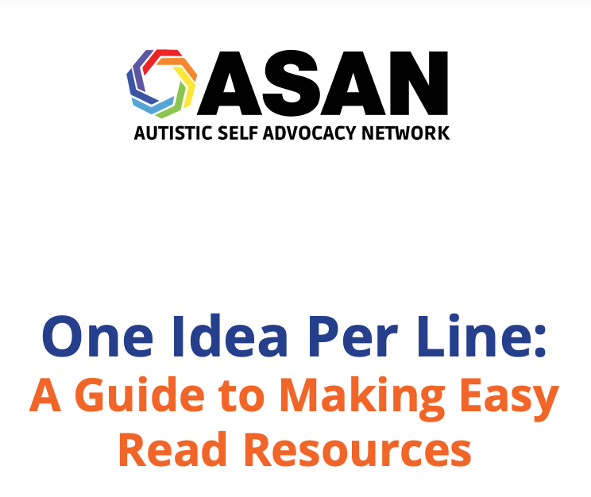
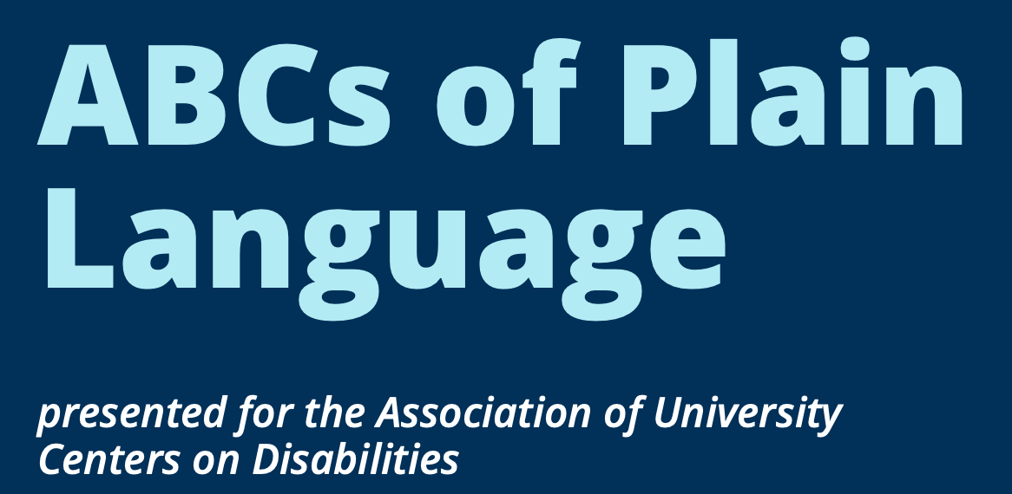
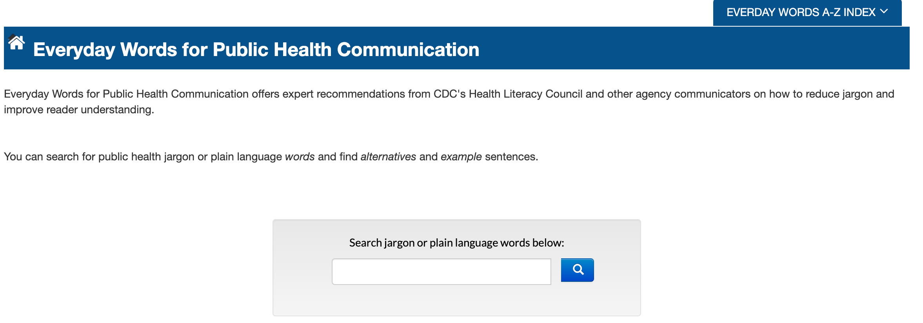
Language
Language
Notes:
ABCs of Plain Language_final.pdf (aucd.org)
Everyday Words for Public Health Communication | The CDC Clear Communication Index | Centers for Disease Control and Prevention
https://autisticadvocacy.org/wp-content/uploads/2021/07/One-Idea-Per-Line.pdf

Slide 4
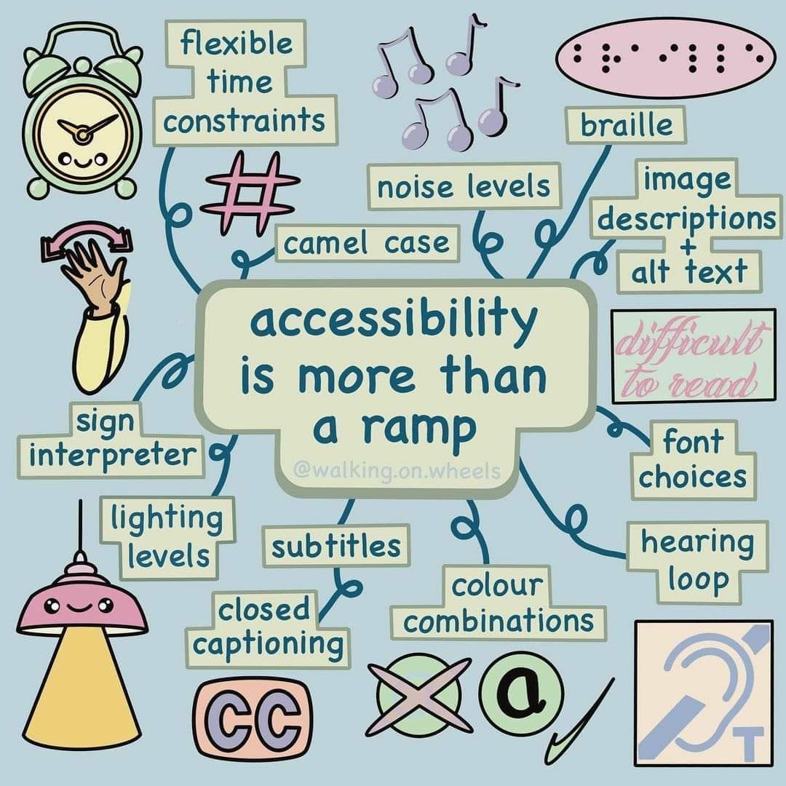
Accessibility is more than a ramp

Slide 5




Technology
Technology
Program | Look For
Adobe Acrobat | Under “Tools”
Microsoft Word, PowerPoint | Under “Review”

Slide 6
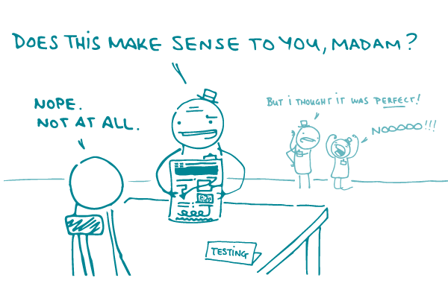
Comic that illustrates why plain language is important

