Slide 1


What is
Universal Design ?
Lindsey C. Mullis, MS, PhD ABD
Morgan Turner

Slide 2
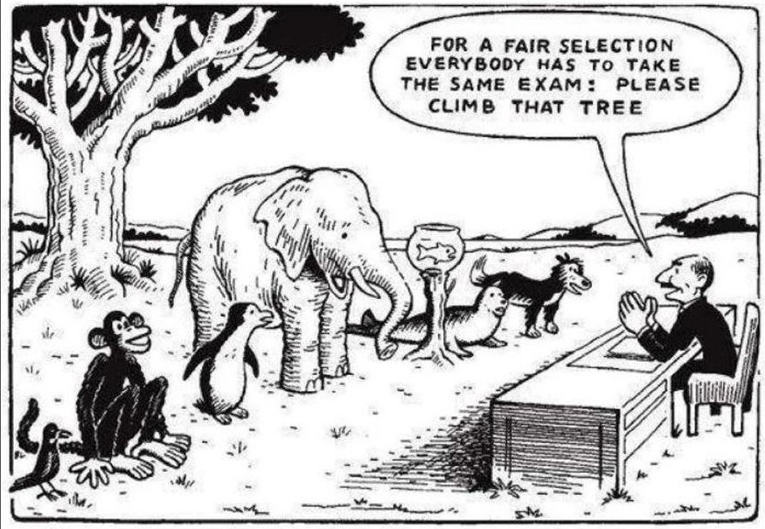
Universal Design is Avoiding…

Slide 3
“UD”
Universal Design for Learning
Universal Design
“UD”
Universal Design:
  Design of buildings, products or environments to make them accessible, inclusive, and usable for all people
Universal Design for Learning (UDL):
  Design of instructional goals, assessments, methods, and materials to ensure all learners can access and participate in meaningful learning opportunities
    Engagement
    Representation
    Action & Expression

Slide 4
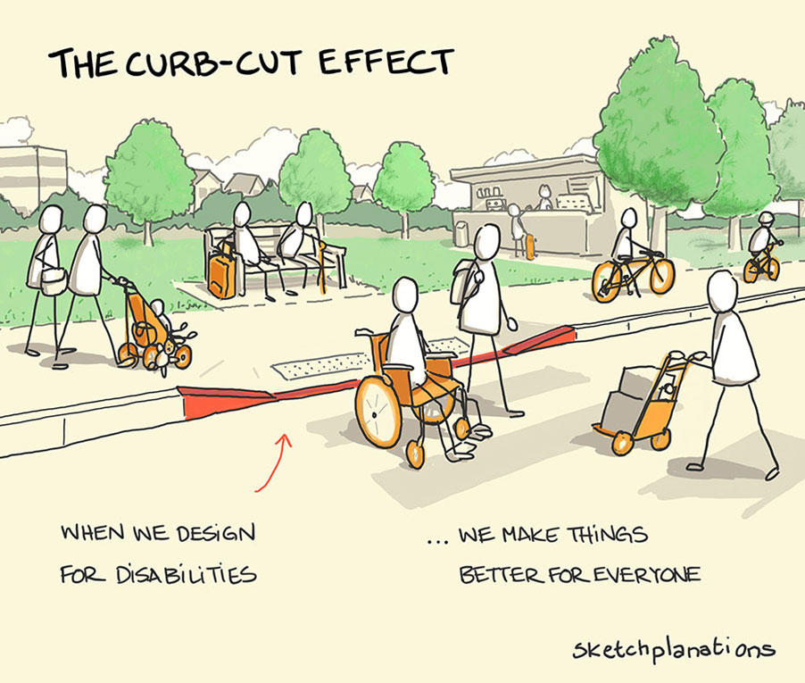
The Curb-Cut Effect

Slide 5
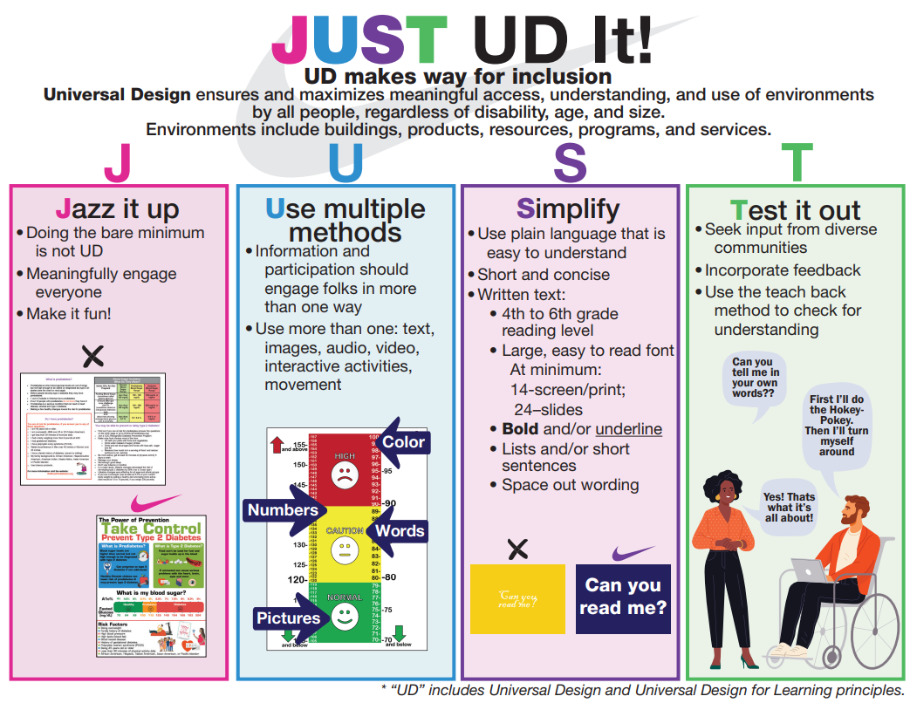
Key Strategies
Present information in multiple ways
  Written text:
    Plain language
    Short & concise
    Easy to read font & format
  Images and graphics
  Videos
    With captions
  Online vs. print

Slide 6

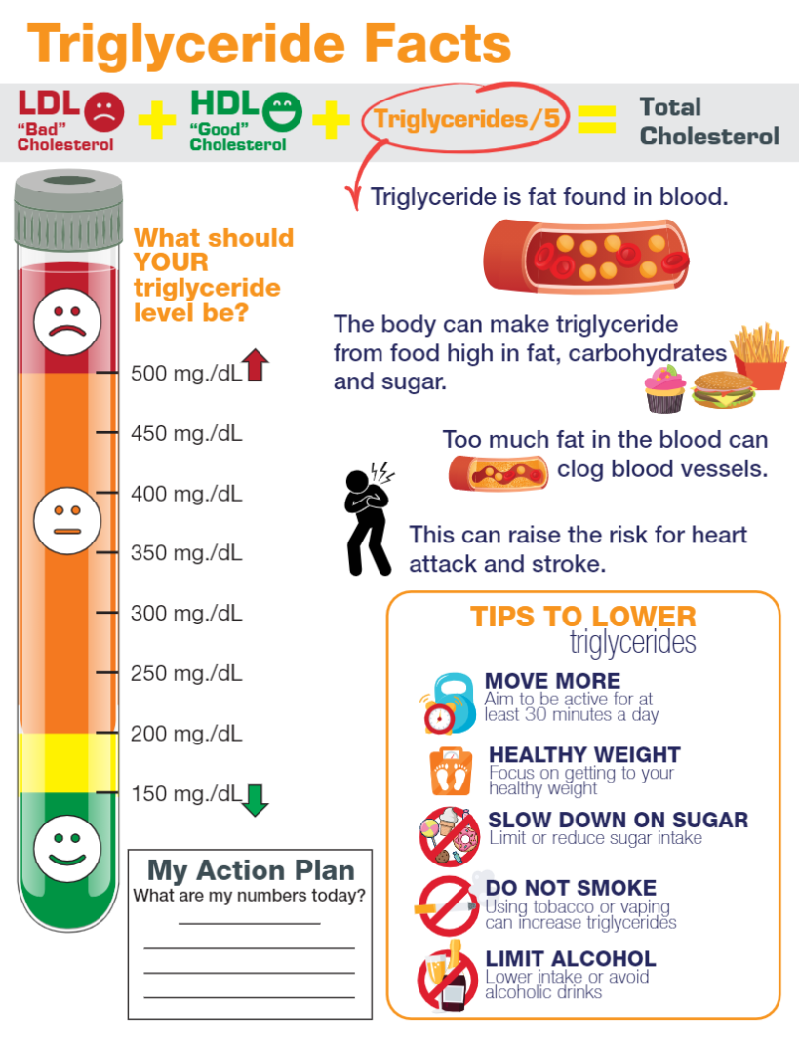

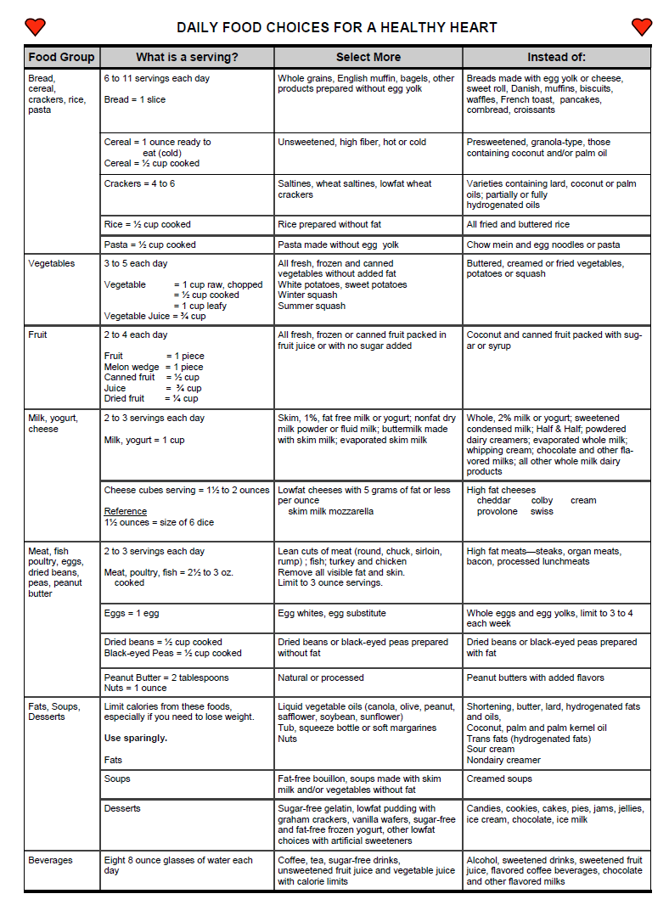
Examples of documents with universal design
Universal
Design

Slide 7

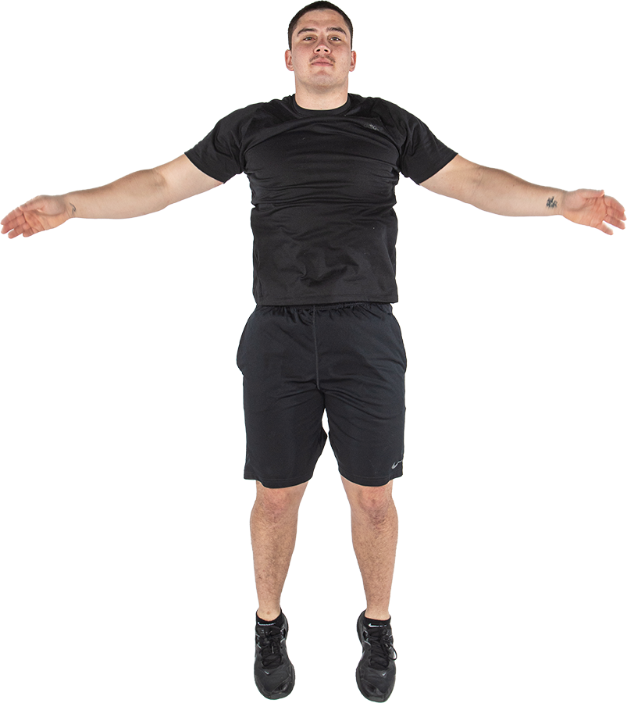


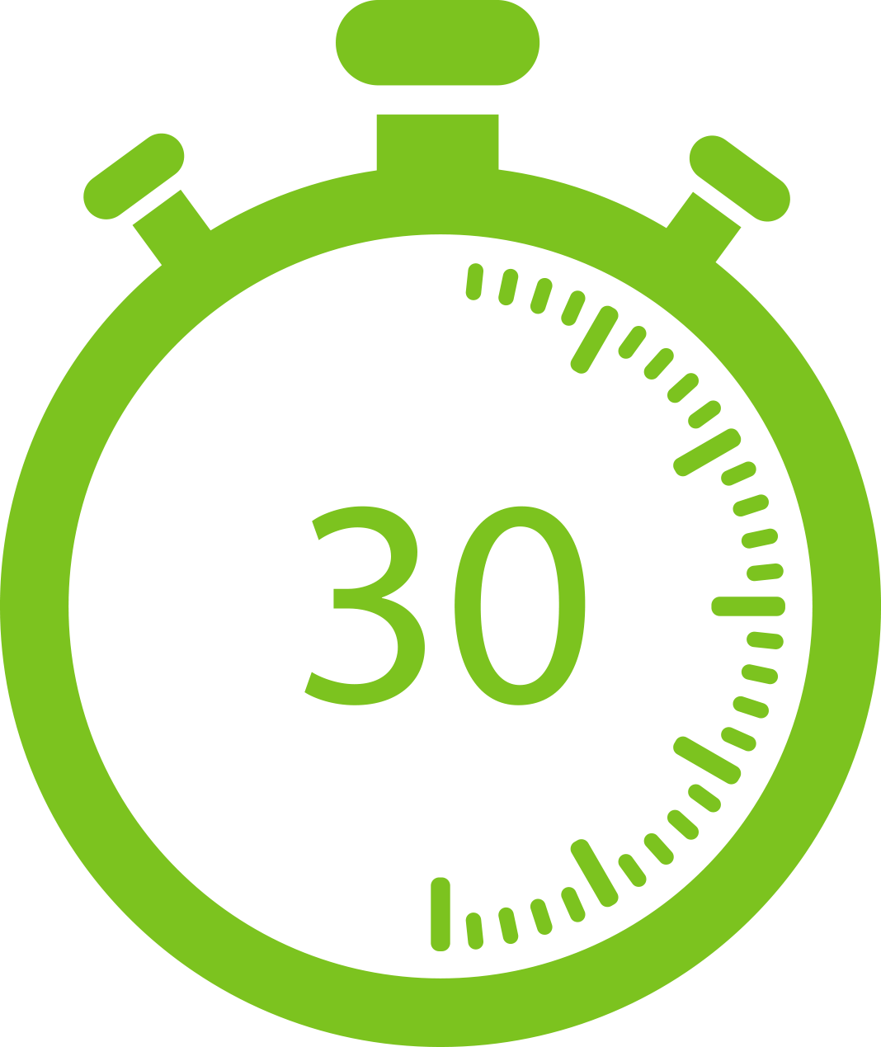
Cardio: Jumping Jacks
1
2
3
4

Slide 8
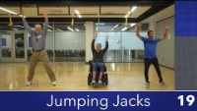
Modified Jumping Jacks Video

Slide 9
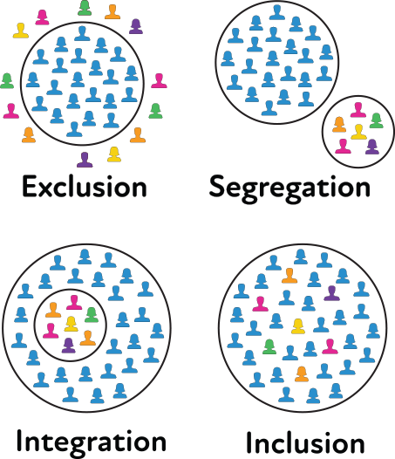
Inclusion
Where individuals, who might otherwise be excluded or marginalized, are equally appreciated, welcomed, and valued.

Slide 10
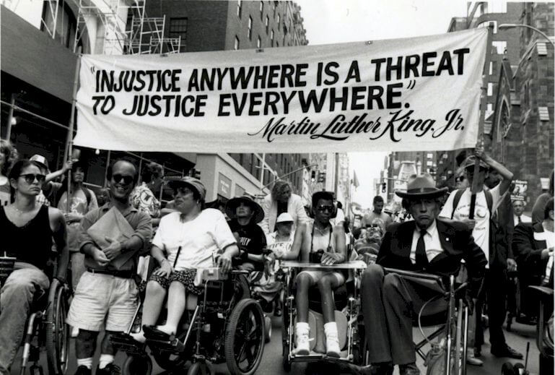
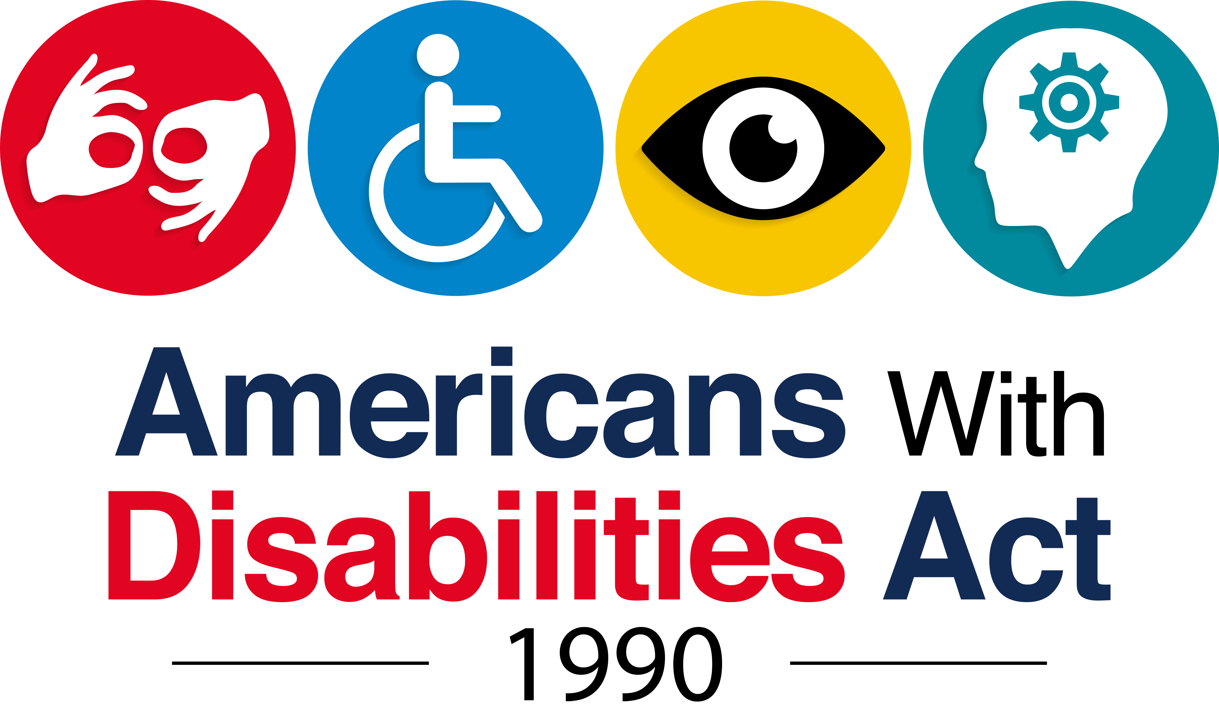
Americans with Disabilities Act
“A public entity shall operate each service, program, or activity so that the service, program, or activity, when viewed in its entirety, is readily accessible to and usable by individuals with disabilities. Policy and programming should actively work to create health equity for individuals with disabilities through inclusion, thus helping to address the disparities experienced by individuals with disabilities.”
Photo Credit: Tom Olin

Slide 11
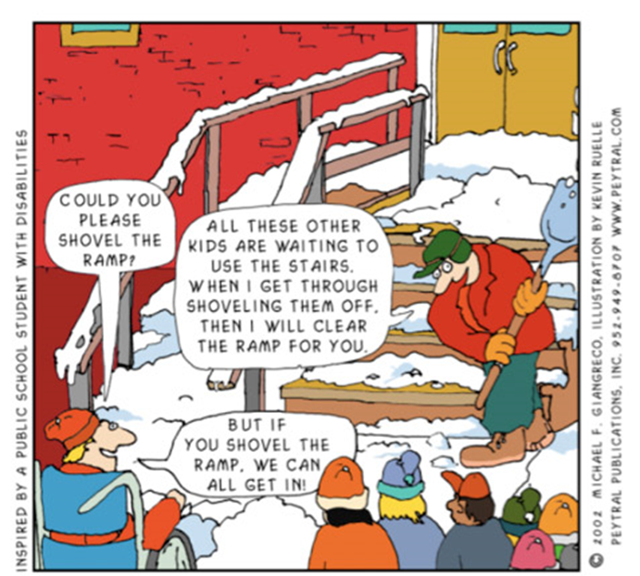
Comic strip illustrating why universal design is important

